Slide 1

Modular PowerPoint Template Design
Professional Solutions for Corporate Meetings
Presented by [Your Name Here]

Slide 2

25%
Quarterly Revenue Increase
1,500
Active Customers This Quarter
80%
Project Milestone Completed

Slide 3
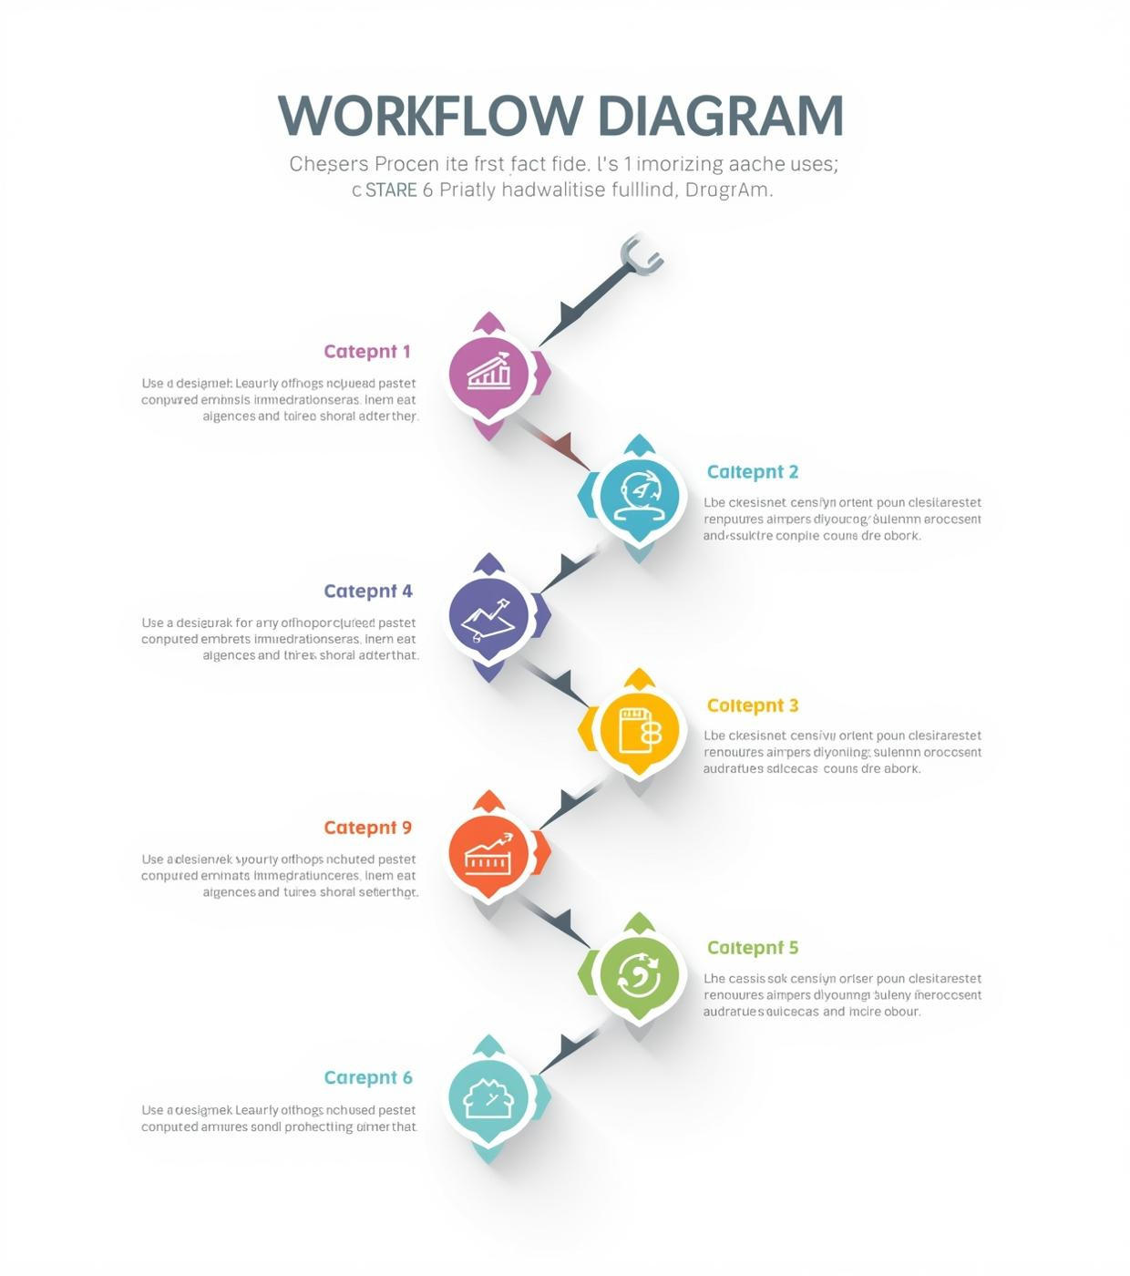
Process Visualization
Streamlining workflows for enhanced productivity and clarity in presentations
Step-by-step workflows
Decision trees for clear paths
Iconography to convey relationships
Numbered lists for organization
Suitable for project plans

Slide 4

Thank You
We appreciate your attention and engagement in this presentation
Email
hello@reallygreatsite.com
Phone Number
123-456-7890
Website
reallygreatsite.com

