Slide 1

Modular PowerPoint Templates
Presented by [Your Name Here], Date: 2025-10-15

Slide 2
Introduction Overview
Purpose and Design Approach
OBJECTIVE
MODULAR STYLE
The objective is to provide a professional PowerPoint template tailored for corporate meetings, ensuring clarity and engagement during presentations while accommodating various audience needs and scenarios.
The modular design allows for interchangeable infographic components, providing flexibility and customization in presenting information, making it easy to adapt to different meeting formats and topics.

Slide 3


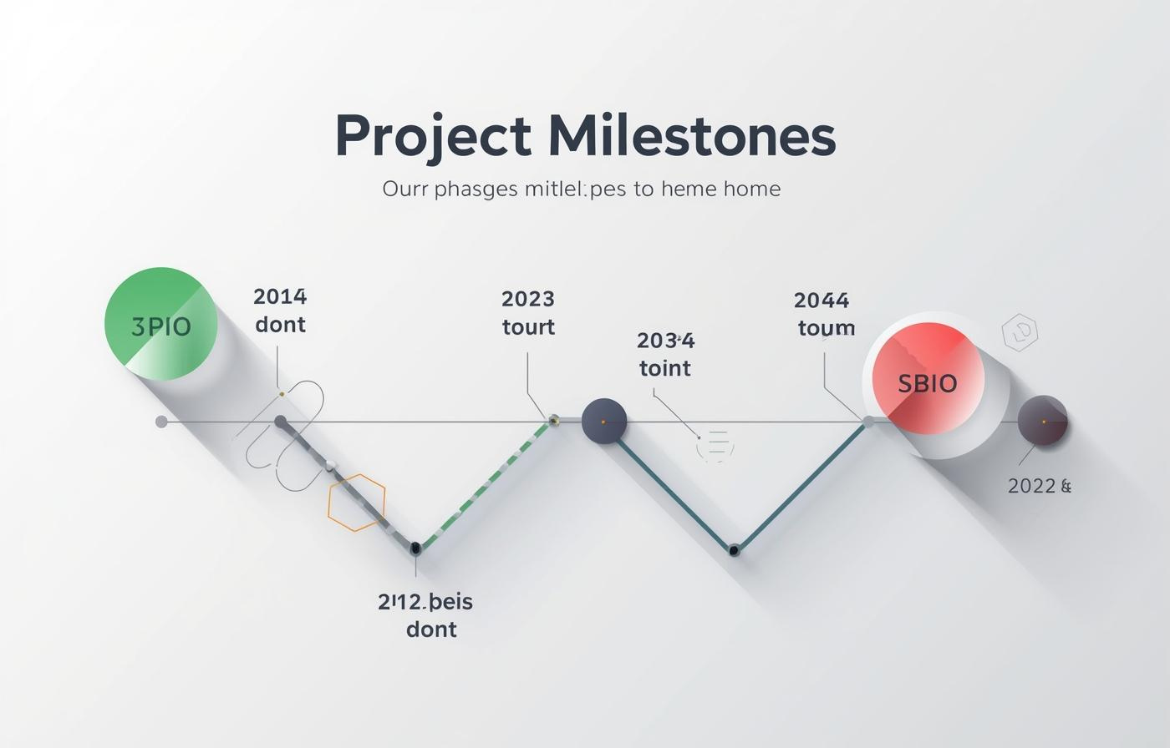
Infographic Template 1: Data Summary Dashboard
FINANCIAL DATA
PERFORMANCE INDICATORS
PROJECT MILESTONES
Visual blocks showcase key financial metrics and trends.
Clear visuals highlight essential KPIs and outcomes.
Modular sections illustrate critical stages and achievements.

Slide 4
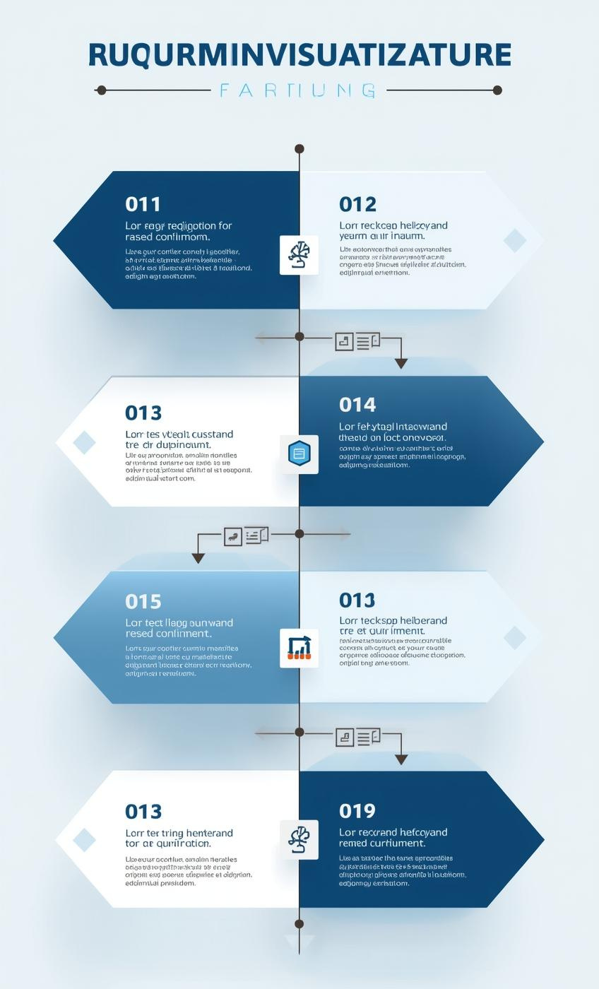
Process Visualization
STEP-BY-STEP WORKFLOWS
Clearly outline each stage of project development.
DECISION TREES
Visual aids to simplify complex decision-making processes.
PROJECT PLANS
Modular sections help streamline project management tasks.

Slide 5

EMAIL
hello@reallygreatsite.com
SOCIAL MEDIA
@reallygreatsite.com
PHONE
123-456-7890

