Slide 1



Corporate Meeting Template
[Presenter Name]

Slide 2
Introduction
Purpose and Modular Design for Corporate Meetings
Clear Objectives
Modular Flexibility
Professional Use Cases
A clean and professional PowerPoint template optimizes presentations for corporate meetings, ensuring effective communication and engagement among participants.
The modular design approach incorporates interchangeable infographic components, allowing users to customize slides based on specific needs and presentations seamlessly.
This template is suitable for board meetings, project updates, and strategy sessions, facilitating a structured approach to presenting crucial information effectively.

Slide 3

Data Summary Dashboard
Professional layout for key metrics and KPIs

Slide 4
75%
This reflects a 75% growth compared to the previous quarter, indicating strong market demand and effective sales strategies implemented over the last few months.
Increase in quarterly revenue
1500
A total of 1500 new customers have been onboarded this quarter, showcasing our expanding reach and successful marketing campaigns tailored to target audiences.
New customers acquired

Slide 5
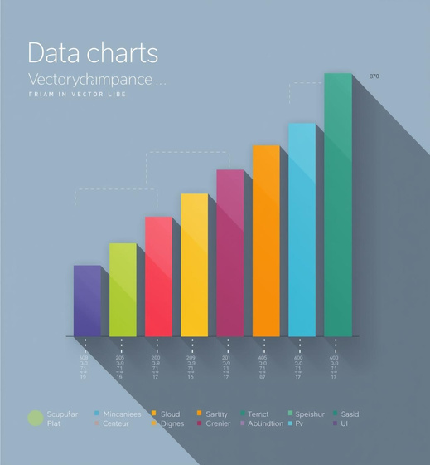
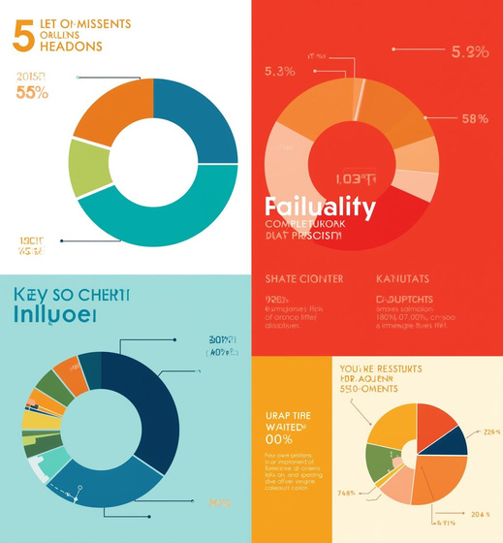

Visual Elements
Visual representations for enhanced presentations
The images highlight essential visual elements like charts and icons that enhance data representation, ensuring clarity and engagement during corporate presentations.

Slide 6

Process Visualization
Streamlining Corporate Workflows Effectively

Slide 7
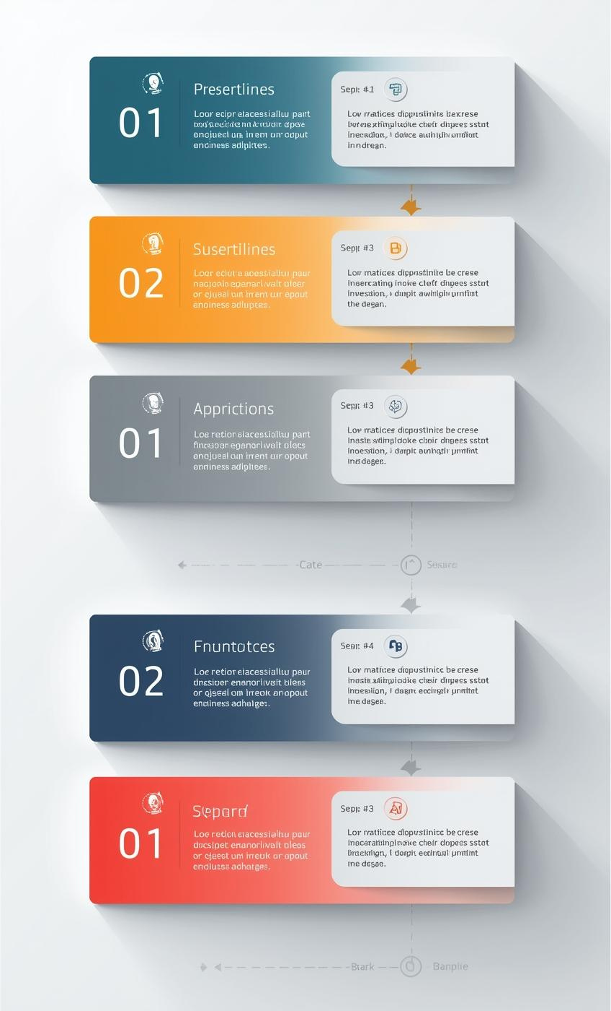
Step-by-Step
Workflow
The template allows for clear communication of complex processes through visual aids, enhancing audience comprehension and engagement throughout meetings.
Process Visualization
Sequential Clarity
Utilizing modular sections effectively showcases step-by-step workflows, ensuring clarity and ease of understanding during corporate presentations.
Incorporating numbered lists and arrows promotes logical progression, making it easier for stakeholders to follow critical business operations or project phases.

Slide 8

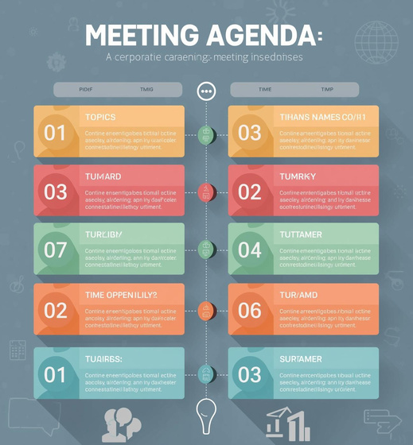

Visualizing Meeting Agendas
Effective PowerPoint Templates for Corporations

Slide 9
Effective Template Usage
Best Practices for Corporate Presentations
Utilizing modular templates enhances professionalism and clarity, ensuring impactful presentations tailored to your corporate needs.

Slide 10

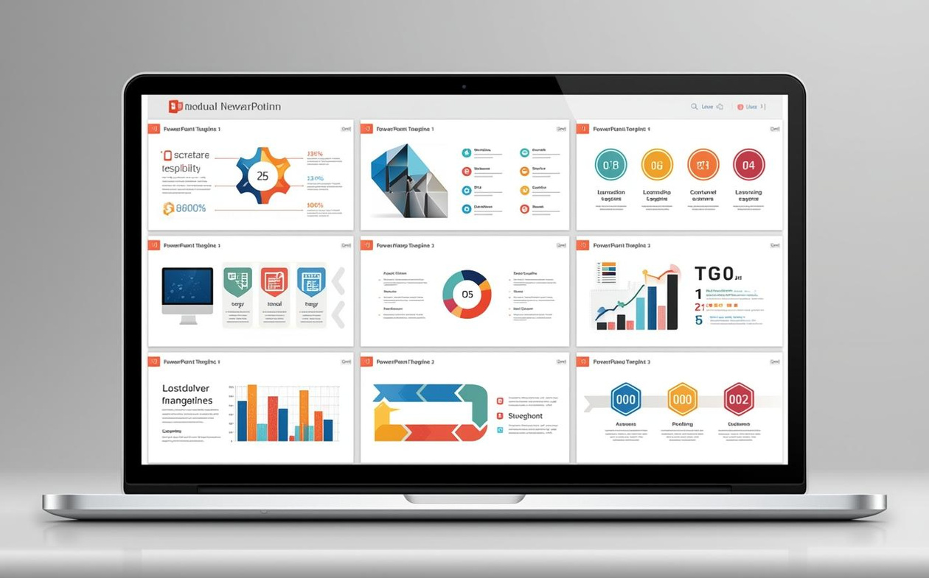
Thank You
Customize Your Template

