Slide 1

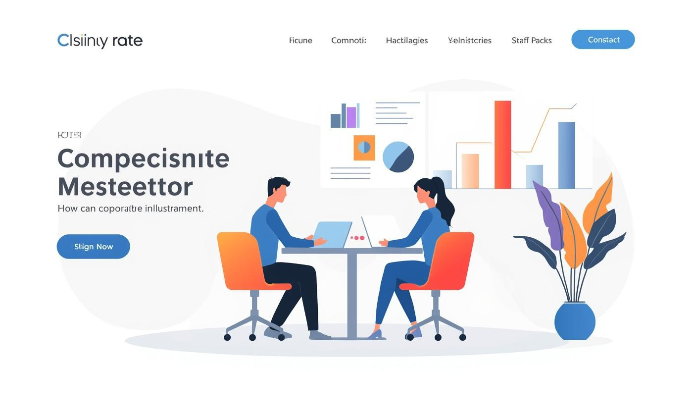
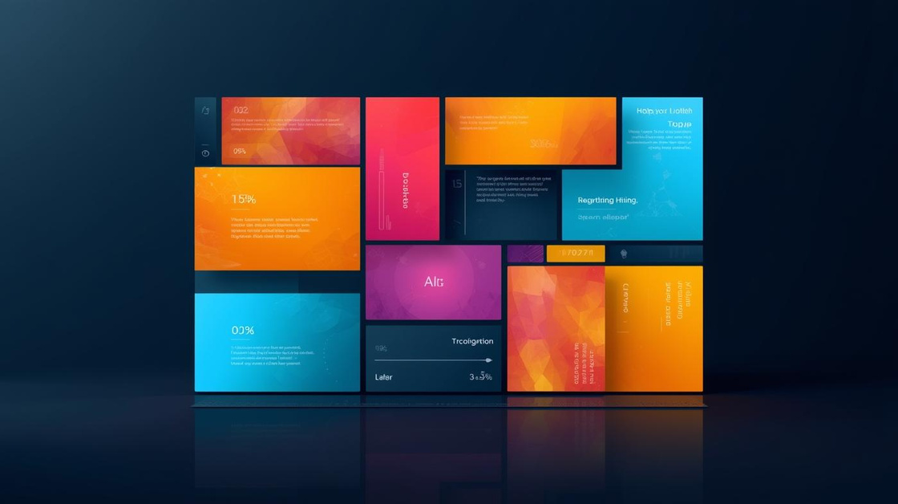
PowerPoint Template
Presented by
[name here]

Slide 2
Template Overview
Objective of the Template
Modular Design Approach
Intended Audience and Use Cases
A clean presentation optimized for corporate meetings.
Interchangeable infographic components for customization and flexibility.
Ideal for board meetings and strategy sessions.

Slide 3


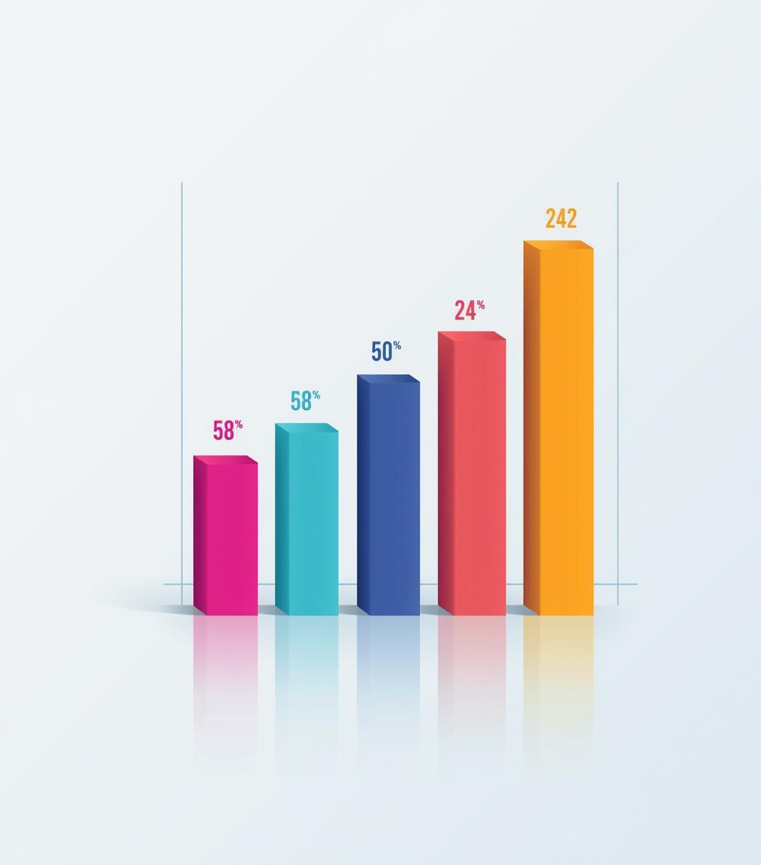
85%
100%
$5 million
Customer Satisfaction Rate
On-Time Project Delivery
Quarterly Revenue Achieved

Slide 4
Design Tips
Clear Typography for Professional Presentations
Consistent Color Coding for Data Clarity
Use simple fonts, maintain legibility, and ensure consistency.
Apply uniform colors to categories for easy data interpretation.

Slide 5
Meeting Agenda Overview
Event One
Event Two
Event Three
Discuss project milestones and timelines.
Review team roles and responsibilities.
Address budget allocations and resources.

Slide 6


Visualizing Processes Effectively
Numbered Lists
Simple Iconography
Clearly outline steps in any process.
Utilize icons to represent actions effectively.

Slide 7
Usage Guidelines
Flexibility in Template Design for Various Needs
Professionalism in Corporate Presentation Standards
Templates allow easy adaptation to meet specific presentation goals.
Maintain a polished look to enhance brand credibility and trust.
Clarity in Information Presentation for Audience Engagement
Customization Tips for Tailoring to Corporate Identity
Utilize clear visuals to convey messages effectively and simply.
Adjust colors and fonts to align with your brand's style.

Slide 8

Thank You
Email
hello@reallygreatsite.com
Social Media
@reallygreatsite.com
Phone
123-456-7890

