Slide 1


15 Oct
Project Management Overview
Project Management: Driving Success

Slide 2
Key Benefits
Understanding the value of project management
Improved Efficiency
Risk Mitigation
Stakeholder Alignment
Project management streamlines processes, leading to quicker completion of tasks and projects. This results in optimal resource utilization and better alignment with business objectives.
Effective project management identifies potential risks early, allowing teams to develop strategies to minimize their impact. This proactive approach ensures smoother project execution and fewer disruptions.
Strong project management fosters clear communication among stakeholders. Regular updates and feedback loops ensure everyone is on the same page, enhancing collaboration and overall project success.

Slide 3

Project Initiation
The project kickoff meeting sets the foundation for success, aligning stakeholders and clarifying objectives to ensure a unified vision.

Slide 4


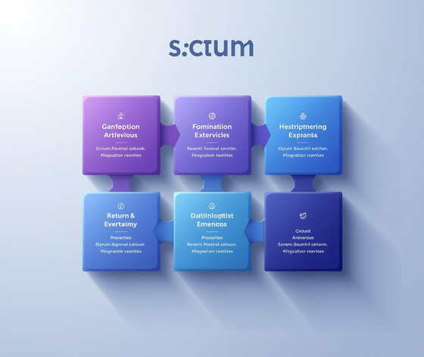
Common Project Management Methodologies
Waterfall
Agile
Scrum
A sequential process with defined stages of completion.
An iterative approach focusing on flexibility and customer feedback.
A framework emphasizing teamwork and accountability in sprints.

Slide 5
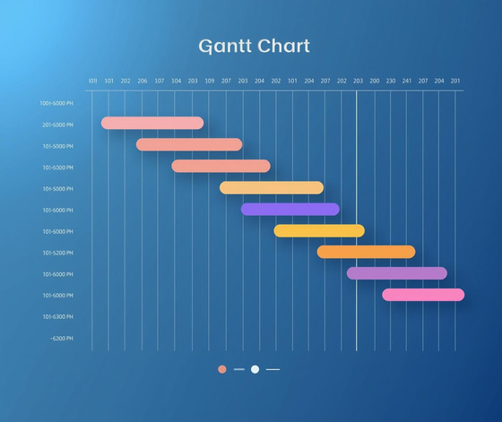
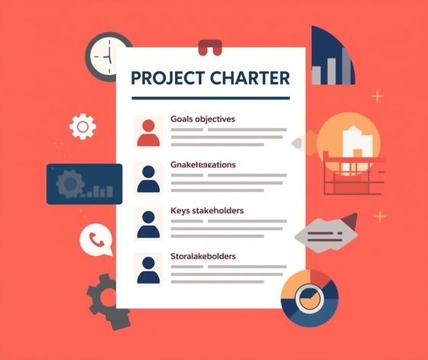

Essential Tools for Effective Project Management
Gantt Charts
Project Charters
Risk Registers
Essential for visualizing project timelines and tasks.
Define project goals and stakeholder responsibilities clearly.
Track and manage potential project risks effectively.

Slide 6
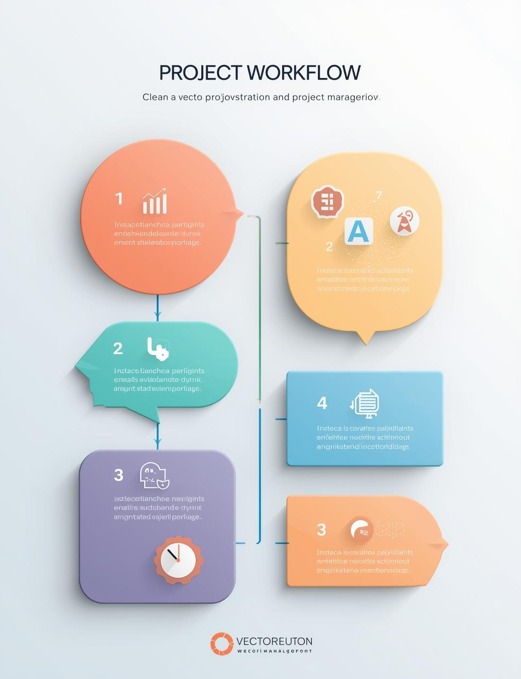
Project Workflow
This illustration presents a clear visualization of project workflows, showcasing the essential phases for effective project management.

Slide 7

Tracking Project Progress
Effective dashboards provide real-time visibility into project status, enabling teams to monitor progress and make informed decisions quickly.

Slide 8

KPIs and Milestones
Effective tracking of key performance indicators (KPIs) ensures project goals are met on time and within budget.

Slide 9

Digital Tools
Project management software enhances team collaboration and streamlines tracking, ensuring projects stay on schedule and within budget.

Slide 10

Key Takeaways
Structured project management is vital for achieving objectives, enhancing efficiency, and fostering collaboration among teams and stakeholders.

Slide 11
Contact Information
Phone
123-456-7890
Email
hello@reallygreatsite.com
Social Media
@reallygreatsite

