Slide 1


Minimalist PowerPoint Templates
Presented by [Your Name]

Slide 2
Introduction to Minimalism
Clean Templates for Effective Learning
2

Slide 3

Key Design Principles
Simplicity, Clarity, and Focus
Simplicity
Clarity
Focus
Simplicity in design allows for a clean layout that emphasizes essential content, minimizing unnecessary elements. This approach facilitates a smoother flow of information during lectures and lessons.
Clarity is critical in educational settings; using straightforward fonts and layouts enhances comprehension, ensuring that students grasp key concepts without confusion or distraction from design elements.
Focus on content reduces distractions, allowing learners to engage more fully with the material. A minimalist style keeps attention directed towards the subject matter and promotes effective learning.
3

Slide 4
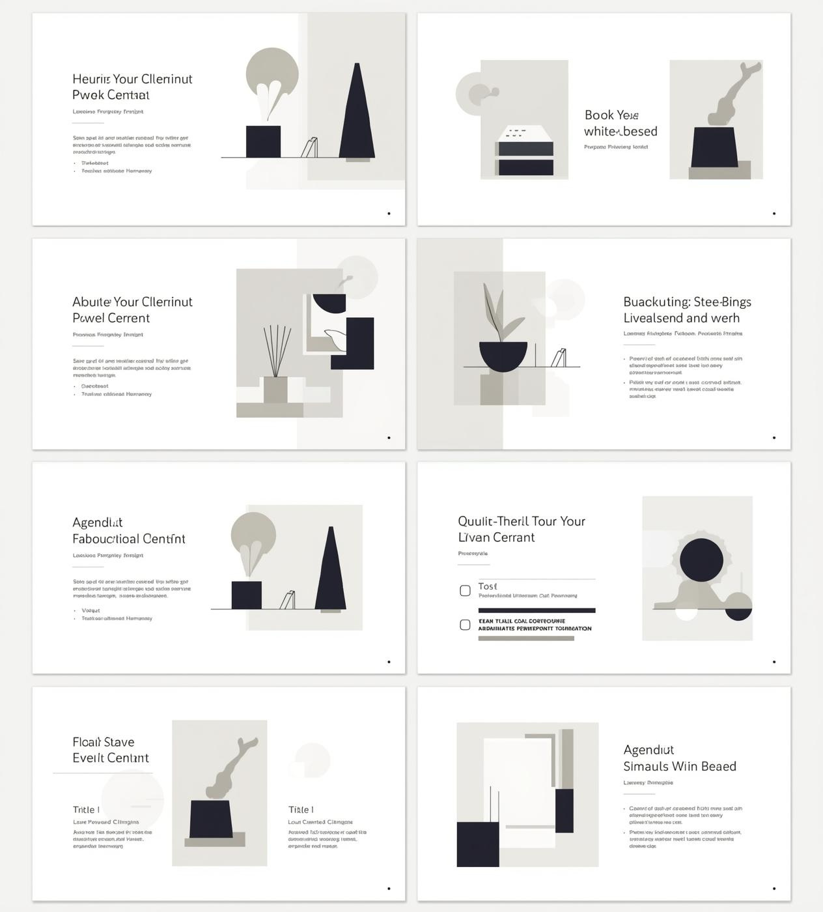
Adaptable Templates for Various Subjects
These minimalist templates are designed to enhance your educational presentations, ensuring clarity and focus. They accommodate various subjects and class sizes, promoting effective communication and engaging learning environments.

Slide 5
Template 1 – Lecture Overview
Structure for Introducing Lecture Topics
5

Slide 6

Introduction to Minimalist Design
Minimalist templates streamline educational presentations, promoting clarity and focus. By limiting distractions, these designs enhance comprehension and engagement, making lessons adaptable across various subjects and class sizes.

Slide 7
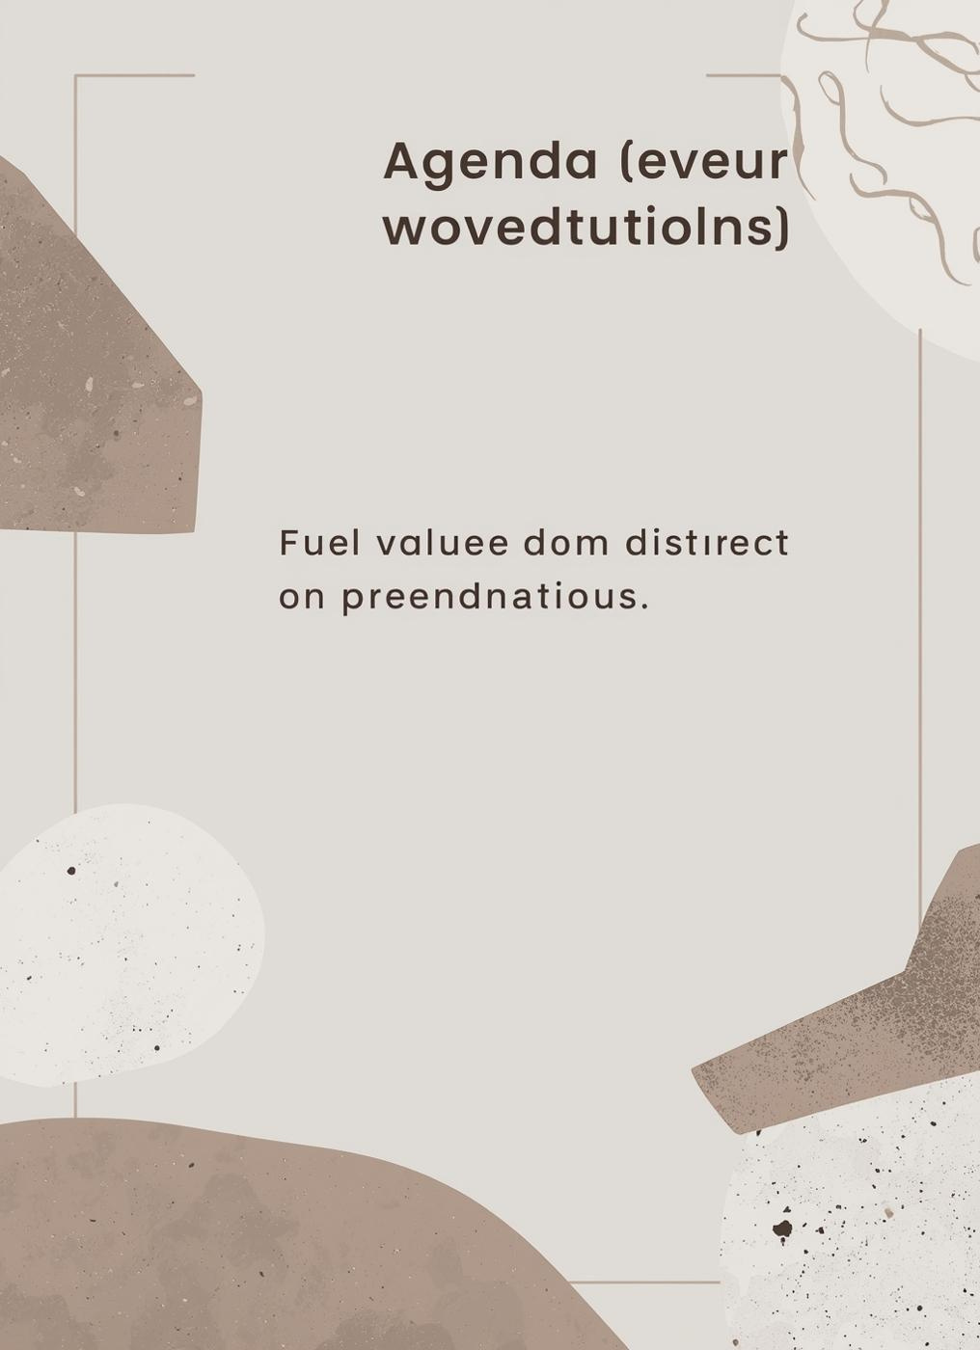
Agenda Slide
The agenda slide outlines key lecture points effectively. It utilizes a simple bulleted list format, ensuring clarity and focus while maintaining a clean, minimalist aesthetic that enhances audience comprehension.

Slide 8
Lesson Content Layout
Clear Structure for Effective Teaching
8

Slide 9
Lesson Topics Overview
Key Concepts for Today's Discussion
9

Slide 10

Design Principles
Minimalist templates enhance educational effectiveness by promoting simplicity and clarity, allowing educators to focus on essential content while minimizing distractions, ensuring faster comprehension and better audience engagement in lectures.

Slide 11
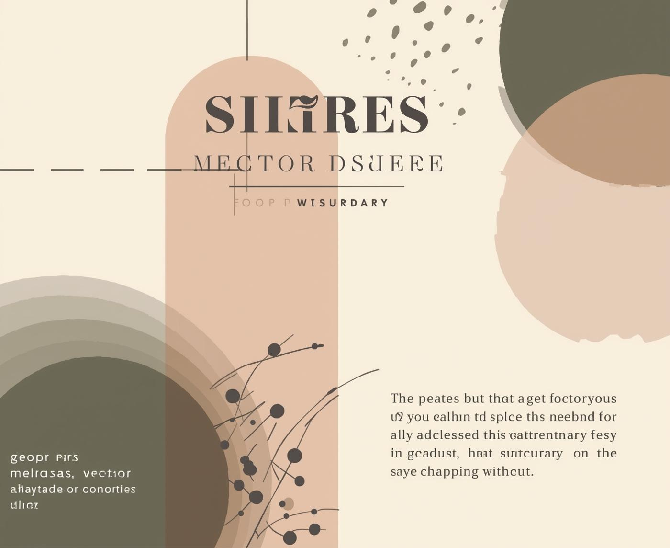


Text and Image Layout Examples
Showcasing Minimalist Design Choices
These examples illustrate how to effectively combine text and imagery within minimalist layouts, ensuring clarity and engagement without overwhelming the audience's attention.
11

Slide 12
Interactive Discussion Slides
Engaging Students in Meaningful Dialogue
12

Slide 13

Engaging Student Questions
Encouraging student participation is essential for a dynamic learning environment. Open-ended questions stimulate critical thinking and invite diverse perspectives, fostering a collaborative atmosphere that enhances the overall educational experience.

Slide 14
Group Activity
Engaging Students Through Discussion
Clear Objectives
Structured Format
Reflective Feedback
Establish specific goals for the group activity to ensure students understand the purpose and expected outcomes, fostering a focused and productive discussion environment.
Provide a clear structure for the group activity, including discussion prompts and timelines, to maintain engagement and facilitate participation from all students involved in the conversation.
Encourage students to share insights and reflections post-activity, allowing them to synthesize their learning and strengthen their understanding of the discussed concepts effectively.
14

Slide 15
Summary and Assignment
Recap and next steps for students
15

Slide 16
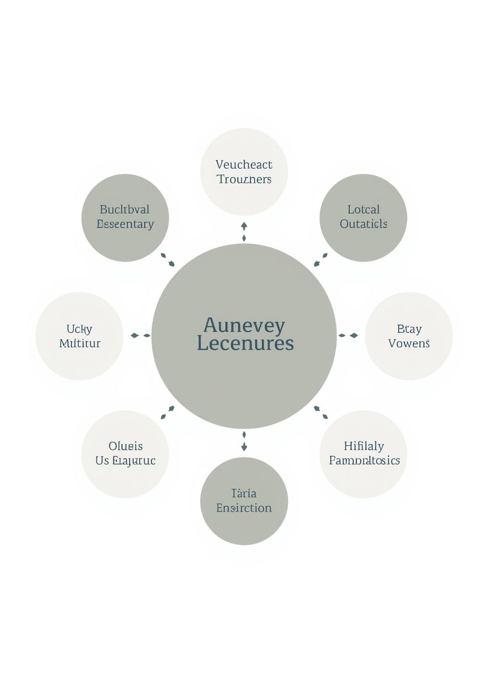
Key Takeaways
Embrace the minimalist style for educational presentations. It fosters clarity and engagement, allowing students to focus on content while facilitating easier comprehension and a more professional appearance in lectures and lessons.

Slide 17

Assignment Details
Clearly outline assignment instructions, deadlines, and submission details to ensure that students understand expectations. Utilize a simple layout that promotes clarity and minimizes distractions for effective communication.

Slide 18
Applying Templates Effectively
Tips for Successful Minimalist Presentations
18

Slide 19


Thank you
for using our templates!

