Slide 1

Introduction to Presentations
Minimalist PowerPoint Templates
Presented by [Presenter's Name] on 2025-10-15

Slide 2

Design Principles
Emphasizing clarity and focus
Minimalist design principles prioritize simplicity, ensuring that content stands out and is easily digestible, fostering clarity and enhancing audience engagement without distractions from unnecessary elements.
NOTES ON SIMPLICITY
2

Slide 3
Benefits of Minimalist Style
Comprehension
Minimalist design promotes faster understanding of core concepts presented.
Professionalism
A clean layout gives a professional appearance to lectures and lessons.
Focus
Reduced distractions help maintain better audience engagement during presentations.
ADDITIONAL NOTES
3

Slide 4

Lecture Overview
Introducing key topics and agenda for the lecture
NOTES ON DESIGN
4

Slide 5


Title Slide
Essential Elements for Lecture Presentations
NOTES
5

Slide 6
Agenda Overview
Key Points for Today’s Lecture
IMPORTANT DETAILS
6

Slide 7

Lesson Content Overview
Engaging students with clear and direct lesson material
NOTES ON STRUCTURE
7

Slide 8
Lesson Topics
Key Chapters for Today's Discussion
ADDITIONAL INSIGHTS
8

Slide 9
Key Design Principles
Understanding Minimalist Template Usage in Classrooms
IMPORTANT CONSIDERATIONS
9

Slide 10

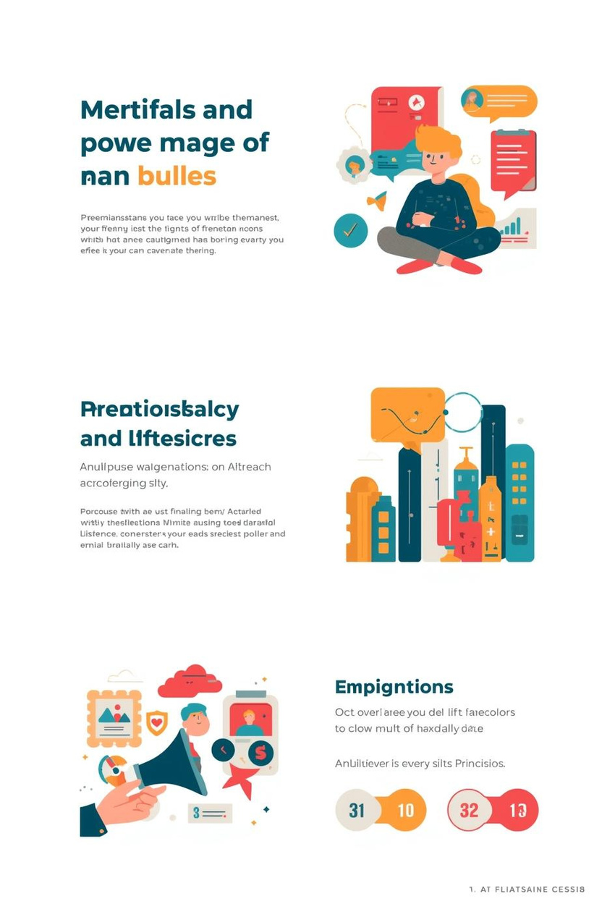
Minimalist Design
Principles for Effective Educational Presentations
Adopting a minimalist approach enhances clarity and focus, allowing students to absorb material effectively, facilitating better retention and engagement during lectures and lessons with streamlined visuals.
NOTES ON DESIGN
10

Slide 11

Emphasizing minimalist design principles
DESIGN PRINCIPLES
11

Slide 12

Interactive Discussion
This section encourages student participation and engagement.
NOTES
DISCUSSION POINTS
12

Slide 13
Discussion Prompt
Engage students with thought-provoking questions
KEY POINTS
13

Slide 14
Group Activity
Engage students with interactive discussions
PREPARE MATERIALS IN ADVANCE
14

Slide 15

Contact Information
For Further Inquiries
Phone
123-456-7890
Email
hello@reallygreatsite.com
Website
www.reallygreatsite.com

