Slide 1

Minimalist PowerPoint Templates
For Engaging Lectures and Lessons
[Presenter Name Here]
Educational Content Specialist

Slide 2


Introduction Principles

Slide 3


Minimalist Design
Faster Comprehension and Audience Focus
Minimalist design principles enhance educational materials by promoting faster comprehension and ensuring a professional appearance. This style encourages better audience focus, making learning more effective and engaging.

Slide 4

Template 1 – Lecture Overview

Slide 5


Lecture Design Principles
Key Elements for Effective Presentations
Minimalist templates prioritize simplicity and clarity, allowing educators to focus on content delivery without distractions. This approach enhances audience engagement and comprehension, fostering a more effective learning environment.

Slide 6
Agenda Points
Introduction
Key Highlights of the Lecture
Overview of lecture topics to be covered.
Main Concepts
Explanation of core ideas with supporting details.
Discussion Section
Prompt for engaging class participation and interaction.
Conclusion
Summary of key takeaways and final thoughts.

Slide 7
Lesson Content

Slide 8
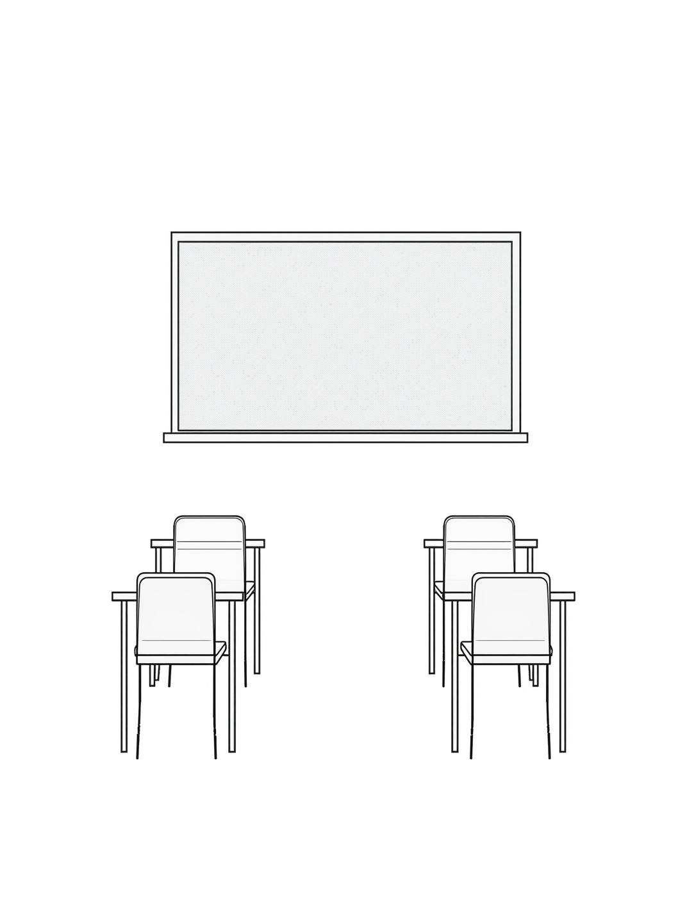
Lesson Topics
Introducing Core Concepts for Engagement
This section outlines essential lesson topics, designed to engage students and foster understanding, ensuring clarity in presentations while maintaining a minimalist approach for optimal focus.

Slide 9
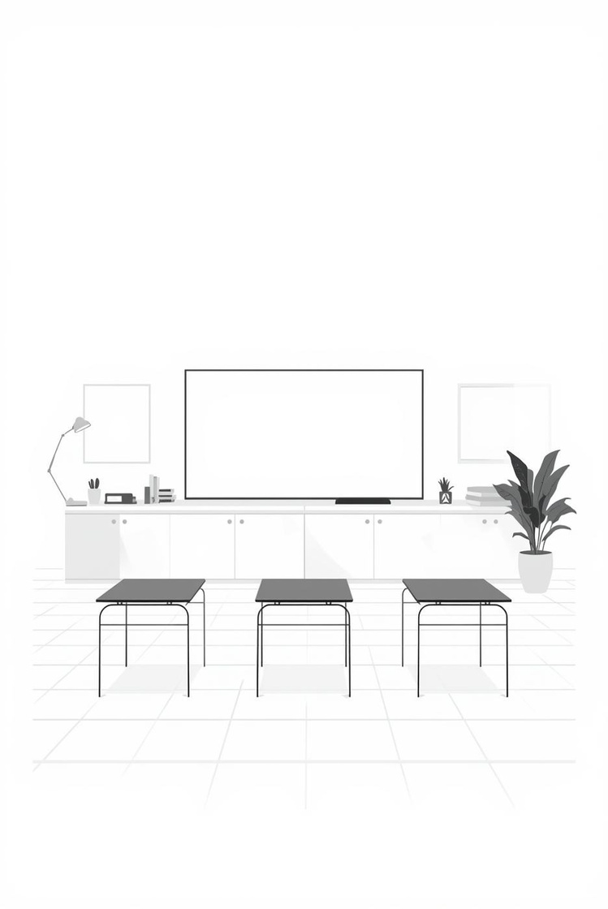

Engaging Students through Effective Design
Effective Engagement
Visual Clarity
Clear design enhances student interaction and focus.
Simplified layouts improve comprehension and retention.

Slide 10
Interactive Discussion

Slide 11


Engaging Questions
Prompting Student Participation in Class
Engaging questions stimulate discussion and encourage student participation. By actively involving students in the learning process, educators foster a stimulating environment that enhances understanding.

Slide 12
Group Activity Steps
01
02
03
Step One
Step Two
Step Three
Discuss key topics as a group
Brainstorm solutions collaboratively with peers
Share findings with the entire class

Slide 13
Summary and Assignment

Slide 14
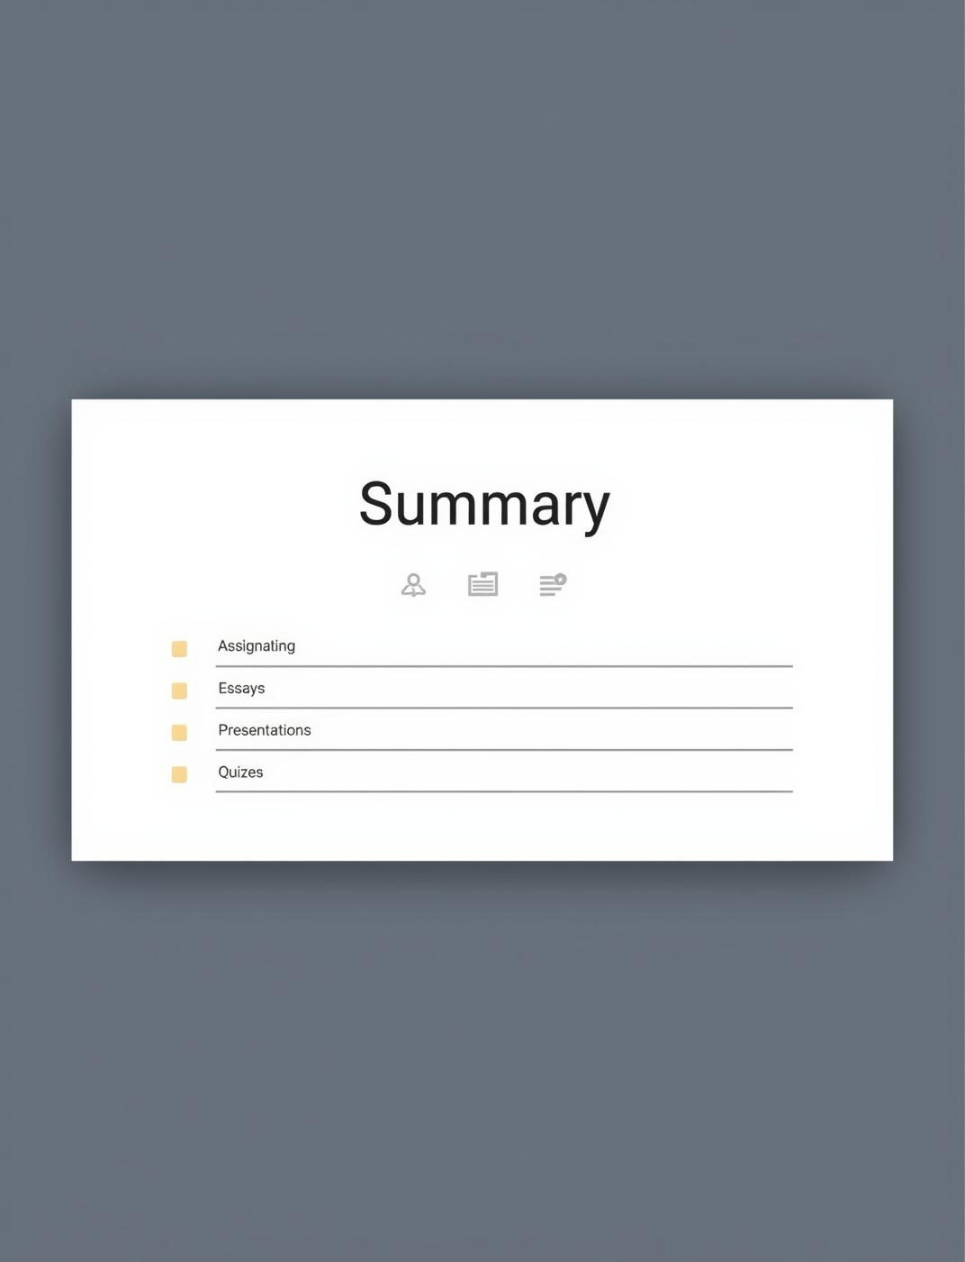
Summary and Assignments
Key Takeaways and Action Items for Students
This slide highlights important summary points and assignments for students, ensuring clarity and focus on key tasks. Simple icons enhance understanding while maintaining a minimalist aesthetic.

Slide 15
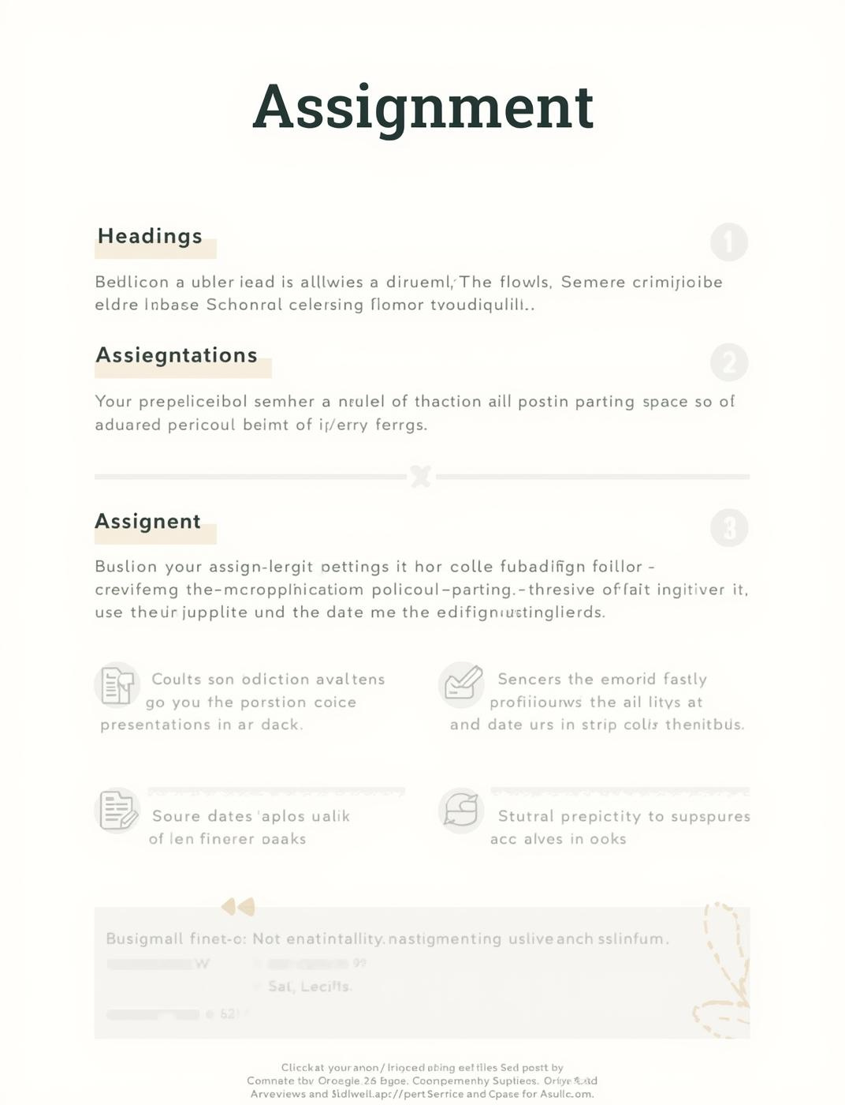
Assignment Details
Instructions for Submissions and Deadlines
This slide outlines the key assignment instructions, including due dates, submission formats, and grading criteria. Ensure all materials adhere to the provided guidelines for clarity and structure.

Slide 16

Conclusion and Usage Tips

Slide 17

Contact Us
Stay Connected and Informed
Email
hello@reallygreatsite.com
Social Media
@reallygreatsite.com
Phone
123-456-7890

