Slide 1


Educational Solutions
Minimalist PowerPoint Templates
Presented by [Your Name Here]
October 15, 2025, 10:00 AM, Auditorium A

Slide 2
Introduction
An overview of minimalist PowerPoint templates
2

Slide 3

Design Principles
Simplicity
Clarity
Embrace minimalism to enhance comprehension and audience engagement.
Strive for clear visuals that convey messages without distraction.
Focus on Content
Adaptability
Prioritize essential information to facilitate effective learning experiences.
Ensure templates can be customized for various educational contexts.
3

Slide 4
Lecture Overview
Structure for Introducing Topic and Agenda
4

Slide 5

Lecture Title Slide
Template for Effective Presentations
Clear, legible fonts for readability
Ample white space for focus
Consistent color palette recommended
Use thematic images for engagement
5

Slide 6

Agenda Overview
Key points for today's lecture
Lecture Structure
Engagement Strategies
Introduction to topic
Main concepts overview
Supporting evidence
Conclusion and discussion
Encourage questions
Group discussions
Interactive activities
Feedback opportunities
6

Slide 7
Lesson Content Layout
Clear structure for presenting lesson materials
7

Slide 8

Introducing Lesson Topics
Engaging Students with Material
Clearly defined lesson objectives
Overview of key concepts
Interactive discussion prompts
Visual aids to enhance understanding
8

Slide 9

Key Design Principles
Essential Elements for Effective Templates
Simplicity enhances audience engagement
Clarity improves comprehension and retention
Focus directs attention to content
Consistency maintains a professional appearance
9

Slide 10

Introduction to Minimalist Design Principles
Design
Emphasizes clarity and simplicity in education
10

Slide 11
Interactive Discussion
Engaging students through thoughtful questions
11

Slide 12

Engaging Student Participation
Strategies to Foster Discussions
Pose open-ended questions
Encourage peer interactions
Utilize think-pair-share activities
Incorporate technology tools for feedback
12

Slide 13
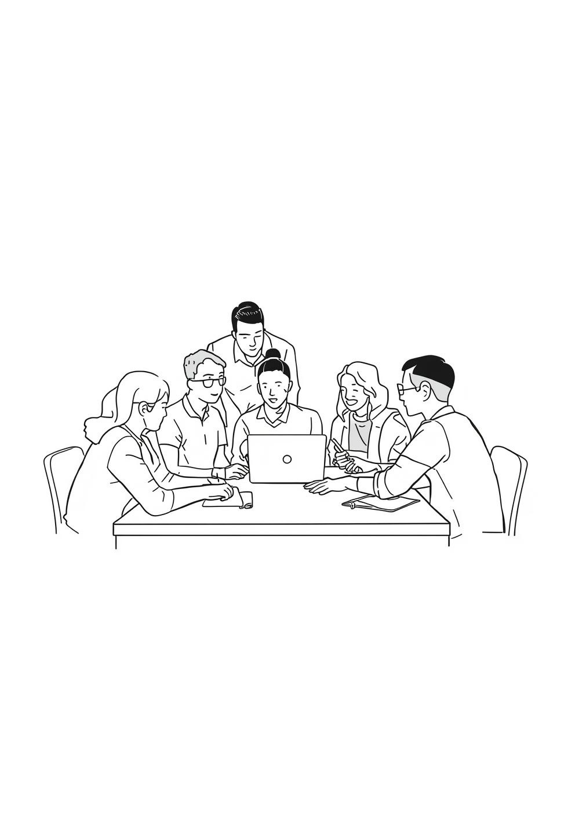
Group Activity Reflections
Encouraging Collaborative Learning Experiences
Share insights with peers
Discuss diverse perspectives openly
Reflect on personal learning outcomes
Contribute to group conclusions
13

Slide 14
Summary & Assignments
Key takeaways and student tasks outlined
14

Slide 15
Thank You for Your Attention
Email
hello@reallygreatsite.com
Social Media
@reallygreatsite
Phone
123-456-7890
Minimalist PowerPoint Co.

