Slide 1


BrandX
Presentations
JOHN DOE

Slide 2

Marketing and Sales Templates
PROFESSIONAL DIGITAL PRESENTATION DESIGNS
These versatile templates enhance your marketing and sales presentations, ensuring a sleek design, clear messaging, and branding adaptability to effectively engage diverse professional audiences.

Slide 3
Key Design Principles
Clean Layout
A clean layout enhances audience engagement and understanding.
Digital Style
Incorporating digital style elements creates a modern aesthetic.
Balanced Color
A balanced color scheme promotes visual harmony and clarity.

Slide 4

Modern Marketing

Slide 5

Marketing
OVERVIEW
01
Purpose
Our templates provide versatile, polished options tailored to marketing and sales presentations, ensuring impactful communication in every slide.
02
Design
Key design principles include clean layouts, balanced color use, and digital style elements that enhance professional presentation quality.

Slide 6

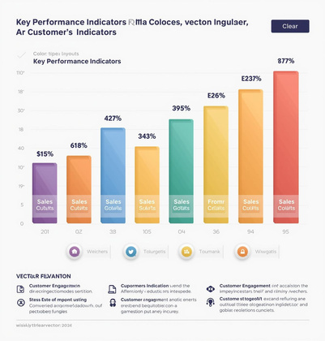
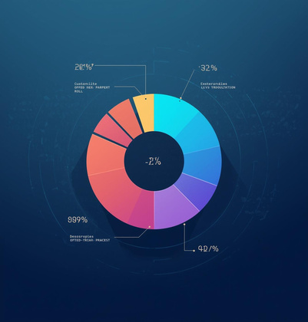
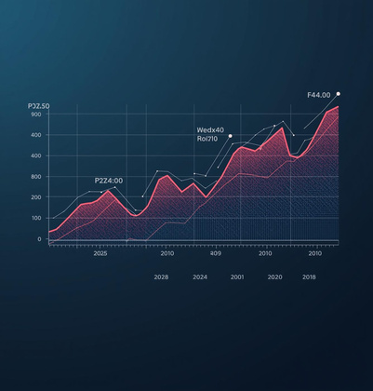
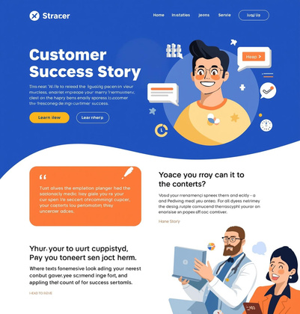
Key Insights into Marketing Success
KPI Metrics
Customer Demographics
Visualizing performance through key metrics.
Understanding target audience for better outreach.
Traffic Trends
Customer Success
Analyzing trends to inform marketing strategy.
Showcasing impactful results of marketing efforts.

Slide 7

Sales Pitch Deck

Slide 8

Value
PROPOSITION
01
Problem
Clearly identifying the customer’s pain points enables effective solutions tailored to their needs and enhances engagement.
02
Features
Highlighting key attributes of products or services effectively communicates their value and helps build trust with potential clients.

Slide 9
85%
60%
Customer Satisfaction Rate
Conversion Rate Boost
A recent survey revealed that 85% of clients reported satisfaction with our sales pitch deck templates, highlighting their effectiveness in presentations.
Implementing our marketing presentation templates has resulted in a 60% increase in conversion rates for businesses, demonstrating their impact on sales success.

Slide 10

Digital Analytics

Slide 11
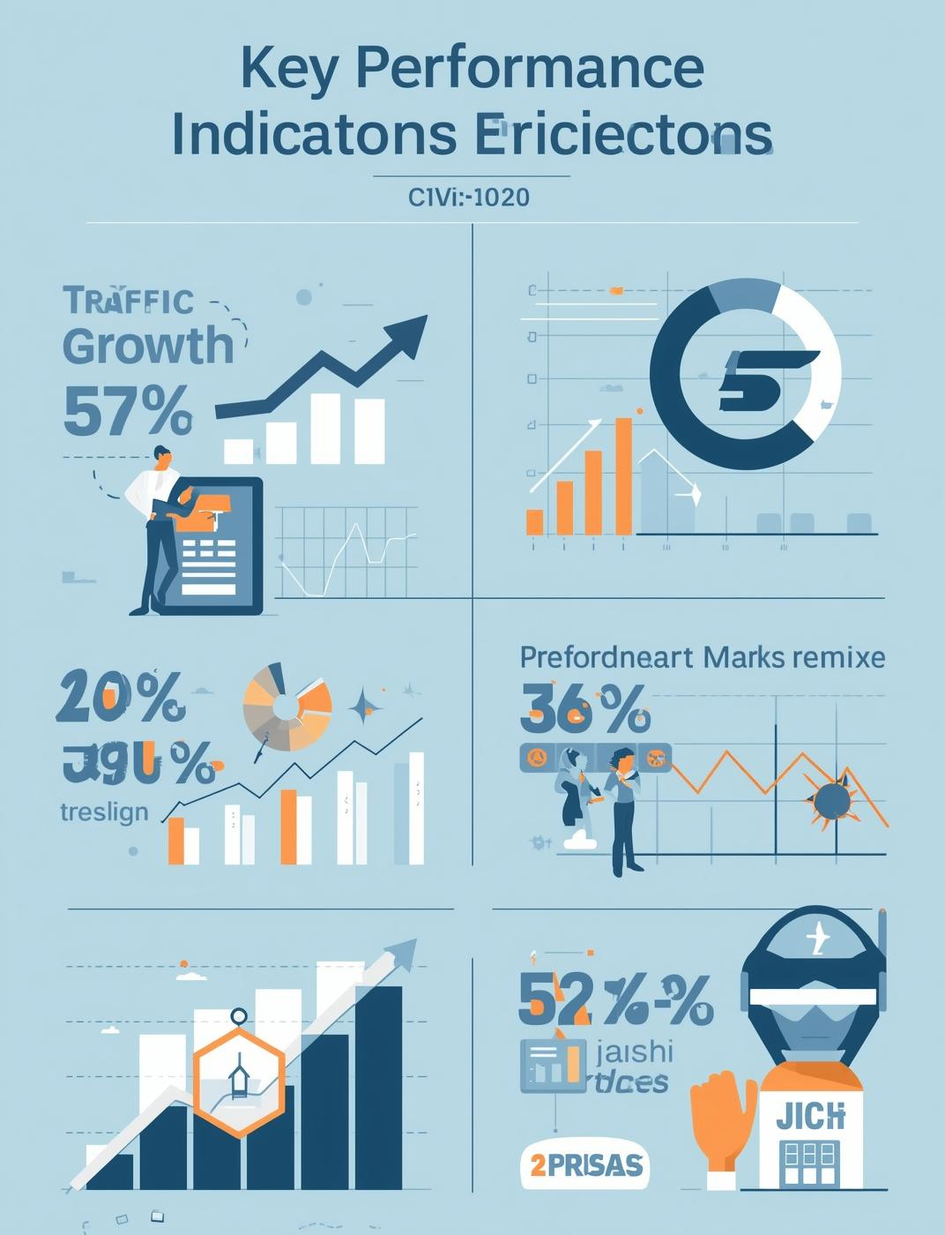
Summary
KEY METRICS
01
Traffic
Our digital marketing efforts have resulted in significant traffic growth, indicating a successful outreach strategy and effective content engagement.
02
Engagement
Enhanced engagement metrics show increased user interaction, showcasing the effectiveness of tailored content and targeted marketing initiatives.

Slide 12
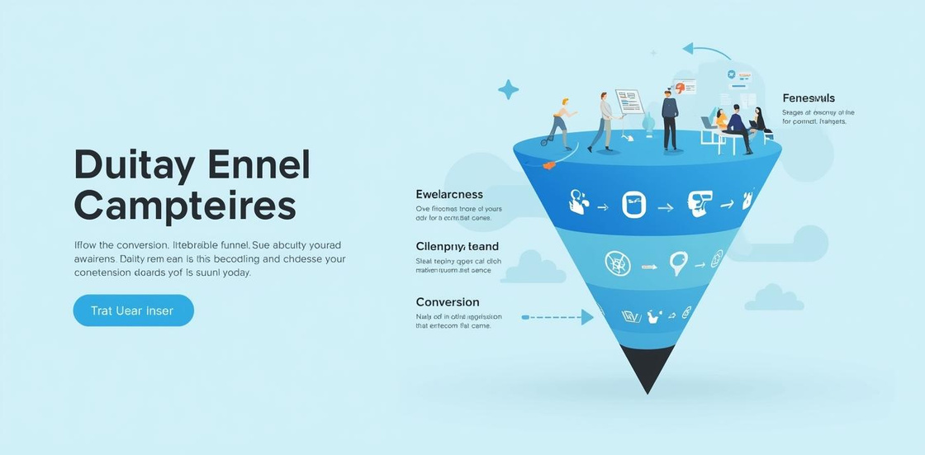

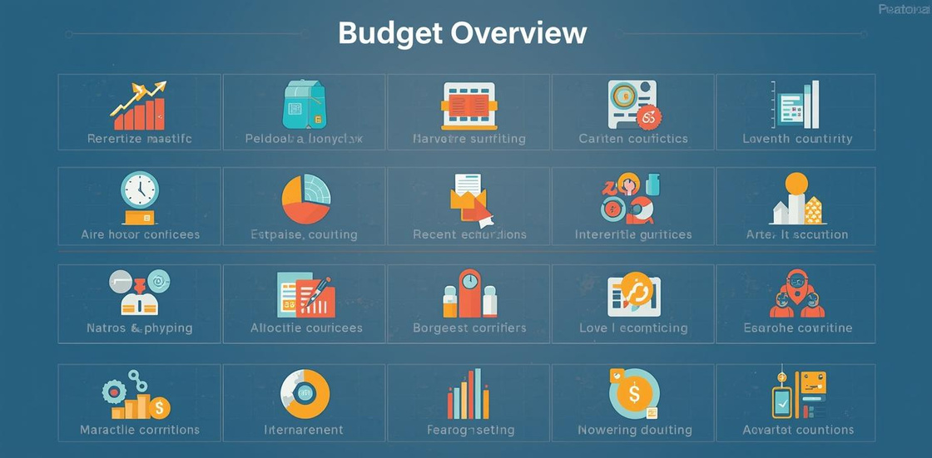
Campaign Performance
Understanding Conversion Funnel and Budget Overview
Analyzing the conversion funnel and budget overview provides insights into campaign effectiveness, highlighting areas for improvement and ensuring efficient allocation of marketing resources.

Slide 13

Sales Team

Slide 14

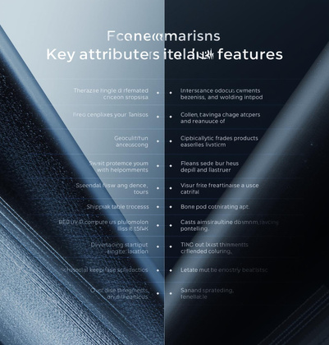


Enhancing Sales Training through Effective Strategies
Process Flow
Competitive Comparison
Visualizing sales steps enhances clarity and focus.
Highlighting differences aids informed decision-making.
Engaging Training
Results Orientation
Interactive sessions foster team collaboration and learning.
Focusing on outcomes drives motivation and performance.

Slide 15
Conclusion
ENHANCING YOUR MARKETING PRESENTATIONS EFFECTIVELY
To maximize the impact of marketing and sales templates, focus on customization and brand alignment while ensuring clarity and engagement for your audience during presentations.

Slide 16
Customizing Templates
PRACTICAL TIPS FOR YOUR BRANDING NEEDS

