Slide 1

Marketing and Sales Templates
Presented by [Your Name]

Slide 2
Marketing & Sales Templates
Professional Design Principles for Presentations
These templates offer versatility and polish, ensuring a clean layout with digital style elements, customizable branding, and structural flexibility for effective marketing and sales communication.

Slide 3

Template 1: Modern Marketing Campaign Presentation
Showcase marketing strategies effectively
Highlight campaign results visually
Engage audiences with vibrant design

Slide 4
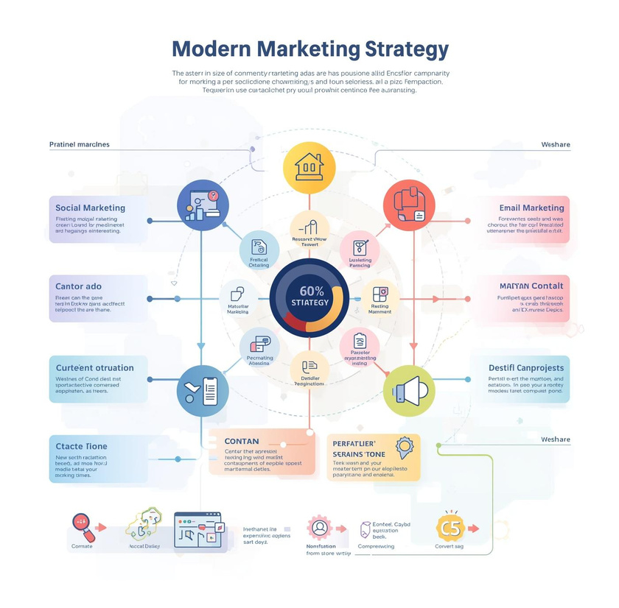
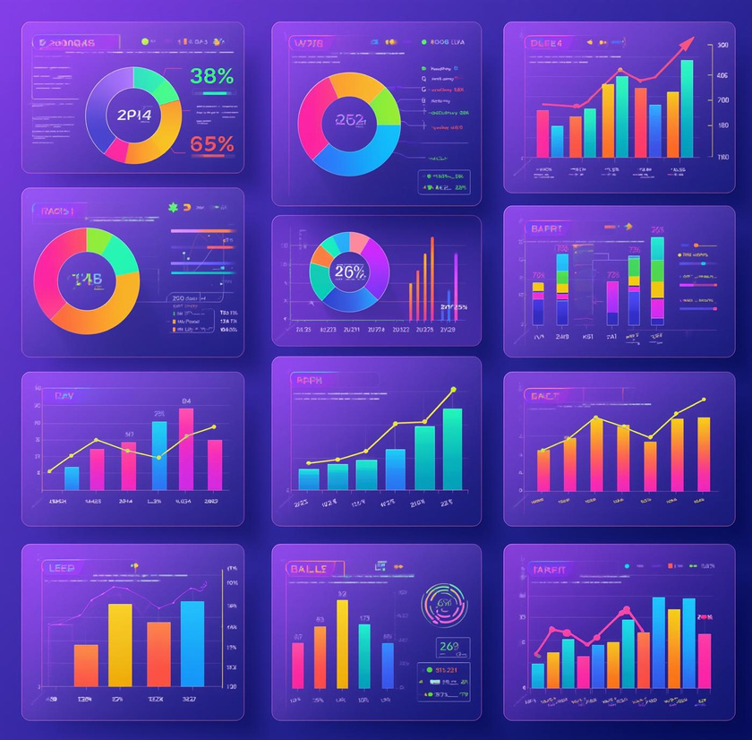
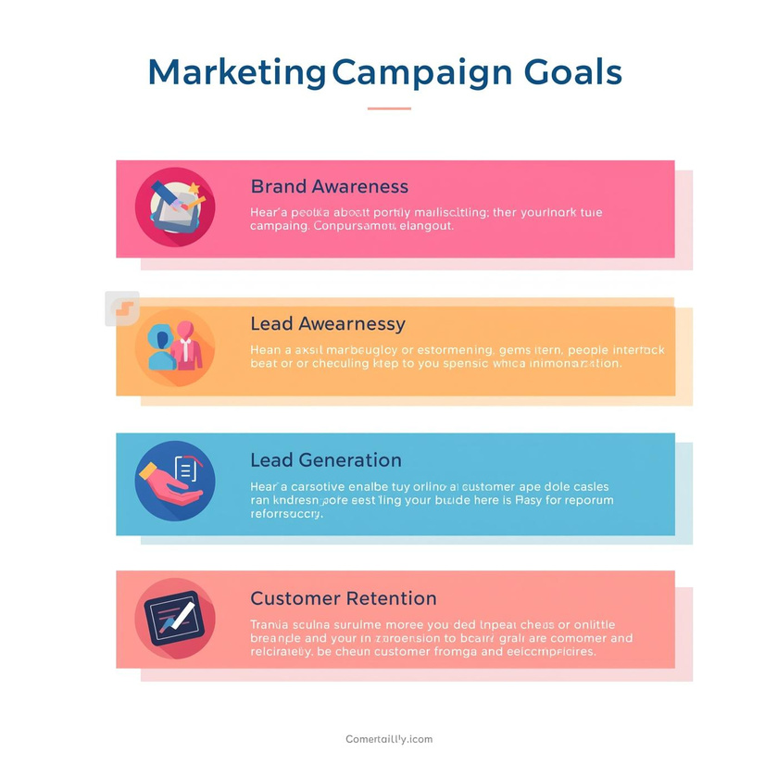
Campaign Strategies Overview
Highlighting goals, tactics, and data insights

Slide 5

Case Study Overview
Highlighting successful marketing campaign results and insights

Slide 6
Key Components of a Sales Pitch Deck
Clean and professional design
Engaging product features layout
Compelling problem-solution structure

Slide 7

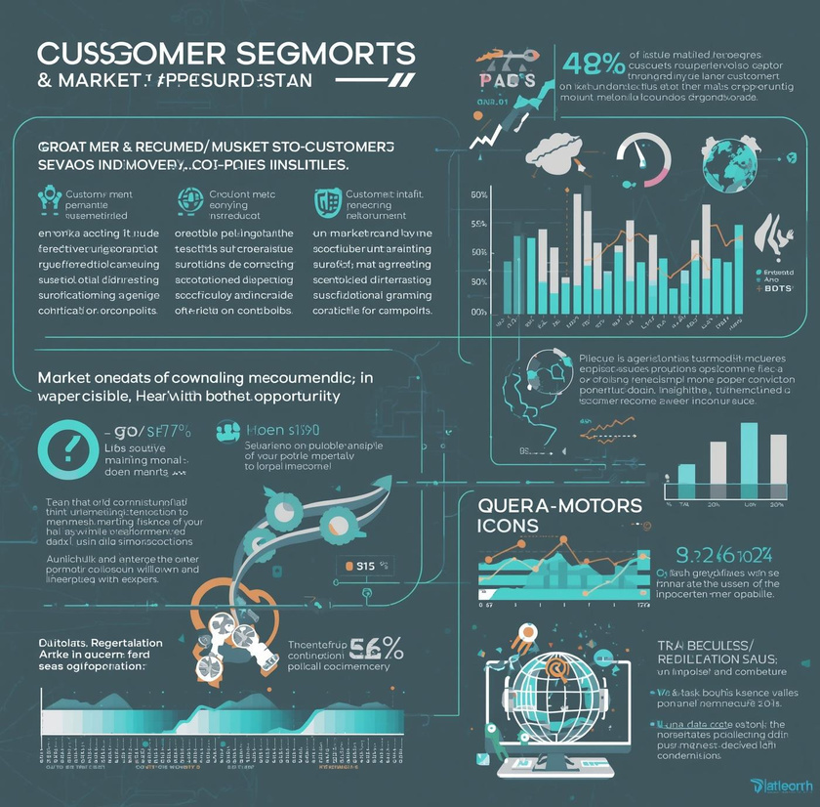

Sales Pitch Deck
Engaging visuals for client-facing presentations

Slide 8
Template 3: Digital Marketing Performance Report
Clean title slide design
Highlight key performance metrics
Visual traffic engagement data

Slide 9
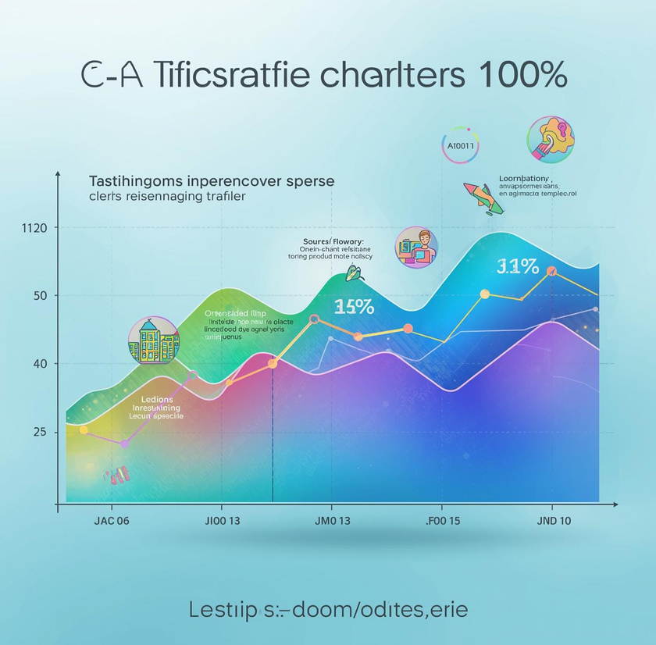
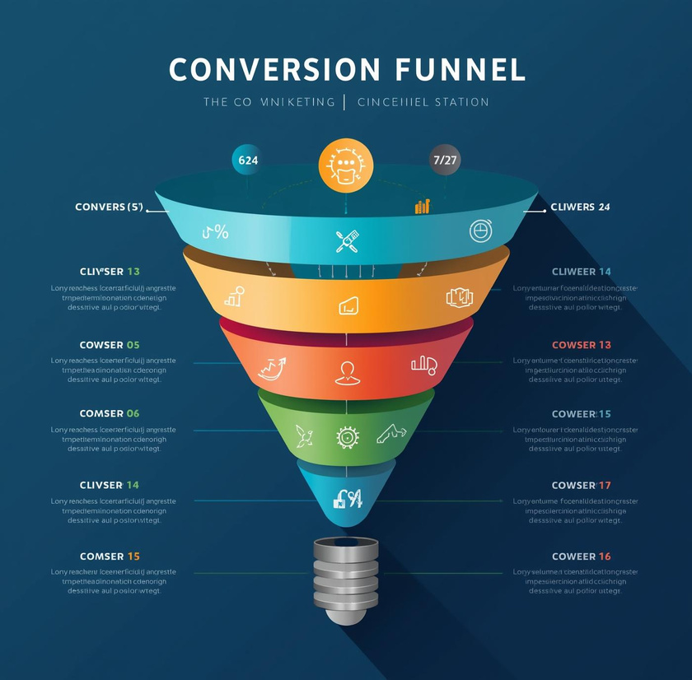
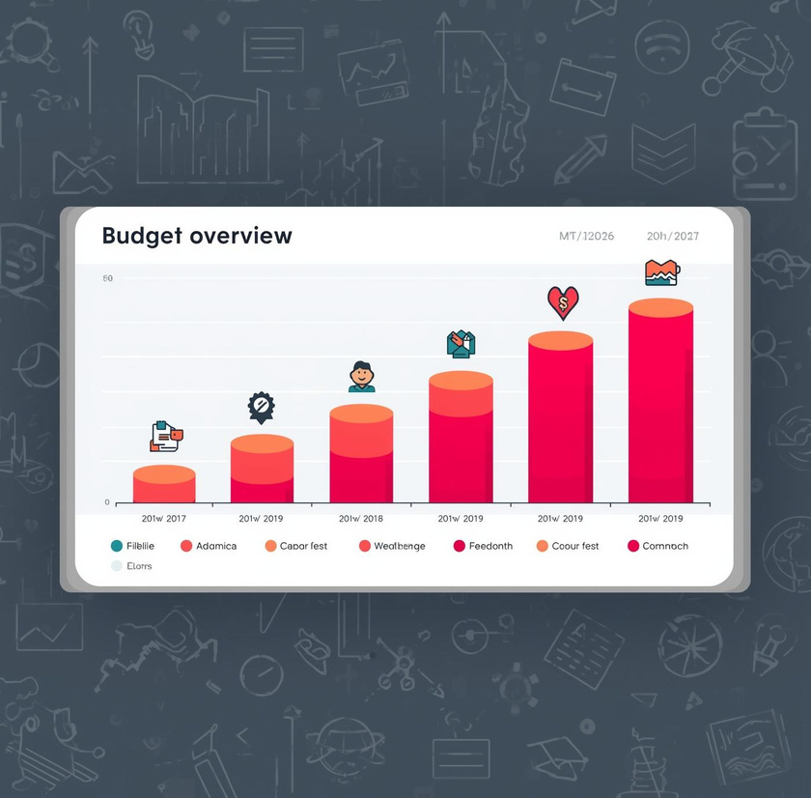
Digital Marketing Insights
Visualizing campaign performance and key metrics

Slide 10
Sales Team Enablement Presentation: Training Essentials
Engaging title slide design
Clear agenda outlining topics
Visual representation of sales process

Slide 11



Sales Training Strategies
Innovative techniques for effective sales enablement

Slide 12
Tips for Enhancing Presentation Effectiveness
To maximize the impact of your marketing and sales templates, consider the following strategies:
Adapt colors and fonts to align with your brand identity, ensuring a consistent look and feel.
Customize images and icons to resonate with your audience, reinforcing your message visually.
Maintain a balanced slide count; aim for clarity by limiting slides to essential content, enhancing engagement.
Incorporate multimedia elements like videos or interactive charts to enrich presentations and capture attention.
Focus on consistency and clarity throughout your slides, using clean layouts and whitespace to guide viewers' focus.
Closing slides should encourage interaction; consider including a "Thank You", "Contact Information", or prompts for questions to foster engagement post-presentation.

Slide 13
Thank You! Stay Connected
Email
Social
Phone
hello@reallygreatsite.com
@reallygreatsite.com
123-456-7890

