Slide 1

Portfolio
Digital Showcase
Presented by [Presenter Name Here]

Slide 2
Introduction
Understanding the digital portfolio landscape
Definition
Accessibility
Personal Branding
A digital portfolio is an online collection of work samples showcasing skills and achievements, vital for enhancing professional visibility and establishing credibility in today’s job market.
Digital portfolios provide instant access to your work from anywhere, enabling potential employers or clients to view your achievements effortlessly and ensuring a wider audience engagement.
By curating your online presence, a digital portfolio reflects your unique professional identity, allowing you to highlight strengths and showcase personality, setting you apart from competitors.

Slide 3

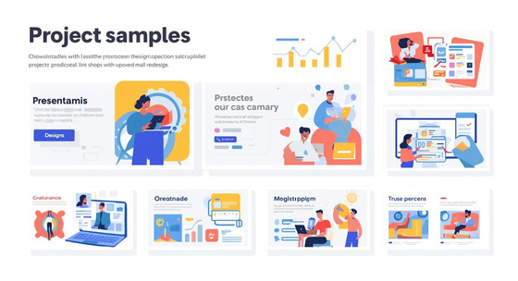
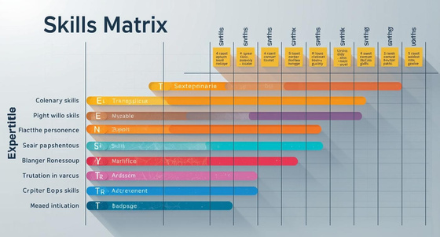
Essential Components of Digital Portfolios
Personal Introduction
A strong first impression with photo and summary.
Showcase of Work
Displaying impactful projects to engage and impress.
Skills and Expertise
Clear listing of abilities with endorsements or certifications.

Slide 4



Essential Components: Testimonials and Optional Sections
Testimonials
Client feedback enhances credibility and builds trust.
Blog
Sharing insights can demonstrate expertise and thought leadership.
Awards
Showcasing accomplishments can enhance professional reputation.

Slide 5
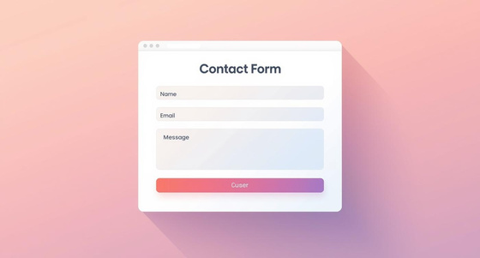


Essential Components of Your Digital Portfolio
Contact Information
Ensure your contact details are clearly visible for outreach.
Call to Action
Encourage viewers to take the first step towards your success.
Next Steps
Highlight the importance of taking action today.

Slide 6
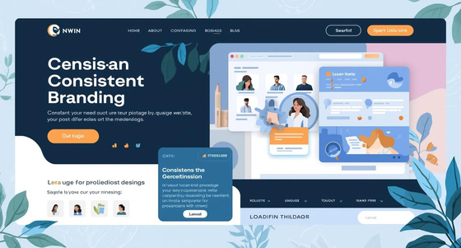
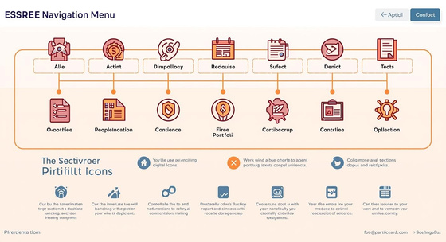
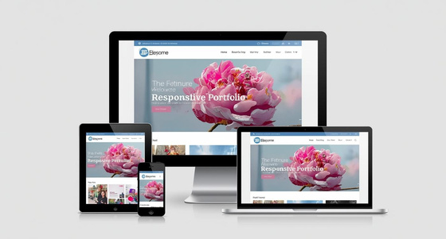
Key Design Principles for Digital Portfolios
Consistent Branding
Creates a unified look across all portfolio elements.
Intuitive Navigation
Ensures quick access to essential portfolio sections.
Mobile Responsiveness
Adjusts seamlessly to enhance viewing on any device.

Slide 7
Design Principles for Digital Portfolios
Effective Multimedia
Integrating videos and images enhances engagement and showcases work dynamically without overwhelming the viewer's experience.
Accessibility
Ensuring designs are accessible allows diverse audiences to navigate and enjoy your portfolio effortlessly and inclusively.

Slide 8
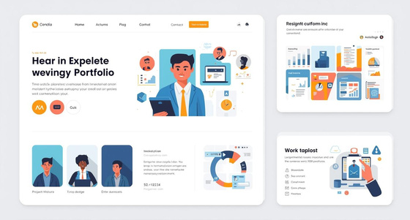
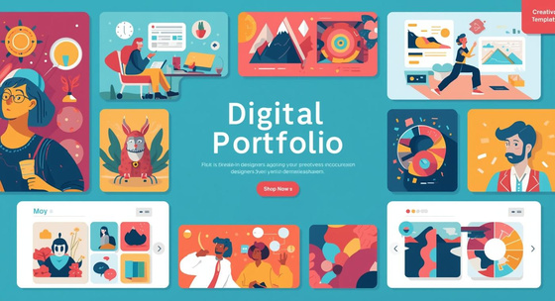
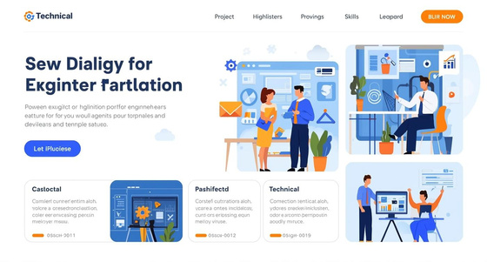
Digital Portfolio Template Examples
Minimalist Template
Emphasizes clarity and professional appearance for corporate settings.
Creative Template
Offers rich visuals and interactive features for creative fields.
Technical Template
Highlights projects and technical skills for specialized audiences.

Slide 9
Conclusion
Importance of a Well-Structured Portfolio
Clear Structure
Design Best Practices
Take Action
A well-designed digital portfolio provides clarity and focus, helping potential clients and employers easily navigate and understand your professional journey and key qualifications.
Following design principles ensures that your portfolio is not only visually appealing but also user-friendly, creating an engaging experience that highlights your skills and expertise effectively.
Start crafting your digital portfolio today to stand out professionally. Regular updates and tailored content will keep your portfolio relevant and aligned with your personal brand and career goals.

Slide 10

Get in Touch
Start your journey to an outstanding digital portfolio today!
Phone: 123-456-7890
Email: hello@reallygreatsite.com
Website: reallygreatsite.com

