Slide 1



Crafting Your Portfolio
Presented by
[Your Name Here]

Slide 2
Introduction to Digital Portfolios
Digital portfolios are becoming essential in the professional landscape. They offer unmatched accessibility, allowing potential employers to view your work anytime and anywhere. Additionally, dynamic content showcases your skills and experiences in an engaging way, making it easier to convey your professional narrative.
The importance of personal branding cannot be overstated; a well-crafted digital portfolio reflects your unique identity and values, helping you stand out in a competitive market. Investing time in creating an impactful portfolio can significantly enhance your career opportunities and professional presence.

Slide 3
Essential Components
Personal Introduction
Showcase of Work
Skills and Expertise
Highlight your best projects to demonstrate expertise.
Clearly list skills and relevant endorsements or certifications.
Include a photo and professional summary for connection.
Testimonials or References
Blog
Awards
Share insights and thoughts to engage your audience.
List any recognitions to enhance your professional credibility.
Gather positive feedback from clients or colleagues for credibility.

Slide 4



Additional Essential Components
Professional Summary
Case Studies
Blog
A concise overview of your experience.
Highlighting key projects and their impact.
Sharing insights and fostering engagement.

Slide 5


Design Principles of UX
Intuitive Navigation
Cluttered Layout
Essential for enhancing user experience and retention.
Detracts from the user experience and accessibility.

Slide 6
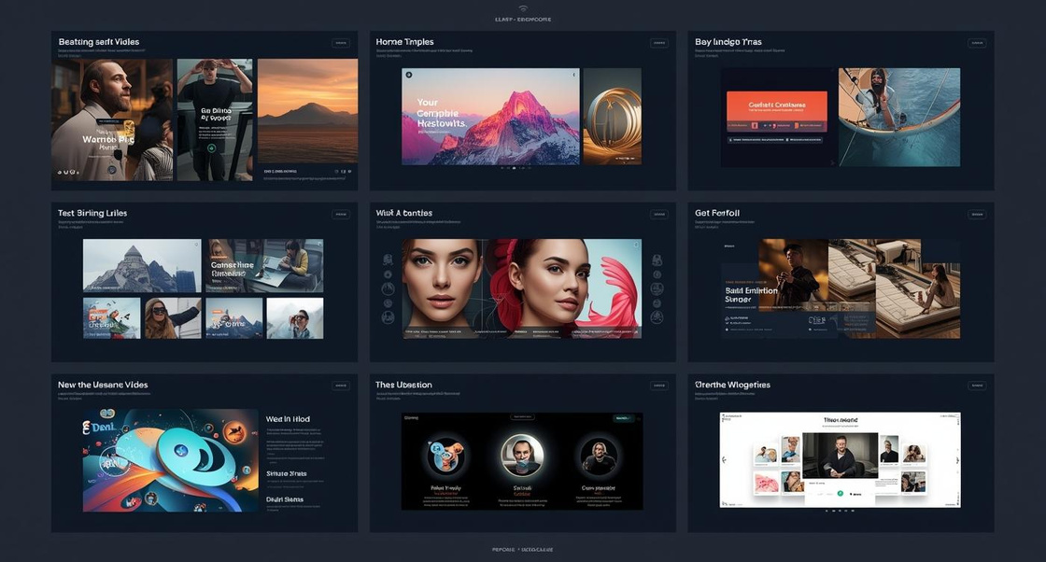

Multimedia Elements
Incorporating multimedia elements into your digital portfolio enhances engagement and showcases your skills effectively. Utilize images, videos, and interactive features that complement your work, ensuring a harmonious balance that captures attention without overwhelming the viewer, ultimately conveying your professional narrative more dynamically.

Slide 7

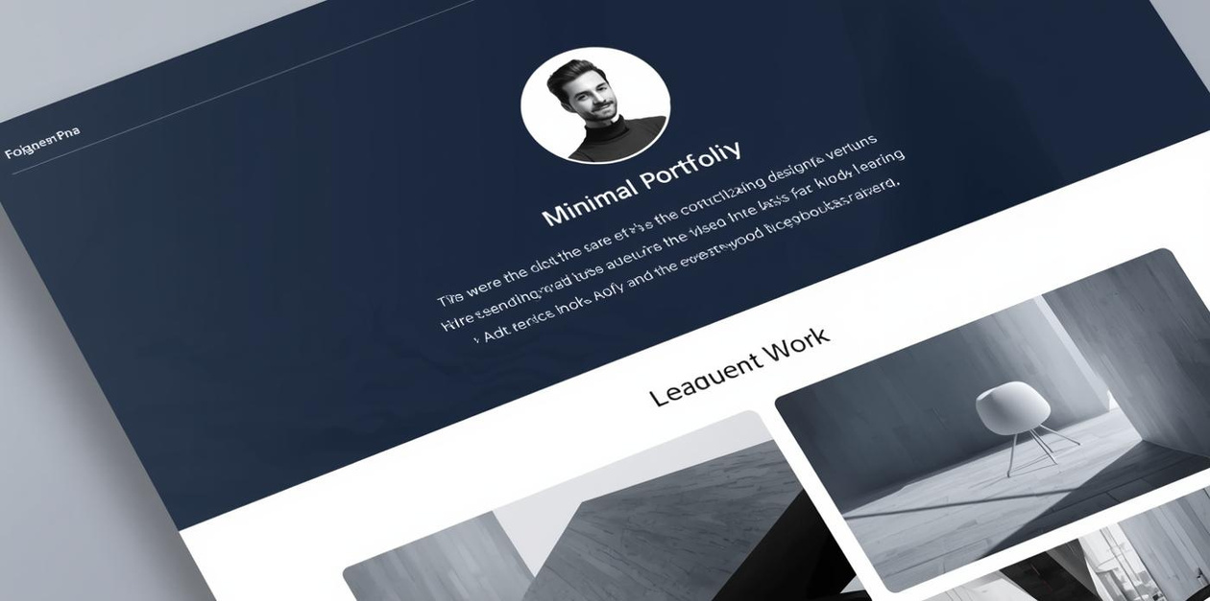
Minimalist Template
A minimalist digital portfolio showcases clarity and simplicity, allowing content to shine. The design emphasizes clean lines, effective use of white space, and structured layouts, creating an engaging user experience. This approach is ideal for corporate professionals aiming for a polished and professional appearance.

Slide 8


Creative Portfolio Showcase
Inspiring designs for artistic professionals

Slide 9
Key Takeaways
Importance of a well-structured digital portfolio
Regular updates to reflect changing skills
A well-structured portfolio enhances your professional presence.
Ensure your portfolio stays current with frequent revisions.
Encouragement to start your portfolio today
Recommended tools for creating digital portfolios
Begin crafting your portfolio now to stand out professionally.
Utilize user-friendly platforms to build your portfolio effectively.

Slide 10
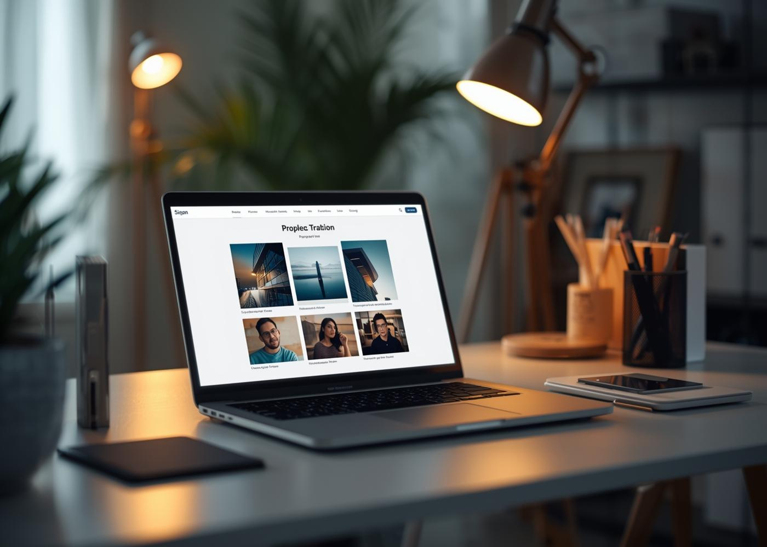
Contact Us
Email
hello@reallygreatsite.com
Social Media
@reallygreatsite
Phone
123-456-7890

