Slide 1
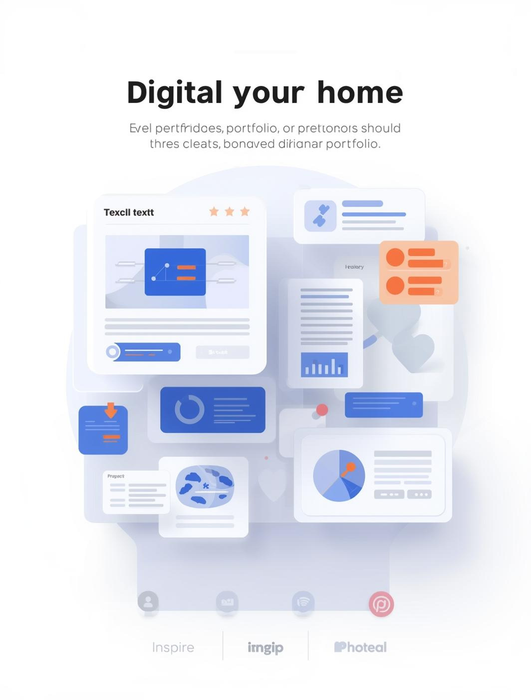

Digital Portfolios Unleashed
Presented by [Your Name]

Slide 2
Introduction to Digital Portfolios
DEFINING YOUR DIGITAL PRESENCE PROFESSIONALLY

Slide 3

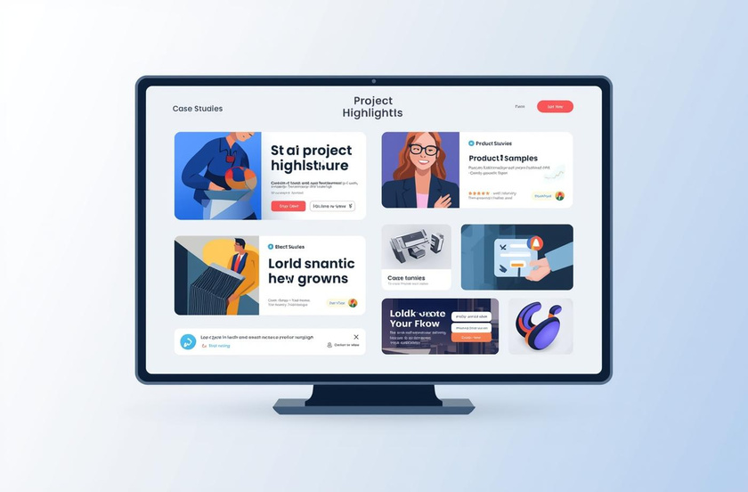
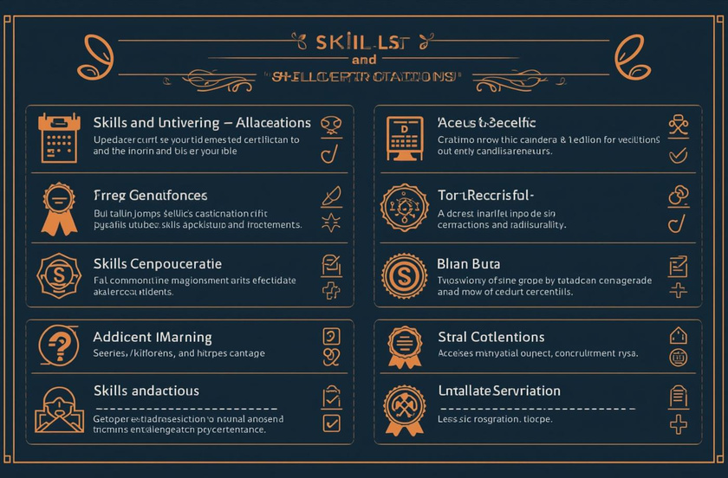
Essential Components of a Portfolio
PERSONAL INTRODUCTION
SHOWCASE OF WORK
SKILLS AND EXPERTISE
Professional summary with contact details
Highlights of projects and case studies
Clear listing with endorsements or certifications

Slide 4



Testimonials and Optional Sections
TESTIMONIALS
OPTIONAL SECTIONS
ILLUSTRATED EXAMPLES
Social proof enhances credibility significantly.
Additional features can enrich portfolios.
Visual layouts provide clear guidance and inspiration.

Slide 5
Design Principles
KEY ELEMENTS FOR EFFECTIVE PORTFOLIOS
CONSISTENT BRANDING
NAVIGATION
Maintaining a cohesive visual identity across your portfolio enhances professionalism, ensuring that color schemes, typography, and logos align with your personal brand throughout the digital space.
An intuitive menu structure simplifies user experience, allowing visitors to easily access important sections and enhancing engagement with the content presented in your digital portfolio.

Slide 6
Responsiveness Matters
ENSURING ACCESSIBILITY ACROSS ALL DEVICES
MOBILE COMPATIBILITY
MULTI-DEVICE SUPPORT
A professional digital portfolio must be mobile-friendly, adapting seamlessly to various screen sizes while maintaining functionality and appearance, ensuring users can access your work anytime, anywhere.
Successful portfolios support diverse devices, from tablets to desktops, enhancing user experience with consistent layouts, ensuring potential employers can navigate smoothly, regardless of their chosen platform.

Slide 7
Accessibility Matters
CONSIDERATIONS FOR DIVERSE AUDIENCES
INCLUSIVE DESIGN
USER-FRIENDLY NAVIGATION
Incorporating inclusive design ensures that your digital portfolio is usable by individuals with various disabilities, enhancing their experience and engagement with your content.
A clear and intuitive navigation structure allows all users to easily access your portfolio, making it more effective and appealing to a wider audience.

Slide 8



Portfolio Templates Overview
MINIMALIST DESIGN
CREATIVE APPROACH
HYBRID STYLE
Focus on clarity and simplicity
Emphasizes artistic expression and engagement
Balances professionalism with creativity

Slide 9



Templates for Engineers and Designers
TECHNICAL FOCUS
CLEAR PRESENTATION
PROFESSIONAL AESTHETIC
Emphasizes precision and structured layouts.
Showcases projects with detailed descriptions.
Balances creativity with industry standards.

Slide 10
Conclusion & Next Steps
RECAP AND ACTIONABLE ADVICE FOR PORTFOLIOS
IMPORTANCE OF STRUCTURE
REGULAR UPDATES
A well-structured digital portfolio showcases your skills and experience effectively, making it easier for potential employers or clients to understand your professional journey and capabilities.
Tailoring your portfolio to reflect current projects and achievements is crucial. Regular updates ensure you're presenting the most relevant and impactful version of your professional self.

Slide 11

Start Crafting Your Digital Portfolio Today!
TAKE THE NEXT STEP

