Slide 1

Project Management: Strategies for Success
[Presenter Name Here]

Slide 2
Introduction to Project Management
Understanding its Value in Business Success
Project management is crucial for achieving business objectives, ensuring efficient resource use, reducing risks, and aligning stakeholders. It encompasses five phases that guide projects from initiation to completion.

Slide 3

Project Management
Definition
Efficiency
Mitigation
Alignment
Organized approach to achieving goals
Streamlined processes for better results
Reducing risks through proactive planning
Ensuring stakeholders share common goals

Slide 4
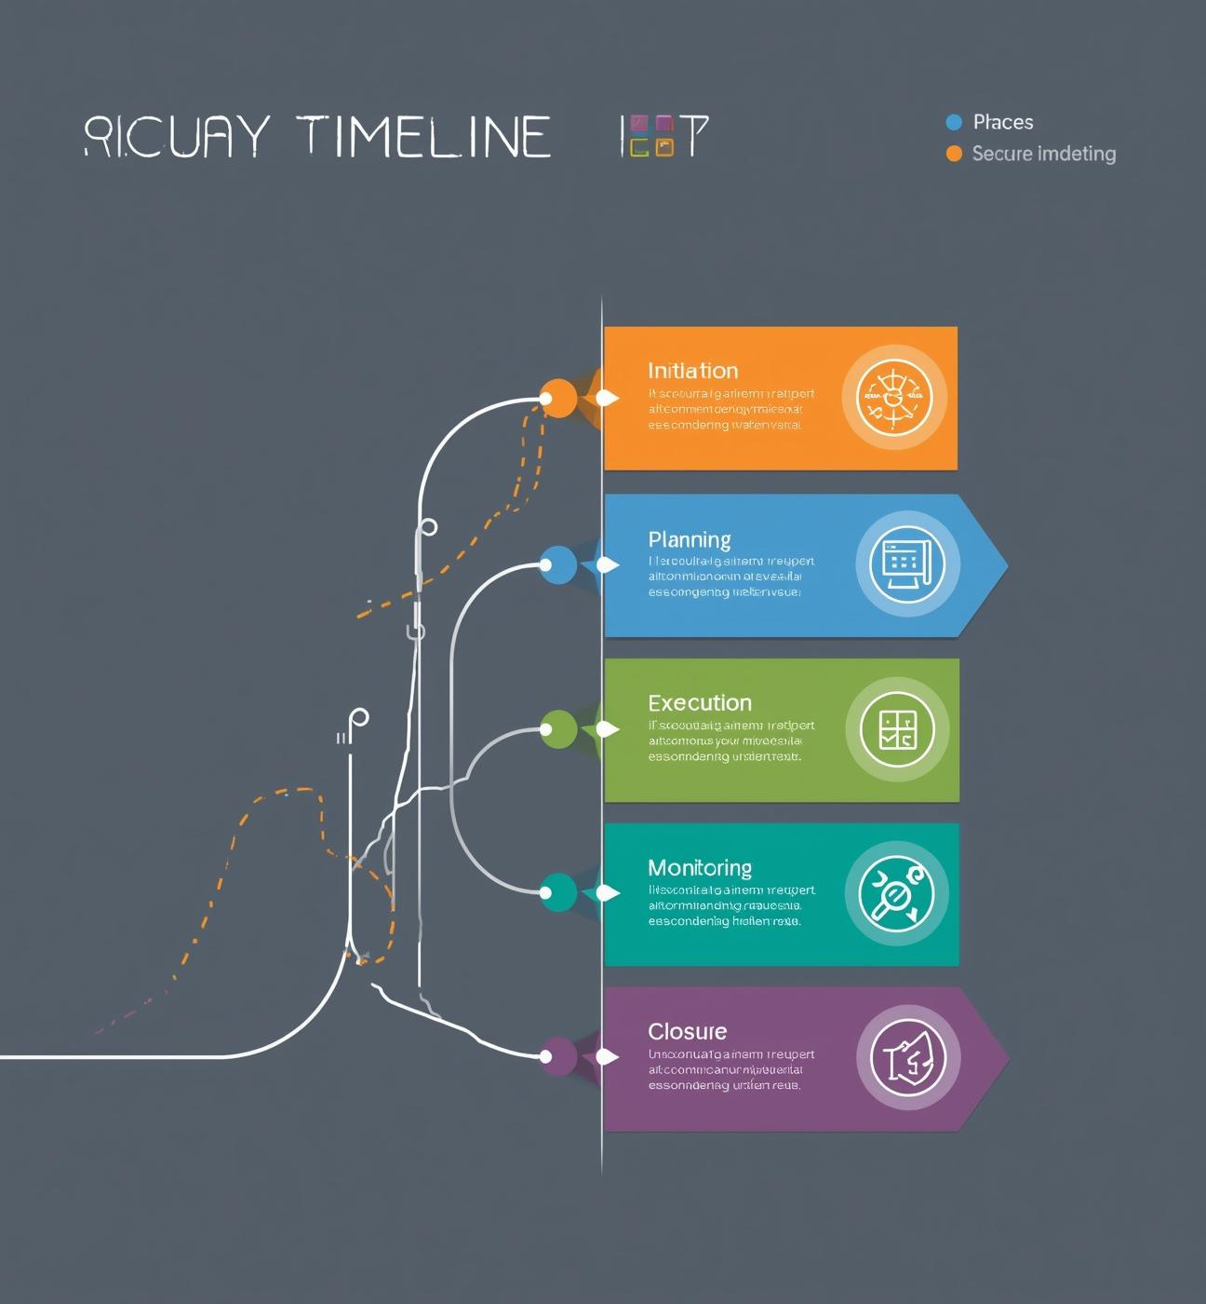
Phases
Initiation: Define project scope and objectives
Planning: Develop project roadmap and allocate resources
Execution: Implement project plans and deliver outputs
Monitoring: Track progress and make adjustments
Closure: Evaluate project outcomes and document lessons learned

Slide 5
Project Management Techniques
Essential Frameworks for Effective Management
Understanding core project management processes, such as initiation and planning, along with methodologies like Agile and tools like Gantt charts, is vital for successful project delivery.

Slide 6
Project Management
Initiation
Planning
Execution
Monitoring
Define project scope and objectives
Develop detailed project roadmap
Implement project plans effectively
Track progress and adjust strategies

Slide 7
Project Management Methodologies: Waterfall, Agile, and Scrum
Waterfall: sequential and linear process
Agile: iterative and flexible approach
Scrum: emphasizes teamwork and quick delivery

Slide 8
Project Management Tools
Gantt
Charter
Risk
Communication
Visual timeline for project tasks
Document defining project scope clearly
Identifying and managing potential issues
Plans for stakeholder information sharing

Slide 9
Practical Applications
Utilizing Data Visualization in Projects
Effective project management relies on data visualization to track progress. Dashboards and KPIs provide insights, making status communication clear and engaging for stakeholders across all levels.

Slide 10
Effective Project Tracking and Reporting Tools
Visualize progress with dashboards
Monitor KPIs for success
Utilize digital project management software

Slide 11
Project Management Tools: MS Project, Jira, Trello
Comprehensive project planning and tracking
Agile task management and collaboration
User-friendly for small teams and projects

Slide 12
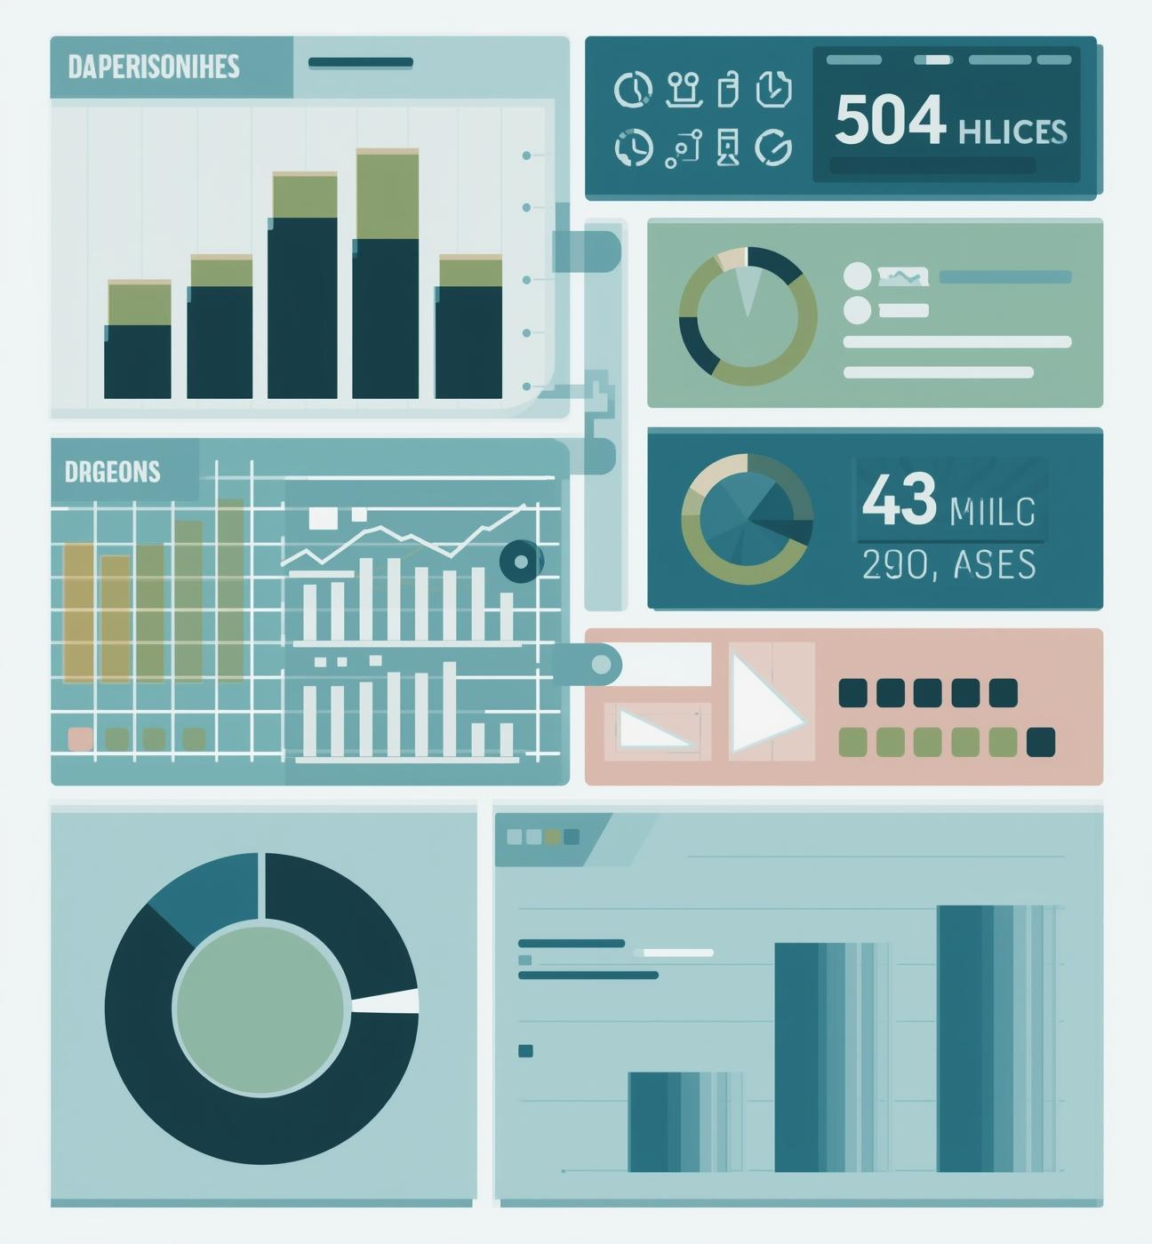
Visualization
Track project progress with dashboards
Use KPIs for performance measurement
Employ visual reporting to engage stakeholders
Leverage tools like MS Project and Trello

Slide 13
Conclusion and Next Steps
Embracing Project Management for Growth
Structured project management is vital for successful outcomes. Adopting digital tools enhances efficiency and encourages data-driven decision-making, paving the way for ongoing professional development and success.

Slide 14
The Importance of Structured Project Management
Enhances overall project efficiency
Mitigates potential risks effectively
Aligns stakeholders towards goals

Slide 15
Questions and Contact Information
Email
Social
Phone
hello@reallygreatsite.com
@reallygreatsite.com
123-456-7890

