Slide 1


Project Management Co.
Streamlining Success
John Doe, Project Manager
PRESENTED BY
John Doe

Slide 2

Defining Project Management
Project management is essential in achieving business goals, providing a structured approach to deliver projects efficiently, aligning resources, and mitigating risks effectively.

Slide 3

75%
Increased project success rate
Effective project management leads to a 75% increase in project success rates, enabling organizations to achieve their objectives on time and within budget while satisfying stakeholder expectations.

Slide 4
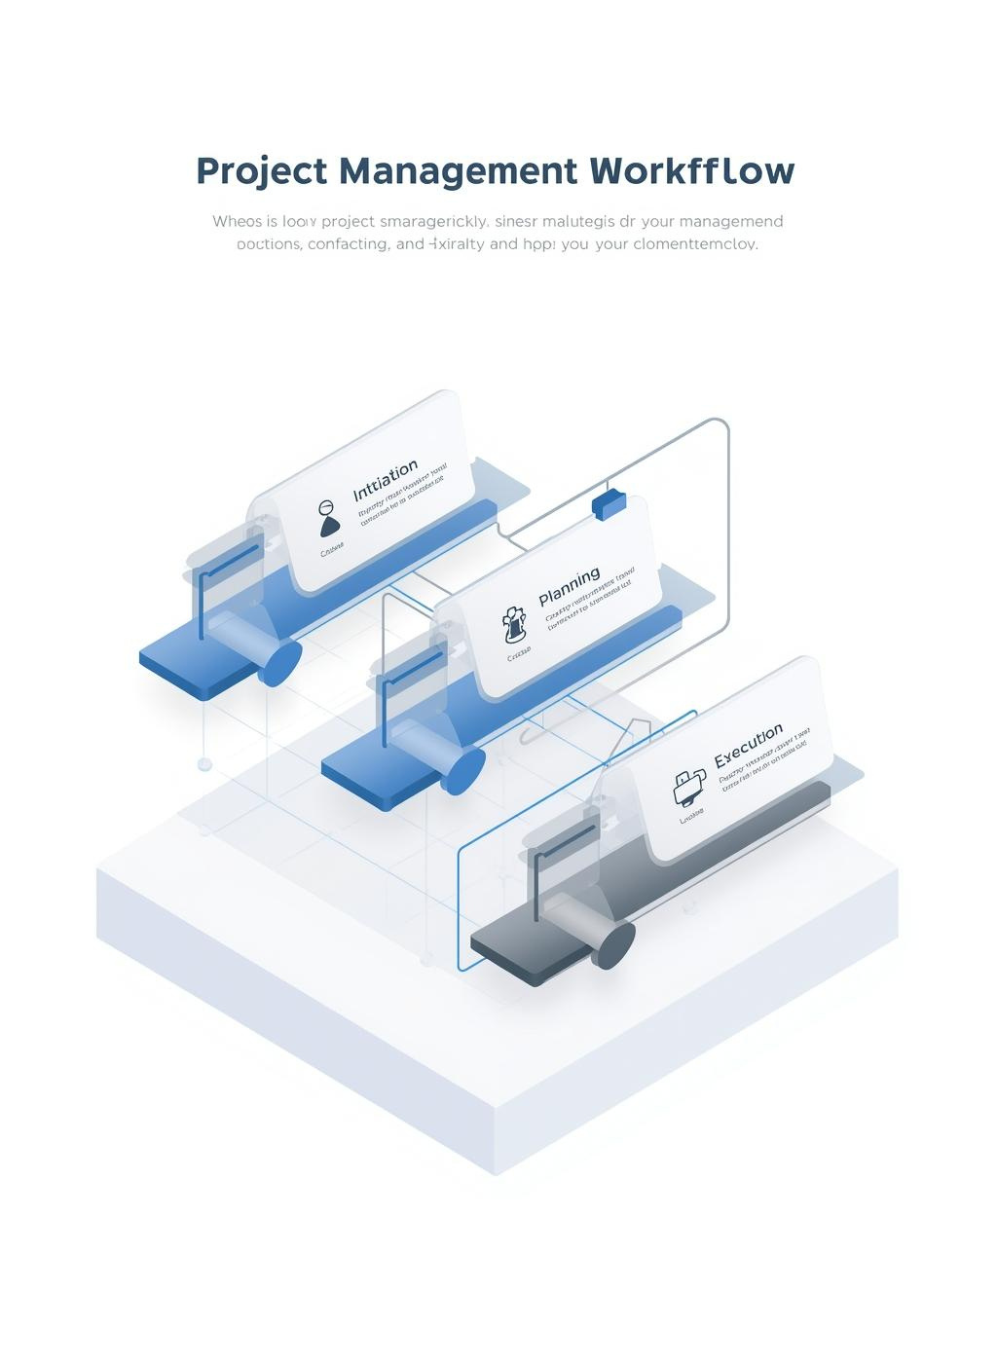
Project Management Overview
Project management is essential for achieving business goals, enhancing efficiency, mitigating risks, and aligning stakeholders. Understanding its phases prepares teams for successful project execution.

Slide 5
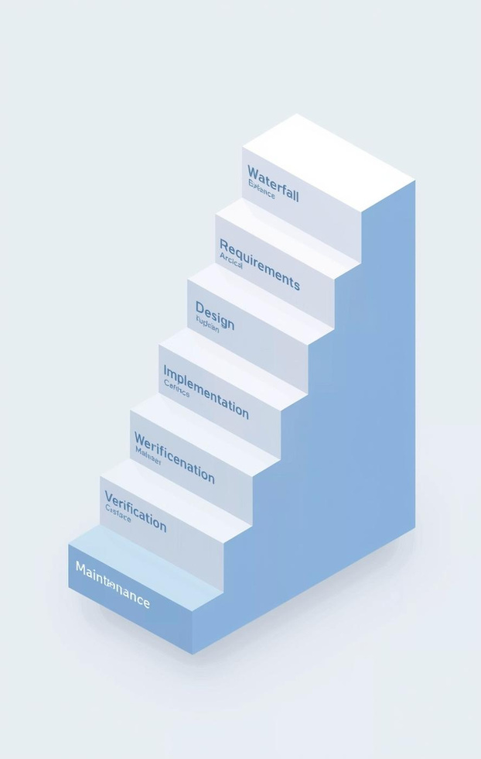
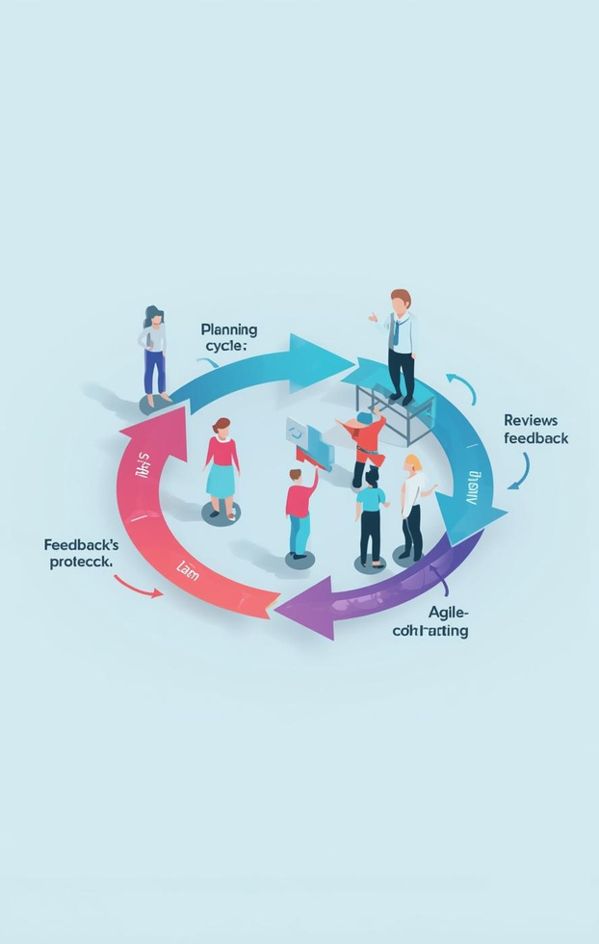
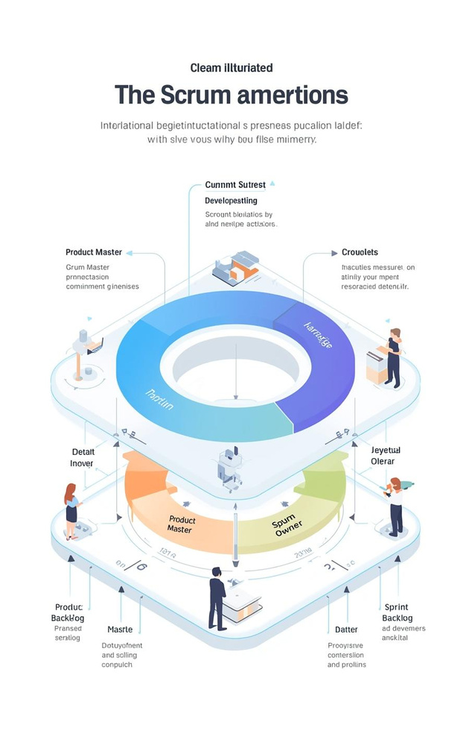
Project Management Methodologies
WATERFALL METHODOLOGY
Linear approach
AGILE METHODOLOGY
Iterative approach
SCRUM FRAMEWORK
Team collaboration

Slide 6
Project Workflow Timeline
INITIATION
PLANNING
EXECUTION
The project officially begins with defining scope, objectives, and forming the project team.
Detailed planning is conducted, including resource allocation, timelines, and risk assessment for project success.
The project is executed according to the plan, with ongoing monitoring to ensure alignment with objectives and timelines.

Slide 7

Tracking Progress
Monitoring project progress is crucial for success. Dashboards and reports provide visual insights, enabling teams to make informed decisions and maintain alignment with project goals.

Slide 8

85%
Projects meeting deadlines
Meeting deadlines is crucial for project success. 85% of projects that adhere to schedules achieve their objectives, fostering stakeholder satisfaction and maintaining project momentum.

Slide 9



Digital Project Management Tools
MS PROJECT
Visual Planning
JIRA
Agile Tracking
TRELLO
Task Management

Slide 10

75%
of projects fail to meet goals
Effective project management is crucial, as 75% of projects fail to meet their goals due to lack of proper planning, stakeholder engagement, and risk management strategies in place.

Slide 11

Embracing Project Management
Adopting project management tools fosters a culture of continuous learning and improvement, enabling teams to adapt processes and enhance efficiency in their workflows.

Slide 12

Contact Us
PROJECT MANAGEMENT TEAM
@reallygreatsite
OFFICE LOCATION
123-456-7890
TRAINING RESOURCES
hello@reallygreatsite

