Slide 1

INFOGRAPHIC TEMPLATE PRESENTATION
Professional
Use
Data Specialist

Slide 2

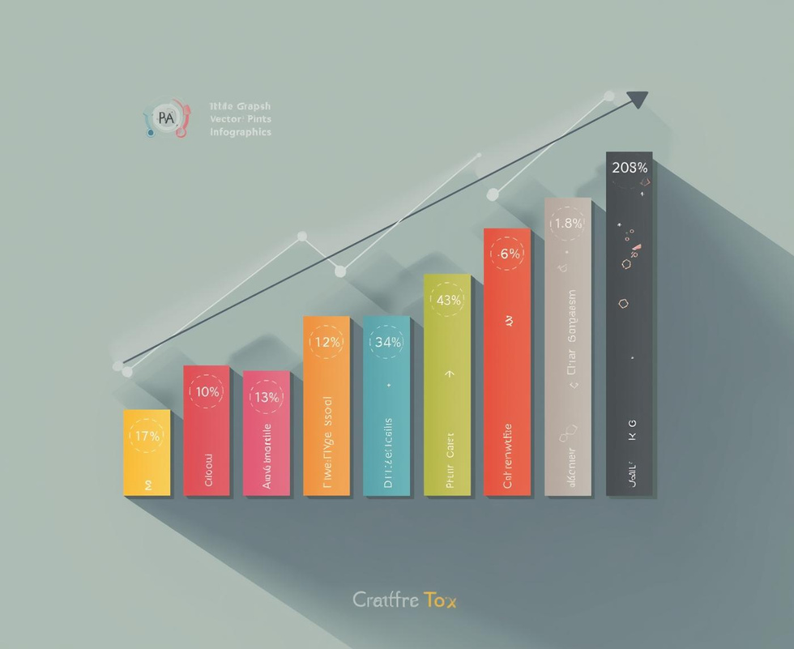

Modular Data Overview
Key Metrics
Data Visualization
Insightful Analysis
Overview of performance
Clear graphical presentation
Summary of findings

Slide 3
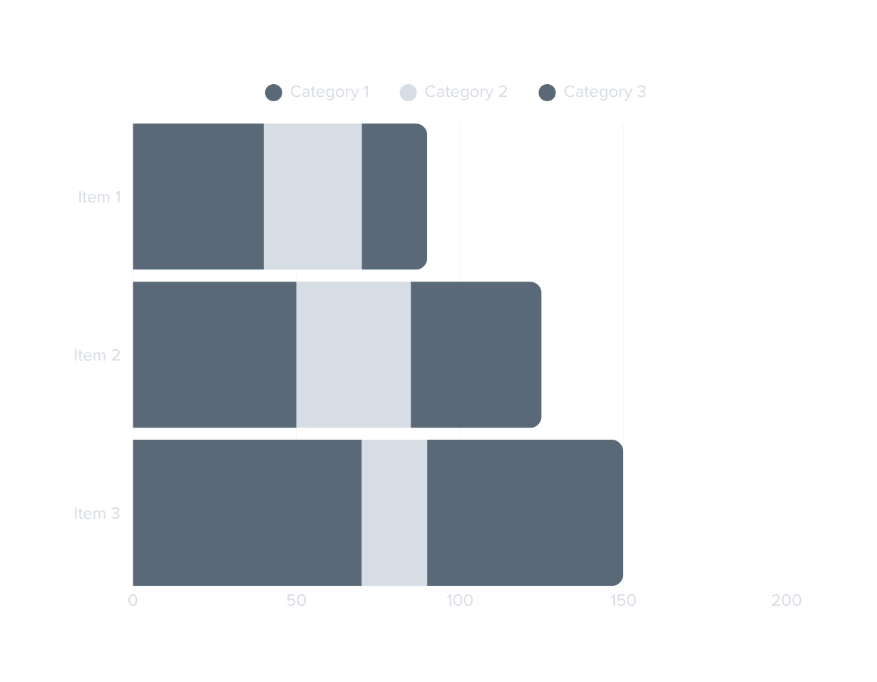
Key Metrics Overview
This bar chart illustrates the trends in key performance indicators over the past quarters.
Metrics reflect growth and performance insights.

Slide 4
Summary Insights
Key Takeaways from the Dashboard
This section highlights the most critical findings and actionable insights derived from the dashboard metrics, optimizing decision-making.

Slide 5



High-Level Process Overview
Initiation
Execution
Evaluation
Identifying project goals and assembling key stakeholders.
Implementing steps to achieve defined objectives effectively.
Assessing outcomes and refining processes for improvement.

Slide 6
Process Explanation
Step-by-step guide to understanding workflows
This section outlines each step in the process, providing clarity and ensuring efficient task execution across teams.

Slide 7

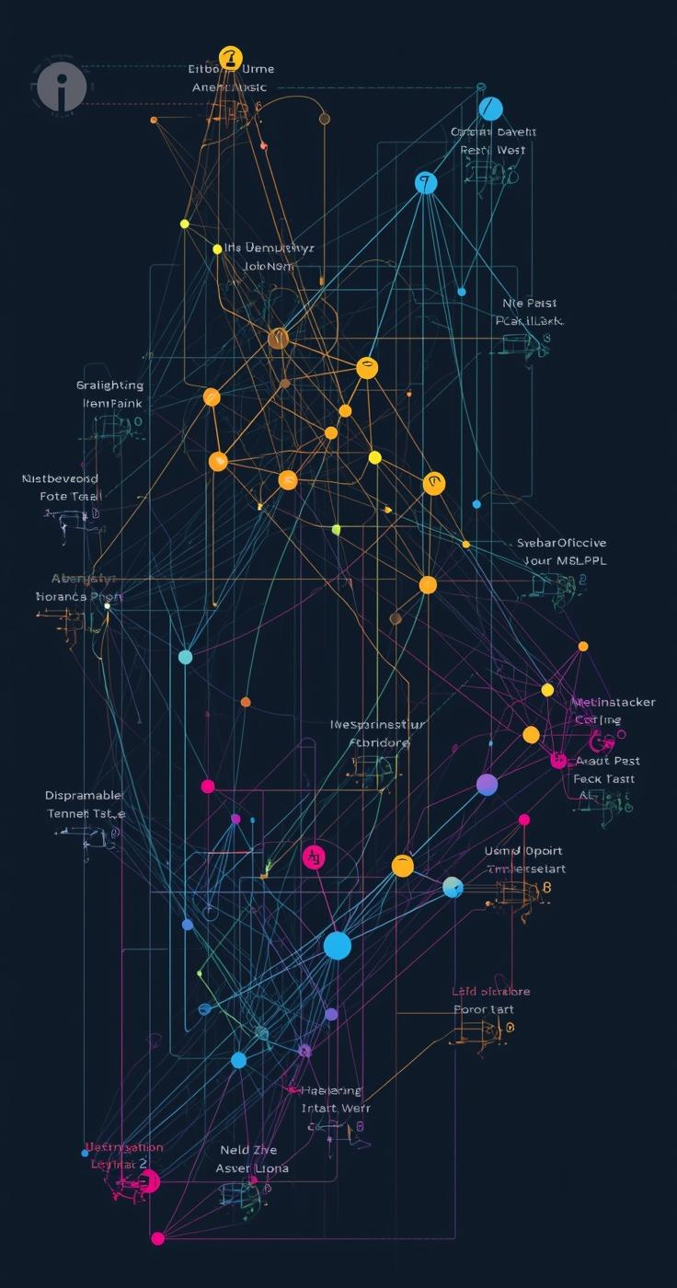
Workflow Comparisons
Exploring different process pathways

Slide 8


Comparison Overview
Metrics
Analysis
Visual representation of critical performance indicators
Insightful examination of comparative data points

Slide 9
Feature Comparison Table
Heading | Heading | Heading | Heading | Heading

Slide 10
Summary Insights
Key takeaways and recommendations for decision-making
This section highlights essential findings and actionable insights to support informed choices and strategic planning.

Slide 11
Timeline Overview
This timeline infographic outlines key milestones in our project, highlighting significant events and their impact on overall goals, ensuring clear visibility into progress and future directions.
Launch
Progress
Review
Completion
Initial product launch
Midway project assessment
Comprehensive evaluation phase
Final project delivery

Slide 12

Key Milestone Insights
Overview
This section explores the essential details of the first key milestone.

Slide 13
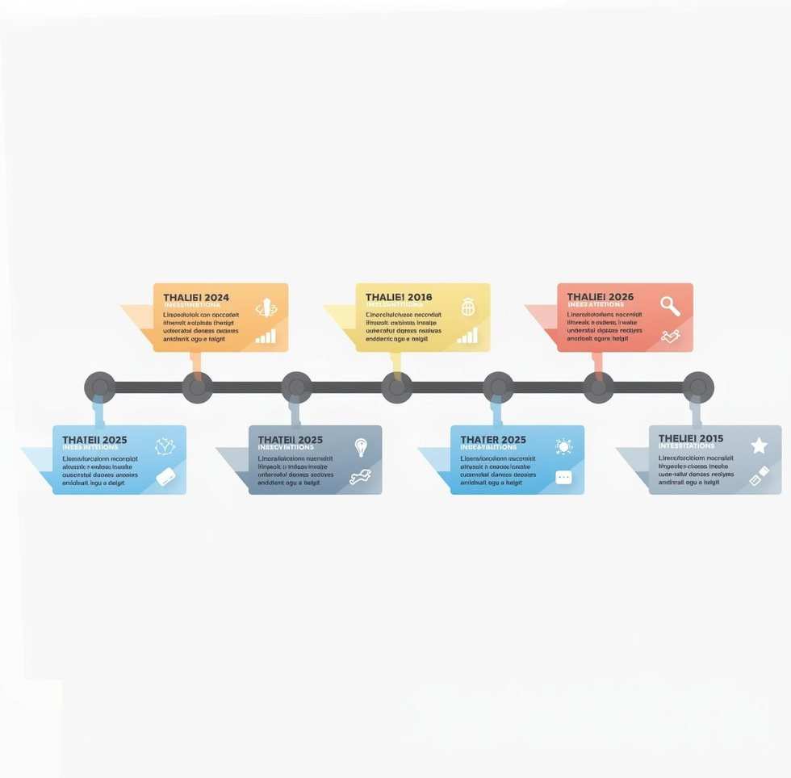
Key Milestone Analysis
Milestone
Analysis of the project's progress and significance.

Slide 14

Key Milestone Insights
Exploration
This section details essential findings and impacts.

Slide 15
Future Projections
This timeline outlines the anticipated milestones and projections for our upcoming projects over the next 12 months, providing clarity on expected developments.
Launch
Expansion
Review
Completion
Project kickoff event
New market entry
Mid-year assessment
Final project delivery

Slide 16
Contact us for your infographic needs
Email
Social Media
Phone
hello@reallygreatsite
@reallygreatsite
123-456-7890

