Slide 1

Infographics
PowerPoint Templates
Presented by [Your Name Here]

Slide 2
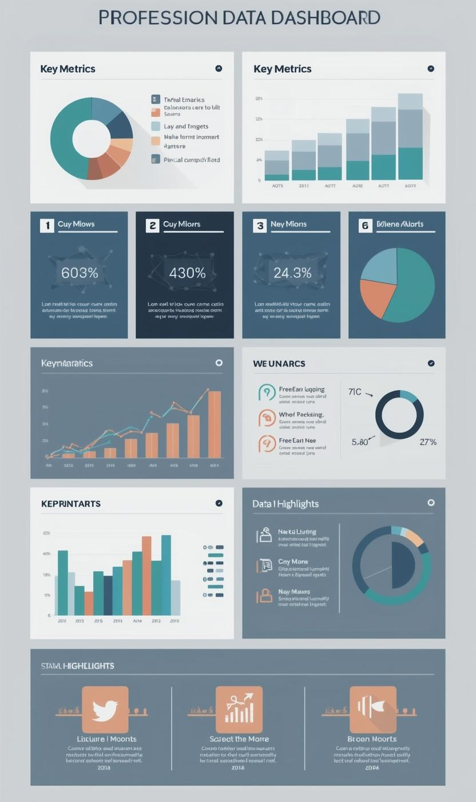
Modular Data Overview
01
High-level metrics help summarize complex data efficiently.
02
Icon-based highlights enhance quick comprehension of figures.
03
Modular layouts allow easy adjustments for diverse presentations.

Slide 3


Expanded Charts: Analyzing Trends and Insights
Data Trends
Analyzing key metrics helps identify patterns effectively.
Insightful Metrics
Detailed examination brings clarity to data analysis.

Slide 4

Summary Insights
This section provides key takeaways and impactful quotes that encapsulate crucial findings from the data presented. Icons enhance visual appeal while guiding the audience through the main points, ensuring clear understanding and retention of information.

Slide 5
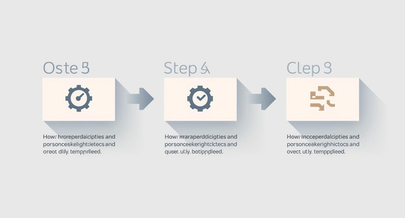


High-Level Process Overview
Step One
Initiate the project with clear goals and objectives.
Step Two
Plan resources and timelines for effective execution.
Step Three
Execute the process with ongoing monitoring and adjustments.

Slide 6
Workflow
Planning
Monitoring
Outline project objectives and goals.
Track progress and adjust plans.
Execution
Completion
Implement tasks according to timeline.
Finalize project deliverables and review.

Slide 7
Overview Comparison
Comparison Tables
Comparison tables facilitate quick evaluation of multiple options against established criteria, aiding decision-making.
Visual Charts
Visual charts provide insights into performance metrics, making complex data more digestible and actionable for analysis.

Slide 8
Feature Comparison
Detailed Analysis of Key Metrics
Performance Overview
User Engagement
Cost Efficiency
This section provides a concise analysis of the feature performance, highlighting the strengths and weaknesses of each metric in relation to overall project goals and objectives.
A detailed breakdown of user engagement metrics showcases trends and patterns, allowing stakeholders to make informed decisions based on user behavior and feedback received during the analysis period.
An examination of cost efficiency reveals the financial implications of each feature, helping organizations allocate resources effectively and maximize return on investment while minimizing potential risks.

Slide 9
Milestones Timeline
Event One
Event Two
Event Three
Launch of the project marked a significant milestone in our strategic planning.
Completion of phase one allowed us to move forward with additional development.
Final review and approval led to the official rollout of the product.

Slide 10
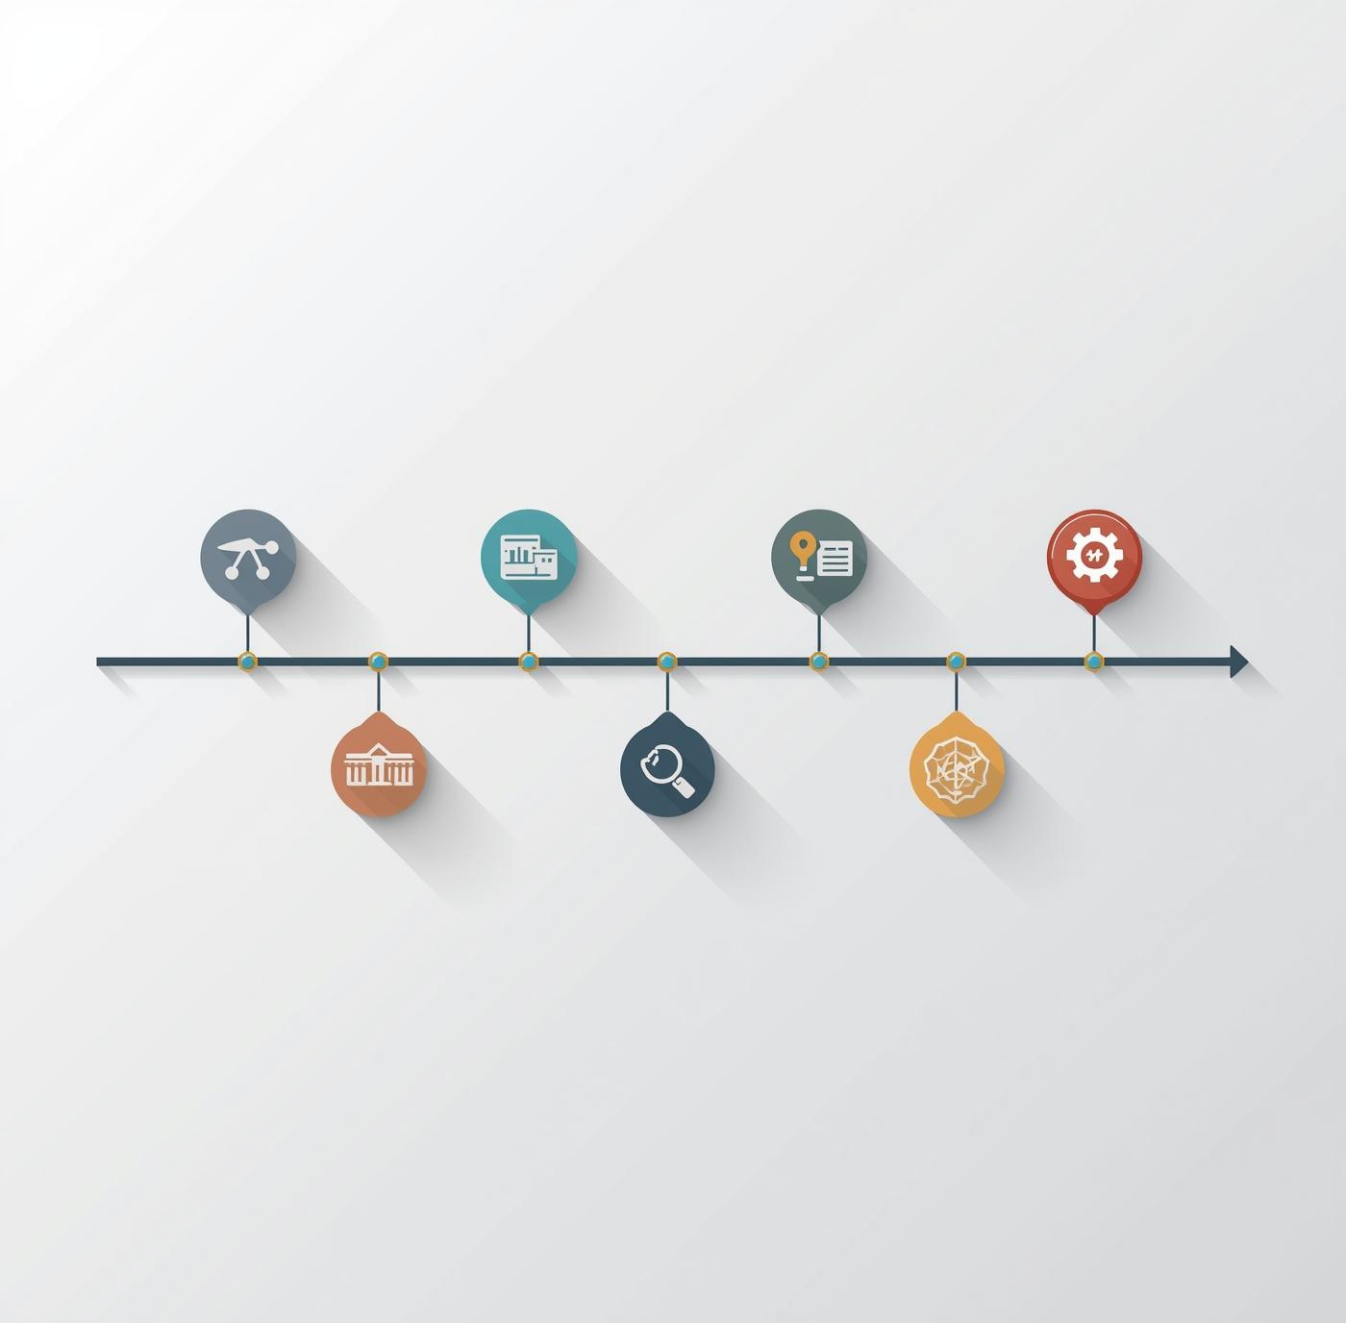
Project Phases
This section outlines the key milestones of our project, detailing each phase from inception to completion. By clearly defining these stages, we aim to provide a comprehensive overview that facilitates understanding and tracking of our progress throughout the project lifecycle.

Slide 11

Future Insights
Projecting Outcomes
This section highlights essential data-driven projections for upcoming initiatives, emphasizing trends and potential impacts to ensure informed decision-making moving forward.

