Slide 1
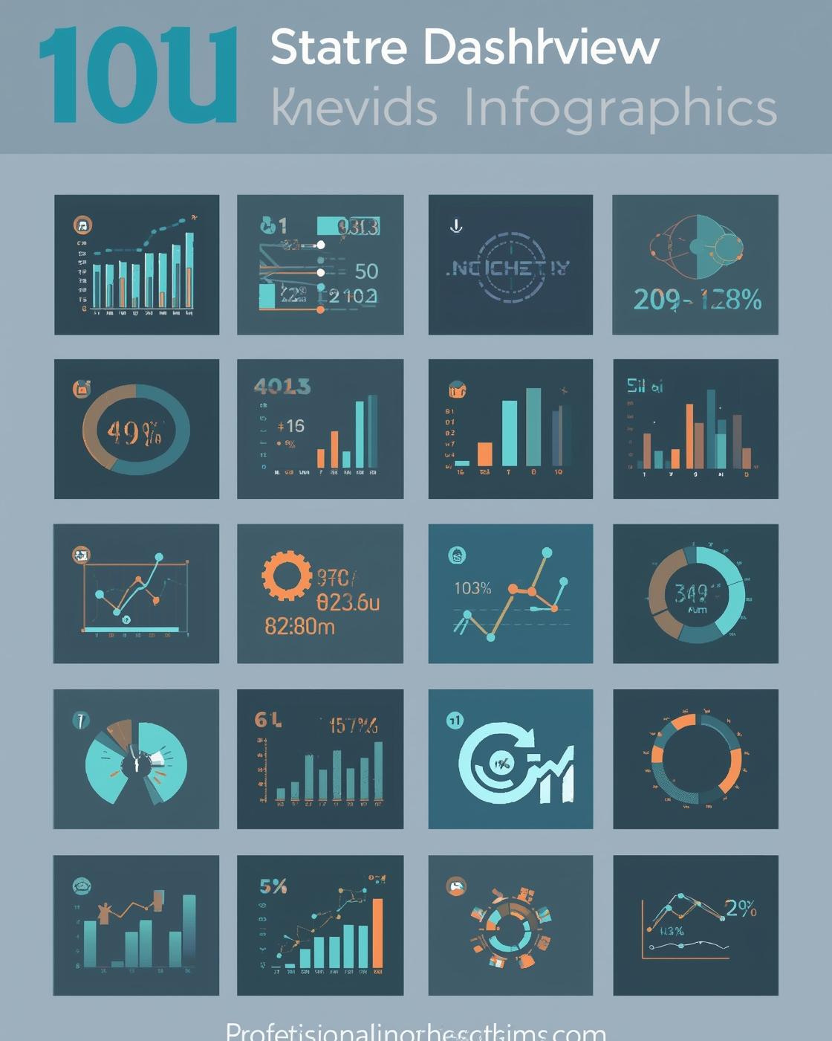
Introduction to Infographics
Infographic PowerPoint Template
Presented by [Presenter Name Here]

Slide 2
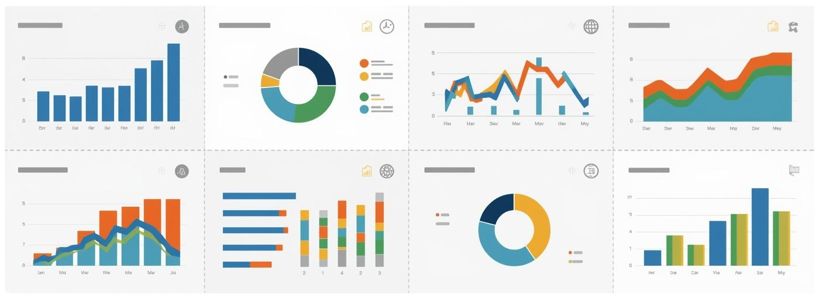
Modular Data Overview
Present concise metrics for quick data digestion.
NOTES AND INSIGHTS
2

Slide 3
75%
$1.5M
Completion Rate
Revenue Generated
The project completion rate stands at 75% as of today.
The total revenue generated is $1.5 million this quarter.
NOTES
3

Slide 4
Summary Insights
Data Overview
Process Flow
Comparison Analysis
Modular layouts facilitate clear, concise data presentation.
Visual steps enhance understanding of complex workflows.
Side-by-side visuals simplify decision-making processes.
KEY TAKEAWAYS
4

Slide 5

Process and Workflow
Visualizing steps enhances clarity and understanding.
NOTES AND INSIGHTS
5

Slide 6

High-Level Overview
Understanding Business Operations Processes
This template provides a comprehensive overview of business operations through modular elements, enabling quick comprehension of workflows and facilitating efficient decision-making for professionals in various industries.
KEY INSIGHTS AND NOTES
6

Slide 7
Step-by-Step Analysis
Understanding processes through visuals
Detailed Explanations
Each step of the process is accompanied by visual aids that enhance understanding, ensuring clarity and engagement for viewers as they navigate through the workflow presented.
ADDITIONAL INSIGHTS
7

Slide 8
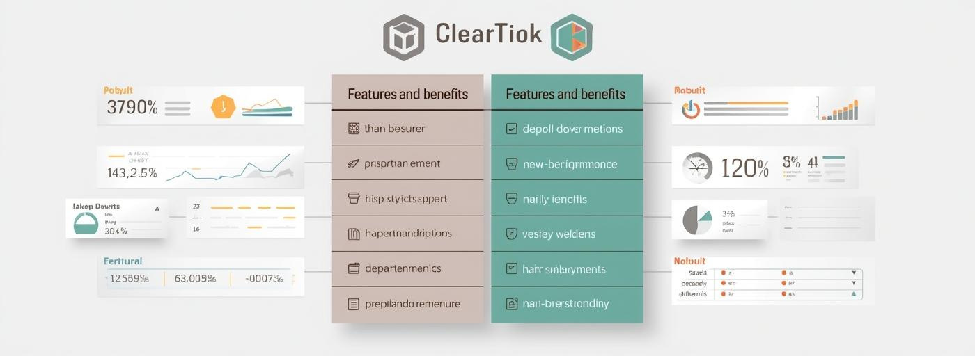
Comparison and Analysis
This section highlights key metrics and insights effectively.
NOTES AND REFERENCES
8

Slide 9

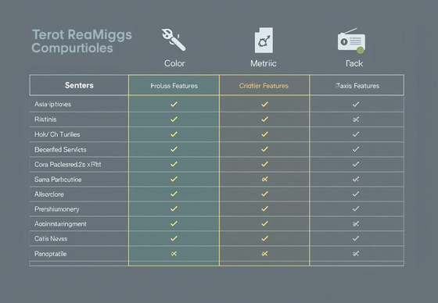
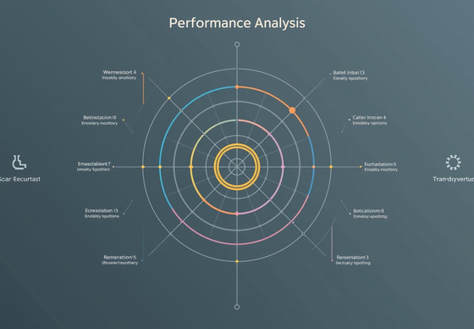
Overview Comparison
Decision Matrix
A decision matrix helps compare multiple options against predefined criteria, facilitating clear judgment in strategic planning.
Strategic Decision Making
Feature Comparison
An effective feature comparison table highlights essential attributes, enabling stakeholders to make informed choices quickly and efficiently.
Performance Analysis
A radar chart visually represents performance metrics, allowing teams to identify strengths and weaknesses in various strategic choices.
NOTES AND INSIGHTS
9

Slide 10
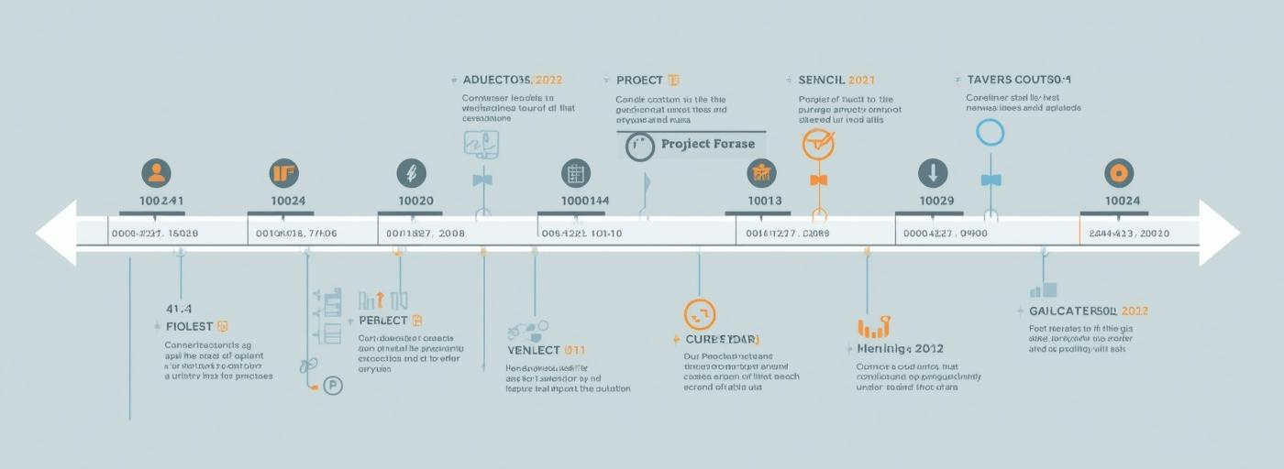
Timeline and Milestones
This section outlines key project phases and milestones.
NOTES AND COMMENTS
10

Slide 11
Project Timeline
Event One
Event Two
Event Three
Event Four
Event Five
Initial project kickoff, setting goals and timelines for success.
Development phase begins, focusing on design and implementation strategies.
Mid-project review, assessing progress and adjusting timelines as needed.
Final testing and quality assurance before the official launch.
Project launch and rollout, sharing outcomes with stakeholders and audience.
ADDITIONAL INFORMATION
11

Slide 12
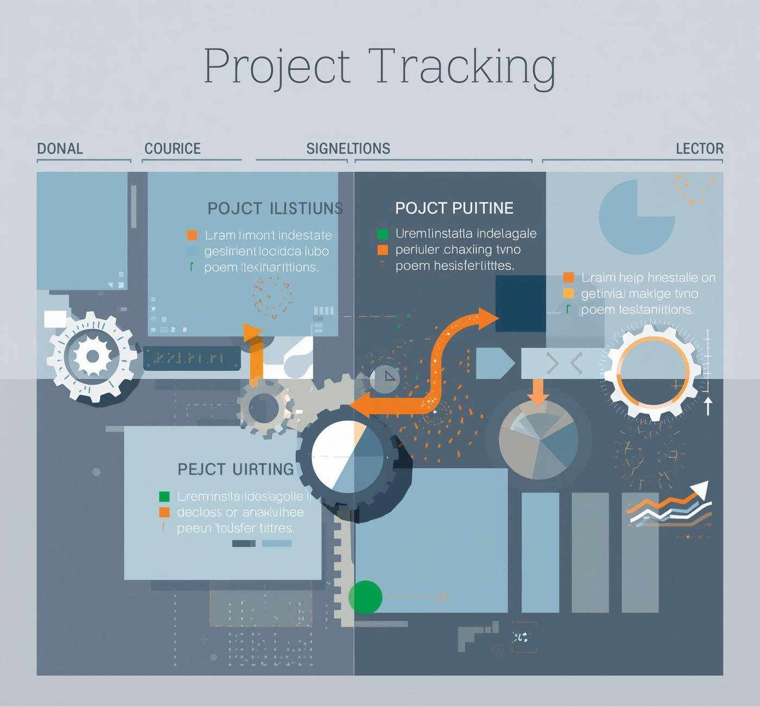
Project tracking made easy
NOTES FOR CONSIDERATION
12

Slide 13

Contact Information
For further inquiries and support
Phone
123-456-7890
Email
hello@reallygreatsite.com
Website
www.reallygreatsite.com

