Slide 1
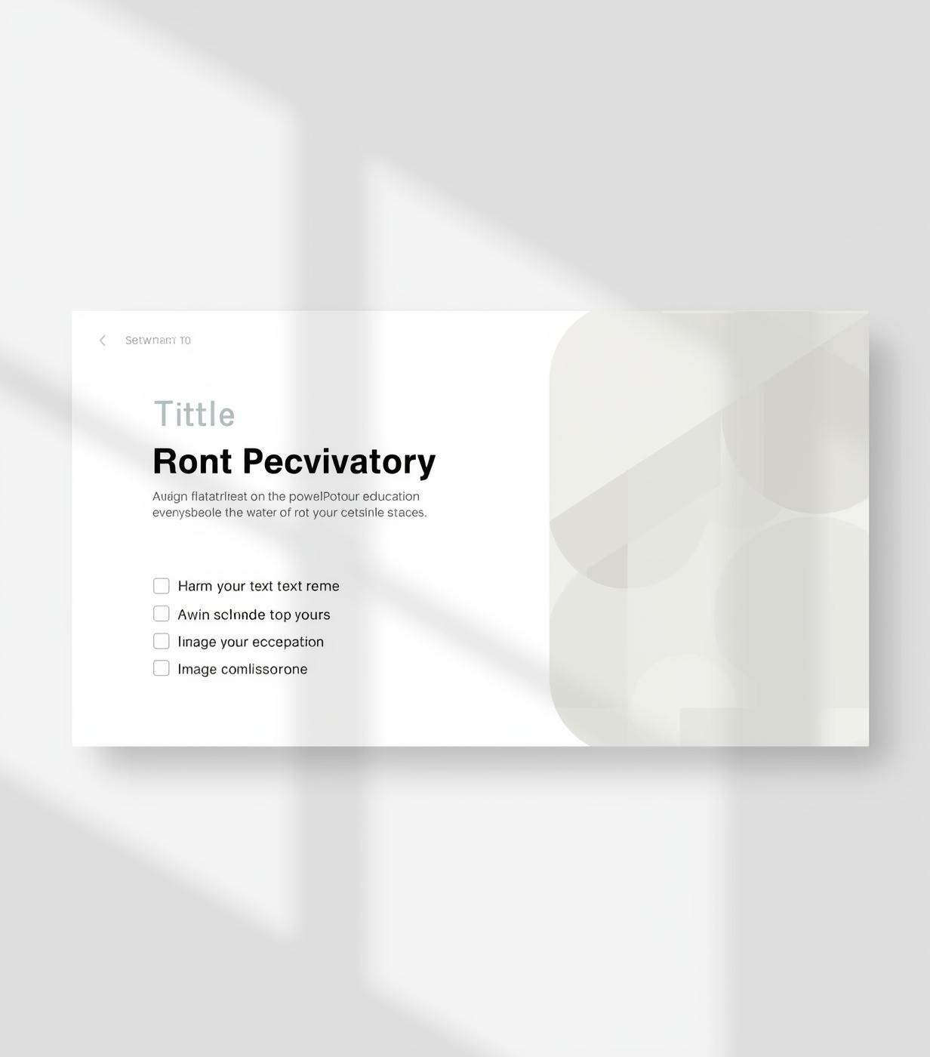

PowerPoint Templates
Clean and Effective Student Assignments
Designed for educational use by students and educators

Slide 2
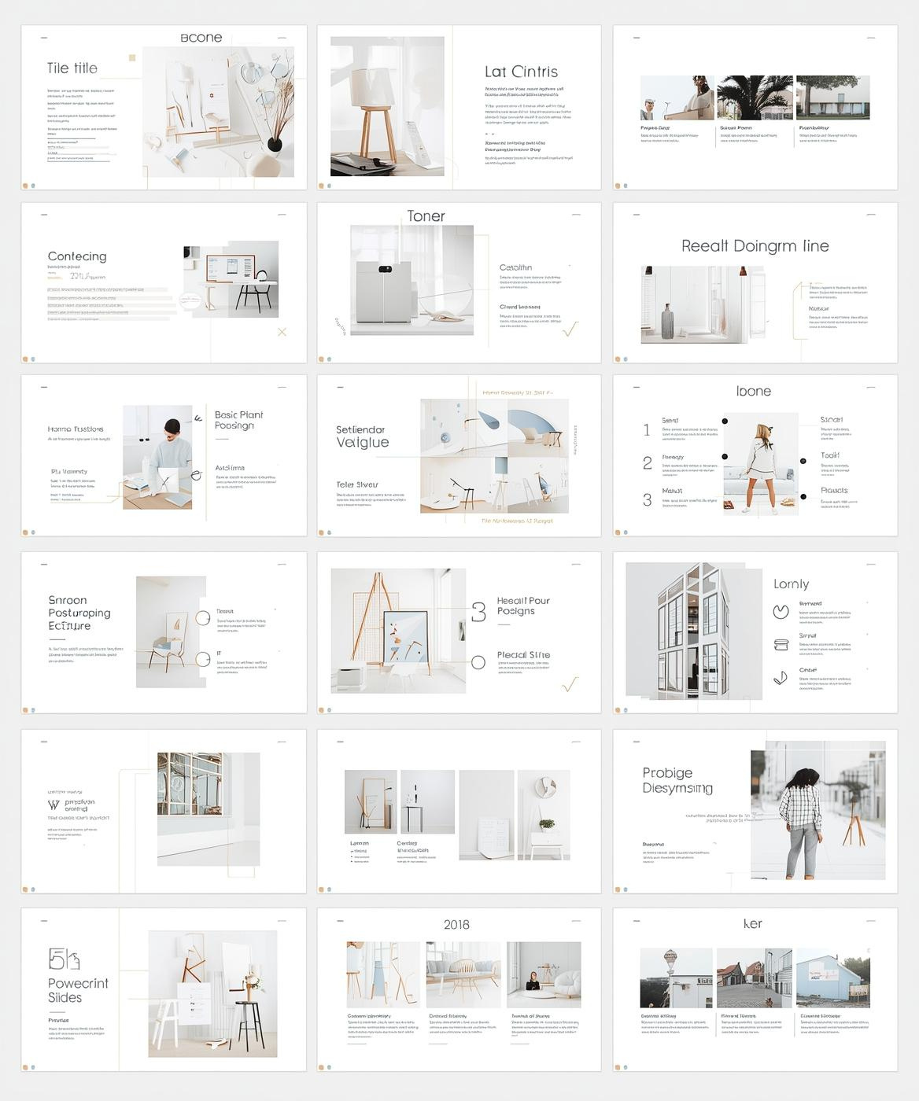
PowerPoint Template Overview
Purpose and Use
This presentation provides students with clean, easy-to-use templates to structure their assignments. Key minimalist style features include ample white space, limited color palette, and clear typography.

Slide 3
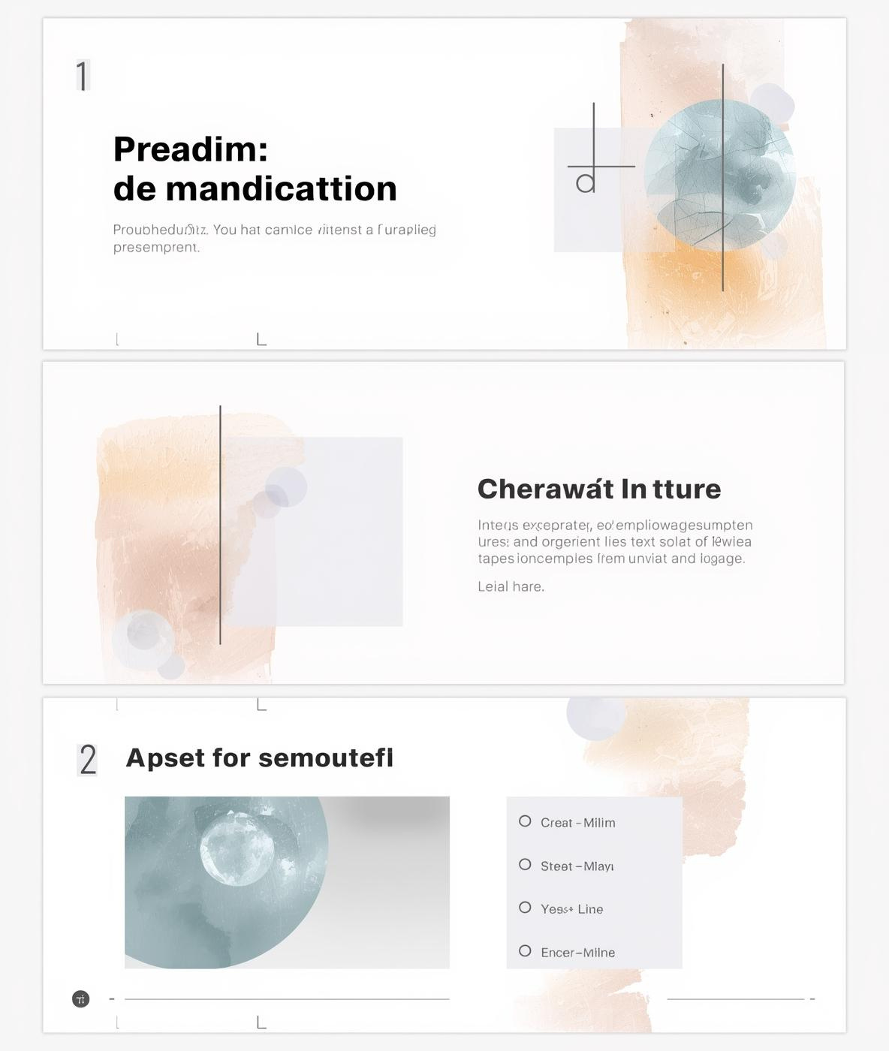
Basic Assignment Structure
Essential Components for Student Presentations
Title slide with details
Content slide for key points
Optional image placeholder
Summary slide for conclusion
Consistent fonts and colors

Slide 4

Research Report Template Overview
Structure for Data-Driven Assignments
This template is designed for assignments that require structured data presentation, featuring clear sections for the introduction, methodology, and findings. The layout promotes clarity and organization.

Slide 5

Creative Project Presentation
Essential Features for Success
Engaging title slide design
Image placeholders for visuals
Clear project timeline layout
Reflection slide for insights
Encouragement of minimal text

Slide 6
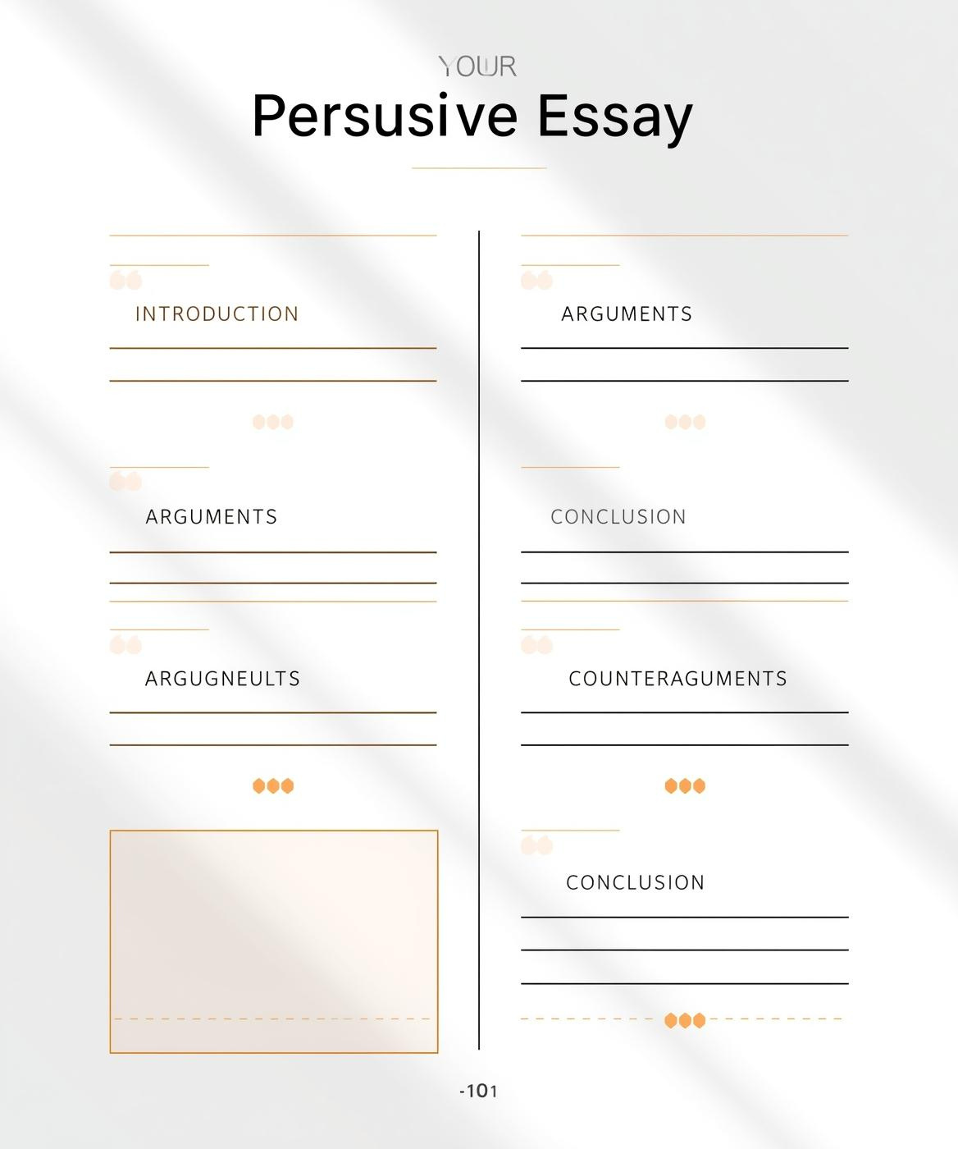
Argumentative Essay Template
Structured for Persuasion
This template is designed for organized presentations, emphasizing coherent arguments and counterarguments. Clear sections facilitate understanding, making it easier for students to articulate their points effectively.

Slide 7

Using Templates Effectively

