Slide 1


Clean Designs
Student Assignment Templates
[Your First Name]
October 15, 2025

Slide 2
Simplicity Matters

Slide 3


Template 2 – Research Report Style
Data Organization
Structured slides facilitate clear presentation of research findings and methodologies.
Visual Representation
Incorporating clean charts enhances comprehension of complex data for the audience.

Slide 4

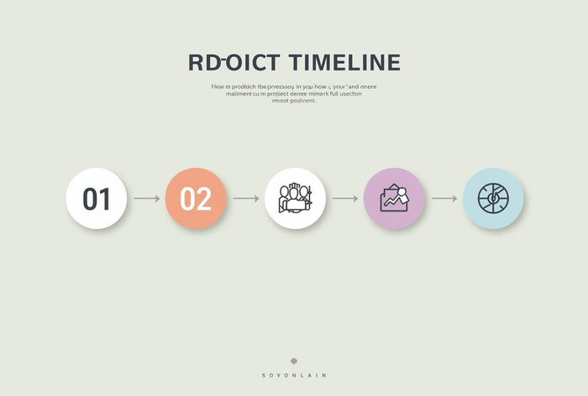
Creative Project Presentation
Visual Elements
Utilize stunning visuals to convey ideas and engage the audience effectively.
Process Steps
Clearly outline project stages using simple icons and minimal text for clarity.

Slide 5


Presenter Name
[name here]
Any questions?

