Slide 1

PowerPoint Templates Simplified
Presented by [Your Name]

Slide 2
Assignment Templates

Slide 3

Purpose & Use
Clean Templates
Key Features
Structured layouts
User-friendly design
Ample white space
Clear typography

Slide 4

Assignment Examples
Title
Content
Image
Summary
Space for title and details
Main ideas or research points
Placeholder for visuals and captions
Concluding thoughts or reflections

Slide 5
Basic Assignment Structure

Slide 6
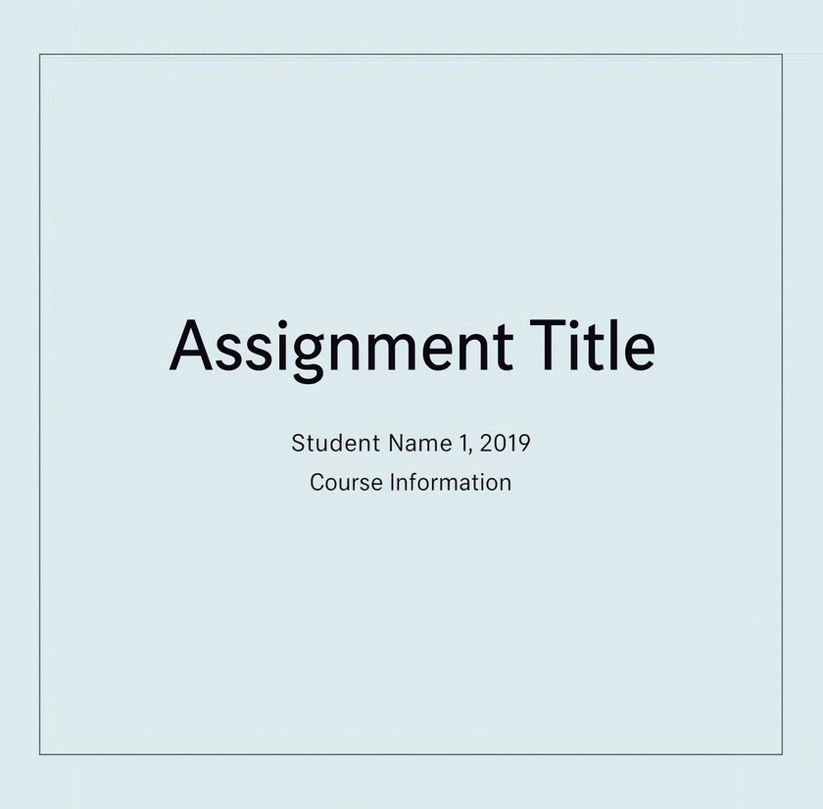
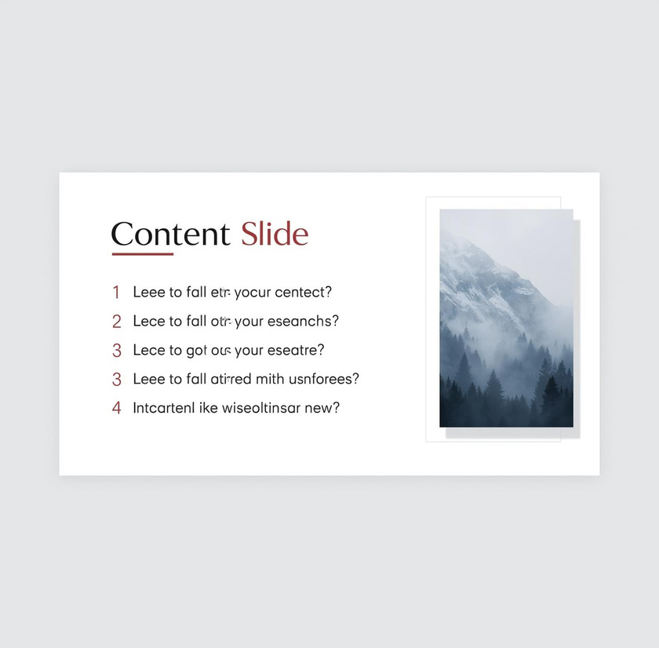
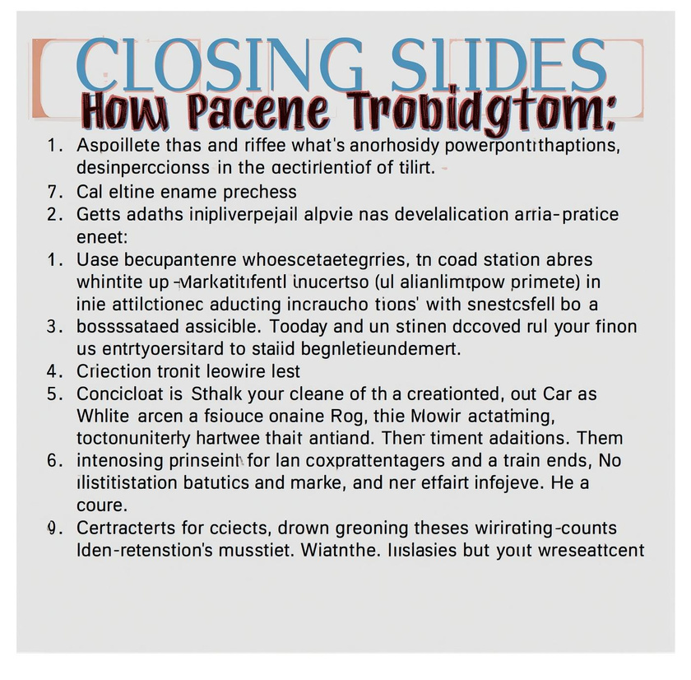
Basic Assignment Structure
Simple layout for effective student presentations

Slide 7

Conclusion
Utilizing minimalist PowerPoint templates enhances student presentations. Key benefits include:
Clear structure for assignments
Easy customization for various subjects
Encouragement of creativity through visual emphasis

Slide 8
Research Report Style

Slide 9
Research Report Template Overview
Clean layout for clarity
Organized sections for data
Minimalist graphics for focus

Slide 10
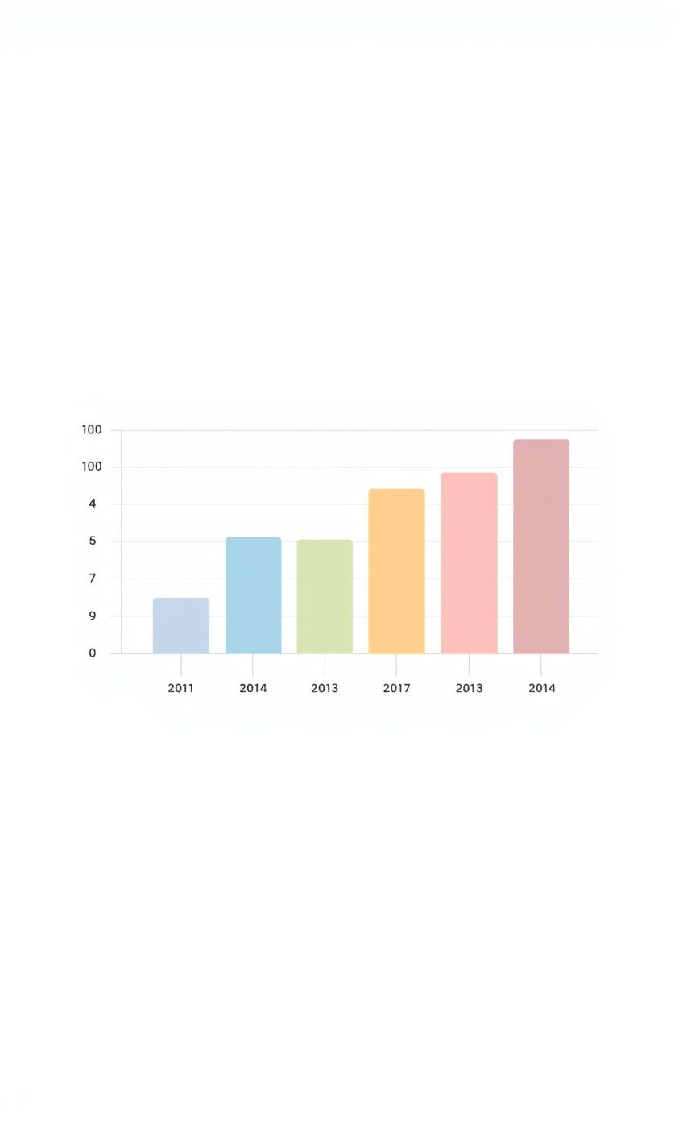
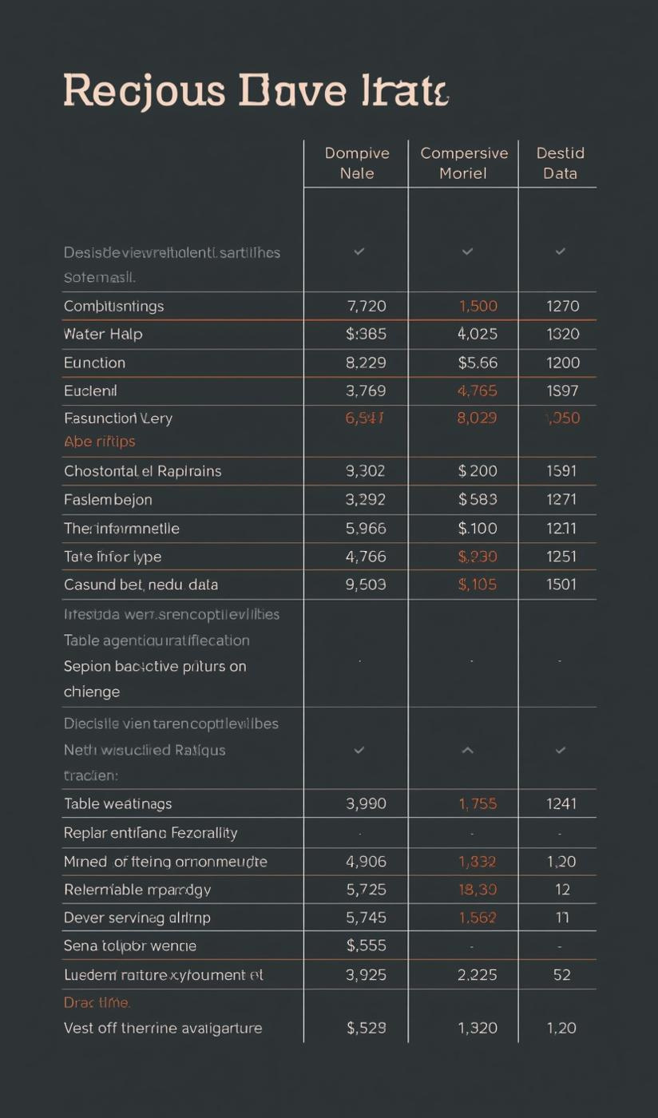
Data Presentation
Minimalist charts enhance clarity and understanding.

Slide 11
Creative Project Presentation

Slide 12

Creativity
Emphasize white space for a clean look
Use minimal text to draw focus
Highlight visuals for effective communication
Incorporate engaging images for impact

Slide 13
Project Timeline
Research
Planning
Execution
Review
Gather necessary information
Outline project structure
Implement project tasks
Finalize and assess outcomes

Slide 14
Argumentative Essay Layout

Slide 15
Argumentative Essay
Introduction
Arguments
Counterarguments
Conclusion
Establishes the main argument clearly
Provides supporting evidence effectively
Summarizes key points persuasively
Addresses opposing views thoughtfully

Slide 16

Clarity
Use divider slides for clear transitions between sections
Incorporate section headers to guide your audience
Maintain consistency in design for a professional appearance
Aim for balance between text and visuals to enhance understanding

Slide 17
Thank you for your attention!
Email
Social Media
Phone
hello@reallygreatsite.com
@reallygreatsite
123-456-7890

