Slide 1
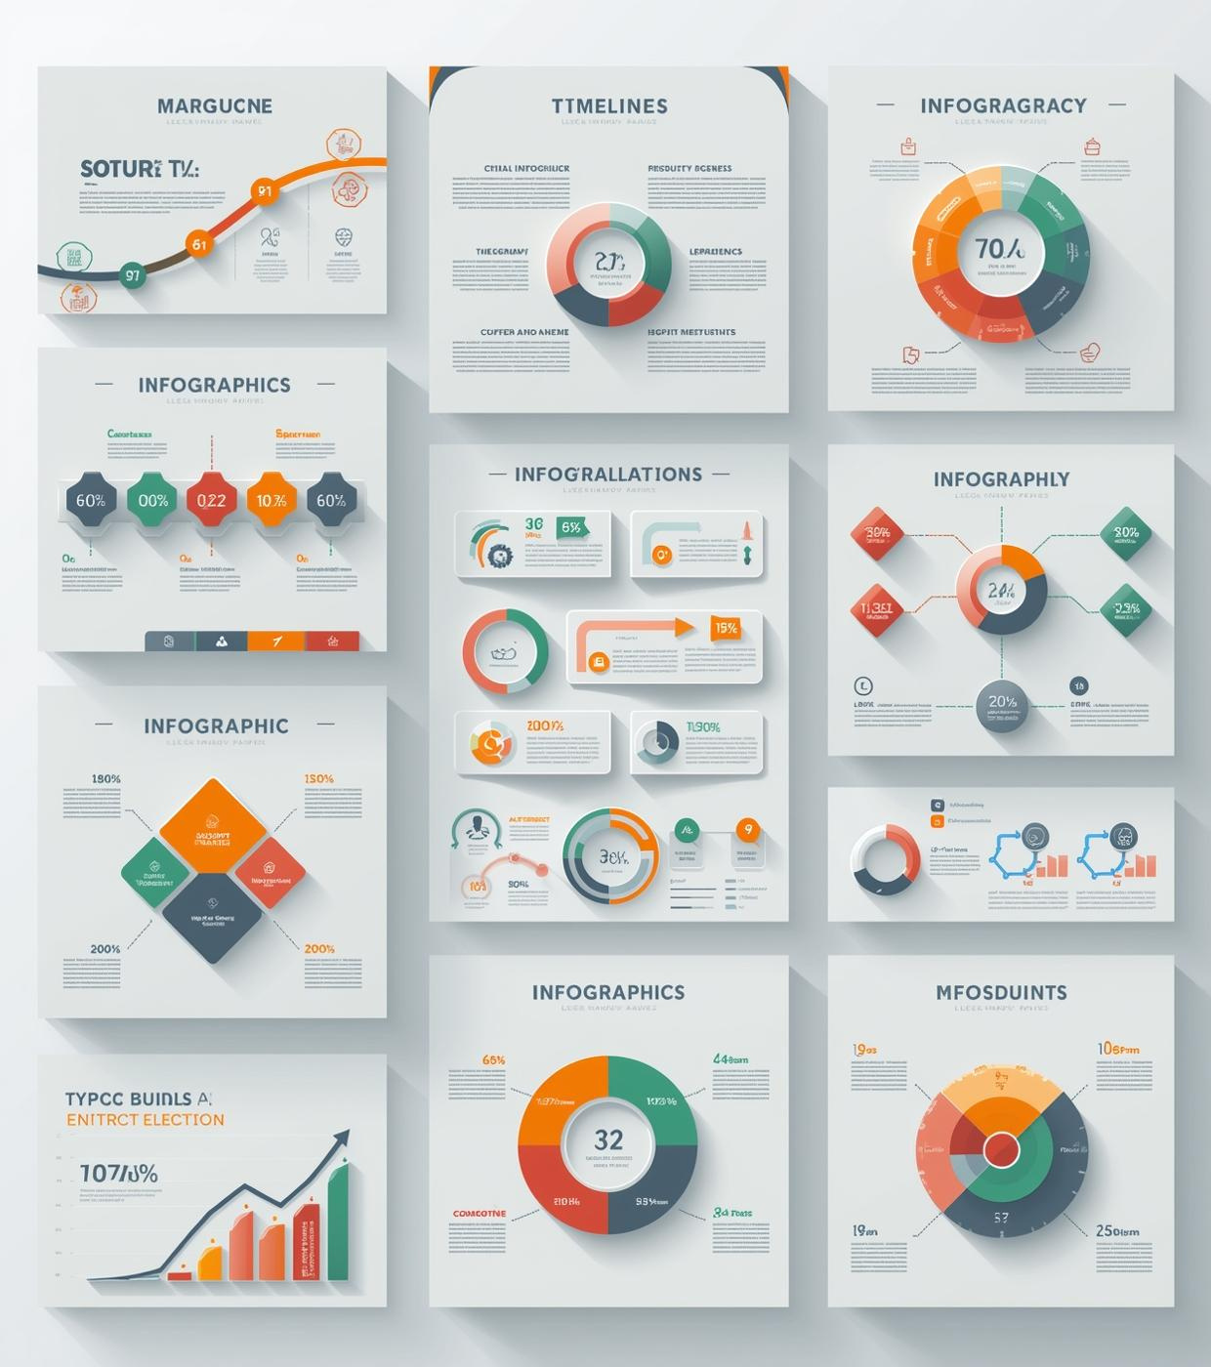
Training & Development Template Overview
Professional modular templates for effective training
Presented by [name here], Training Specialist

Slide 2

The Value of Modular Templates
Enhancing professional training with versatile and customizable PowerPoint solutions
Provide flexibility in design and content
Focus on engagement and clarity
Feature four distinct templates for varied training needs

Slide 3
Skill Development
2023
2025
2026
2024
Launch of New Training Program
Implementation of Feedback Mechanisms
Comprehensive Skills Evaluation and Reporting
Mid-Year Skills Assessment
Initiated program focusing on essential skills.
Evaluated progress and identified improvement areas.
Gathered participant feedback for future improvements.
Analyzed data to enhance training effectiveness and outcomes.

Slide 4
Skill Development
2023
2024
2025
2026
2025
Initial Skill Assessment and Planning
Intermediate Skill Workshops and Training
Advanced Skill Application Sessions
Ongoing Skill Refreshers and Updates
Final Skill Evaluation
Identify learner skills and set goals
Enhance skills through hands-on activities
Assess progress and determine next steps
Apply skills in real-world scenarios
Continuous improvement through regular training

Slide 5
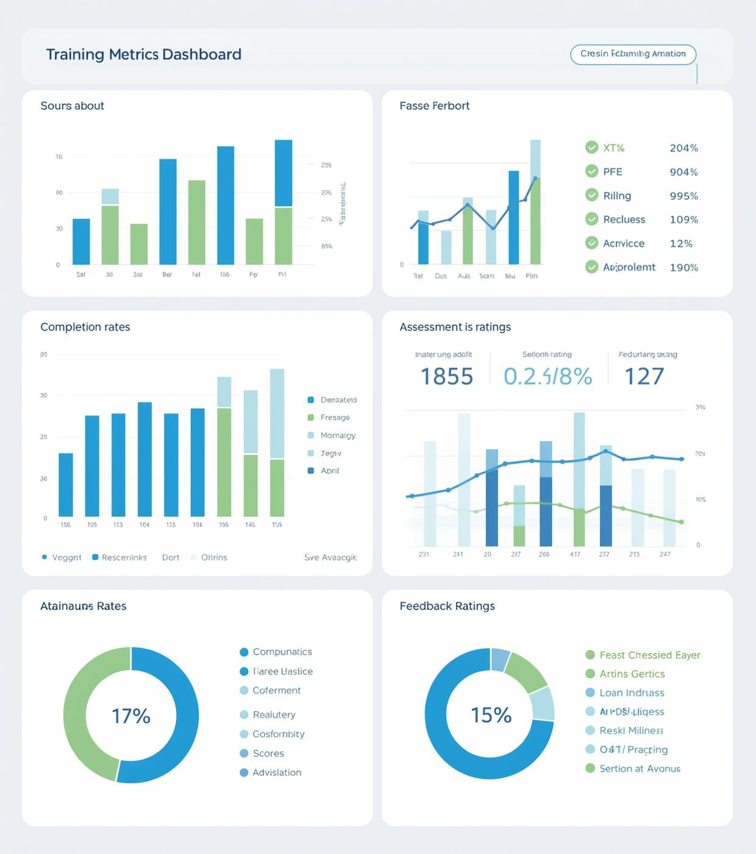
Enhancing Training Effectiveness Through Data Visualization
Key Performance Indicators for Measuring Success

Slide 6
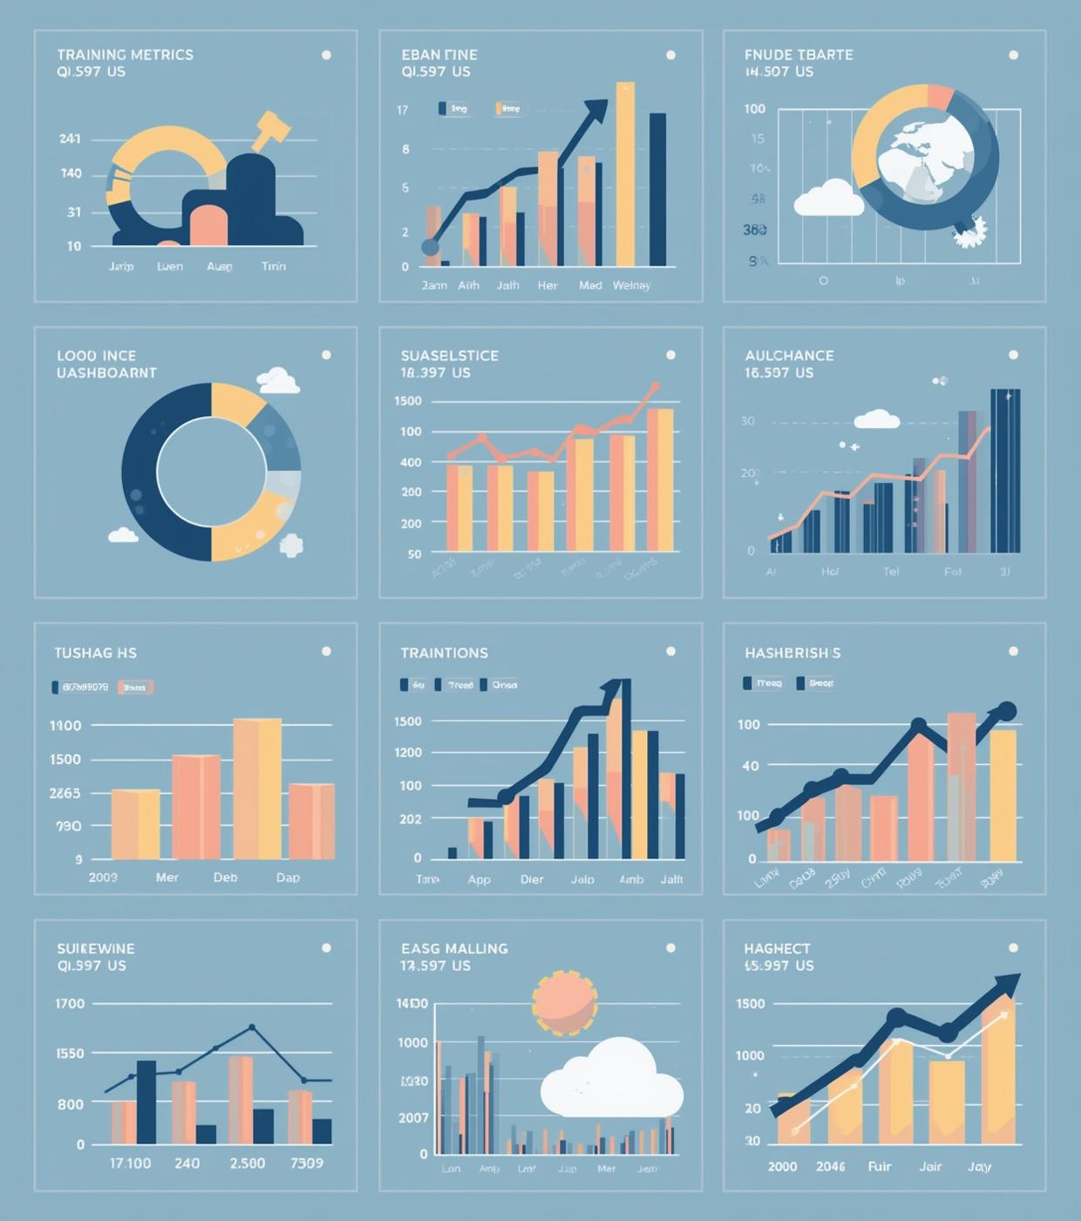
75%
Training Completion Rate
85%
Average Assessment Score
90%
Positive Feedback Ratings

Slide 7

75%
Completion Rate
A significant 75% of participants reported successfully completing the interactive learning cycle. This reflects the effectiveness of iterative training methods that promote engagement and improve knowledge retention through continuous feedback and practice.

Slide 8
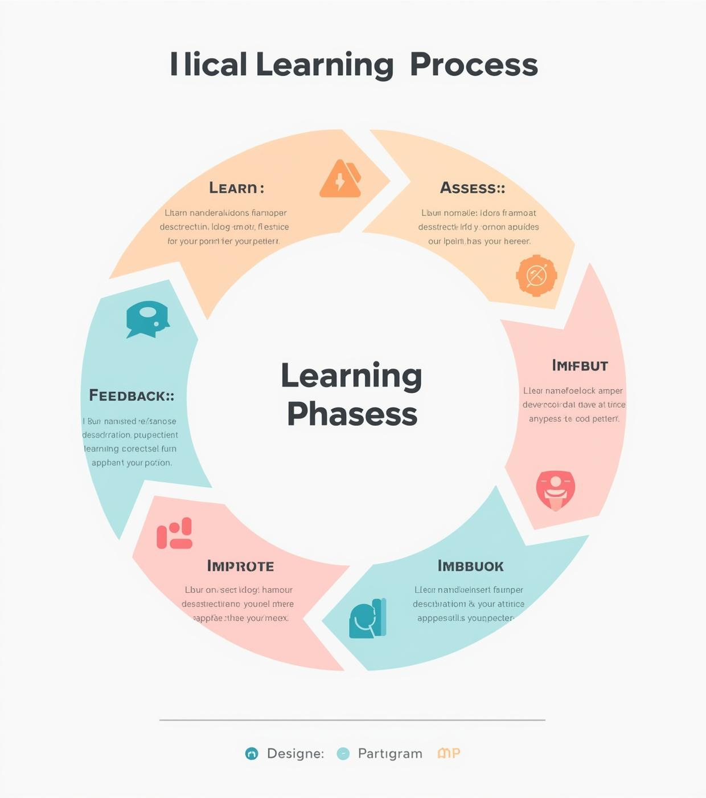
Interactive Learning Cycle
Understanding the iterative process of training and feedback for effective learning
Phases: Learn, Practice, Assess, Feedback, Improve
Clear labeling with directional arrows
Space for brief descriptions of each phase

Slide 9
Training Modules
2022
2023
2025
2021
2024
Onboarding Program Enhancement
Competency Development Workshops
Hybrid Training Model Implementation
Launch of E-Learning Platform
Instructor-Led Training Revamp
Introduced flexible training options online
Improved integration of new hires' training
Focused on skills improvement and feedback
Updated curriculum for better engagement methods
Combined e-learning with in-person training sessions

Slide 10

Features vs. Benefits
Specific tools and methods used
This comparison highlights the distinct advantages of training features against the benefits they provide, aiding in informed decision-making when selecting training methods for diverse learning needs.
Shared outcomes and learner engagement
Positive impacts on skill development

Slide 11
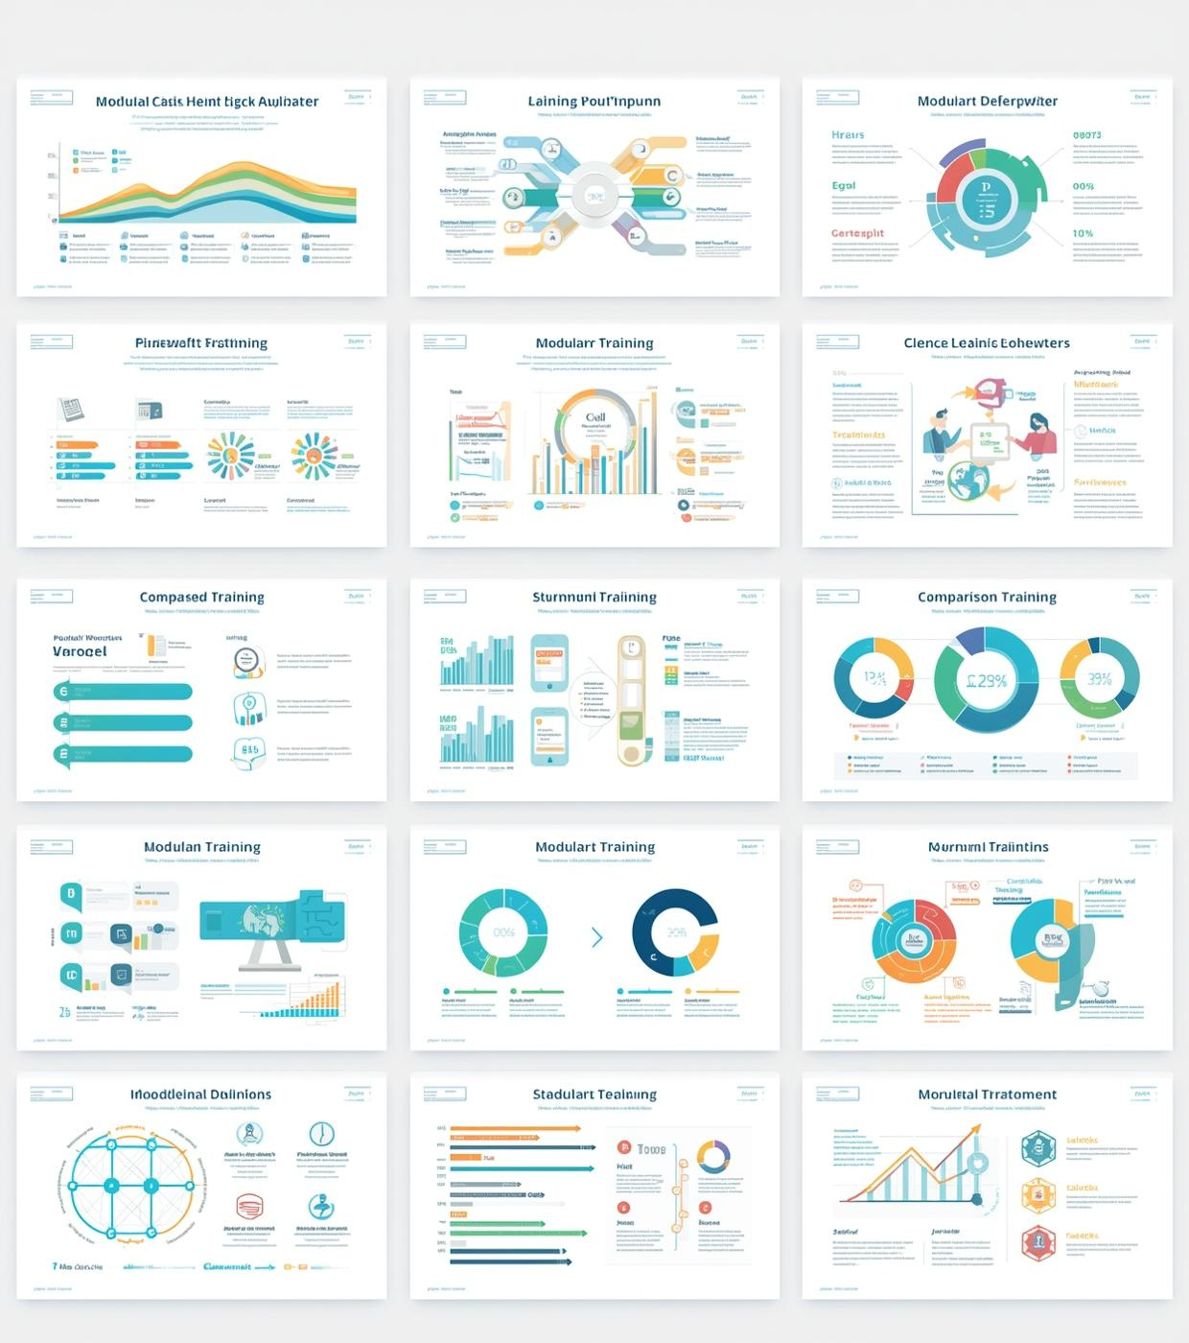
Maximizing Templates
Effective strategies for utilizing modular templates in training sessions
Recap the four template types
Customize elements for specific content
Combine templates for comprehensive training sessions
Experiment with components for enhanced delivery

Slide 12

Contact Us
Reach out for resources and feedback requests
Email
hello@reallygreatsite.com
Phone Number
123-456-7890
Website
reallygreatsite.com

