Slide 1
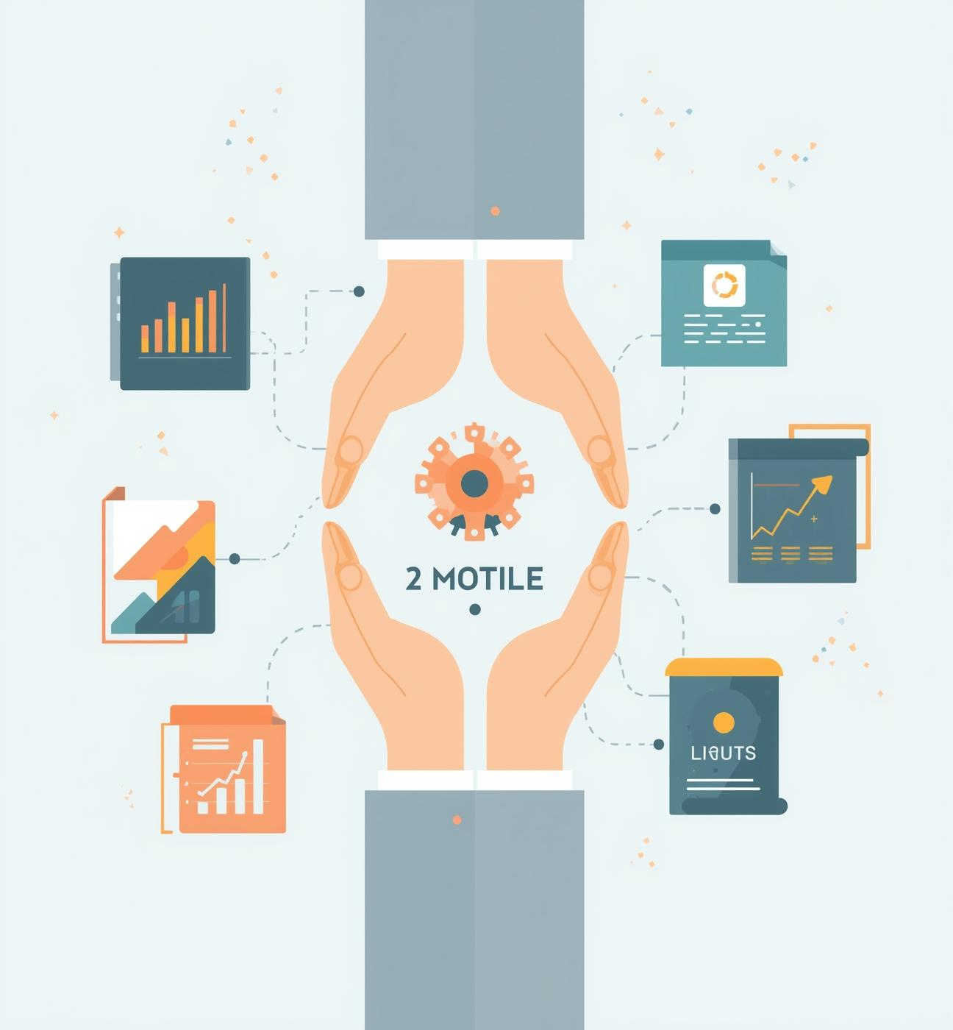
Training & Development Templates
Presented by [Your Name Here], Training Specialist

Slide 2

Introduction
GOAL
To provide versatile, professional templates for training.
DEFINITION
Modular style allows for flexible infographic components.
AUDIENCE FOCUS
Designed for clarity, visualization, and audience engagement.

Slide 3
Skill Development
Visualizing Learning Paths and Progress
MILESTONES
PROGRESS INDICATORS
Clear milestones in the skill development roadmap provide essential markers that guide learners through various stages, ensuring they can track their progress effectively.
Utilizing progress indicators allows trainers to visually demonstrate how learners advance through training modules, fostering motivation and engagement throughout the learning experience.

Slide 4
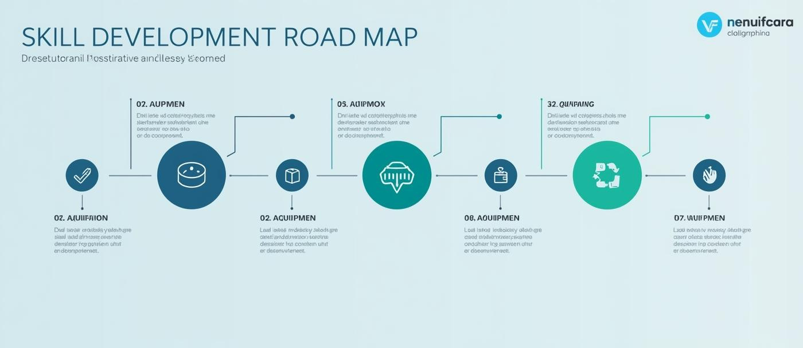
Skill Development Roadmap

Slide 5
Training Metrics Overview
Displaying and Analyzing Key Data
PERFORMANCE INDICATORS
VISUAL REPRESENTATION
CONTINUOUS IMPROVEMENT
Charts and progress circles present data visually, making it easier to digest complex information for stakeholders.
Utilizing KPIs helps track training effectiveness and measure outcomes, ensuring alignment with organizational goals.
Monitoring metrics allows for ongoing adjustments, enhancing training programs to better meet learner needs and objectives.

Slide 6
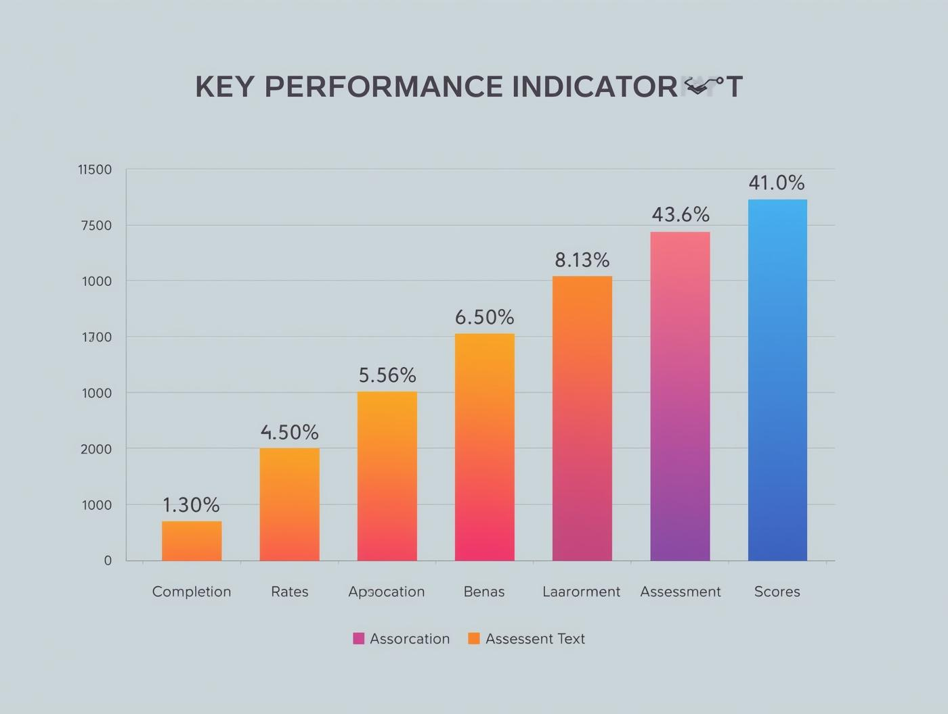

Training Metrics Components

Slide 7
Interactive Learning Cycle
Enhancing Training Effectiveness and Engagement
CONTINUOUS IMPROVEMENT
ITERATIVE FEEDBACK
The Interactive Learning Cycle promotes ongoing development, allowing participants to refine their skills through repeated practice and feedback, fostering a culture of continuous improvement in training environments.
Feedback collected during each cycle phase ensures that learners can adjust their approach, reinforcing knowledge retention and enhancing overall training effectiveness through a structured and engaging process.

Slide 8
Interactive Learning Cycle
Continuous Improvement Through Iterative Training
The Interactive Learning Cycle emphasizes the importance of repetition in training, guiding participants through phases of learning, practice, assessment, and feedback to foster ongoing development and improvement.

Slide 9
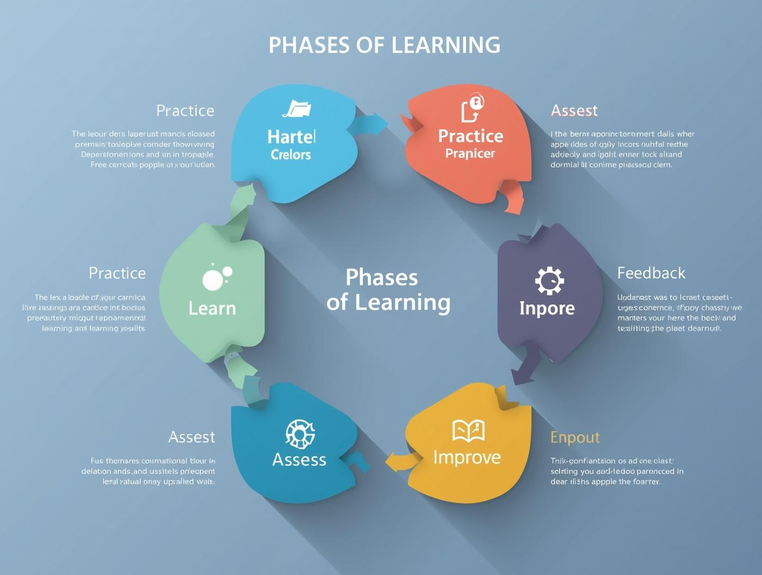
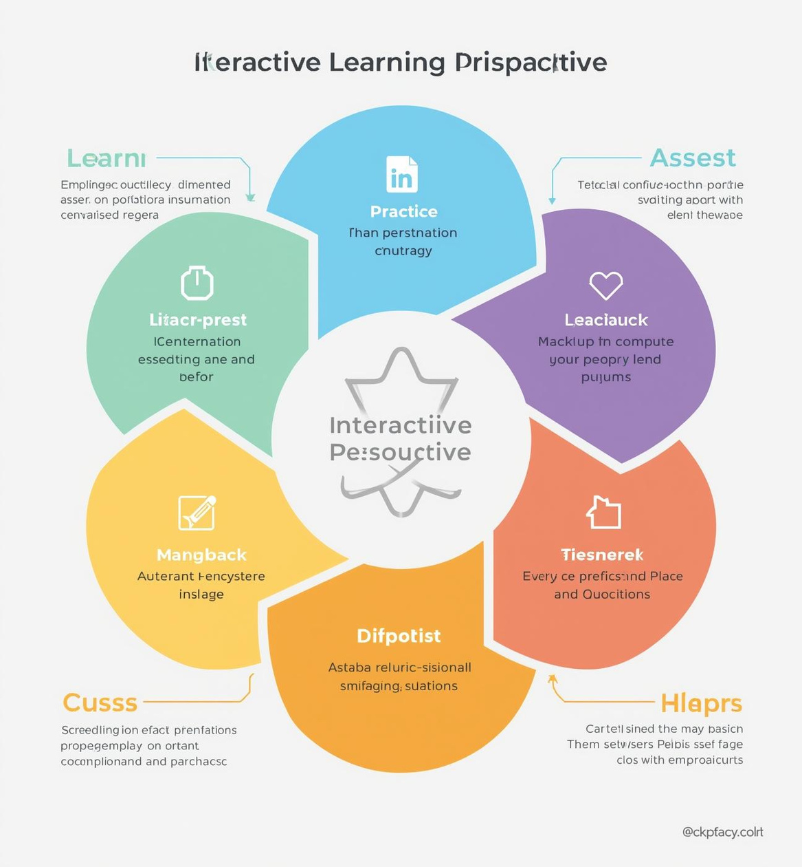
Interactive Learning Cycle

Slide 10
Training Options Comparison
Evaluating Methods and Effectiveness
FEATURES
BENEFITS
PROS AND CONS
Each training method offers unique features that cater to specific learning styles and organizational needs, enhancing overall effectiveness.
Understanding the benefits of each option allows organizations to align training with goals, maximizing employee engagement and retention.
A thorough pros and cons analysis helps decision-makers choose the most suitable training approach for their audience and objectives.

Slide 11
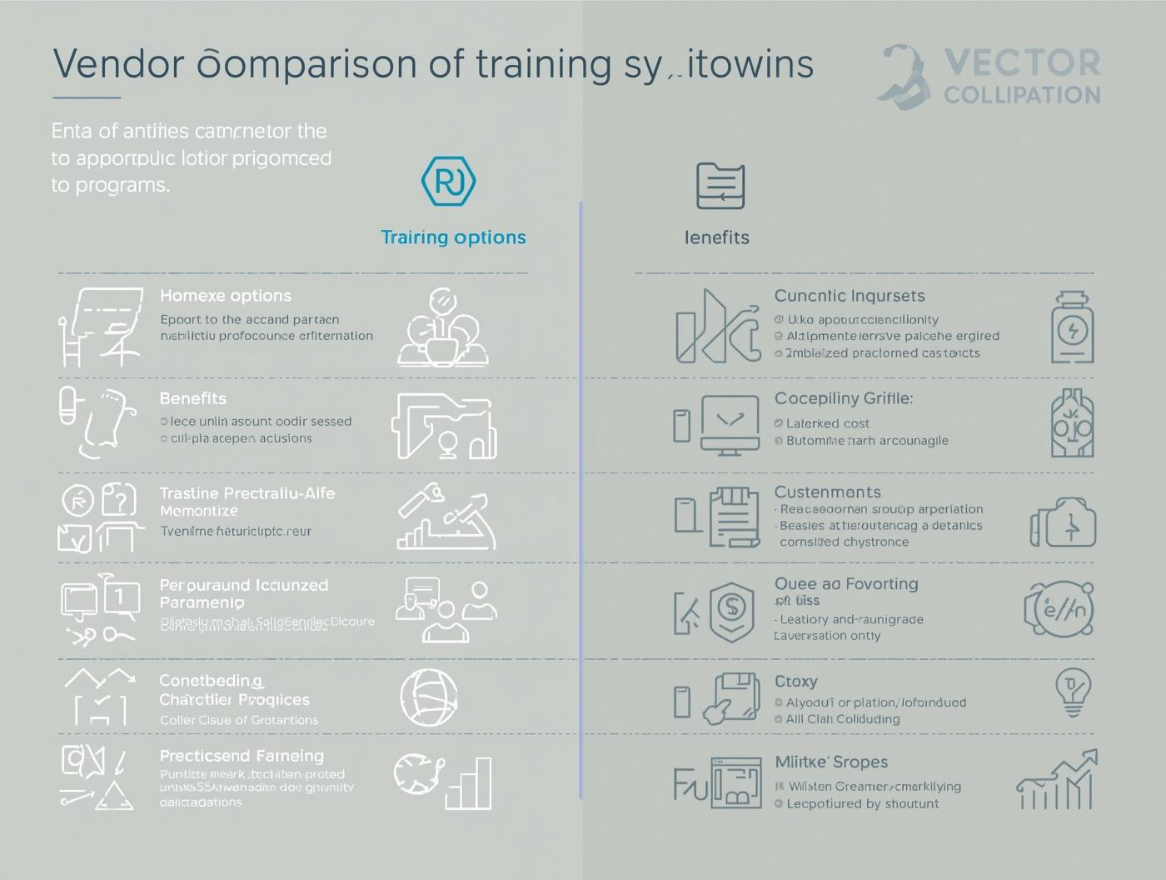
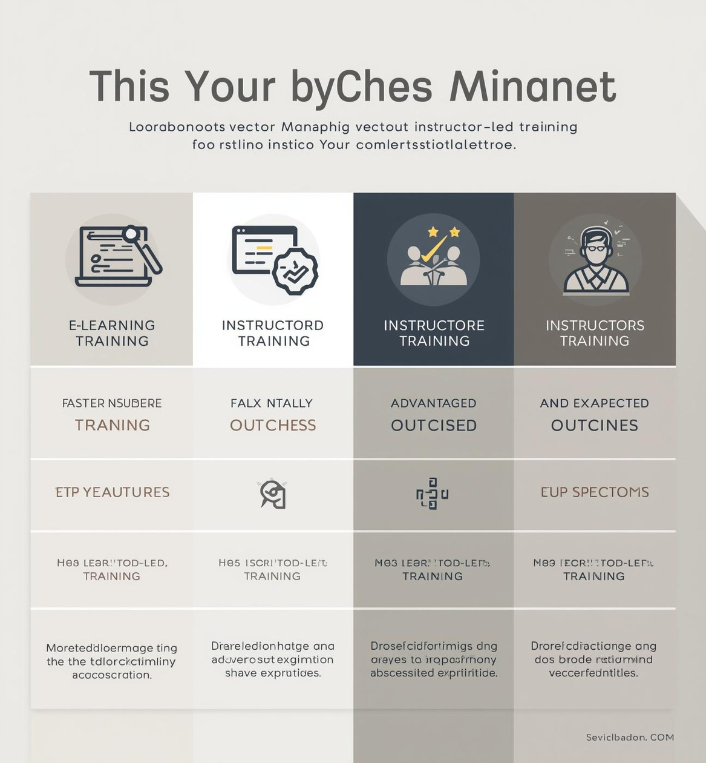
Training Module Comparison

Slide 12


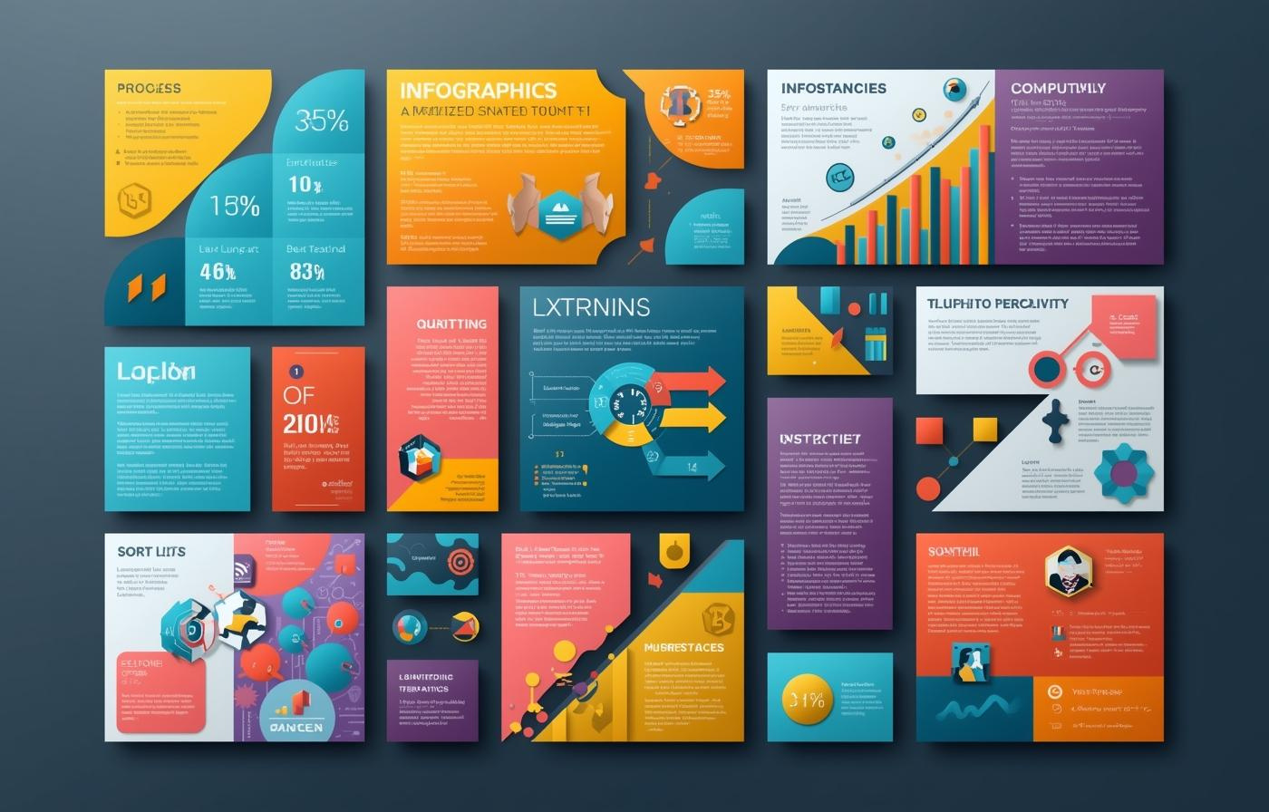
Maximizing the Impact of Templates
TEMPLATE RECAP
CUSTOMIZATION TIPS
COMBINING TEMPLATES
Review the four templates for effective training applications.
Adapt elements easily to suit specific audience needs.
Merge templates for comprehensive training presentations.

Slide 13

EMAIL
hello@reallygreatsite.com
SOCIAL MEDIA
@reallygreatsite
PHONE
123-456-7890

