Slide 1
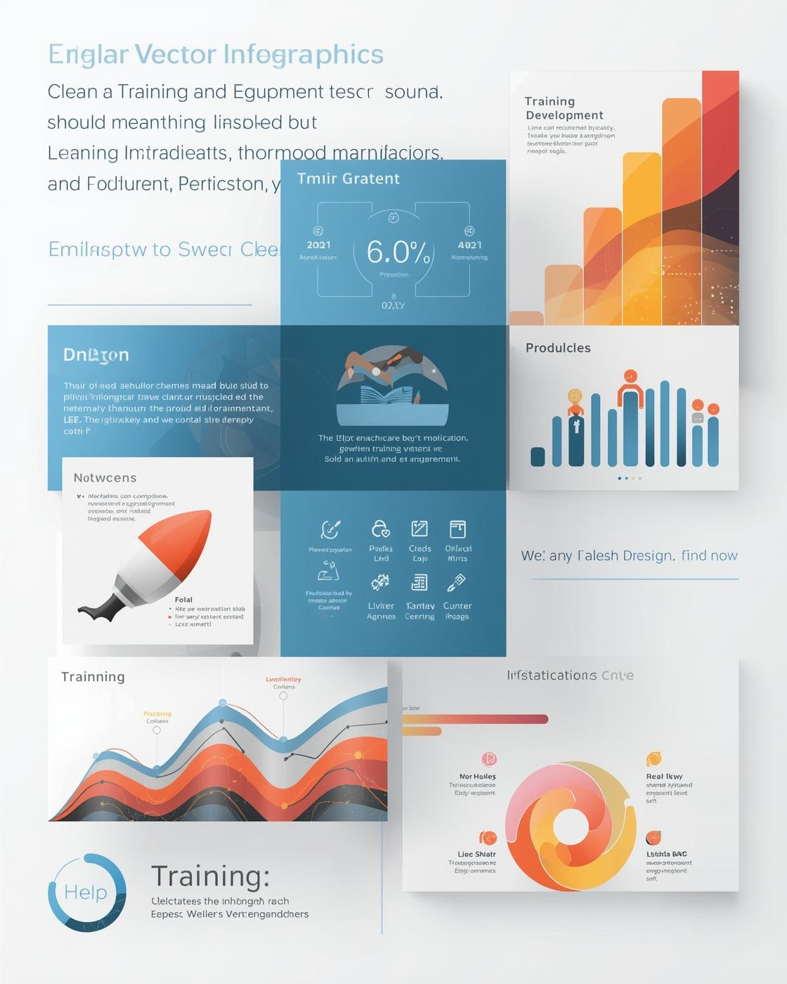
Modular Templates
This presentation introduces professional PowerPoint templates designed to enhance training and development sessions through flexible and modular infographic components.
PRESENTED BY JOHN DOE

Slide 2

Introduction to Templates
Tailored PowerPoint Templates for Training and Development Needs
Our versatile templates provide the flexibility and clarity needed to enhance professional training sessions, ensuring effective delivery of content that engages and informs learners effectively.

Slide 3
Skill Development Roadmap
Year 1
Year 2
Year 3
Initial training phase
Skill assessment and feedback
Advanced application and mastery

Slide 4
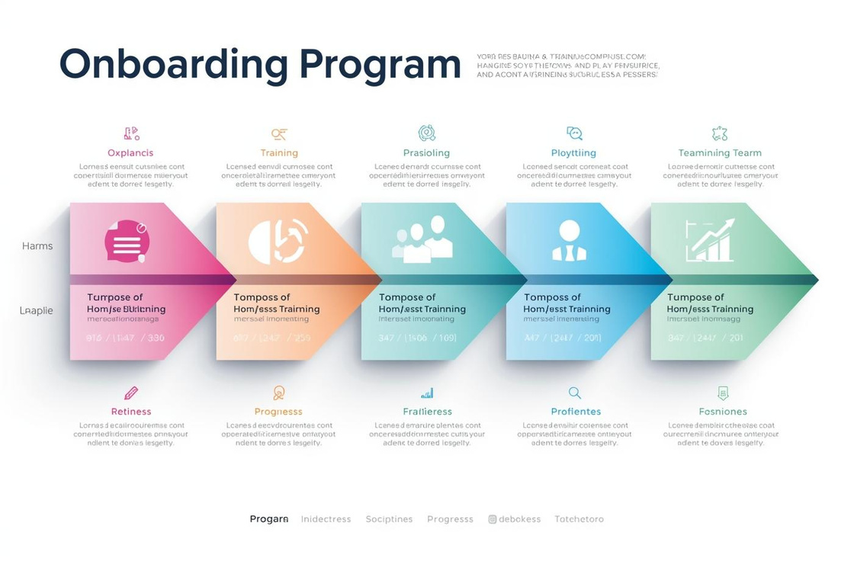
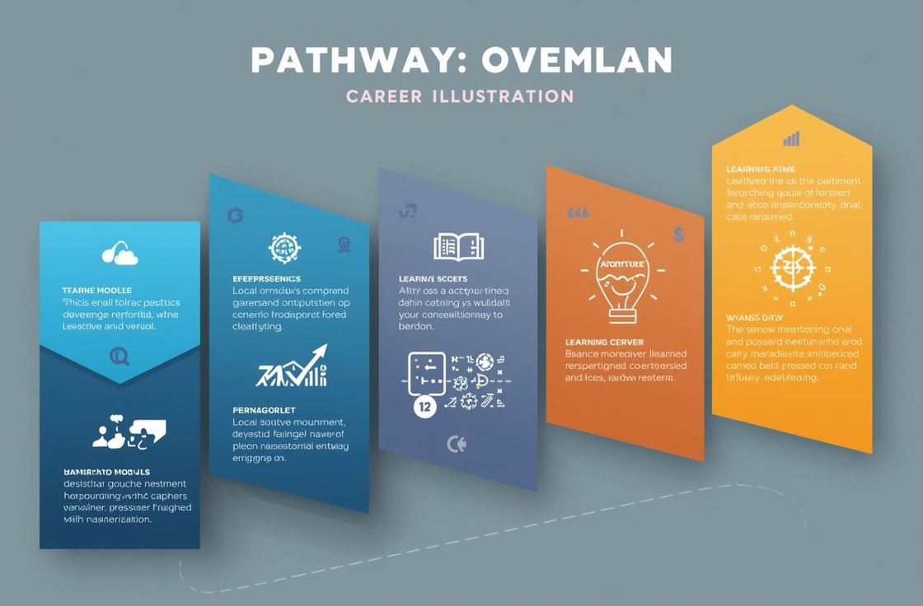
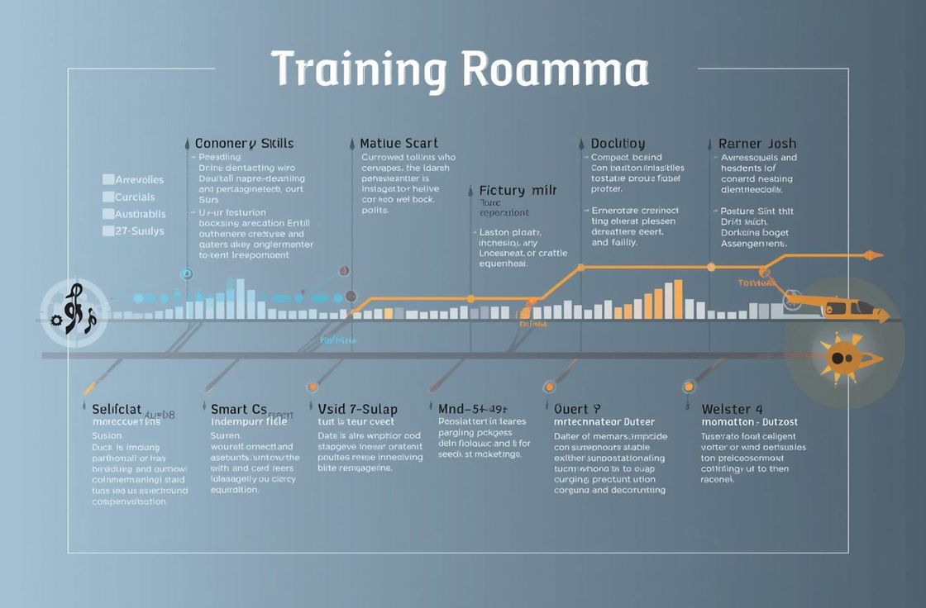
Skill Development Roadmap
Visualizing Learning Paths for Effective Training Programs
The Skill Development Roadmap infographic presents a clear visual representation of training modules and milestones, facilitating structured learning and progress tracking for effective onboarding and skill enhancement.

Slide 5
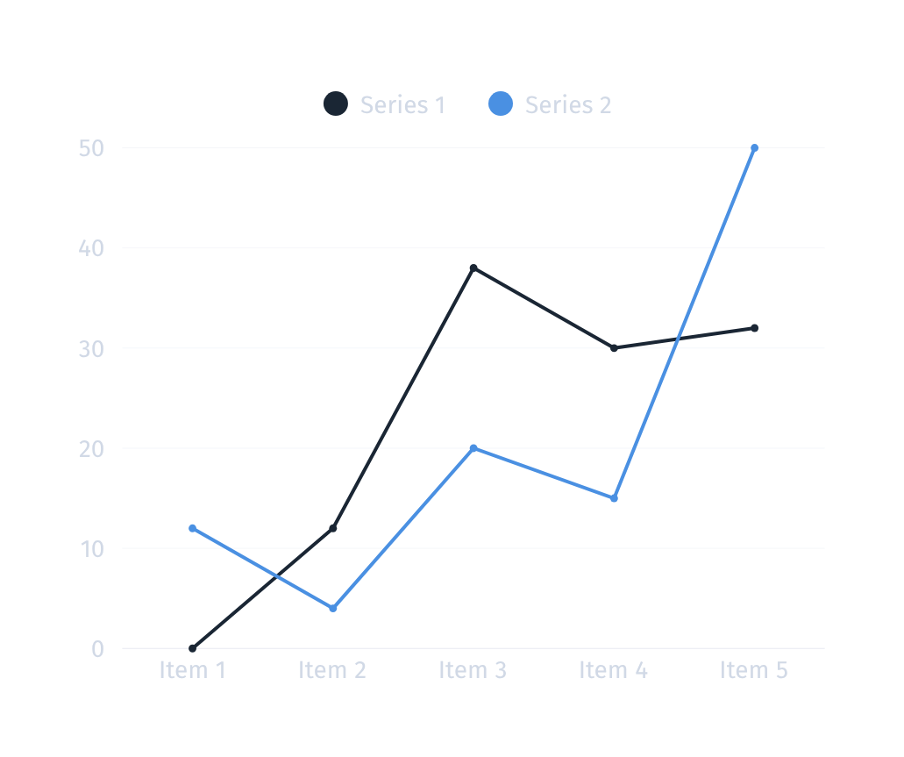
Training Metrics Dashboard
The Training Metrics Dashboard provides a structured overview of training performance, showcasing completion rates, assessment scores, and feedback ratings. This modular approach enables quick data visualization for informed decision-making.
Key performance indicators for training effectiveness

Slide 6
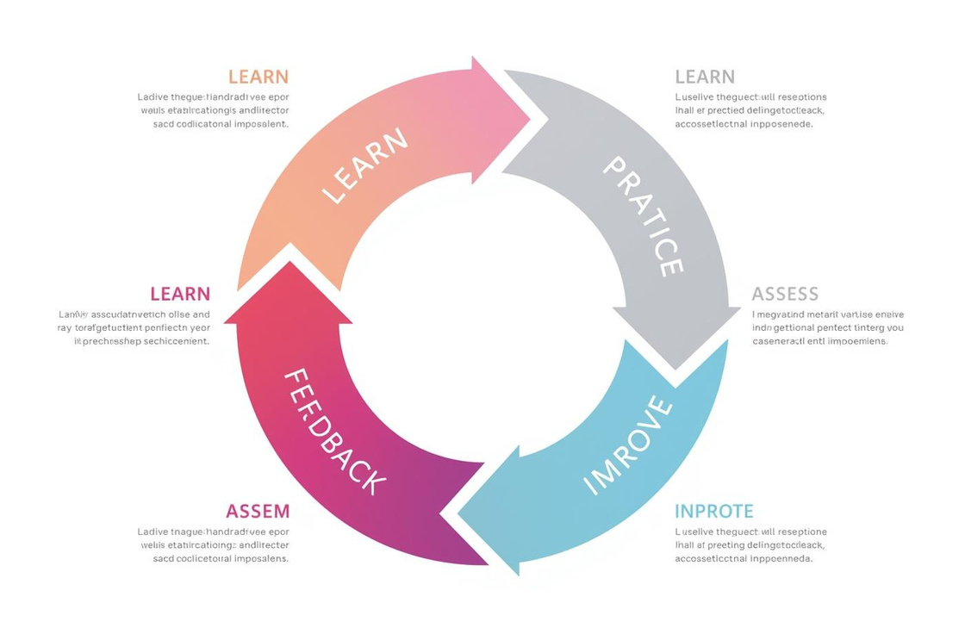
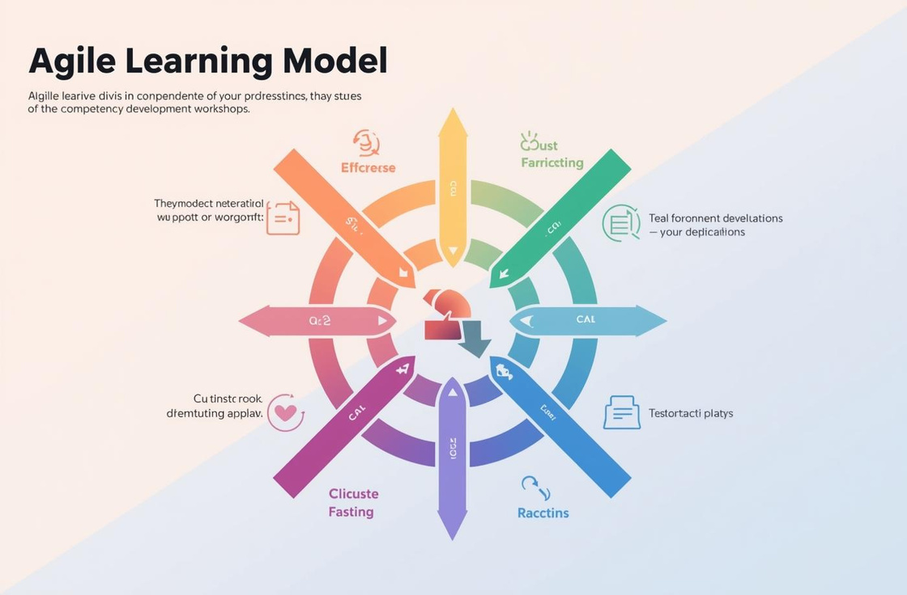

Interactive Learning Cycle
Highlighting iterative training and feedback processes for success
The Interactive Learning Cycle emphasizes continuous improvement through iterative training, fostering growth by integrating feedback and assessment into the learning experience for enhanced skill development.

Slide 7
Training Options Comparison
Heading | Heading | Heading | Heading | Heading

Slide 8

Contact Information
PHONE
123-456-7890
WEBSITE
reallygreatsite.com
EMAIL
hello@reallygreatsite.com

