Slide 1
PADMAPRIYA S
Face recognition using cnn

Slide 2

FACE RECOGNITION USING CNN

Slide 3
AGENDA
Problem Statement
Project Overview
End Users
Solution and Value Proposition
The Wow in Our Solution
Modelling Approach
Results
Conclusion

Slide 4
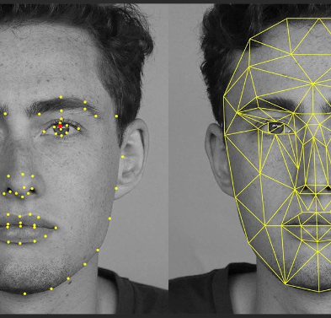
Problem Statement
Traditional face recognition methods are often inefficient and inaccurate, especially in varied lighting conditions and facial expressions.

Slide 5
Project Overview
Our project aims to develop a robust face recognition system using Convolutional Neural Networks (CNN) to accurately identify individuals from images or videos.
01

Slide 6




End users
Law enforcement agencies
Access control systems for buildings and facilities
Border control and security checkpoints.
Identity verification in mobile devices and applications

Slide 7
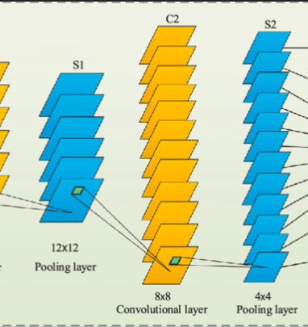
Solution and Value Proposition
Utilizing CNN for face recognition offers improved accuracy and reliability compared to traditional methods.
Our solution provides real-time face detection and recognition, enhancing security and efficiency for various applications.

Slide 8
The Wow in Our Solution
Robust performance in varying lighting conditions and facial expressions
Scalability for large datasets and real-time applications
Integration potential with existing security systems and platforms

Slide 9
Modeling Approach
Data collection and preprocessing
CNN architecture design and training
Model evaluation and optimization techniques

Slide 10
RESULTS
Achieved accuracy rates on benchmark datasets
Performance metrics such as precision, recall, and F1-score
Potential applications and future enhancements

