Slide 1
BOOKRS
Book Recommendation System Presentation

Slide 2
Literature Review
Research Papers
Evaluation of Item-Based Top-N Recommendation Algorithms by Desrosiers and Karypis (2011)
A Comparative Study of Collaborative Filtering Algorithms by Schafer, Frankowski, Herlocker, and Sen (2007)
Item-Based Top-N Recommendation Algorithms" by Lindqvist and Valentin (2011)
Collaborative Filtering for Implicit Feedback Datasets by Hu, Yifan, Koren, and Volinsky (2008)
Amazon.com Recommendations: Item-to-Item Collaborative Filtering by Linden, Smith, and York (2003)
A Comparative Study of Collaborative Filtering Algorithms for Book Recommendations" by Cai-Nicolas Ziegler, Sean M. McNee, Joseph A. Konstan, and Georg Lausen (2005)

Slide 3




Dataset
Analysis
User-ID
ISBN
Book Rating
271,379
278,858
USERS
BOOKS
USER-ID
ISBN
BOOK
RATINGS
User-ID
Location
Age
ISBN
Book-Title
Book-Author
Year-Of-Publication
Publisher
Images
1,149,780

Slide 4
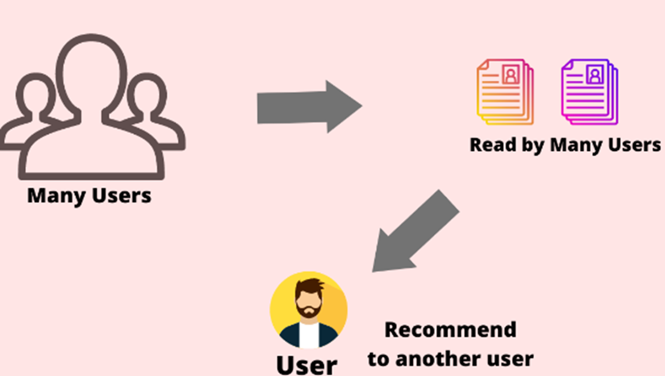
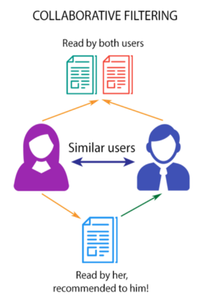
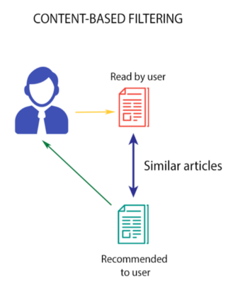
Approaches for Recommendation System(Unsupervised)
Popularity Based Recommendation

Slide 5
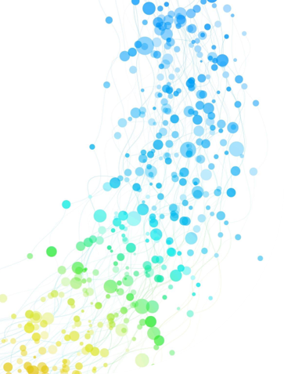
What we have explored:
Exploratory Data Analysis
Popularity based Recommendation
Collaborative - Item Based Recommendation
Collaborative - User Based Recommendation​
Content Based Recommendation​
Flask - UI

Slide 6
THANK YOU!!

Slide 7
BOOKRS
Book Recommendation System Mid Term Presentation - 1

Slide 8

AGENDA
Objectives
Review of Literature
Dataset
Methodology

Slide 9







Project Objectives
What are we trying to achieve:
Personalized recommendations based on user preferences.
Increase book discovery by suggesting diverse genres, authors, and related books.
Optimize to handle a growing user base and provide real-time recommendations
Help increase the Business Growth and Revenue Generation
Provide insights to Publishers and Authors

Slide 10





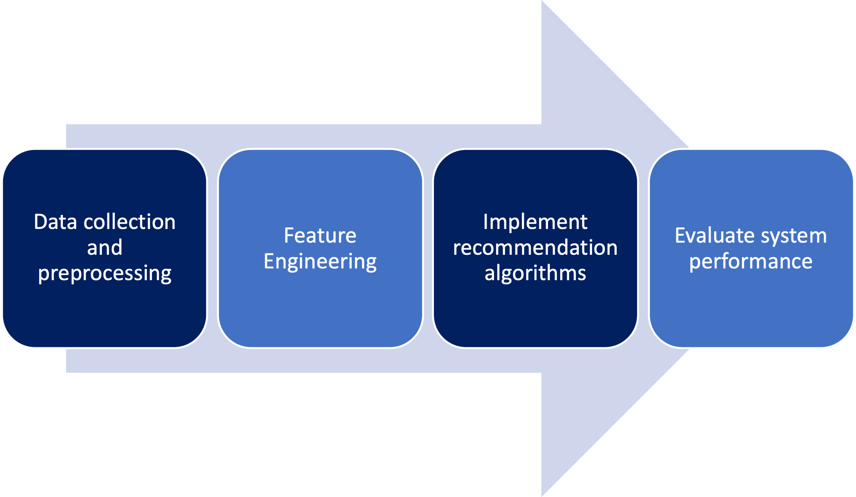
Project Objectives
How are we trying to achieve this:

Slide 11
Literature Review
Research Paper | Brief Summary
Evaluation of Item-Based Top-N Recommendation Algorithms by Desrosiers and Karypis (2011) | This paper used item-based collaborative filtering algorithms, including kNN-based techniques and compared performance of different algorithms using various evaluation metrics and provided the findings
A Comparative Study of Collaborative Filtering Algorithms by Schafer, Frankowski, Herlocker, and Sen (2007) | This paper provides a comparative study of various collaborative filtering algorithms, including kNN-based approaches and evaluates the performance of different algorithms on a real-world dataset and discusses the strengths and weaknesses of each method.
Item-Based Top-N Recommendation Algorithms" by Lindqvist and Valentin (2011) | This paper provides a comprehensive analysis of different item-based collaborative filtering algorithms, including kNN-based methods. It discusses the trade-offs between accuracy and efficiency and provides insights into parameter tuning.

Slide 12
Literature Review
Research Paper | Brief Summary
Collaborative Filtering for Implicit Feedback Datasets by Hu, Yifan, Koren, and Volinsky (2008) | This paper introduces a collaborative filtering approach for recommendation systems based on implicit feedback and discusses the matrix factorization technique and proposes a method to handle missing data and rank-based evaluation.
Amazon.com Recommendations: Item-to-Item Collaborative Filtering by Linden, Smith, and York (2003) | This paper presents the item-to-item collaborative filtering algorithm used by Amazon for its recommendation system. It discusses the advantages of this approach and highlights its scalability and performance.
A Comparative Study of Collaborative Filtering Algorithms for Book Recommendations" by Cai-Nicolas Ziegler, Sean M. McNee, Joseph A. Konstan, and Georg Lausen (2005) | This paper presents a comparative study of different collaborative filtering algorithms for book recommendations. It evaluates the performance of these algorithms using a dataset from a book rating website and discusses their strengths and weaknesses.

Slide 13
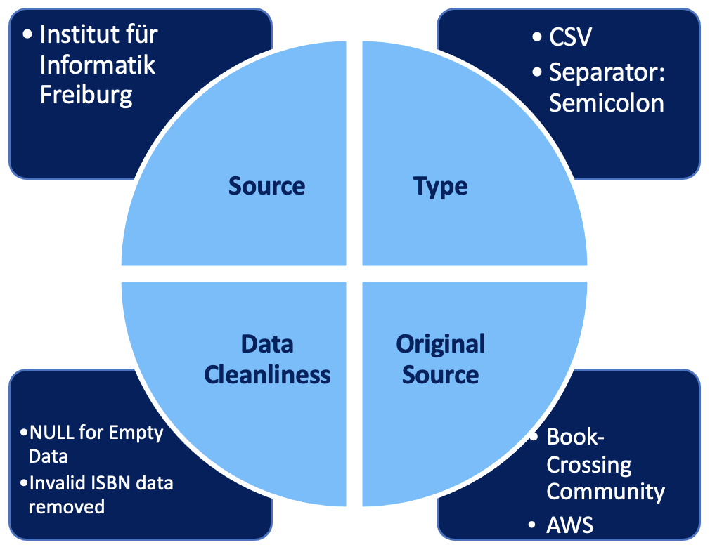
Dataset
Overview

Slide 14
Dataset
Analysis
User-ID
ISBN
Book Rating
271,379
278,858
USERS
BOOKS
USER-ID
ISBN
BOOK
RATINGS
User-ID
Location
Age
ISBN
Book-Title
Book-Author
Year-Of-Publication
Publisher
Images
1,149,780

Slide 15
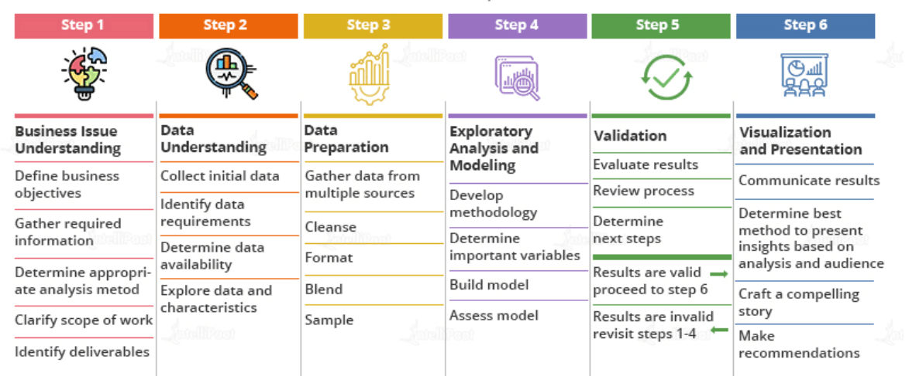
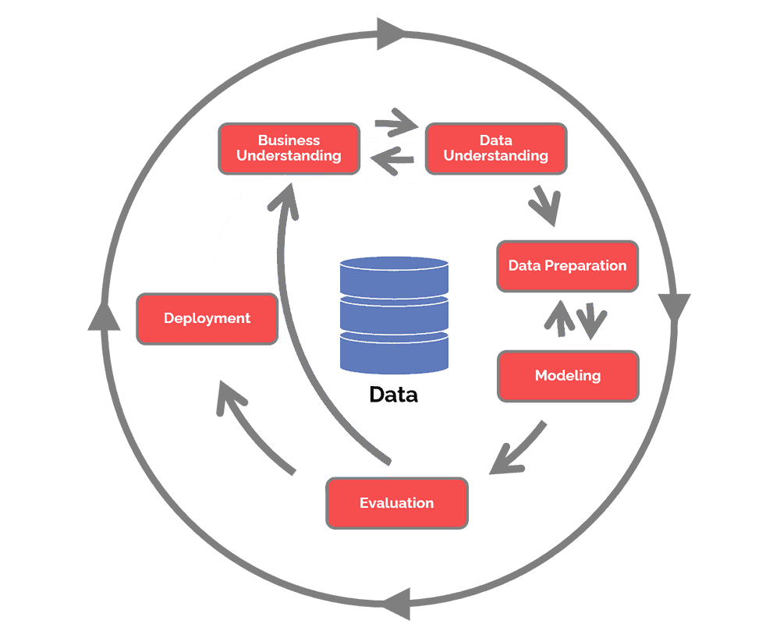
Methodology
Modelling Cycle

Slide 16
Approaches : Recommendation System

Slide 17
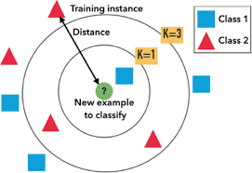
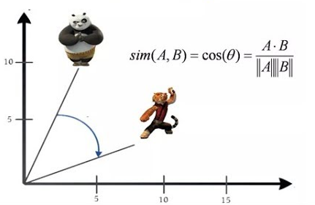
Algorithms & Techniques:
Cosine Similarity
KNN

Slide 18
THANK YOU!!

