Slide 1
NewsFlash:An android application for keeping up with latest headlines

Slide 2
Project Objectives:
The objective of this project is to develop an intuitive and user-friendly news application for Android, providing users with seamless access to the latest news articles. This application ensures a streamlined browsing experience where all news articles are displayed collectively, allowing users to stay informed in real-time without navigating through categories.
Fetch and display up-to-date news articles using NewsAPI, ensuring users receive the most current information.
Create an engaging interface using Jetpack Compose to offer smooth navigation and readability.
Implement Room Database for efficient local storage, enabling users to view saved articles offline.
Focus on providing a responsive design that adapts seamlessly to various screen sizes for an optimal user experience.

Slide 3
Functionalities:
The NewsFlash application offers the following core functionalities to enhance the user experience:
Real-Time News Display: Fetches the latest news articles using NewsAPI and displays them collectively on a single screen, ensuring users have access to current information without categorization.
User Authentication: Implements a secure login and registration system to ensure only authenticated users can access the application, offering a personalized experience.
Responsive User Interface: Built using Jetpack Compose, the application provides a visually appealing and seamless interface that adapts to various screen sizes for an optimized experience..
News Article Preview: Displays a concise preview of each article, including the title, snippet, and image, allowing users to quickly browse headlines.
Efficient Data Management: Integrates Room for efficient and persistent storage of data, ensuring smooth functionality across sessions.
Intuitive Navigation: Provides easy scrolling and interaction, ensuring users can effortlessly navigate through the news feed.

Slide 4
Project description
Tech Stack
Frontend: Android Studio with Jetpack Compose for UI development, creating a responsive and intuitive interface.
Backend: Room Database for local data management, handling user authentication and preferences.
API: News API for fetching up-to-date news articles from various categories in real time.
Libraries and tools:
1.Retrofit for network calls to NewsAPI.
2.Kotlin Coroutines for asynchronous tasks.
3.ViewModel and LiveData for managing UI-related data in a lifecycle-conscious way.

Slide 5
Additional Requirements:
NewsAPI Key Configuration: The application requires a valid NewsAPI key to fetch the latest news articles. Users must configure their unique API key in the application to enable real-time data retrieval.
Network Connectivity: A stable internet connection is necessary for fetching the latest news articles from the NewsAPI. Offline access is supported through locally stored data, but initial data retrieval requires network availability.
Security Measures: The user authentication system must enforce robust security measures, including secure password storage and data encryption, to protect user information.
Testing and Debugging: Comprehensive testing is required to identify and resolve potential issues, ensuring the app runs smoothly under various scenarios.
Future Enhancements: Provisions for adding additional features, such as categorizing news articles, saving favorites, or push notifications for breaking news, should be considered for future updates.

Slide 6
MainActivity. kt:
package com.example.newsheadlines
import android.content.Context
import android.content.Intent
import android.content.Intent.FLAG_ACTIVITY_NEW_TASK
import android.os.Bundle
import android.util.Log
import android.widget.TextView
import androidx.activity.ComponentActivity
import androidx.activity.compose.setContent
import androidx.activity.viewModels
import androidx.compose.foundation.Image
import androidx.compose.foundation.background
import androidx.compose.foundation.clickable
import androidx.compose.foundation.layout.*
import androidx.compose.foundation.lazy.LazyColumn
import androidx.compose.foundation.lazy.itemsIndexed
import androidx.compose.foundation.selection.selectable
import androidx.compose.foundation.shape.RoundedCornerShape
import androidx.compose.material.Card
import androidx.compose.material.MaterialTheme
import androidx.compose.material.Surface
import androidx.compose.material.Text
import androidx.compose.runtime.*
import androidx.compose.ui.Modifier
import androidx.compose.ui.graphics.Color
import androidx.compose.ui.text.font.FontWeight
import androidx.compose.ui.text.style.TextAlign
import androidx.compose.ui.unit.dp
import androidx.compose.ui.unit.sp
import androidx.compose.ui.viewinterop.AndroidView
import androidx.core.text.HtmlCompat
import coil.compose.rememberImagePainter
import coil.size.Scale
import coil.transform.CircleCropTransformation
import com.example.example.Articles
import com.example.newsheadlines.ui.theme.NewsHeadlinesTheme
class MainPage : ComponentActivity() {
val mainViewModel by viewModels<MainViewModel>()
override fun onCreate(savedInstanceState: Bundle?) {
super.onCreate(savedInstanceState)
setContent {
NewsHeadlinesTheme {
// A surface container using the 'background' color from the theme
Surface(color = MaterialTheme.colors.background) {
Column() {
Text(text = "Latest NEWS", fontSize = 32.sp, modifier = Modifier.fillMaxWidth(), textAlign = TextAlign.Center)
MovieList(applicationContext, movieList = mainViewModel.movieListResponse)
mainViewModel.getMovieList()
}
}
}
}

Slide 7
@Composable
fun MovieList(context: Context, movieList: List<Articles>) {
var selectedIndex by remember { mutableStateOf(-1) }
LazyColumn {
itemsIndexed(items = movieList) {
index, item ->
MovieItem(context,movie = item, index, selectedIndex) { i ->
selectedIndex = i
}
}
}
}
@Composable
fun MovieItem(context: Context) {
val movie = Articles(
"Coco",
"",
" articl"
)
MovieItem(context,movie = movie, 0, 0) { i ->
Log.i("wertytest123abc", "MovieItem: "
+i)
}
@Composable
fun MovieItem(context: Context, movie: Articles, index: Int, selectedIndex: Int,
onClick: (Int) -> Unit)
{
al backgroundColor = if (index == selectedIndex) MaterialTheme.colors.primary else
MaterialTheme.colors.background
Card(
modifier = Modifier
.padding(8.dp, 4.dp)
.fillMaxSize()
.selectable(true, true, null,
onClick = {
Log.i("test123abc", "MovieItem: $index/n$selectedIndex")
})
.clickable { onClick(index) }
.height(180.dp), shape = RoundedCornerShape(8.dp), elevation = 4.dp
) {
Surface(color = Color.White) {
Row(
Modifier
.padding(4.dp)
.fillMaxSize()
Image(
painter = rememberImagePainter(
data = movie.urlToImage,
builder = {
scale(Scale.FILL)
placeholder(R.drawable.placeholder)
transformations(CircleCropTransformation())
}
contentDescription = movie.description,
modifier = Modifier
.fillMaxHeight()
.weight(0.3f)

Slide 8
column(
verticalArrangement = Arrangement.Center,
modifier = Modifier
.padding(4.dp)
.fillMaxHeight()
.weight(0.8f)
.background(Color.Gray)
.padding(20.dp)
.selectable(true, true, null,
onClick = {
@Composable
fun HtmlText(html: String, modifier: Modifier = Modifier) {
AndroidView(
modifier = modifier
fillMaxSize()
.size(33.dp),
factory = { context -> TextView(context) },
update = { it.text = HtmlCompat.fromHtml(html, HtmlCompat.FROM_HTML_MODE_COMPACT) }
)
}
}
.context.startActivity(
Intent(context, DisplayNews::class.java)
.setFlags(Intent.FLAG_ACTIVITY_NEW_TASK)
.putExtra("desk", movie.description.toString())
.putExtra("urlToImage", movie.urlToImage)
.putExtra("title", movie.title)
)
})
) {
Text(
text = movie.title.toString(),
style = MaterialTheme.typography.subtitle1,
fontWeight = FontWeight.Bold
)
HtmlText(html = movie.description.toString())
}
}
}
}
@Composable
fun HtmlText(html: String, modifier: Modifier = Modifier) {
AndroidView(
modifier = modifier
.fillMaxSize()
.size(33.dp),
factory = { context -> TextView(context) },
update = { it.text = HtmlCompat.fromHtml(html, HtmlCompat.FROM_HTML_MODE_COMPACT) }
)
}
}

Slide 9
LoginActivity.kt
package com.example.newsheadlines
import android.content.Context
import android.content.Intent
import android.os.Bundle
import androidx.activity.ComponentActivity
import androidx.activity.compose.setContent
import androidx.compose.foundation.Image
import androidx.compose.foundation.background
import androidx.compose.foundation.layout.*
import androidx.compose.foundation.shape.RoundedCornerShape
import androidx.compose.material.*
import androidx.compose.material.icons.Icons
import androidx.compose.material.icons.filled.Lock
import androidx.compose.material.icons.filled.Person
import androidx.compose.runtime.*
import androidx.compose.ui.Alignment
import androidx.compose.ui.Modifier
import androidx.compose.ui.graphics.Color
import androidx.compose.ui.res.painterResource
import androidx.compose.ui.text.font.FontWeight
import androidx.compose.ui.text.input.PasswordVisualTransformation
import androidx.compose.ui.tooling.preview.Preview
import androidx.compose.ui.unit.dp
import androidx.compose.ui.unit.sp
import androidx.core.content.ContextCompat
import androidx.core.content.ContextCompat.startActivity
import com.example.newsheadlines.ui.theme.NewsHeadlinesTheme
class LoginActivity : ComponentActivity() {
private lateinit var databaseHelper: UserDatabaseHelper
override fun onCreate(savedInstanceState: Bundle?) {
super.onCreate(savedInstanceState)
databaseHelper = UserDatabaseHelper(this)
setContent {
LoginScreen(this, databaseHelper)
}
}
}
@Composable
fun LoginScreen(context: Context, databaseHelper: UserDatabaseHelper) {
var username by remember { mutableStateOf("") }
var password by remember { mutableStateOf("") }
var error by remember { mutableStateOf("") }
Column(
Modifier
.fillMaxHeight()
.fillMaxWidth()
.padding(28.dp),
horizontalAlignment = Alignment.CenterHorizontally,
verticalArrangement = Arrangement.Center)
{

Slide 10
Image(
painter = painterResource(id = R.drawable.news),
contentDescription = "")
Spacer(modifier = Modifier.height(10.dp))
Row {
Divider(color = Color.LightGray, thickness = 2.dp, modifier = Modifier
.width(155.dp)
.padding(top = 20.dp, end = 20.dp))
Text(text = "Login",
color = Color(0xFF6495ED),
fontWeight = FontWeight.Bold,
fontSize = 24.sp,style = MaterialTheme.typography.h1)
Divider(color = Color.LightGray, thickness = 2.dp, modifier = Modifier
.width(155.dp)
.padding(top = 20.dp, start = 20.dp))
}
Spacer(modifier = Modifier.height(10.dp))
TextField(
value = username,
onValueChange = { username = it },
leadingIcon = {
Icon(
imageVector = Icons.Default.Person,
contentDescription = "personIcon",
tint = Color(0xFF6495ED)
)
},
placeholder = {
Text(
text = "username",
color = Color.Black
)
},
colors = TextFieldDefaults.textFieldColors(
backgroundColor = Color.Transparent
)
)
Spacer(modifier = Modifier.height(20.dp))
TextField(
value = password,
onValueChange = { password = it },
leadingIcon = {
Icon(
imageVector = Icons.Default.Lock,
contentDescription = "lockIcon",
tint = Color(0xFF6495ED)

Slide 11
)
},
placeholder = { Text(text = "password", color = Color.Black) },
visualTransformation = PasswordVisualTransformation(),
colors = TextFieldDefaults.textFieldColors(backgroundColor = Color.Transparent)
)
Spacer(modifier = Modifier.height(12.dp))
if (error.isNotEmpty()) {
Text(
text = error,
color = MaterialTheme.colors.error,
modifier = Modifier.padding(vertical = 16.dp)
)
}
Button(
onClick = {
if (username.isNotEmpty() && password.isNotEmpty()) {
val user = databaseHelper.getUserByUsername(username)
if (user != null && user.password == password) {
error = "Successfully log in"
context.startActivity(
Intent(
context,
MainPage::class.java
)
)
//onLoginSuccess()
} else {
error = "Invalid username or password"
}
} else {
error = "Please fill all fields"
}
},
shape = RoundedCornerShape(20.dp),
colors = ButtonDefaults.buttonColors(backgroundColor = Color(0xFF77a2ef)),
modifier = Modifier.width(200.dp)
.padding(top = 16.dp)
) {
Text(text = "Log In", fontWeight = FontWeight.Bold)
}
Row(modifier = Modifier.fillMaxWidth()) {
TextButton(onClick = {
context.startActivity(
Intent(
context,
RegistrationActivity::class.java
))})

Slide 12
{ Text(text = "Sign up",
color = Color.Black
)}
Spacer(modifier = Modifier.width(100.dp))
TextButton(onClick = { /* Do something! */ })
{ Text(text = "Forgot password ?",
color = Color.Black
)}
}
}
}
private fun startMainPage(context: Context) {
val intent = Intent(context, MainPage::class.java)
ContextCompat.startActivity(context, intent, null)
}
Display News.kt
package com.example.newsheadlines
import android.content.Intent
import android.os.Bundle
import android.util.Log
import android.widget.TextView
import androidx.activity.ComponentActivity
import androidx.activity.compose.setContent
import androidx.compose.foundation.Image
import androidx.compose.foundation.background
import androidx.compose.foundation.layout.Arrangement
import androidx.compose.foundation.layout.Column
import androidx.compose.foundation.layout.fillMaxSize
import androidx.compose.foundation.layout.padding
import androidx.compose.material.MaterialTheme
import androidx.compose.material.Surface
import androidx.compose.material.Text
import androidx.compose.runtime.Composable
import androidx.compose.ui.Alignment
import androidx.compose.ui.Modifier
import androidx.compose.ui.graphics.Color
import androidx.compose.ui.tooling.preview.Preview
import androidx.compose.ui.unit.dp
import androidx.compose.ui.viewinterop.AndroidView
import androidx.core.text.HtmlCompat
import coil.compose.rememberImagePainter
import com.example.newsheadlines.ui.theme.NewsHeadlinesTheme

Slide 13
class DisplayNews : ComponentActivity() {
override fun onCreate(savedInstanceState: Bundle?) {
super.onCreate(savedInstanceState)
setContent {
NewsHeadlinesTheme {
// A surface container using the 'background' color from the theme
Surface(
modifier = Modifier.fillMaxSize(),
color = MaterialTheme.colors.background
) {
var desk = getIntent().getStringExtra("desk")
var title = getIntent().getStringExtra("title")
var uriImage = getIntent().getStringExtra("urlToImage")
Log.i("test123abc", "MovieItem: $desk")
Column(Modifier.background(Color.Gray).padding(20.dp), horizontalAlignment = Alignment.CenterHorizontally, verticalArrangement = Arrangement.Center) {
Text(text = ""+title, fontSize = 32.sp)
HtmlText(html = desk.toString())
/* AsyncImage(
model = "https://example.com/image.jpg",
contentDescription = "Translated description of what the image contains"
)*/
Image(
painter = rememberImagePainter(uriImage),
contentDescription = "My content
description"
painter = rememberImagePainter(uriImage),
contentDescription = "My content description",
)
}
// Greeting(desk.toString())
}
}
}
}
}
@Composable
fun Greeting(name: String) {
// Text(text = "Hello $name!")
}
@Preview(showBackground = true)
@Composable
fun DefaultPreview() {
NewsHeadlinesTheme {
// Greeting("Android")
}
}
@Composable
fun HtmlText(html: String, modifier: Modifier = Modifier) {
AndroidView(
modifier = modifier,
factory = { context -> TextView(context) },
update = { it.text = HtmlCompat.fromHtml(html, HtmlCompat.FROM_HTML_MODE_COMPACT) }
)

Slide 14
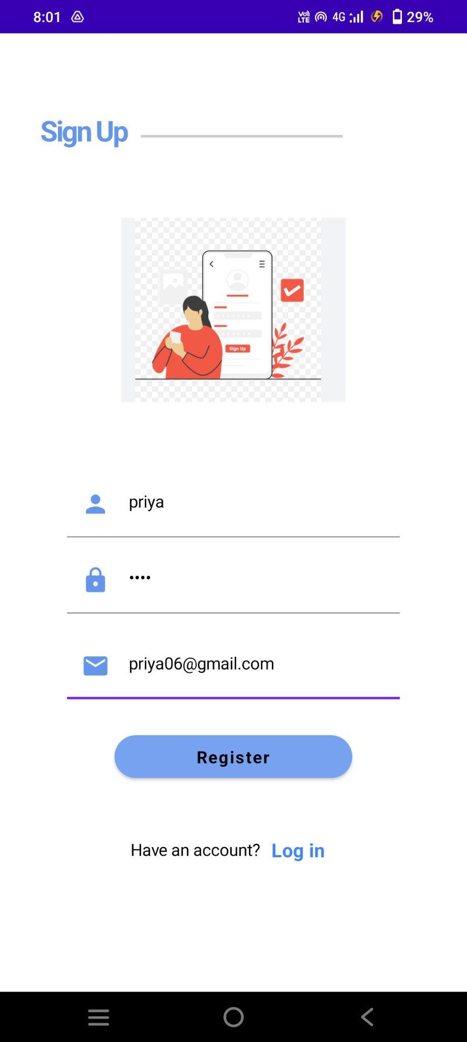
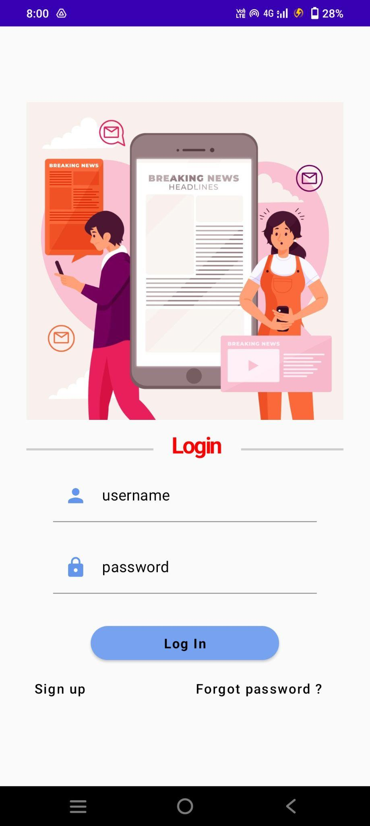
OUTPUT:
Fig 1: SignUp page
Fig 2: Login Page

Slide 15
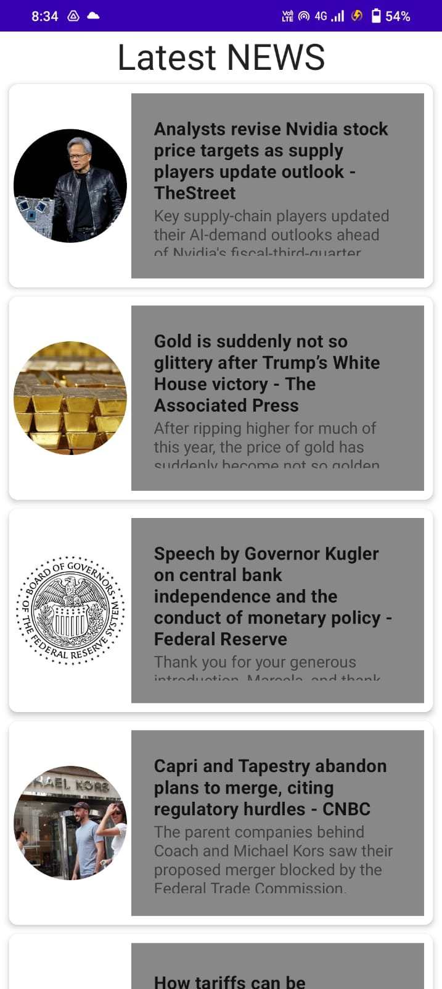
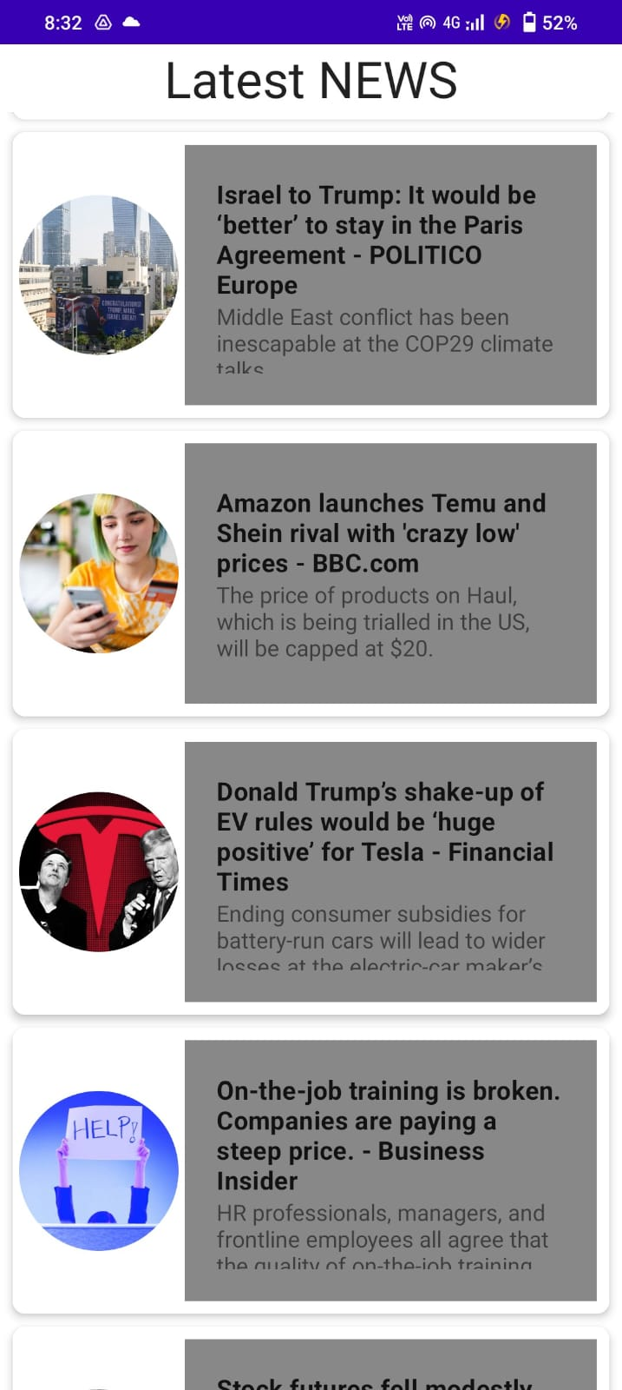
Fig 3: Headlines Page

Slide 16
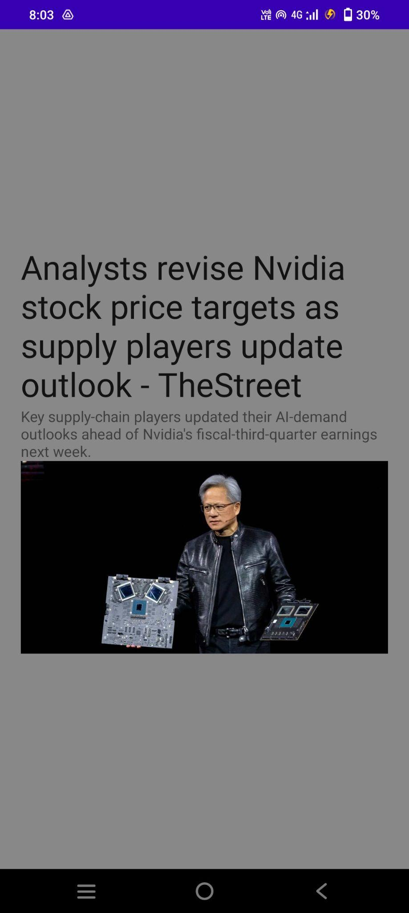
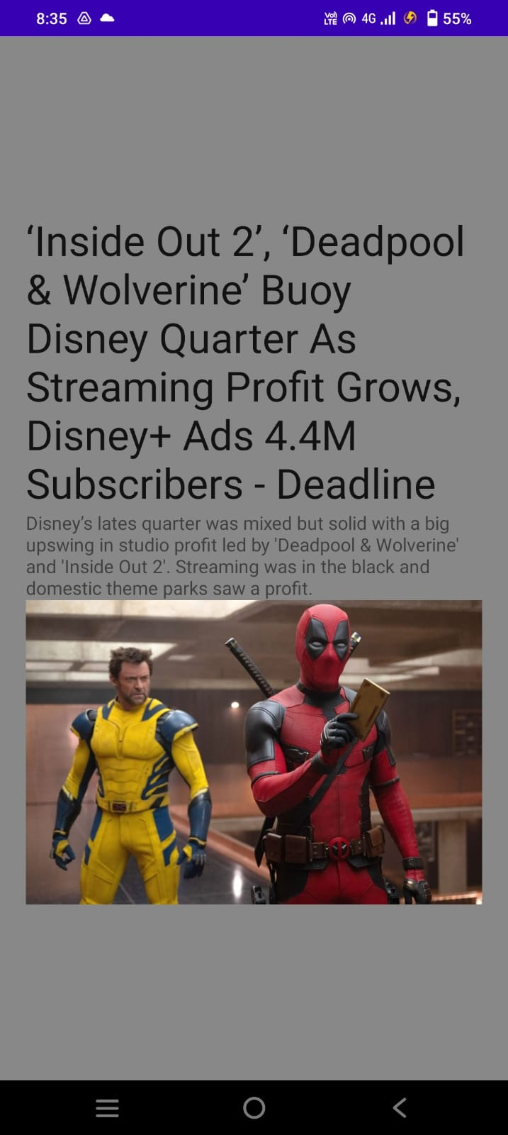
Fig 4 : News page

