Slide 1
NewsFlash:An android application for keeping up with latest headlines

Slide 2
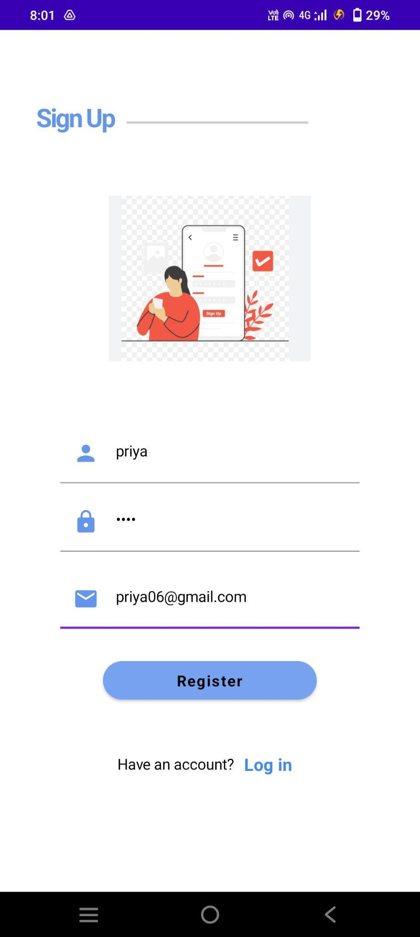
OUTPUT SCREENSHOTS
Fig 1: SignUp page

Slide 3
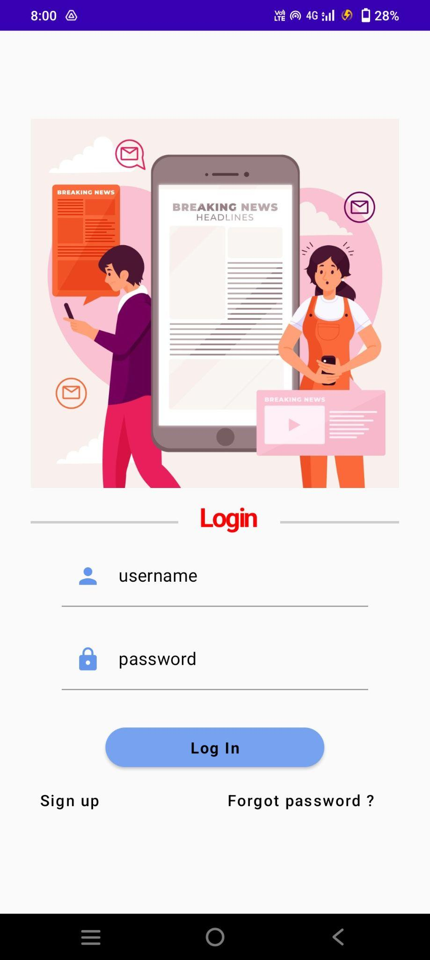
Fig 2: Login Page

Slide 4
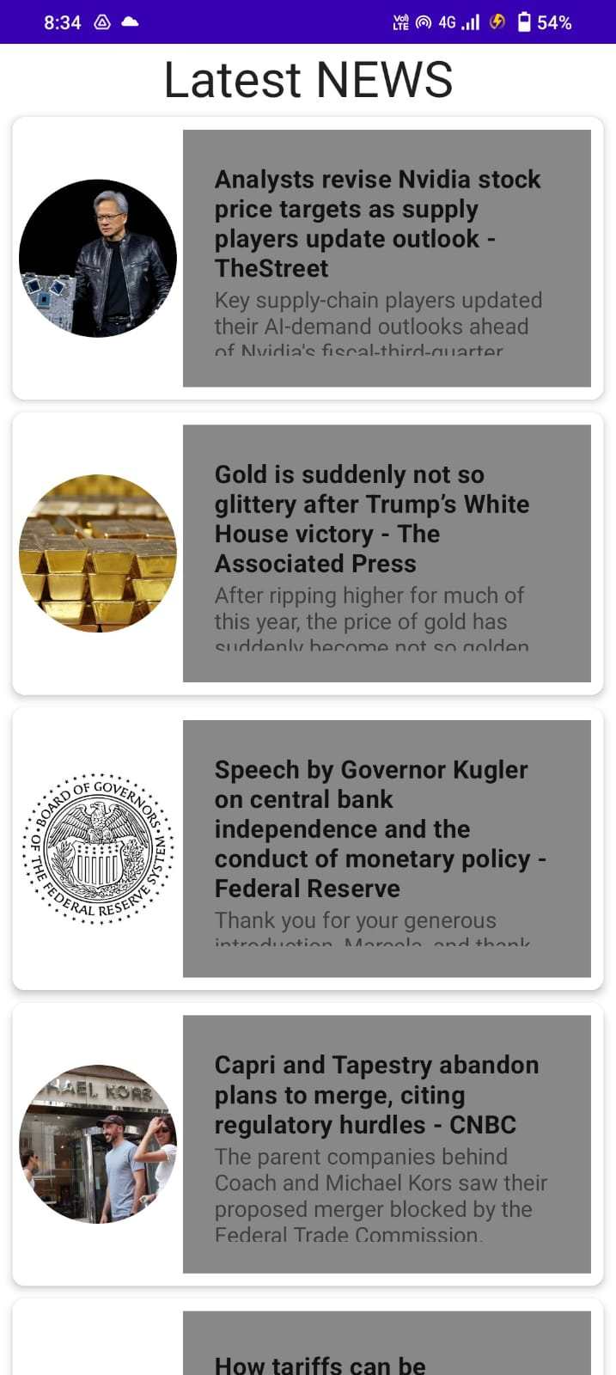
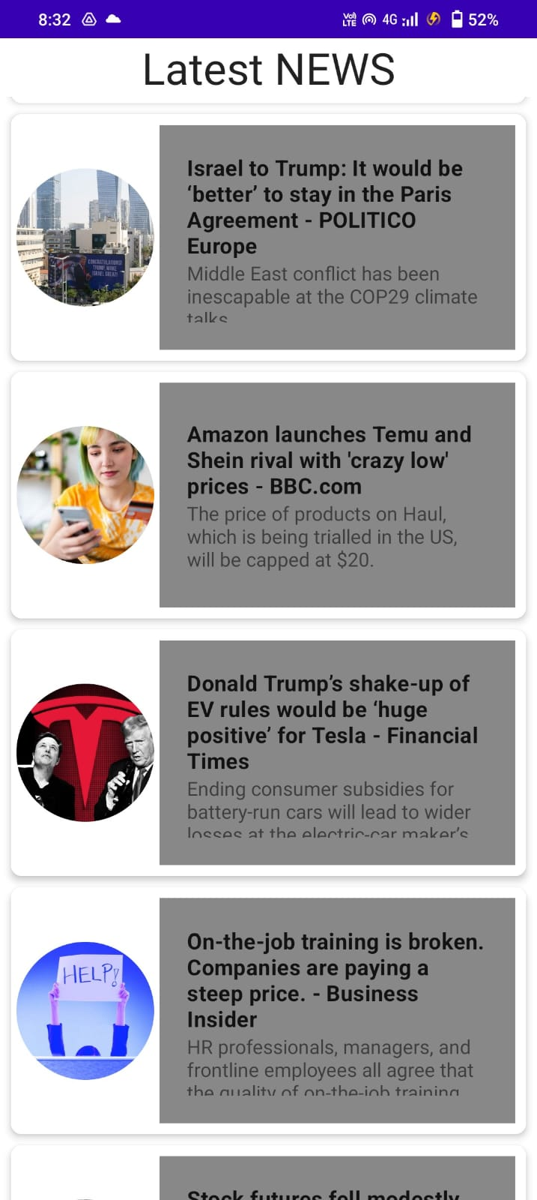
Fig 3: Headlines Page

Slide 5
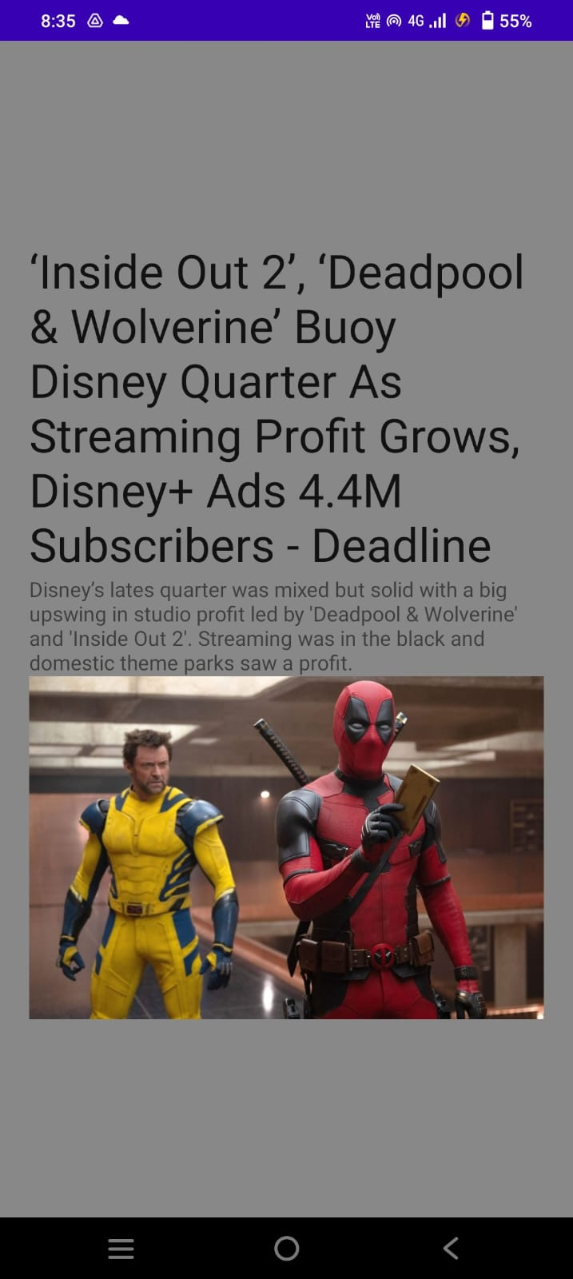
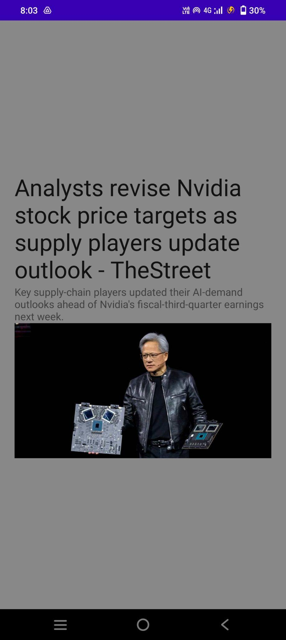
Fig 4 : News page

