Slide 1
Coronary Heart Risk

Slide 2
Business Problem Understanding

Slide 3
Business Problem Understanding
To predict the probability of a patient suffering Coronary Heart
disease in the next 10 years.
Build a model to identify the most important factors that
influence the heart disease.
Help to identify the factors which can prevent or reduce the
chance of getting heart disease.

Slide 4
Constraints:
Null Values
Outliers
Highly Correlated Features
Scope to create new variables
Scope:
To predict the probability of a patient suffering Coronary Heart
disease in the next 10 years using the features given in the
data set .

Slide 5
Work flow of the Process Steps:
Data gathering and processing in R
Exploratory Data Analysis using R
Data Cleaning and Feature Engineering
Model Selection, Tuning and Evaluation
Reporting
Upload the data in R
Evaluate the raw data and analyze the summary and structure of the data
Download data from data source
Identify the missing values
Data Visualization
Finding data distribution and correlation between the variables
Missing Value Treatment
New Variable Creation
Outlier Identification
Outlier Treatment
Split data into Training and Testing Data sets
Build different models and check for various performance measures
Improve model performance using different techniques
Create a comparison table

Slide 6
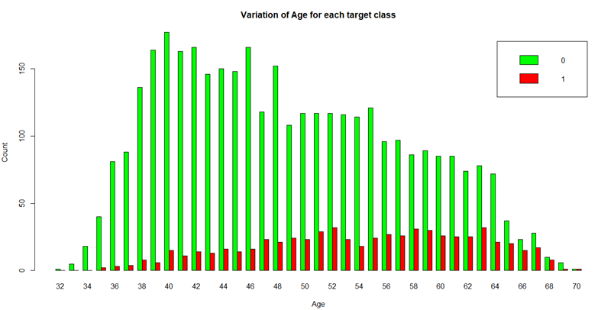
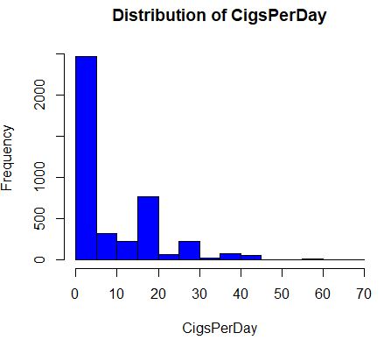
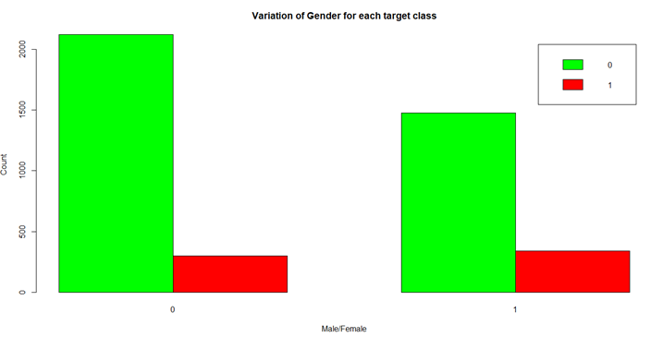
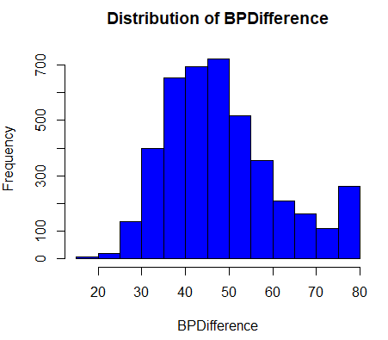
Exploratory Data Analysis:

Slide 7
Modeling Approach

Slide 8
Modeling Approach :
Model | Why
Logistic Regression | Significant Variables
CART | Intuitive decision rules, easy to explain significant features and their weights.
Random Forest | Variable Importance
Artificial Neural Networks | Accurate prediction values
Bagging | Reduce Variance and avoid overfitting

Slide 9
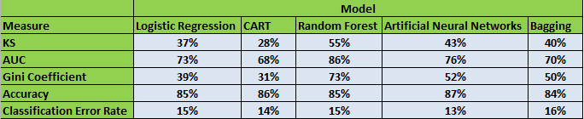
Model Comparison:
The Random Forest method has the best performance among all the five models.
Neural Network has given relatively secondary performance.

Slide 10
Insights from Analysis

Slide 11
Insights from Analysis:
Age, gender, cigsperday and BPDifference are the significant features in the given data set.
Consuming more cigarettes has high risk of getting heart disease.
Males have high risk of getting heart disease compared to females.
As the age increases, risk of getting heart disease also increases.
The higher the BPDifference, more risk of getting the heart disease.

Slide 12
Recommendations

Slide 13
Recommendations:
People getting older must screen themselves often.
Avoid smoking.
Control BP.

Slide 14
Thank you

