Slide 1
Mini Project - MRA

Slide 2
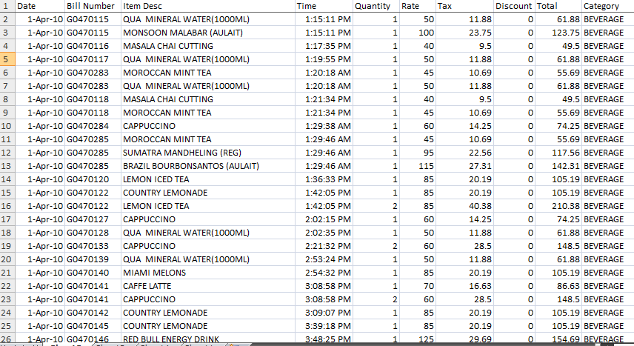
Project Objective: The objective of the report is to explore Café Great Transactions dataset in R and prepare a Managerial Report by explaining the following points.
This Managerial report consists of the following:
Business Objective Statement
Perform Exploratory data analysis(EDA)
Illustrate the insights based on visual graphs created
A thorough analysis of the most commonly occurring sets of menu items in the customer orders(Market Basket Analysis).
The sample Cars dataset is:

Slide 3
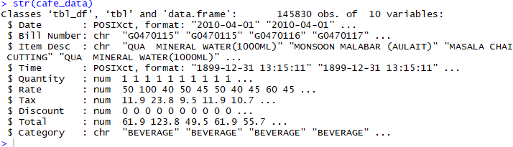
Business Objective: Identify the most popular combos that can be suggested to the restaurant chain after a thorough analysis of the most commonly occurring sets of menu items in the customer orders.
  Exploratory Data Analysis(EDA):
  EDA has been performed using Tableau software and R code.
  Please refer Appendix A for Source Code.
  The internal structure of the data is

Slide 4
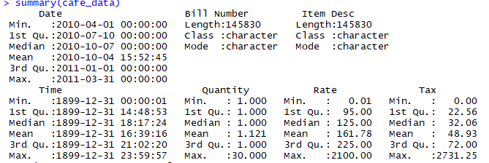
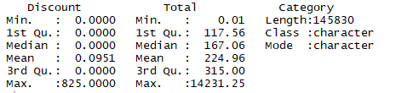
Summary of the data is

Slide 5
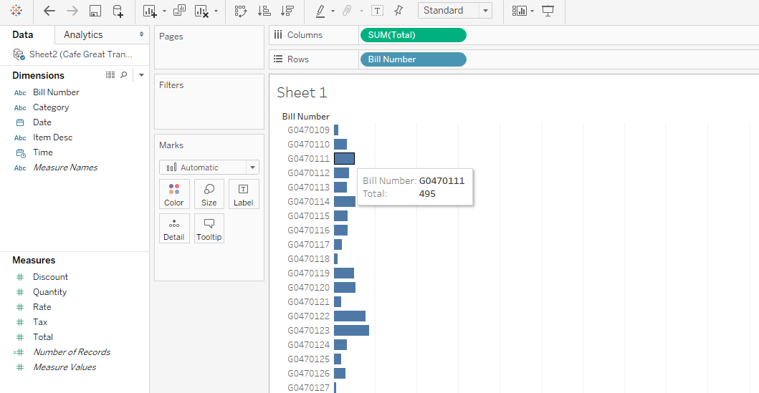
A bar graph is shown below with the sum of total value of each bill number using Tableau.

Slide 6
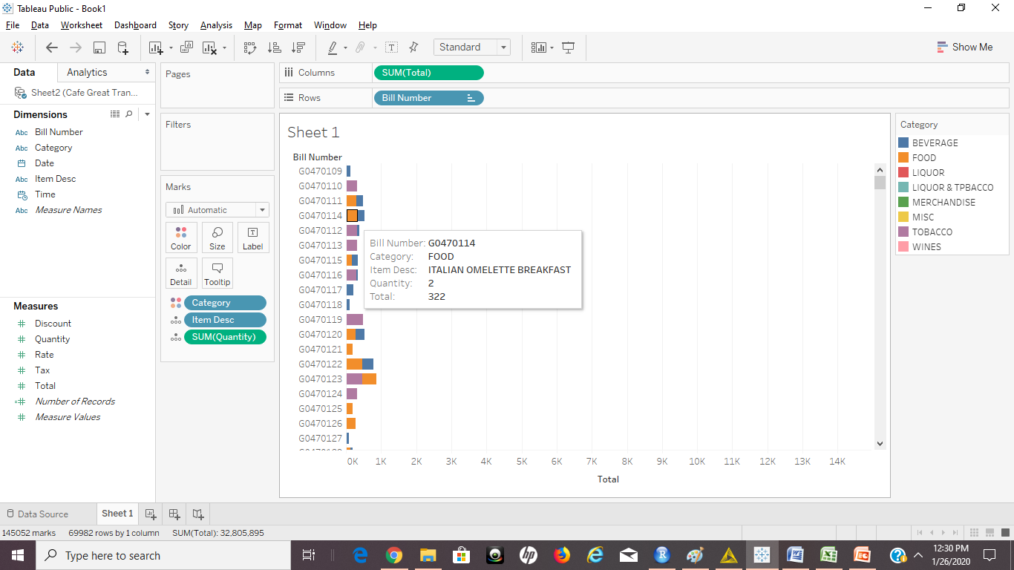
The below graph explains each bill number in more detail with category of the items ordered, quantity, Item Description and the total order value.

Slide 7
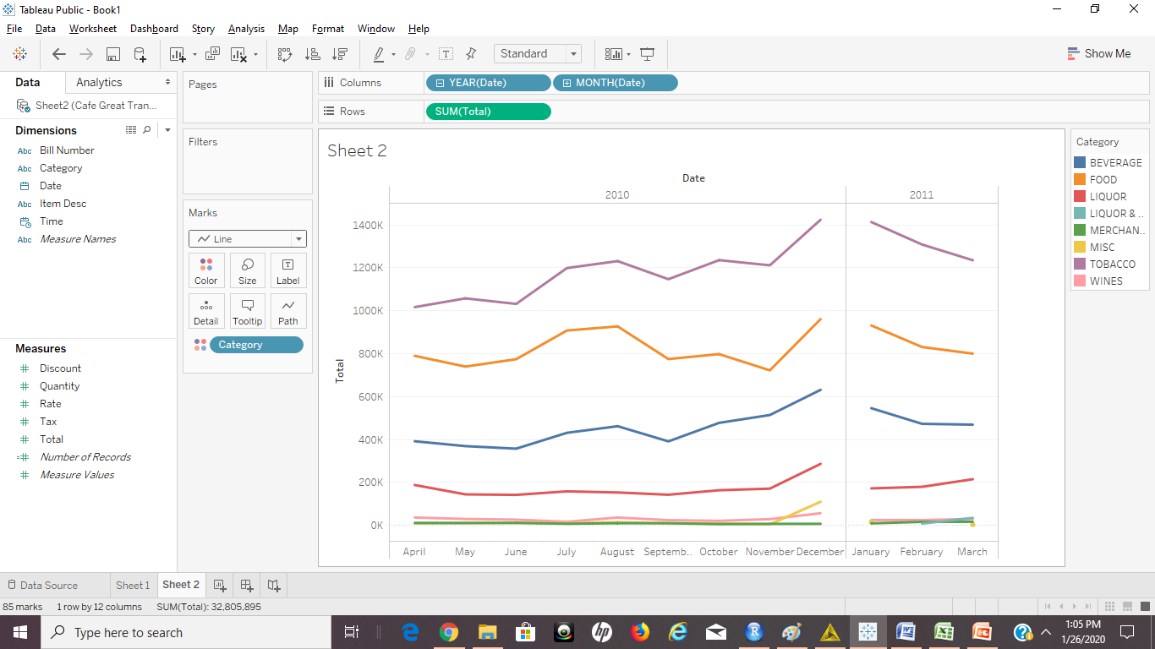
The below mentioned graphs explains the trends observed across months and the years.
There is increase in sales from June to August, then decrease till September and then increase from September to December in 2010 for the categories of Beverages, Food and Tobacco.
However, there is a decline from January to March in 2011.
For the category Liquor, its almost constant but there is increase from November to December.
For Wine and Merchandise Categories, its constant across all the months.
There is a slight increase for Liquor & Tobacco Category from February to March 2011.

Slide 8
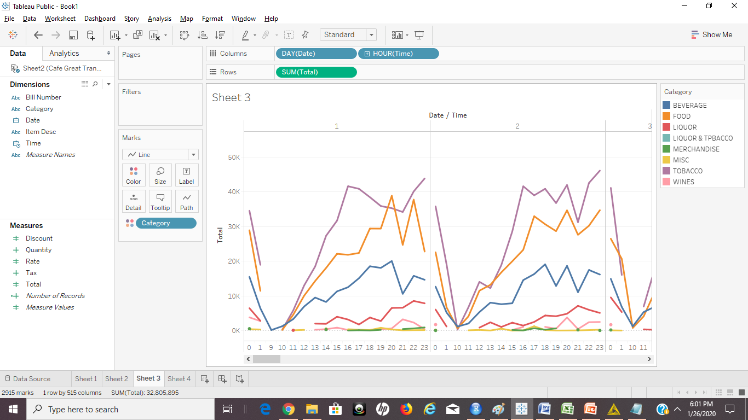
The below mentioned graphs explains the trends observed at different time intervals in a week day.
There is increase in sales from 10 AM till 16.00PM and sales were maintained at high from 16.00pm till 23.00PM.
However, Sales have been dropped gradually from 23.00pm till 1.00AM.
Graphs have been captured for 7 days for each hour.

Slide 9
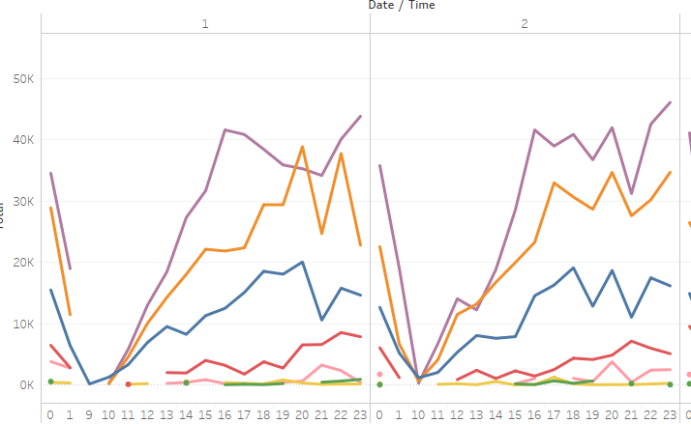
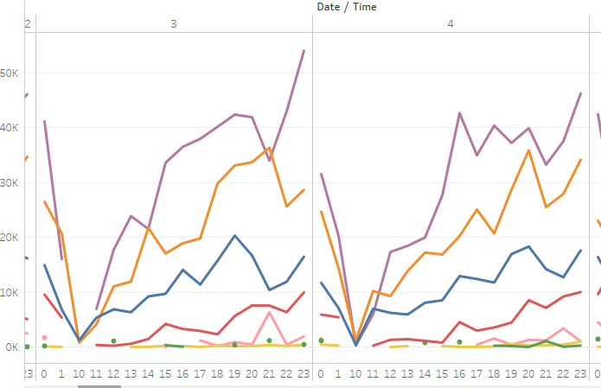

Slide 10
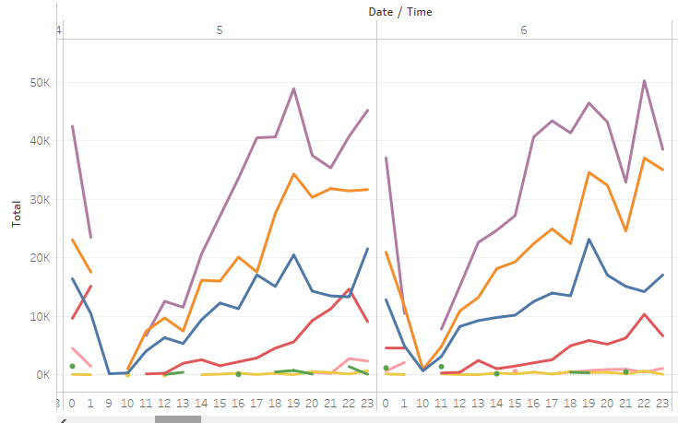
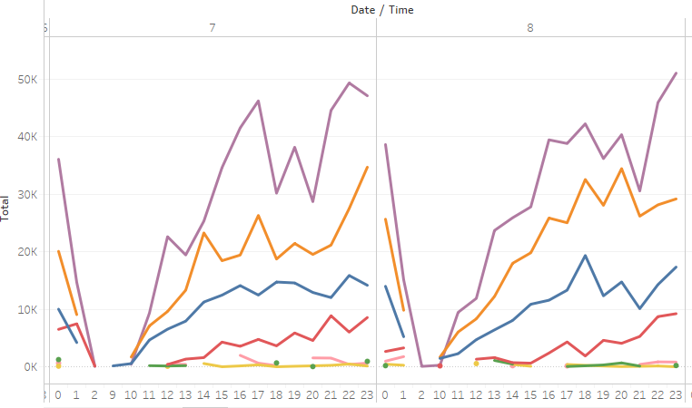

Slide 11
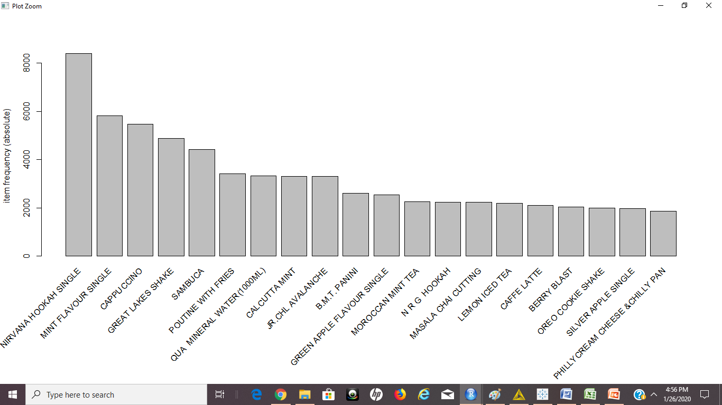
Market Basket Analysis:
As the data is in the data frame format, It has been split into transactions in order to perform Market Basket Analysis.
The below graph shows the top 20 transactions with their item descriptions and their frequencies of occurring in the orders.
The item, Nirvana Hookah Single has highest number of occurrences followed by Mint Flavour Single.

Slide 12
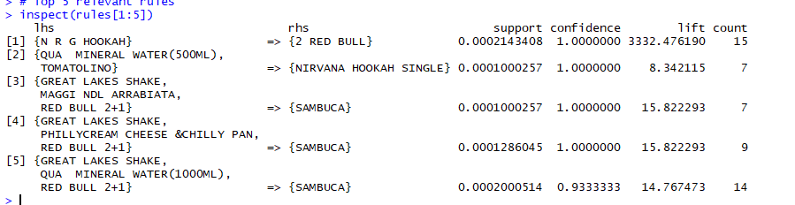
11 sets of Items have been generated with support value of 0.0001 and Confidence of 80%.
These 11 sets of items are the most commonly occuring sets of menu itmes in the customer orders.
Among these 11 sets, the top 5 recommendations have been shown below based on the Lift values.
These are the most likely combinations, customers likely to buy.
The best combo meal is NRG HOOKAH AND 2 RED BULL.
Also, as the sales of the items belonging to Merchandise category are low, these items can be removed from the Menu.

Slide 13
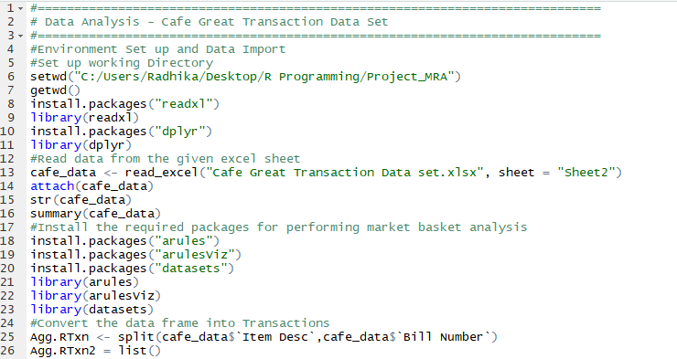
Appendix A – Source Code

Slide 14
