Slide 1
CHARM2: AN EFFICIENTPRICING MODEL FOR MULTI-CLOUD DATA HOSTING SCHEME WITH HIGH AVAILABILITY
Mythele.B (111712104065)
Nandhini Kumari.J (111712104067)
Padmaja.S (111712104071)
Radhika.S.S (111712104081)

Slide 2
More and more enterprises and organizations are hosting their data into the cloud, in order to reduce the IT maintenance cost and enhance the data reliability. However, facing the numerous cloud vendors as well as their heterogeneous pricing policies, customers may well be perplexed with which cloud(s) are suitable for storing their data and what hosting strategy is cheaper. The general status quo is that customers usually put their data into a single cloud (which is subject to the vendor lock-in risk) and then simply trust to luck. Based on comprehensive analysis of various state-of-the-art cloud vendors, this paper proposes a novel data hosting scheme (named CHARM) which integrates two key functions desired. The first is selecting several suitable clouds and an appropriate redundancy strategy to store data with minimized monetary cost and guaranteed availability. The second is triggering a transition process to re-distribute data according to the variations of data access pattern and pricing of clouds. We evaluate the performance of CHARM using both trace-driven simulations and prototype experiments. The results show that compared with the major existing schemes, CHARM not only saves around 20% of monetary cost but also exhibits sound adaptability to data and price adjustments.
ABSTRACT

Slide 3
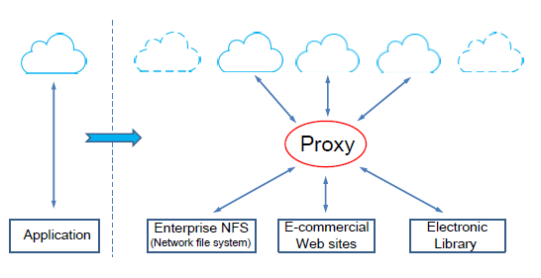
DETAILED SYSTEM DESIGN

Slide 4
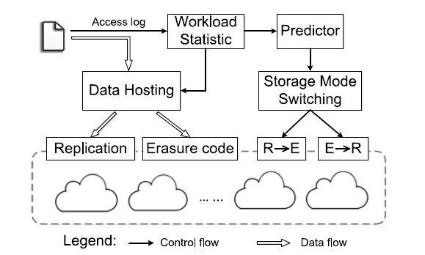
Architecture of Charm-'R'-Replication and 'E'-Erasure Coding

Slide 5
Cloud storage services have become increasingly popular. Because of the importance of privacy, many cloud storage encryption schemes have been proposed to protect data from those who do not have access. All such schemes assumed that cloud storage providers are safe and cannot be hacked; however, in practice, some authorities (i.e., coercers) may force cloud storage providers to reveal user secrets or confidential data on the cloud, thus altogether circumventing storage encryption schemes. In this paper, we present our design for a new cloud storage encryption scheme that enables cloud storage providers to create convincing fake user secrets to protect user privacy. Since coercers cannot tell if obtained secrets are true or not, the cloud storage providers ensure that user privacy is still securely protected.
CLOUD STORAGE

Slide 6
Most of the proposed schemes assume cloud storage service providers or trusted third parties handling key management are trusted and cannot be hacked; however, in practice, some entities may intercept communications between users and cloud storage providers and then compel storage providers to release user secrets by using government power or other means. In this case, encrypted data are assumed to be known and storage providers are requested to release user secrets. we aimed to build an encryption scheme that could help cloud storage providers avoid this predicament. In our approach, we offer cloud storage providers means to create fake user secrets. Given such fake user secrets, outside coercers can only obtained forged data from a user’s stored cipher text. Once coercers think the received secrets are real, they will be satisfied and more importantly cloud storage providers will not have revealed any real secrets. Therefore, user privacy is still protected. This concept comes from a special kind of encryption scheme called deniable encryption.

Slide 7
OWNER MODULE Owner module is to upload their files using some access policy. First they get the public key for particular upload file after getting this public key owner request the secret key for particular upload file. Using that secret key owner upload their file.
MODULES

Slide 8
USER MODULE This module is used to help the client to search the file using the file id and file name .If the file id and name is incorrect means we do not get the file, otherwise server ask the public key and get the encryption file. If you want the decryption file means user have the secret key

Slide 9
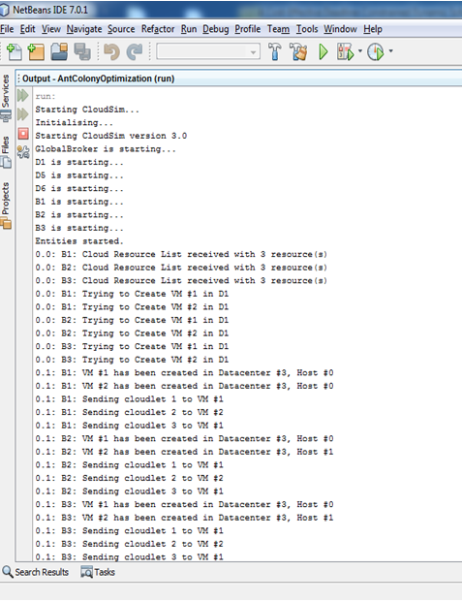
SCREENSHOTS

Slide 10
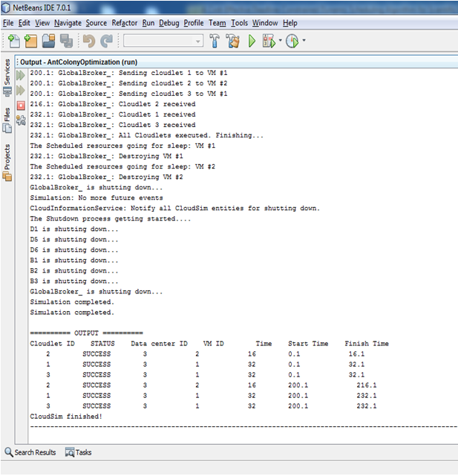

Slide 11
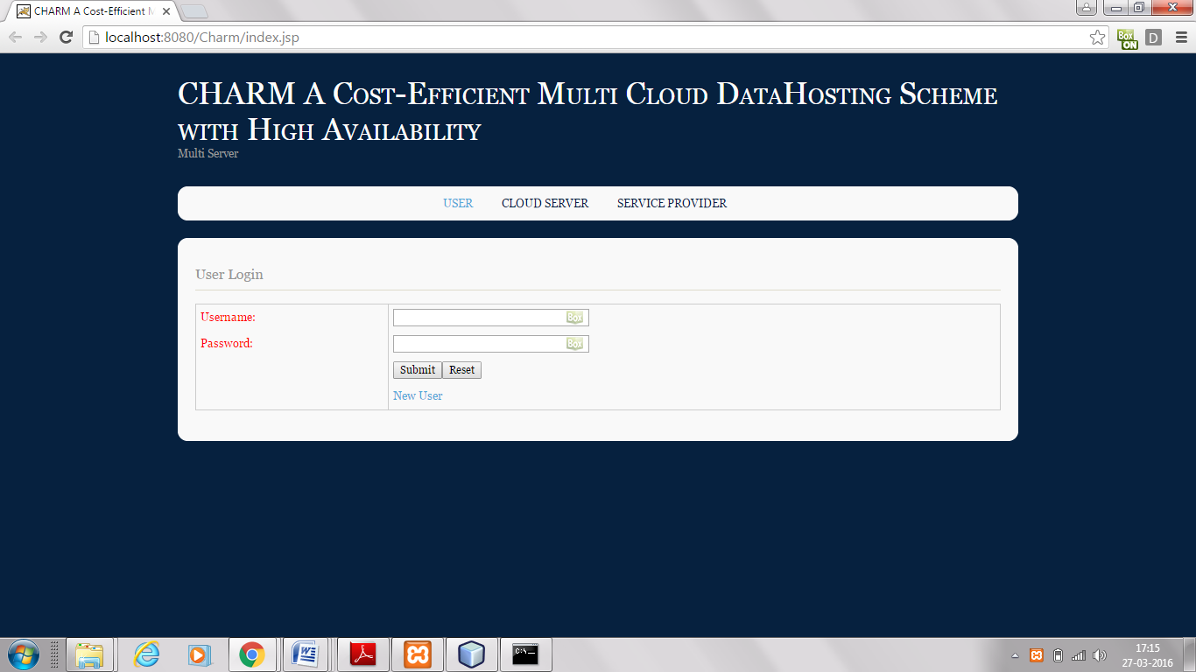
USER LOGIN PAGE:
User logs in with username, password and uploads a file for example "NEW or OLD.txt". click Submit to upload

Slide 12
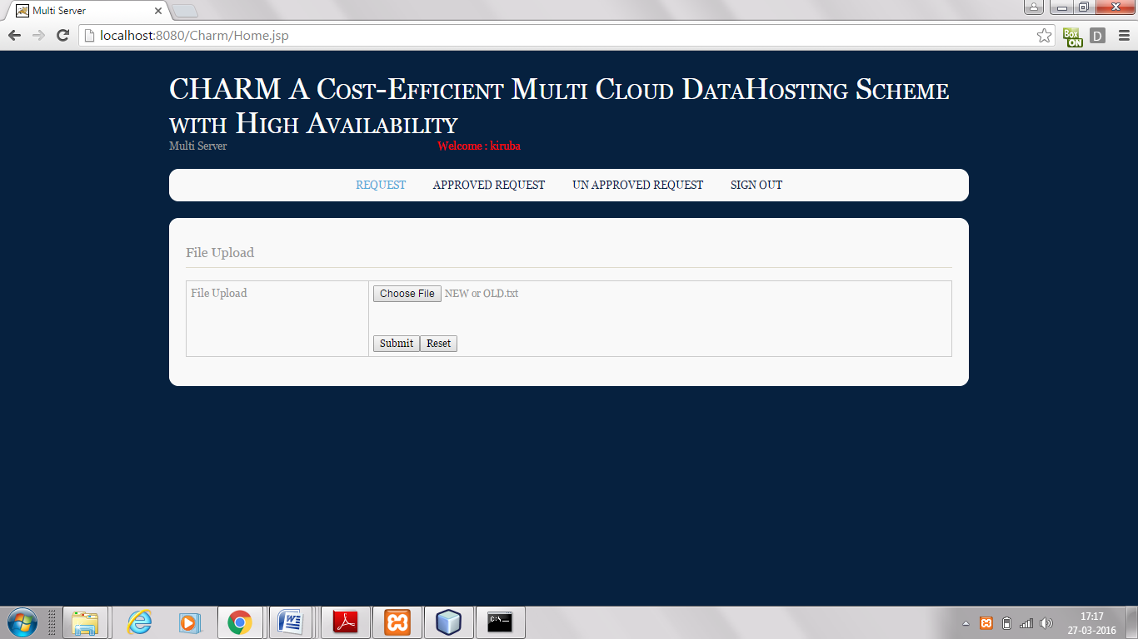

Slide 13
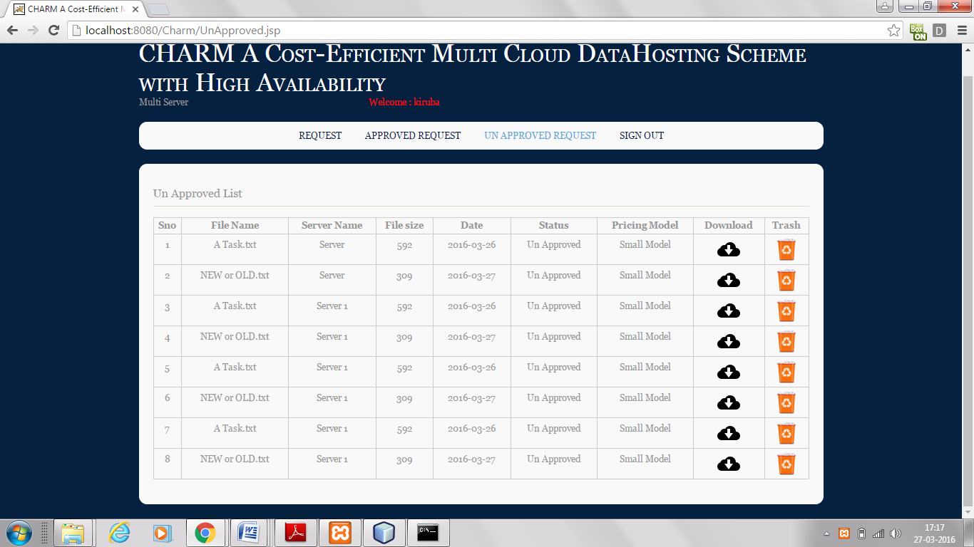
The Uploaded file is still in Unapproved Request.

Slide 14
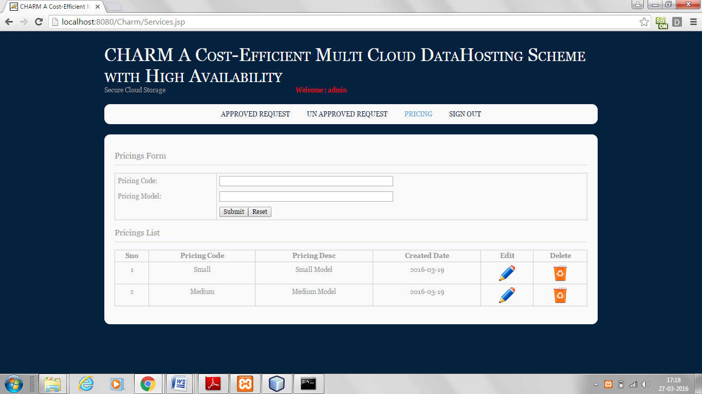
In the Service Provider there are pricing policies which classifies the file based on that strategy. Pricing policy may be small, medium or large.

Slide 15
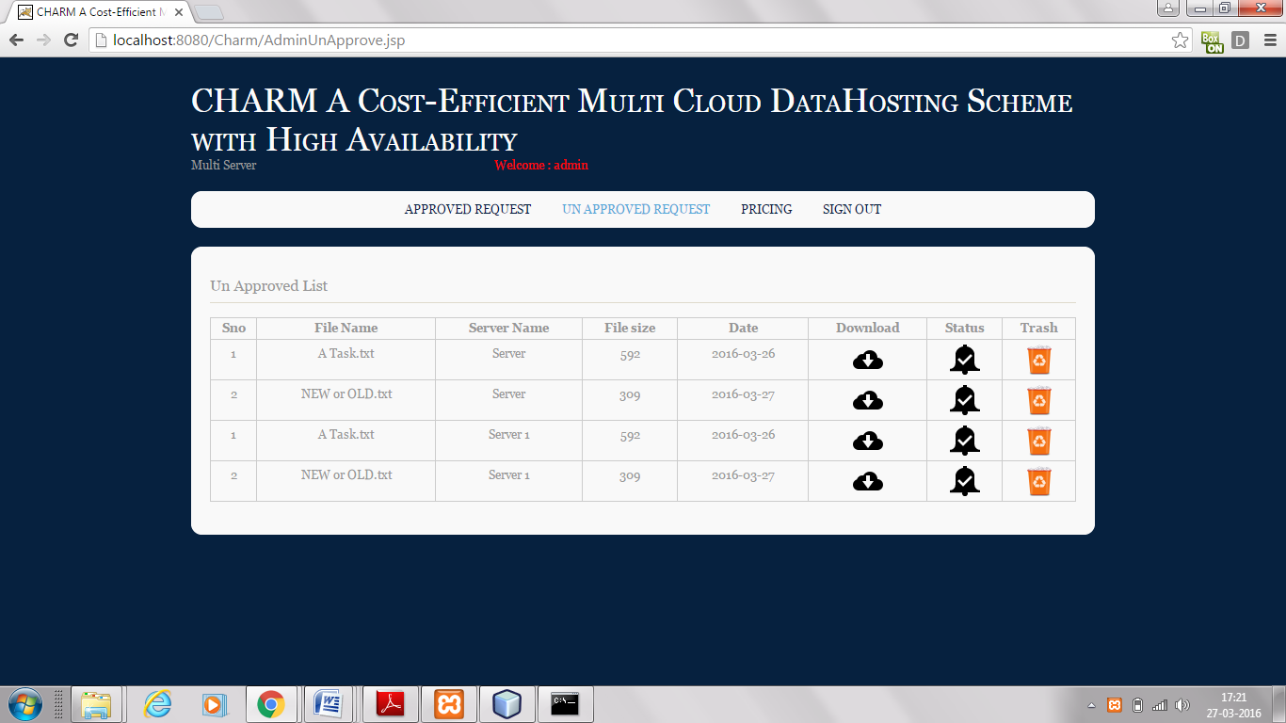
In the Unapproved Request the uploaded file exists. As the file is approved in the cloud server it gets automatically updated in the service provider.

Slide 16
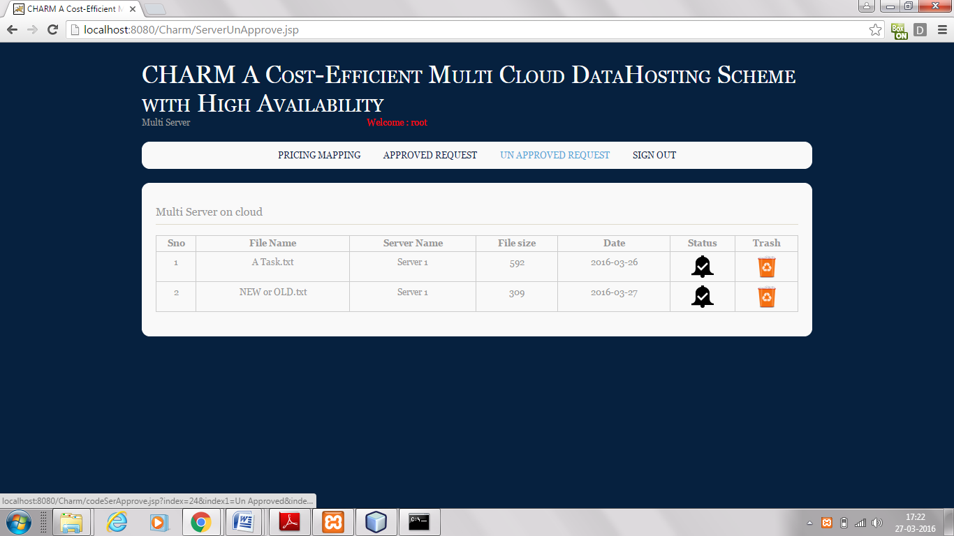
In the cloud server the unapproved list contains the file uploaded by the user "NEW or OLD.txt". The status of the file must be chosen so that the file is approved by the server.

Slide 17
As the server approves the file it is sent to the approved list of the server.
The server can also unapprove the file.
The user will get the file in the approved list such that the pricing model is efficient enough.
The user can download the file whenever needed from the list such that the hosting scheme is effective with minimal monetary cost.
If the file is not needed by the user they can delete it by putting it into the trash.

Slide 18
