Slide 1
PUBLIC VERIFIABILITY FOR ENHANCEMENT OF SECRET DATA DELETION WITH TIMEOUT
Project Guide: Ms.Radhikaa
Batch no : 30
S.Sittukala(111712104094)
S.Suwetha(11712104104)
E.Vasavi(111712104317)

Slide 2
ABSTRACT
Existing software-based data erasure programs can be summarized as following the same one-bit-return protocol: the deletion program performs data erasure and returns either success or failure.
However, such a one-bit-return protocol turns the data deletion system into a black box – the user has to trust the outcome but cannot easily verify it.
This is especially problematic when the deletion program is encapsulated within a Trusted Platform Module (TPM), and the user has no access to the code inside.
Here we present a cryptographic solution that aims to make the data deletion process more transparent and verifiable.

Slide 3
SYSTEM REQUIREMENTS
HARDWARE REQUIREMENTS
System : Pentium IV 2.4 GHz.
Hard Disk : 40 GB.
Floppy Drive : 1.44 Mb.
Monitor : 15 VGA Colour.
Mouse : Logitech.
Ram : 512 Mb.
SOFTWARE REQUIREMENTS
Operating system : Windows XP/7.
Coding Language : JAVA/J2EE
IDE : Netbeans 7.4
Database : MYSQL

Slide 4
EXISITING SYSTEM
There is a lack of transparency in the cloud that allows the customers to monitor their own privacy information.
When a customer decide to use multiple cloud service, the customer will have to store his/her password in multiple cloud, the more cloud service the customer is subscript to, the more copy of the user’s information will be.

Slide 5
This is a security issue for the customers and the cloud service providers. For every cloud service, the customer needs to exchange his/her authentication information.
This redundant actions may lead to an exploit of the authentication mechanism.
Several Existing systems have recognized the importance of verifiability in the secure data deletion process which does not use any cryptography.

Slide 6
DISADVANTAGE
The deletion program performs data erasure and returns either success or failure. However, such a one bit-return protocol turns data deletion system into a black box-the user has to trust the outcome but cannot easily verify it.
This is especially problematic when deletion program is encapsulated within a TPM and the user has no access to the code inside

Slide 7
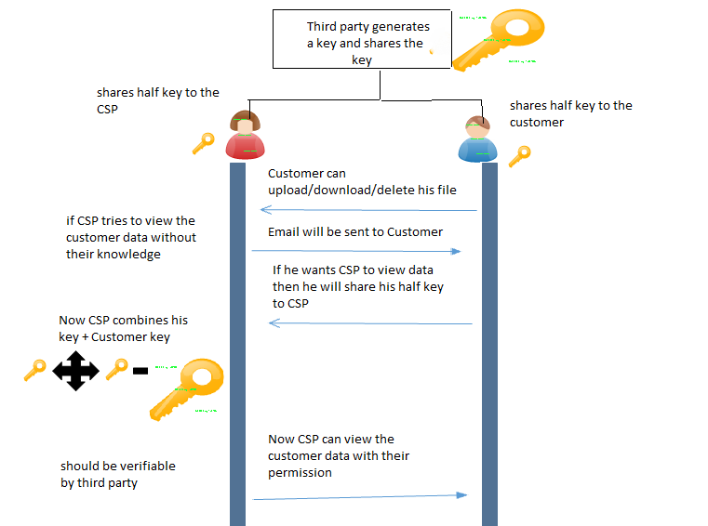
Architecture Diagram:

Slide 8
System Design (Proposed System description with overview/system architecture diagram)
Cloud service providers request customers to store their account information in the cloud, cloud service providers have the access to these information. This presents a privacy issue to the customer’s privacy information.
Many SLAs have specified the privacy of the sensitive information, however, it is difficult for customers to make sure the proper rules are enforced. There is a lack of transparency in the cloud that allows the customers to monitor their own privacy information.
We are introducing the third party which generates a long secret key and shares the half part of the long key to the cloud service providers and remaining part of the half key to the customers.
Customers once registers for a new account they can login into the system using their account.

Slide 9
Once after login into the account before performing any operations on file they first request for the third party to generate a long key. Third party as requested by the customers generates a long key and shares their corresponding share to cloud service providers and customers respectively.
Now when the cloud service providers tries to access the file without the knowledge of their customers, immediately an mail should be sent to the customers indicating that CSP is trying to access their data.
If suppose customers want to share their data to the CSP they can share their half part of the key to the CSP.
CSP in turn combines his half key with the customers half key which gives full key which should be verified by the third party.
Now the cloud service provider can access the customers file. In our proposed system we are providing privacy to customers data assuring that the customers data cannot be viewed without their knowledge.

Slide 10
Design details - DFD for each module
1.User side
Data upload scenario
Data download scenario
Data delete scenario
2. Admin side

Slide 11
Data upload scenario
1.The end user registers for new account
2.The end user login to the system with his/her username & password.
3.Once the user is authenticated, separate folder has created for the user which monitors all the activities of the user
4.Before a user upload the files he has to request for the secret key from the third party
5.Once the user receives the key from the third party he can upload the files to the cloud

Slide 12
Data upload
Register
Request & uploaded
Login & folder created

Slide 13
Data download scenario
1.The end user registers for new account
2. The end user login to the system with his/her username & password.
3. Once the user is authenticated, separate folder has created for the user which monitors all the activities of the user
4. Once the user receives the key from the third party he can download the files from the cloud

Slide 14
Data download
Register
Receive & downloaded
Login & folder created

Slide 15
Data delete scenario:
1.The end user registers for new account
2. The end user login to the system with his/her username & password.
3. Once the user is authenticated, separate folder has created for the user which monitors all the activities of the user
4. once the user receives the key from the third party he can delete the files from the cloud

Slide 16
Data delete
Register
Delete data from cloud
Login & folder created

Slide 17
Admin side:
When the admin wants to see the other user files he has to do the following steps
1. Admin enters his half key which is provided by the third party
2. Now he has to request from the user the remaining half key so that by combining his half key and admin half key to view the file
3. Once the user wants to share his file to the admin they can provide their half key to admin and grants the admin to view their file

Slide 18
Admin
Enters half key
User share half key & Admin views the file
Request for users remaining half key

Slide 19
Algorithm Description
Traditional Secret Sharing Scheme
Shamir [21] presented the first secret sharing method in1979. Secret sharing involves transmitting different shares in different channels.
With a single share nobody can see the entire secret message. The general idea behind secret sharing is to distribute a secret to n different participants so that any k participants can reconstruct the secret, and any (k - 1) or less participants cannot reveal anything about the secret.
Such schemes are also known as (k, n) threshold-based scheme.
For any secret sharing schemes it has the following two processes: Distribution Process This process input is the secret k that gets portioned into n number of shares S1, S2,...Sn that is privately delivered to the participants. Reconstruction Process It reconstructs the secret when a suitable set of shares is present using a certain algorithm.

Slide 20
Threshold Secret Sharing Scheme:
These schemes are the first kind of schemes that were constructed individually by both Shamir who uses polynomial interpolation [21] and Blakely who uses finite geometry [28].
To share a secret we can split the secret and spread the pieces to all participants.
In some schemes, reconstructing the secret needs combining all shares from participants, but this might not be practical since we might need the secret reconstructed by some of the participants and not all.
The reason is as follows: Imagine if a country splits the access codes for its missiles among three officials and they found themselves in a dire need to access the missiles, but one of the officials is not present or he simply refuses to attack. Then, we need to have a different scheme where a subset of the participants can reconstruct the secret. These schemes are secure and do not require all n shares [24].

Slide 21
Threshold Changeable Secret Sharing Scheme
Threshold Changeable secret sharing scheme was invented by the scientist Wang and Wong for changing thresholds in the absence of secure channels after the setup of threshold secret sharing schemes[24].
Initially, we construct a perfect (t, n) threshold scheme that is threshold changeable to t which is optimal with respect to the share size.
But these threshold changeable schemes along with most previously known schemes turn out to be insecure under the collusion attack of players holding initial shares [29].

Slide 22
Verifiable Secret Sharing Scheme
This scheme was first introduced to overcome the problem of dishonest dealers. VSS schemes lets the participants verify that their shares are consistent, thus they can properly reconstruct the secret.
To get a clear idea about how these schemes work, let us assume a dealer Trent sends shares to Alice, Bob, Carol and Dave.
The only way they can be sure they have a valid share is to reconstruct the secret, but it may happen that Trent sent a bogus share to Bob or Bob received a bad share as a result of a communication error.
VSS schemes allow these participants to validate their shares without the need to reconstruct the secret [25].
It is designed to resist an adversary who can corrupt the dealer and some of the participants.VSS requires an additional algorithm called verify that allows participants to verify their shares before any reconstructing attempts [26].

Slide 23
SECURITY CHECK
Security can be provided in two ways
Hardware security (using TPM)
Software security (using Key approach)

Slide 24
TPM(Trusted Platform Module)
A Trusted Platform module provides secure asymmetric key generation. This paper [11] describes the use of a secure key generating authority in shamir identity based signature scheme implementation.
They proposed an idea of identity-based asymmetric cryptosystems (IBC) and together with an identity based asymmetric signature. The proposed IBS scheme in this paper has itself proven secure against forgery under chosen message attacks.
This paper also proposed a new concept that assigning TPM as key generating authority and list out the various benefits of implementing it. The paper [12] initially identifies the challenges for establishing the trust in the cloud and then proposes a secure framework which helps in addressing those identified challenges.

Slide 25
KEY SECURITY
Security is ensured using C-code-like formal modeling at application level.
As a result of this approach, security of the protocol is ensured not only at the abstract level of protocol l, but also at the concrete level.
In the authors proposes the virtualization of trusted platform module, so than not only single machine can use the TPM but also any number of virtual machines can also use the TPM, doing so will support higher level services like remote attestation and so on.

Slide 26
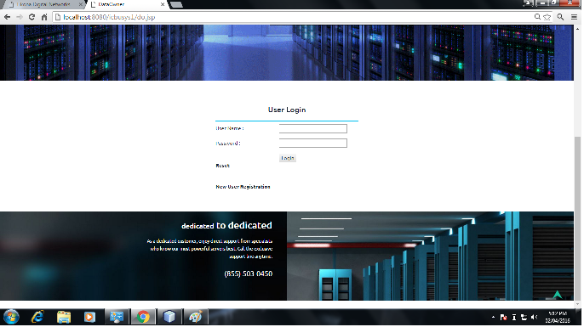
SCREENSHOTS

Slide 27
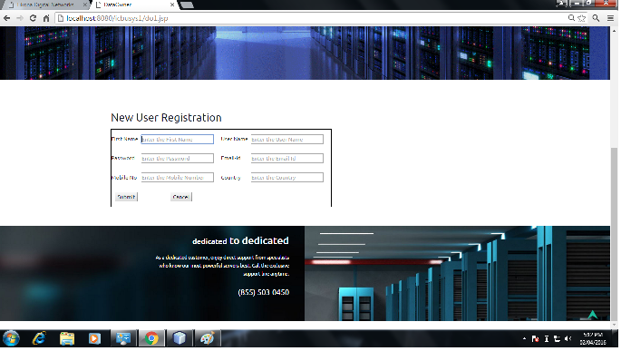

Slide 28
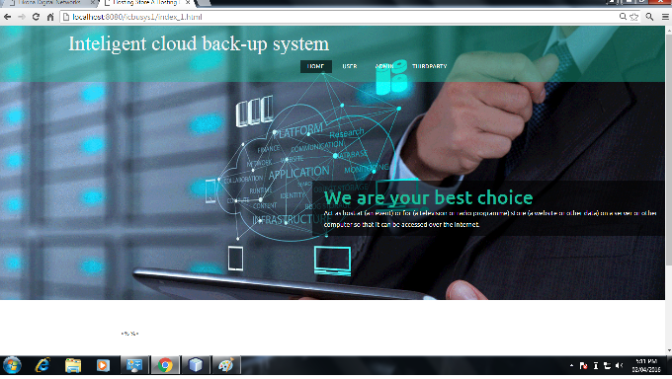

Slide 29
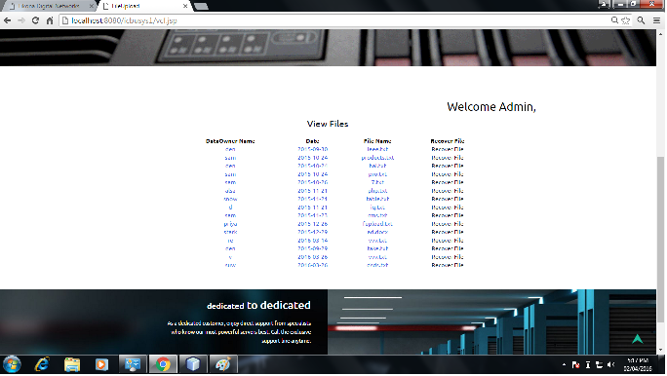

Slide 30
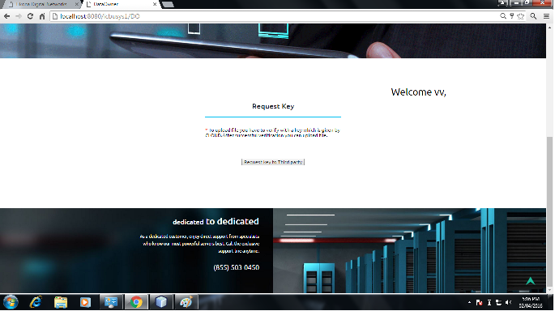

Slide 31
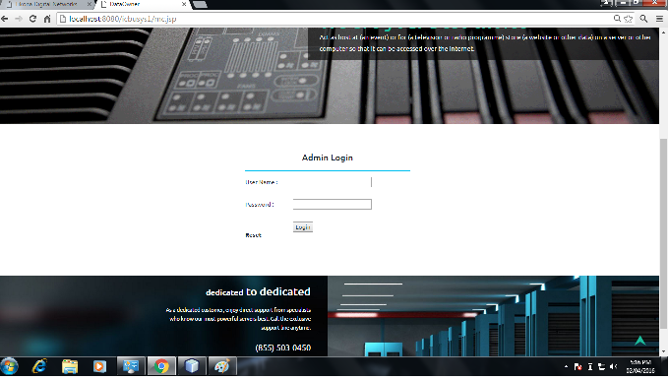

Slide 32
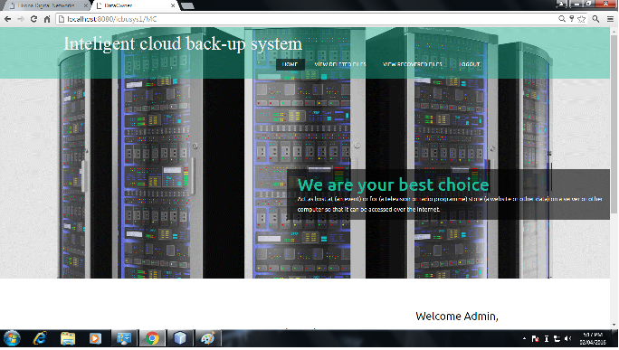

Slide 33
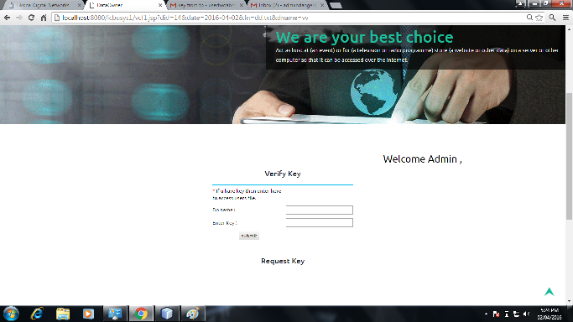

Slide 34
THANK YOU

