Slide 1


Team Details
  Team name: Human in the loop
  Team leader name: Padmaja Giribabu
  Problem Statement: AI for how organisations access knowledge and make decisions

Slide 2
Brief about the idea
Policy Vault captures why enterprise systems are configured the way they are, before the experts who know leave.
1
Detect drift
Compares the policy PDF with the live configuration, value by value, and finds the root cause of each mismatch in old tickets.
The problem
Expense, procurement and inventory systems are shaped over years by a few experts. When they retire, nobody knows why a rule, approval step or hidden field exists, so teams are afraid to change anything.
Meanwhile the written policy and the live configuration quietly drift apart. That leaks money and breaks controls auditors were told exist.
Wikis and enterprise search can only find what someone wrote down. The most valuable knowledge never was.
2
Capture the why
Finds rules nobody can explain, interviews the expert with evidence, and a human verifies the answer as a Decision Record.
3
Answer with proof
“Can I change this rule?” is answered with citations to policy, tickets and verified records.

Slide 3
Opportunities
How different is it from any of the other existing ideas?
How will it be able to solve the problem?
USP of the proposed solution
Confluence, Rovo, Glean and Copilot retrieve what was written down. Policy Vault creates knowledge that was never written.
Process-mining tools such as SAP Signavio show how a process runs. Policy Vault explains why a rule is configured that way.
It checks the policy against the live system, not documents against documents.
One scan compares every policy value with the configuration export.
Each drift is traced to the ticket that caused it.
The gap finder lists rules nobody can explain; an evidence-led interview captures the reason.
Decision Records answer every future “why”.
Elicitation, not just retrieval
“AI reads, code compares”: auditable value checks
Every claim carries evidence; “no record found” is an allowed answer
A human verifies every record
One engine, many domains: expense and inventory today

Slide 4
List of features offered by the solution
1
2
3
4
Drift detection
Policy PDF vs configuration export: policy value, system value and risk for every rule.
Root-cause finder
Links each drift to the ticket that caused it, or says “no record found, ask the expert”.
Evidence panel
Policy sentence, live configuration (who changed it, when) and ticket text side by side.
Gap finder
Lists rules with no policy section and no ticket, plus drifts nobody can explain.
5
6
7
8
Knowledge coverage meter
“13 of 17 rules have a known reason”, rising as records are added.
Evidence-led interview
Asks the expert with clues: “hidden 3 days after TKT-1135 reported ERP failures. Related?”
Verified Decision Records
What, why, who, when, sources and risk if removed; saved in Firestore and indexed for search.
Ask Why
Grounded answers citing policy, tickets and records; admits when there is no recorded rationale.
Domain packs: expense and inventory run on the same engine with no code changes.

Slide 5
Process flow diagram or Use-case diagram
Detect
1 Load domain pack
Policy PDF, configuration export, ticket history
2 Extract
Gemini reads the policy into structured rules
3 Compare
Python checks every value and unit
4 Explain
Gemini reads the ticket history and names the root-cause ticket
Input
AI
Code
AI
Capture & answer
5 Find gaps
Rules with no policy section and no ticket
6 Interview expert
Evidence-led question with Vertex AI Search and date clues
7 Verify record
Expert answer becomes a Decision Record
8 Ask Why
Grounded answer with cited sources
Code
AI + expert
Human
AI
Human in the loop: AI proposes, code decides the numbers, and no Decision Record exists until a person verifies it. Drifts with no known reason feed the gap finder.

Slide 6
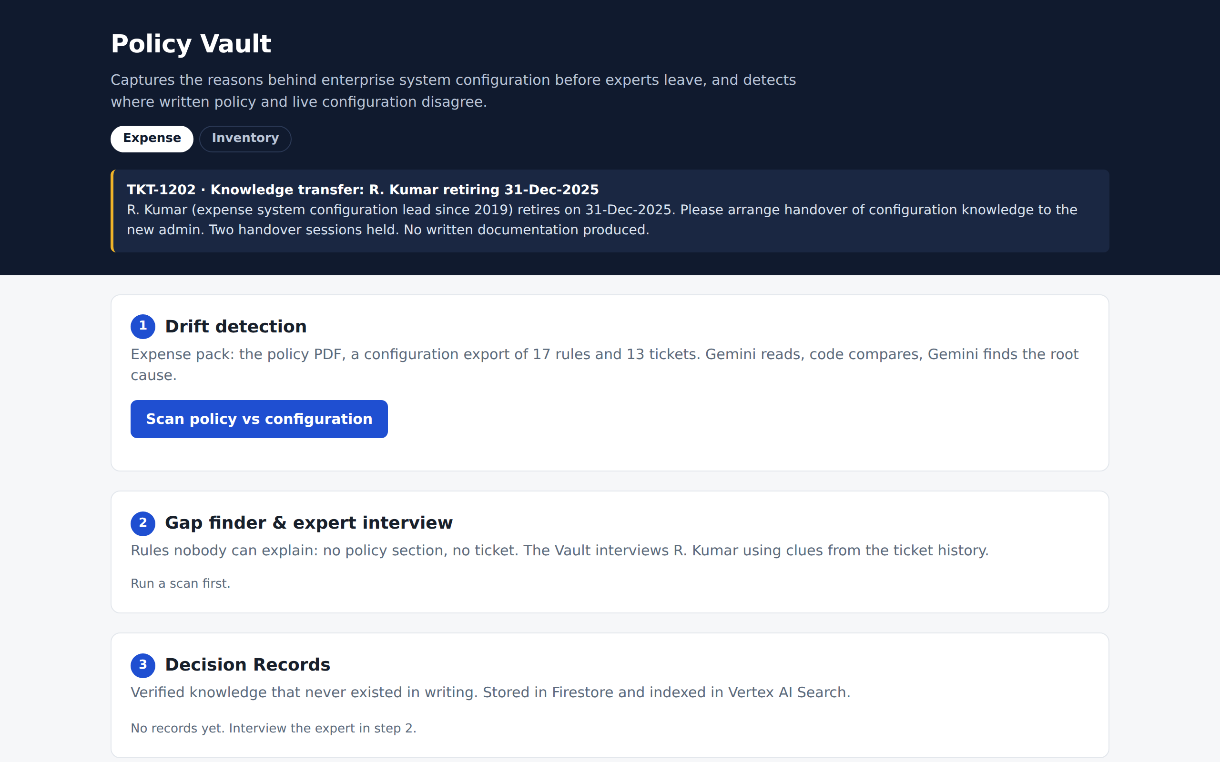
Wireframes/Mock diagrams of the proposed solution (optional)
One page, top to bottom
Header: domain switch (Expense / Inventory) and the expert’s handover ticket
1 Drift detection: scan button, live step timings, summary tiles, drift table with evidence
2 Gap finder & interview: unexplained rules, clues, question, expert answer
3 Decision Records: coverage meter and verified records
4 Ask the Vault: question box, answer, source chips
Landing screen of the deployed prototype

Slide 7
Architecture diagram of the proposed solution
Browser
new admin / expert
Cloud Run one Flask service: UI + JSON API · asia-south1
extract.py
policy PDF → rules
drift.py
compare + root cause
gaps.py
gaps, interview, draft
records.py
Decision Records
ask_why.py
grounded answers
Domain pack
policy.pdf · config_rules.csv · tickets.json
Guard-rails
Answer key never reaches a prompt. IDs are schema enums. Search timeout and saved-scan fallback.
Gemini on Vertex AI
Vertex AI Search
Firestore
Cloud Storage
gemini-3.5-flash: extraction, root cause, interview, answers
policy, tickets and Decision Records; grounding with sources
verified Decision Records (local fallback)
search corpus; new records imported into search

Slide 8
Technologies to be used in the solution
Gemini on Vertex AI
Vertex AI Search
Cloud Run
gemini-3.5-flash reads the policy PDF directly into JSON (schema with enum rule and ticket IDs), finds root causes, writes interview questions and answers Ask Why.
Indexes policy, tickets and Decision Records (layout parser, chunking). Grounds Ask Why, so sources come from grounding metadata, not model text.
One containerised Flask service for UI and API, deployed from source in asia-south1; scales to zero when idle.
Firestore
Cloud Storage
Python stack
Stores verified Decision Records: what, why, who, when, sources, risk. A local-file fallback keeps the demo running.
Holds the search corpus; each new Decision Record is written here and imported into Vertex AI Search.
Flask, google-genai SDK, Discovery Engine and Firestore clients, pytest: 83 offline tests and 13 live end-to-end checks.

Slide 9
Estimated implementation cost (optional)
Fully serverless and pay-per-use: no servers to run and nothing to pay while idle. Cost grows with scans and questions, not with headcount.
Component
What drives cost
Usage per action in Policy Vault
Gemini on Vertex AI
Input and output tokens per call
Scan: 2 calls (extract + explain all drifts) · interview: 2 calls · Ask Why: 1 grounded call
Vertex AI Search
Search queries and indexed data
1 query per Ask Why or interview clue; corpus of tens of documents
Cloud Run
CPU and memory while serving requests
Scales to zero; one small instance covers a team
Firestore
Document reads and writes
One small document per Decision Record
Cloud Storage
Data stored
A few MB (policy PDFs, tickets, records)
Cost control: the extraction result can be cached and reused, all drifts are explained in one call, and Cloud Run idles at zero. Prices follow Google Cloud’s current rate cards.

Slide 10
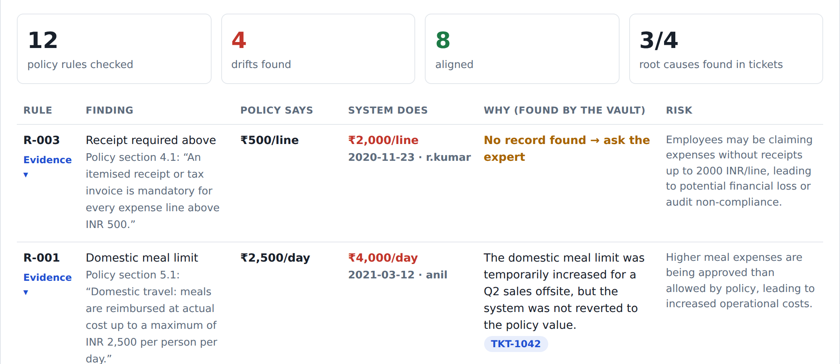
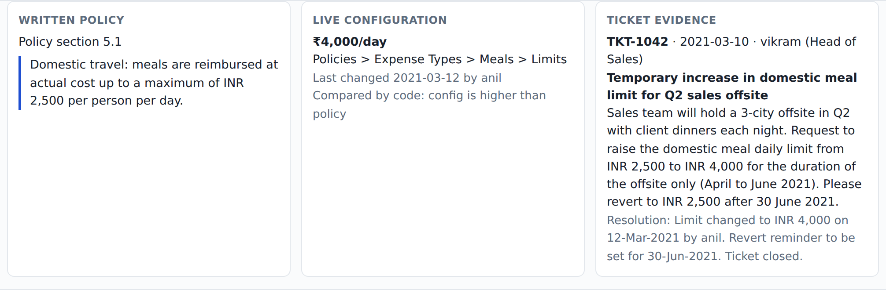
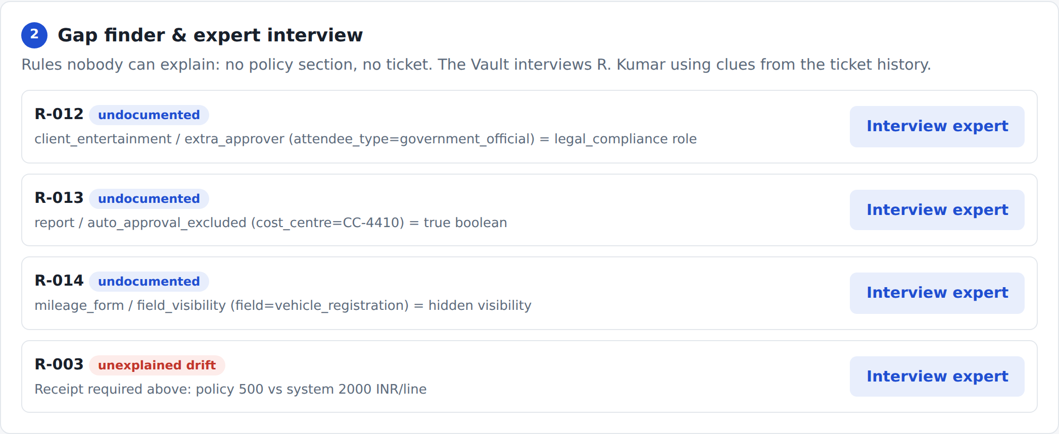
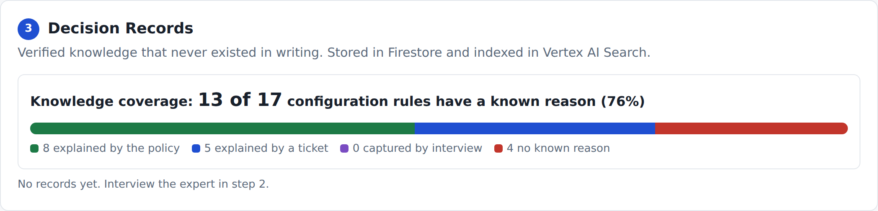
Snapshots of the prototype
Evidence panel: policy sentence, live configuration and ticket side by side
Drift report: 12 rules checked, 4 drifts, 8 aligned, root cause per drift
Knowledge coverage: 13 of 17 rules have a known reason before interviews
Gap finder: rules nobody can explain, ready for the expert interview

Slide 11
Prototype Performance report/Benchmarking
4 / 4
0
4 / 4
3 / 3
planted drifts detected
false alarms (8 / 8 aligned rules confirmed)
root causes right (3 tickets + 1 “ask the expert”)
expected tickets ranked first by Vertex AI Search
Ask Why checks
Engineering checks
83 / 83 offline tests: comparison logic, guard-rails, app flow
13 / 13 live end-to-end checks on Gemini + Vertex AI Search
2 / 2 drifts, 0 false alarms on the inventory pack (7 / 7 aligned)
Why is the meal limit ₹4,000 when policy says ₹2,500?
✓ Cites TKT-1042
Can I re-enable the vehicle registration field?
✓ “Not until ERP mapping is fixed” · DR + TKT-1135
Why is cost centre CC-4410 excluded from auto-approval?
✓ Cites the Decision Record
Why was the international meal limit set at USD 75? (trap)
✓ “No recorded rationale found”
Measured with gemini-3.5-flash against a hidden answer key (ground_truth.json) that never reaches a prompt. All data synthetic.

Slide 12
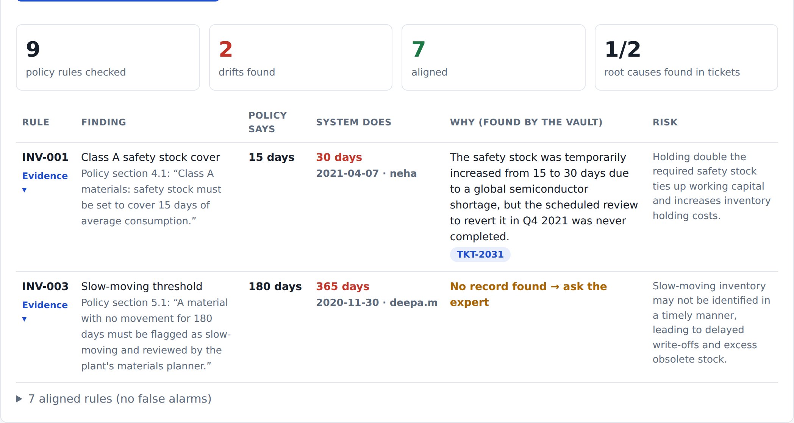
Additional Details/Future Development (if any)
More domain packs procurement (Ariba-style), finance, sales discount approvals
Real connectors SAP Concur, SAP Ariba and S/4HANA configuration APIs; ServiceNow / Jira tickets
Continuous monitoring re-scan on every policy or configuration change via Pub/Sub
Change impact check warn which Decision Records a planned change touches
SAP BTP edition AI Core / Generative AI Hub and Joule, as a knowledge-retention layer for S/4HANA migrations
Enterprise hardening SSO, role-based access, audit trail of who verified what
Already working: a second domain on the same engine
Inventory pack: class A safety stock at 30 days vs policy 15, traced to a 2021 shortage ticket (TKT-2031) that was never reverted.

Slide 13
Provide links to your:
GitHub Public Repository
https://github.com/PadmajaG-ai/policy_vault
1
Demo Video Link (3 Minutes)
Demo Video
2
Final Product Link
https://policy-vault-240640518337.asia-south1.run.app
3

Slide 14
Design decisions that make it trustworthy
1
2
3
AI reads, code compares
No anchoring
It can only cite what exists
Gemini turns policy text into rules; plain Python compares values, including Indian digit grouping like 1,00,000 and units.
Gemini sees the configuration’s rule slots, never its values, so an extracted value can only come from the policy.
Rule and ticket IDs are enums in the JSON schema and re-validated in code; sources come from grounding metadata.
4
5
6
“I don’t know” is valid
Generic rule shape
Demo never breaks
Every step has a no-evidence path, and the tests include trap questions with no rationale.
domain, entity, attribute, condition, value, unit: a new domain is a data pack, not new code.
Search timeout, date-clue fallback for interviews, local fallback for records, last saved scan if a live scan fails.

Slide 15


