Slide 1
INVESTMENT ASSIGNMENT SUBMISSION
Name: P.Padmanaban

Slide 2
Objective
The aim of this Data analysis is to suggest spark fund company for investing in Top companies and sector for investment. The input are 3 files:
Companies.csv – Name of the companies
Reports2.csv- Information about investments made in the past
Mapping.csv – Get information about the category and its corresponding sectors
Primary criteria:
Invest between 5 to 15 millions
Invest only in English speaking countries

Slide 3
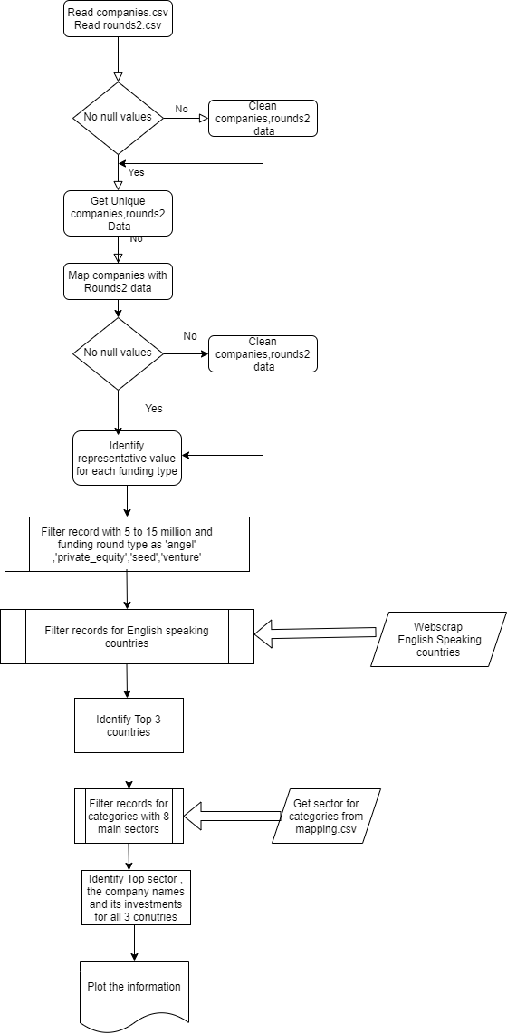
Process flow

Slide 4
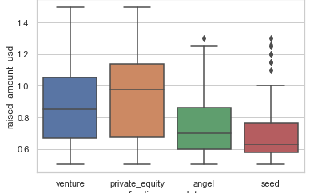
Representative amount for each funding type
Plot 1

Slide 5
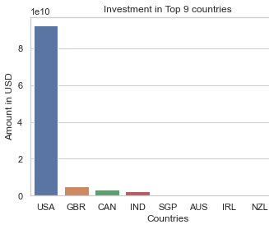
Investment in Top 9 countries

Slide 6
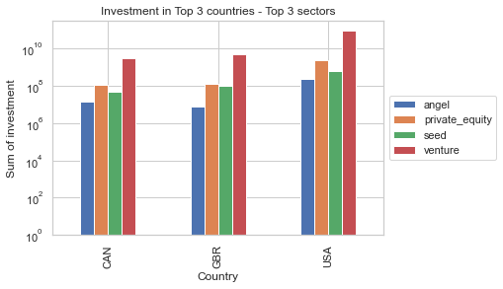
Investment in Top 3 countries

Slide 7
Suggestions for investment - USA
Sectors to invest
Others
Social, Finance, Analytics, Advertising
Cleantech / Semiconductors
Companies to invest
SpiderCloud Wireless
Flite

Slide 8
Suggestions for investment - GBR
Sectors to invest
Cleantech / Semiconductors
Others
Social, Finance, Analytics, Advertising
Companies to invest
SportPursuit
ip.access

Slide 9
Suggestions for investment - CAN
Sectors to invest
Cleantech / Semiconductors
Others
Social, Finance, Analytics, Advertising
Companies to invest
FilterBox Water & Environmental
NewStep Networks

