Slide 1

Data Science Presentation
Analysis of Crime Data using Machine Learning Algorithms
Padmanabh Wanikar,
Sem: VII Sec C
Symbiosis Institute of Technology, Nagpur Campus

Slide 2

Machine Learning on Crime Data
A summary of Regression, Clustering, Classification, and Deep Learning models applied to the districtwise-ipc-crime-by-juveniles-2017-onwards data.
Introduction & Data Preparation
Objective: To analyze, cluster, and predict crime patterns using various ML techniques.
Dataset: istrictwise-ipc-crime-by-juveniles-2017-onward
Target Variables:
  murder (for Regression)
  crime_level (Binary: High/Low, based on median total crimes) (for Classification)
Feature Engineering:
  Grouped 116 individual crime columns into 4 main categories: violent_crimes_total, property_crimes_total, crimes_against_women_total, and negligence_deaths_total.
  Also used all 116 columns as predictors for a comprehensive model.

Slide 3
Section 1: Regression (Predicting Murder Rates)
: Regression Overview
Goal: To predict the numeric value of 'Murder' incidents based on other crime types.
Models Used:
  Simple Linear Regression (SLR)
  Multiple Linear Regression (MLR) with Backward Elimination
  XGBoost Regressor

Slide 4
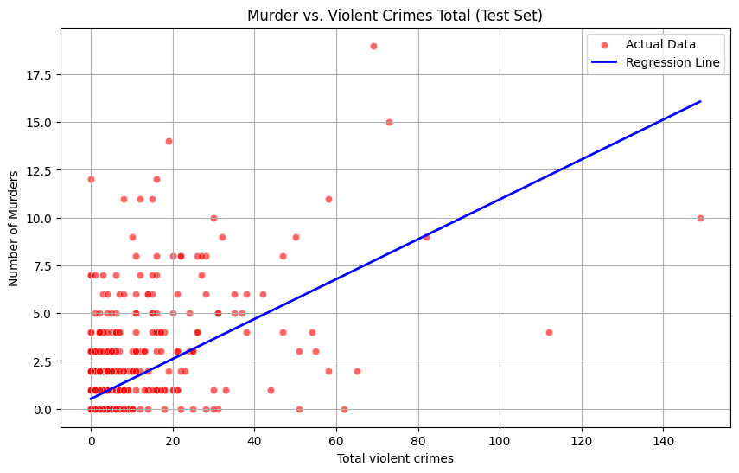
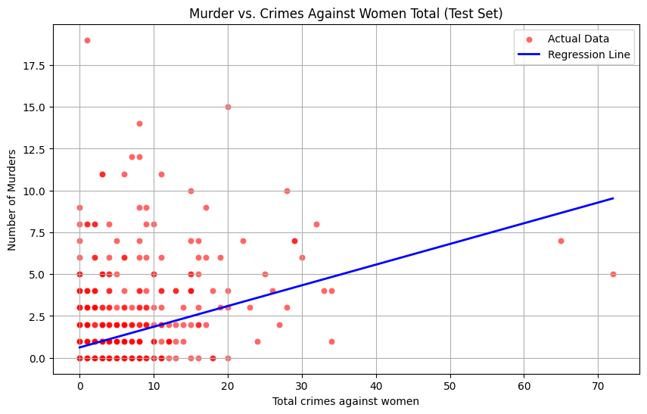
Regression Models & Results
Simple Linear Regression (SLR):
  Analyzed 'Murder' vs. the 4 main crime categories.
  Best R-squared (Violent Crimes): 0.3307
  Analyzed 'Murder' vs. the Top 10 individual crime columns.
  Top Predictor (ofnc_affect_humn_body): R-squared = 0.4016
Multiple Linear Regression (MLR):
  Used Backward Elimination (p < 0.05) on all 116 crime columns.
  Final model used 68 significant predictors.
  Result: Adjusted R-squared = 0.760 (A strong predictive model).
XGBoost Regressor:
  Used the 4 main categories as features.
  Result: R-squared = 0.3577 (Slightly better than SLR with the same features).

Slide 5
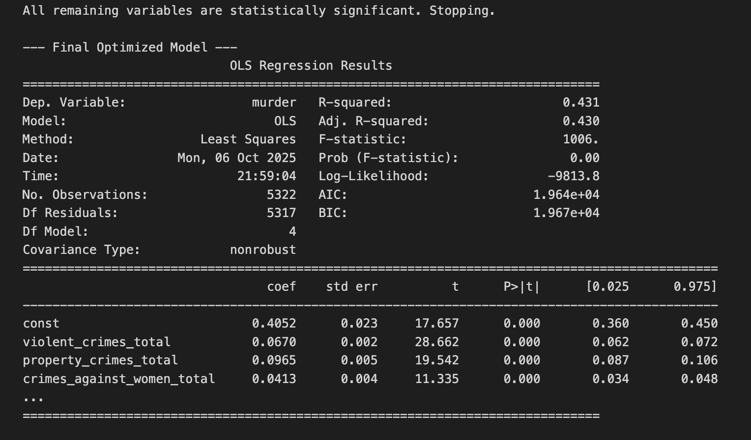
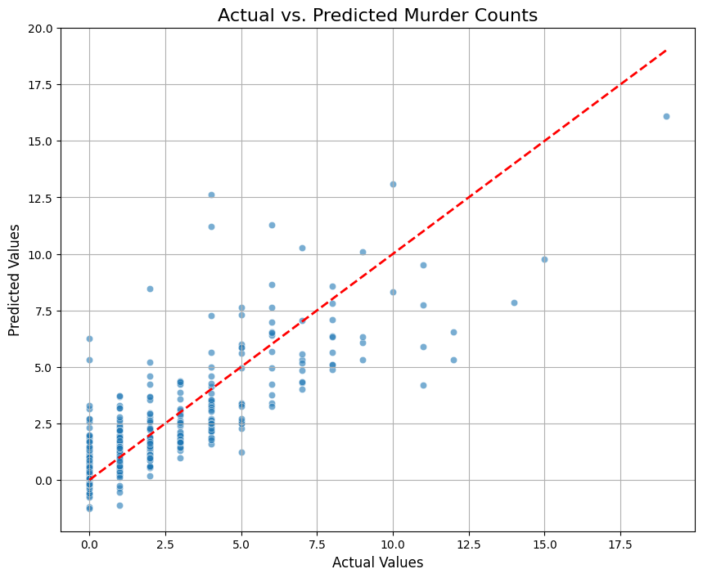
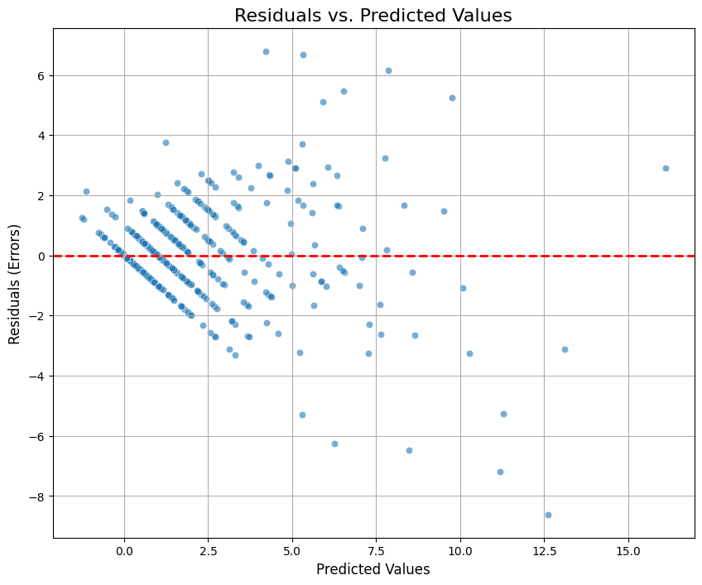
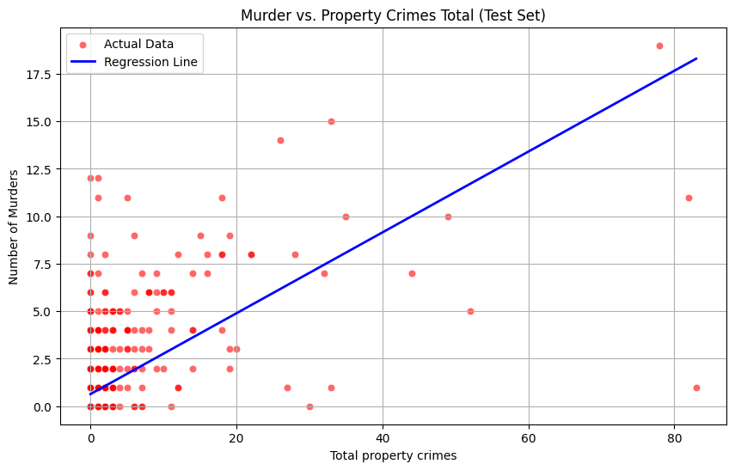

Slide 6
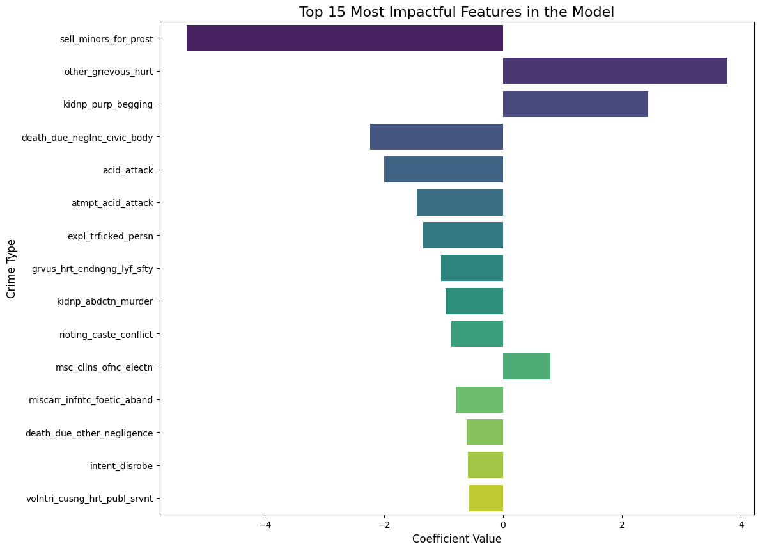

Slide 7
Section 2: Clustering (Grouping Districts by Crime Profile)
Clustering Overview
Goal: To find natural, unsupervised groupings (clusters) of districts based on their crime profiles (using the 4 main categories).
Models Used:
  K-Means Clustering
  DBSCAN
  Hierarchical Clustering
  Gaussian Mixture Model (GMM)

Slide 8
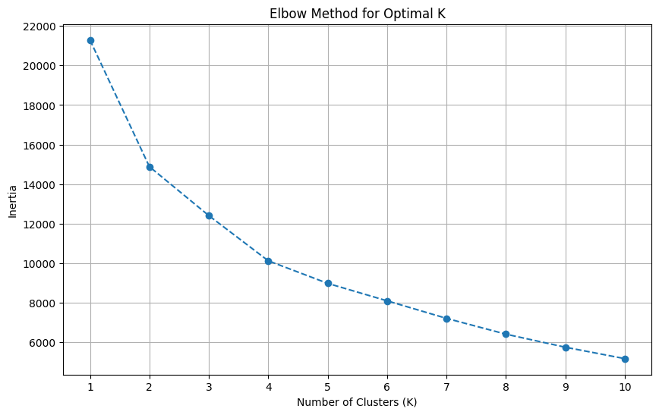
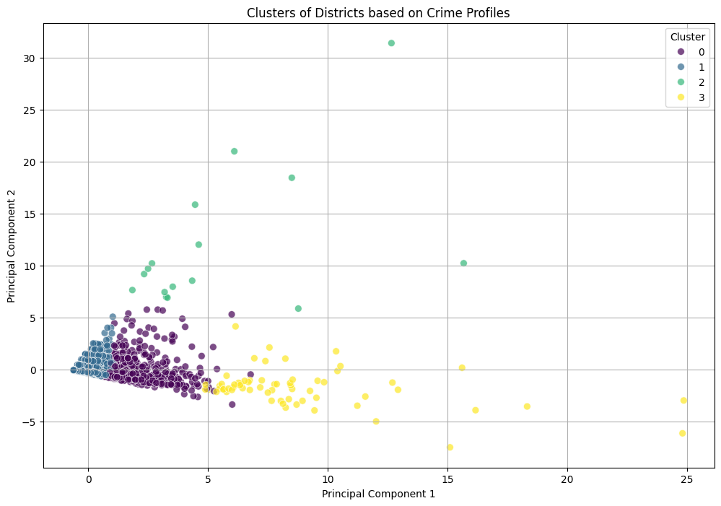
Clustering Results
K-Means Clustering:
  The Elbow Method suggested an optimal k=4 clusters.
  PCA visualization showed these 4 distinct groups.
  Profile: Clusters were identified, e.g., 'High All-Crime', 'Low All-Crime', and mixed profiles.
DBSCAN:
  Identified 13 smaller clusters and 401 noise points (outliers).
  This is useful for finding districts with unique crime patterns that don't fit the main groups.
GMM & Hierarchical:
  GMM also identified 4 primary clusters, similar to K-Means.
  A dendrogram was created to visualize the hierarchical merging of groups.

Slide 9
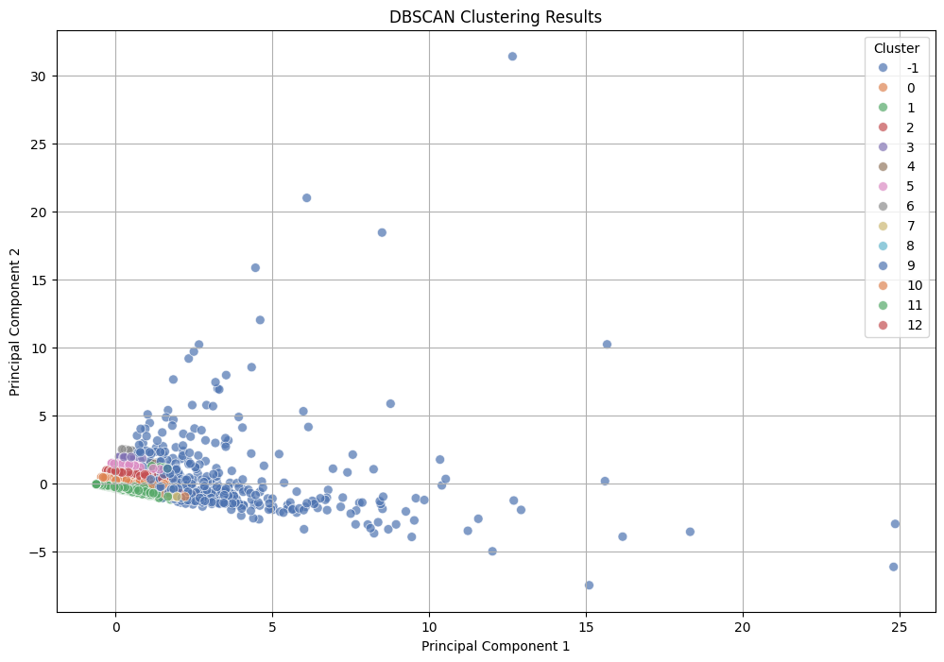
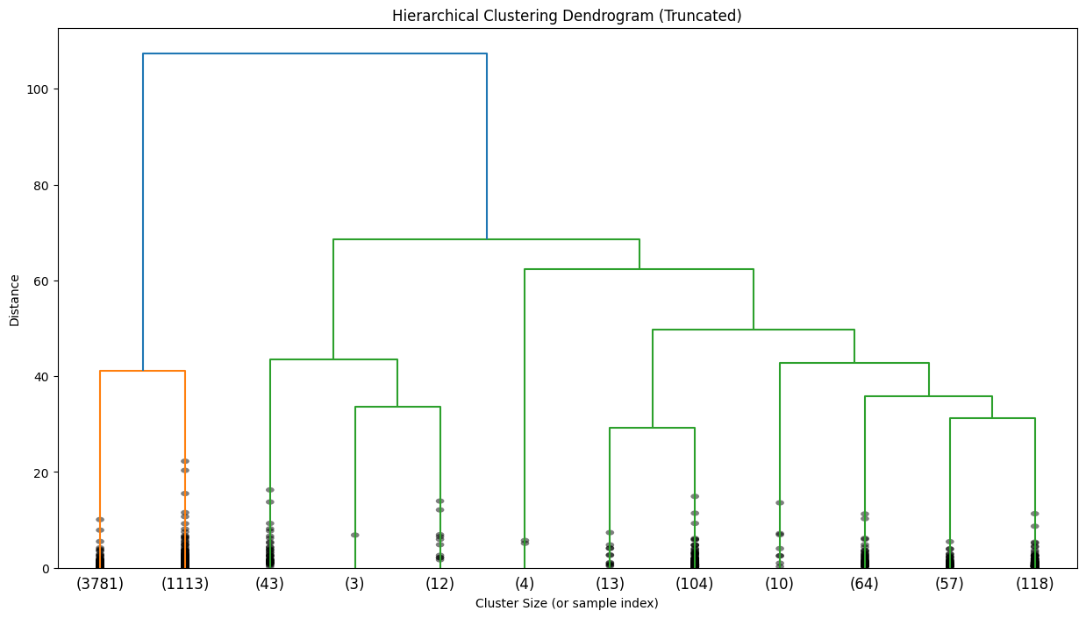
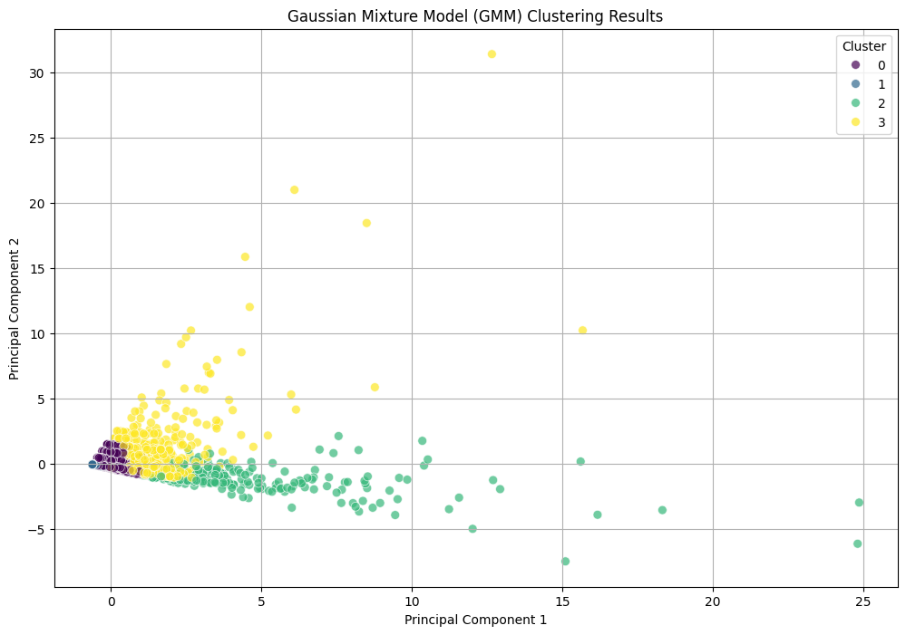

Slide 10
Visualization Techniques (PCA & t-SNE)
Purpose: Used to reduce the 4 feature dimensions (or 116 for the full dataset) down to 2 dimensions for plotting.
Techniques Used:
  Principal Component Analysis (PCA): Used to visualize all clustering models.
  t-SNE: Also used to visualize the relationships between districts.

Slide 11
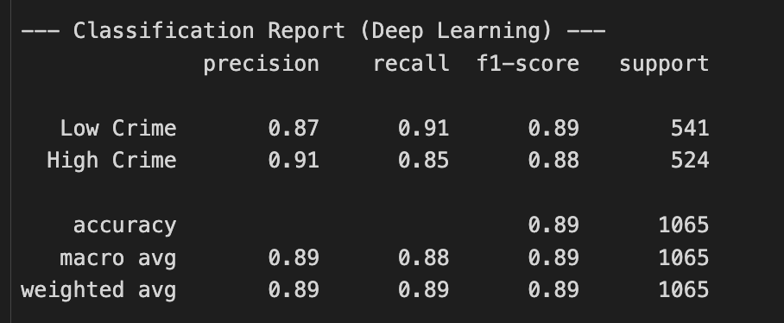
Section 3: Classification (Predicting High/Low Crime Level)
Classification Overview
Goal: To predict a binary category: Is a district 'High Crime' or 'Low Crime'?
Target Variable (crime_level):
  0 (Low): Total crimes ≤ 12 (the median)
  1 (High): Total crimes > 12 (the median)
Features: The 4 main crime categories.
Models Used:
  Logistic Regression
  Random Forest Classifier
  Support Vector Machine (SVM)
  K-Nearest Neighbors (KNN)

Slide 12
Classification Model Performance
All traditional models performed very well, showing that the 4 categories are strong predictors of the overall crime level.
Random Forest: 88.64% Accuracy
SVM (RBF Kernel): 88.17% Accuracy
Logistic Regression: 88.08% Accuracy
K-Nearest Neighbors (k=5): 87.79% Accuracy

Slide 13
Section 4: Deep Learning (Neural Networks)
Deep Learning Overview
Purpose: To apply advanced Sequential Neural Networks (using Keras/TensorFlow) to both the classification and regression tasks.
Deep Learning - Classification
Task: Predict 'crime_level' (High/Low) using the 4 main features.
Model: 3-Layer Sequential Network (64 nodes, 32 nodes, 1 output node) with 'ReLU' and 'Sigmoid' activations.
Loss: 'binary_crossentropy'
Result (Test Data): 90.14% Accuracy
Conclusion: The deep learning model slightly outperformed all other classification models.

Slide 14
Deep Learning - Regression
Task: Predict 'murder' (numeric) using the 4 main features.
Model: 3-Layer Sequential Network (64 nodes, 32 nodes, 1 output node) with 'ReLU' and 'Linear' activations.
Loss: 'mean_squared_error'
Result (Test Data): R-squared: 0.3541
Conclusion: This performed similarly to SLR/XGBoost on the same 4 features, but was not as strong as the 68-feature MLR model.

Slide 15
Summary & Conclusion
Regression: Predicting 'Murder' is complex. Simple models on 4 features have low R² (~0.35), but a comprehensive MLR model with 68 features is highly effective (Adj. R² = 0.760).
Clustering: Districts can be clearly grouped into 4 distinct profiles (K-Means/GMM) or analyzed for outliers (DBSCAN).
Classification: Predicting a simple 'High' or 'Low' crime level is very accurate (~88-90%) using just the 4 main categories.
Deep Learning: Provided the best accuracy for the classification task (90.14%).

