Slide 1


CAPSTONE PROJECT
Amazon Product Performance and Customer Sentiment Analysis using Power BI
Presented By
Student Name: PADMAPRIYA V
College Name: EASWARI ENGINEERING COLLEGE
Department: INFORMATION TECHNOLOGY
Email ID:
padmapriyav006@gmail.com

Slide 2
OUTLINE:
Problem Statement (Should not include solution)
Proposed System/Solution
System Development Approach (Technology Used)
Algorithm & Deployment
Result (Output Image)
Conclusion
Future Scope
References

Slide 3
Problem Statement:
E-commerce platforms such as Amazon contain a vast number of products with different prices, ratings, and customer reviews. Analyzing such large datasets manually is difficult and time-consuming.
Businesses and analysts need a clear understanding of product performance, customer feedback, and pricing trends in order to make informed decisions. However, without proper data visualization tools, identifying popular brands, highly rated products, and customer sentiment becomes challenging.
Therefore, there is a need for an interactive dashboard that can effectively analyze Amazon product data and present insights in a simple and meaningful way.

Slide 4
Proposed Solution:
The proposed solution is to develop an interactive Power BI dashboard that analyzes Amazon product data and provides meaningful insights about product performance and customer sentiment.
The system uses a cleaned dataset containing product information such as product name, brand, rating, number of ratings, actual price, discount price, and review sentiment.
The dashboard will display:
Key Performance Indicators such as total products, average ratings, and total reviews
Brand performance and product popularity
Comparison of actual price and discount price
Customer sentiment distribution based on reviews
Most reviewed brands and products
This visualization helps users easily understand product trends and customer feedback.

Slide 5
System Approach:
System Requirements
Power BI Desktop
Amazon Product Dataset (CSV format)
Computer system with basic data analysis tools
Tools & Technologies Used
Microsoft Power BI
Data Cleaning and Transformation
CSV Dataset Processing
Development Steps
Collect Amazon product dataset
Clean and preprocess the data
Import dataset into Power BI
Create KPIs and measures
Design interactive dashboard visuals
Generate insights using data visualization

Slide 6
Algorithm & Deployment:
Analytical Process
The system follows a structured data analysis workflow using Power BI to extract insights from the Amazon product dataset.
Step 1 – Data Import: The dataset in CSV format is imported into Power BI for analysis.
Step 2 – Data Cleaning: Missing values and inconsistencies are identified and corrected to ensure data accuracy and reliability.
Step 3 – Data Transformation: Important fields such as product ratings, number of reviews, actual price, and discount price are formatted and prepared for analysis.
Step 4 – Data Visualization: Interactive charts and KPI cards are created to represent key metrics such as total products, average rating, total reviews, brand performance, price comparison, and sentiment distribution.
Deployment: The final dashboard is developed using Power BI Desktop and can be shared as reports or interactive dashboards for analysis and presentation.

Slide 7
Result:
The Power BI dashboard successfully provides insights about Amazon product performance and customer feedback.
The dashboard includes:
KPI cards showing total number of products, average ratings, and total reviews
Brand performance visualization showing top brands by product count
Comparison between actual price and discounted price
Sentiment distribution showing positive and negative reviews
Most reviewed brands indicating customer engagement
These visualizations help understand product popularity and customer satisfaction more effectively.

Slide 8
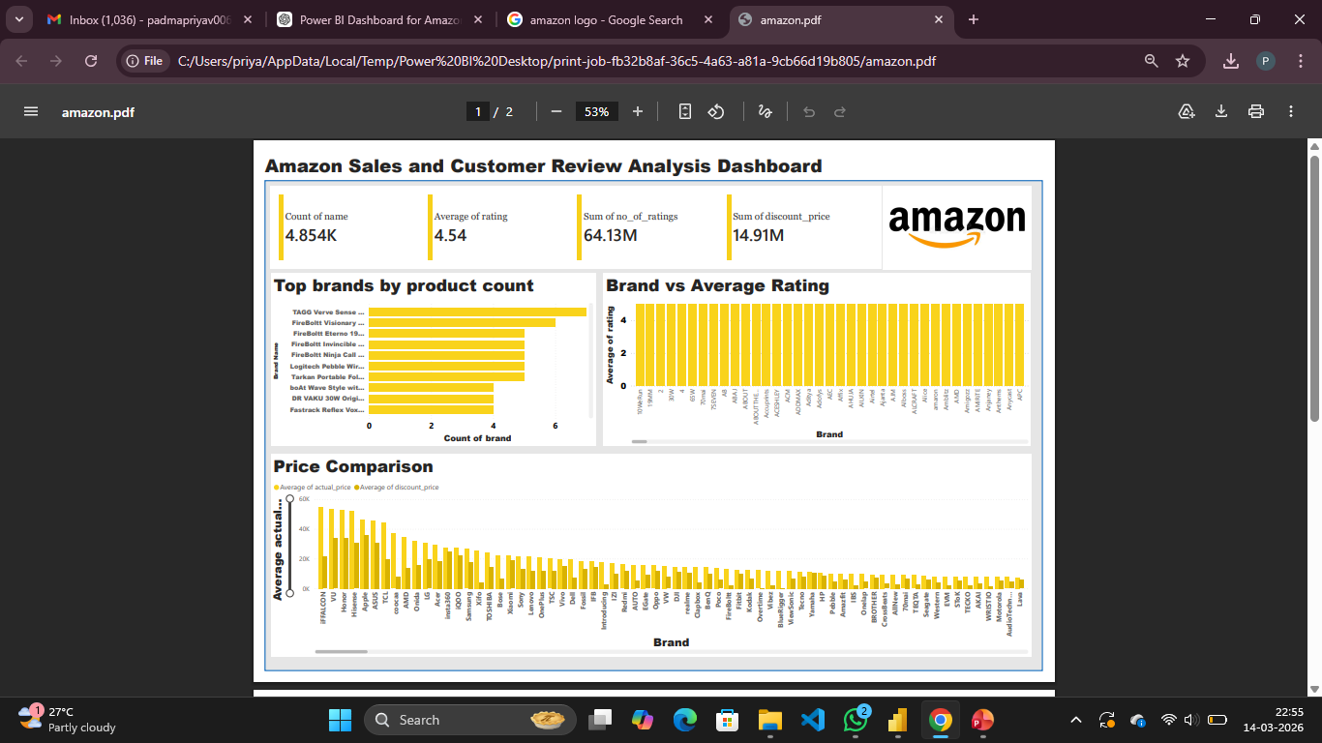

Slide 9
Conclusion:
This project demonstrates how Power BI can transform raw Amazon product data into meaningful business insights.
The dashboard helps analyze product performance, brand popularity, customer engagement, and pricing trends through interactive visualizations.
By using data analytics and visualization techniques, the system enables users to quickly understand large datasets and make informed decisions.

Slide 10
Future scope:
The project can be further improved by:
Integrating real-time Amazon marketplace data
Applying machine learning techniques for sales prediction
Adding product category-based analysis
Performing advanced sentiment analysis using Natural Language Processing (NLP)
Deploying the dashboard on Power BI cloud for real-time reporting

Slide 11
References:
Kaggle Amazon Product Dataset
Microsoft Power BI Documentation
Data Visualization and Business Intelligence Resources
Git hub link:
https://github.com/Padmapriya1206/Amazon-PowerBI-Project

Slide 12
Thank You

