Slide 1


VISVESVARAYA TECHNOLOGICAL UNIVERSITY BELAGAVI
Project Phase-2 Presentation on
FAKE NEWS DETECTION USING NLP AND MACHINE LEARNING
Presented by
Druva S N 4BB19CS009
Harshitha D S 4BB19CS012
Padmashree B H 4BB19CS016
Under the guidance of
Smt .Teerthalakshmi A M.B.E.,M.TECH
Asst.prof. & Guide,IS&E.
DEPARTMENT OF COMPUTER SCIENCE AND ENGINEERING
BAHUBALI COLLEGE OF ENGINEERING
Shravanabelagola-573 135
2022-2023

Slide 2
CONTENTS
AIM
SCOPE
OBJECTIVE
LITERATURE SURVEY
DRAWBACKS OF EXISTING SYSTEM
ADVANTAGES OF PROPOSED SYSTEM
REQUIREMENT SPECIFICATION
DESIGN
IMPLEMENTATION
TESTING
SNAPSHOTS
CONCLUSION
REFERENCE
FUTURE WORK

Slide 3
1
AIM :
Aim of the project is to develop a FAKE NEWS DETECTION system using natural language processing and its accuracy will be tested using machine learning algorithms.

Slide 4
SCOPE:
2
In order to detect fake news and prevent its viral spread have recently been actively discussed using leverage artificial intelligence technologies particularly machine/deep learning techniques and natural language processing (NLP).
Large technology companies have begun to take steps to address this trend.

Slide 5
OBJECTIVES:
To develop a model that classifies given news article as either fake or true.
To develop a method for detecting and classifying the news stories using Natural Language Processing.
To gather the data, pre-processed the text, and translated the articles into supervised model features.
3

Slide 6
LITERATURE SURVEY
4
LITERATURE SURVEY PAPERS:
1. Title: Fake News detection using Naive Bayes, SVM, Neural Network and LSTM :
Author Name: Poonam Tijare
Year: 2020.
The surge in fake news was noticed during the 2016 presidential elections that happened
in the US that determined the fate of these elections.
This paper explores the application of Natural Language Processing and Machine Learning techniques.
Naive Bayes, Support Vector Machine (SVM), neural network and long short-term memory (LSTM) to find the best fit for the model.

Slide 7
5
2. Title: Fake News detection using NLP:
Author Name: Lakshmi Panneerselvam
Year: 2022
There are several social media platforms in the current modern era, like Facebook, Twitter, Reddit, and so forth where millions of users would rely upon for knowing day-to-day happenings.
Fake news is a piece of incorporated or falsified information often aimed at misleading people to a wrong path or damage a person or an entity‘s reputation.
In this paper they used PAC and Naïve Bayes algorithms.

Slide 8
6
3. Title: Fake News Detection Using N-Gram Analysis and Machine Learning Algorithms:
Author Name: Asha J. and Meenakowshalya A.
Year: 2022.
The main challenge in fake news detection is limited availability of resources (datasets).
In this paper, a detection model for fake news was using n-gram analysis through different features extraction techniques and machine learning algorithms.
The proposed methodology gives highest accuracy when using unigram features (N=1) and SGD classifier (Machine learning).

Slide 9
7
4. Title: A Taxonomy of Fake News Classification Techniques:
Author Name: Dhiren Rohera, Harshal Shetna and Keyur Patel
Year: 2022.
In this paper we select Machine Learning (ML) models such as Long-Short Term Memory (LSTM), Passive Aggressive Algorithm, Random Forest (RF), and Naive Bayes (NB).
We implemented these models by hyper tuning various parameters such as smoothing, drop out factor, and batch size, which has shown promising results in accuracy and other evaluation metrics such as F1-score, recall, precision, and Area under the ROC Curve (AUC) score.
The model is trained on 6335 news articles, with LSTM showing the highest accuracy of 92.34% in predicting fake news and NB were showing the highest recall. Based on these results, we propose a hybrid fake news detection technique using NB and LSTM.

Slide 10
8
5. Title: A Multi-modal Framework for Fake News Detection Systems:
Author Name: Shivangi Singhal and Rajiv Ratn Shah
Year: 2018.
Images, text, audio, and videos.
The performance of fake news detection degrade by 10% on an average. To solve this issue, We introduce Spot Fake- a multi-modal framework for fake news detection.
It exploits both the textual and visual features of an article. Specifically, we made use of language models to learn text features, and image features are learned from VGG19 pre-trained on Image Net dataset.
The proposed model performs better than the current state-of-the-art on Twitter and Weibo datasets by 3.27% and 6.83%, respectively.

Slide 11
9
6. Title: Fake News Detection in Different Applications State of the Art and Future Direction:
Author Name: Amen Jolly and Shailender Kumar
Year: 2022.
This paper reviews conventional artificial news detection methods to solve the mentioned issue. The Systematic Literature Review, often known as SLR, is a procedure that assesses review papers connected to detecting fake news.
A technique known as unsupervised learning was used for this article review, along with ensemble learning, semi-supervised learning, reinforcement learning, and supervised learning.
In conclusion, the deep learning model generates practical outputs and outperforms classical machine learning models.

Slide 12
10
7. Title: Fake News Detection using Machine Learning:
Author Name: Akash Dixit and Ishaan Kalbhor.
Year: 2022.
Because of the spread of phony news, there is a need for computational strategies to identify them. Thus, to forestall the mischief that should possibly use innovation, we have executed Machine Learning calculations and strategies like NLTK, and LSTM.
Should present the datasets which contain both phony and genuine news and direct different analyses to coordinate phony news finder. We came by improved results contrasted with the existing frameworks. Keywords: Embedding, LSTM, NLTK.
The model referenced in this paper is extremely successful and accuracy is 92%.

Slide 13
11
8. Title: A Smart System for Fake News Detection using Machine Learning.
Author Name: Anjali Jain, Harsh Khatter and Avinash Shakya
Year: 2019
The proposed system helps to find the authenticity of the news. If the news is not real, then the user is suggested with the relevant news article. It is significant to find the accuracy of news which is available on internet.
Naïve Bayes classifier, SVM, and NLP are used. In future, ensuing algorithm may provide better results with hybrid approaches for the same purpose fulfillment.
The mentioned system detects the fake news on the based on the models applied. Also, it provides the efficiency and accuracy of the prototype can be enhanced to a certain level, and also enhance the user interface of the proposed model.

Slide 14
12
9. Title: Automatic deception detection Methods for finding fake news:
Author Name: Niall conroy, Victoria L Rubin and Yiimin chen
Year: 2015
This research surveys the current state-of-the-art technologies that are instrumental in the adoption and development of fake news detection. "Fake news detection" is defined as the task of categorizing news along a continuum of veracity, with an associated measure of certainty.
The paper provides a typology of several varieties of veracity assessment methods emerging from two major categories -- linguistic cue approaches (with machine learning), and network analysis approaches.
Designing a fake news detector is not a straightforward problem, we propose operational guidelines for a feasible fake news detecting system.

Slide 15
13
10. Title: Fake News Detection using Naive Bayes Classifier:
Author Name: Rahul Srivastava and Dr. Pawan Singh
Year: 2022
The use of Natural Language Processing and Machine Learning techniques to properly identify fake news is the subject of this research. The data is cleaned, and feature extraction is performed using pre-processing techniques.
The research examines and contrasts the accuracy of Naive Bayes, Support Vector Machine (SVM), neural net-work, and long short-term memory (LSTM) methodologies in order to determine which is the most accurate.
Finally, in order to determine the best fit for the model, the re-search explores and analyzes the accuracy of Naive Bayes, Support Vector Machine (SVM), neural network, and long short-term memory (LSTM) approaches. The proposed model is working well with an accuracy of products up to 93.6%.

Slide 16
14
DRAWBACKS OF EXISTING SYSTEM:
In machine learning existing system there is no computerizes system to identified the fake news detection system.
Our system does not guarantee 100% accuracy.
The system is unable to test data that is unrelated to training data.

Slide 17
15
ADVANTAGES OF PROPOSED SYSTEM:
Fake news Detection is Secure and Efficient system.
It has a High Accuracy Rate.
The data, pre-processed the text, and translated the articles into supervised model features.
Detecting and classifying the news stories.

Slide 18
16
REQUIREMENT SPECIFICATION
Requirements are the key for the successful completion of the project. The requirement can be said as the heart of the software cycle.
INPUT REQUIREMENTS:
The System Uses a Data Set of news articles which are in CSV format.
OUTPUT REQUIREMENTS:
0 or 1 based on real or fake respectively.

Slide 19
17
HARDWARE REQUIREMENTS:
Processor : i3 processor.
Hard Disk : 500 GB (min).
RAM : 4GB (Min).
SOFTWARE REQUIREMENTS:
Operating System : Windows 7 and above Linux based OS or MAC OS.
Coding Language : Python 3.5.
IDE : PyCharm

Slide 20
18
FUNCTIONAL REQUIREMENTS:
The functions of software systems are defined in functional requirements and the behavior of the system is evaluated when presented with specific inputs.
Our system should be able to read the data and preprocess data.
It should be able to analyze the fake data.
It should be able to group data based on hidden patterns.
It should be able to assign a label based on its data groups.

Slide 21
19
NON FUNCTIONAL REQUIREMENTS:
Nonfunctional requirements illustrate how a system must behave and create constraints of its functionality. Some Non-Functional Requirements are as follows:
Reliability : Our Project is thrust worthy and it’s a real project.
Maintainability : The maintenance of the project is easy.
Scalability : Adding, Removing, Altering and Modifying the data can be done.

Slide 22
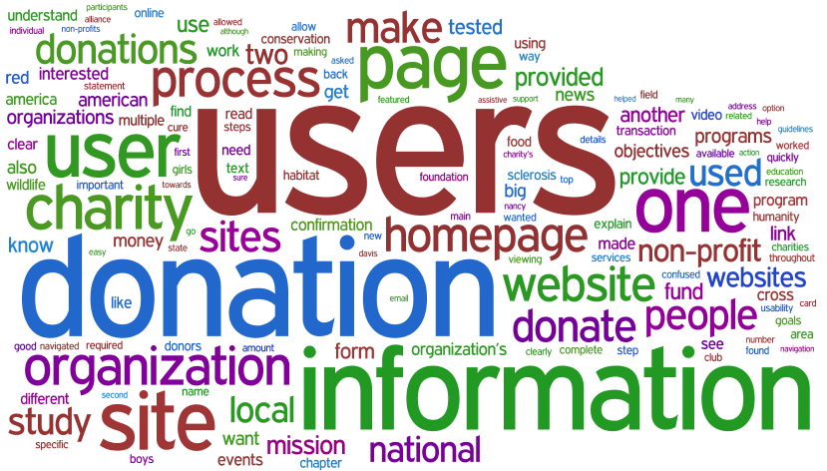
DESIGN:
The proposed system contains a WordCloud model for generating word clouds from text data.
For fake news detection, we have to train the system using dataset. Before entering to the detection of fake news, entire dataset is divide into two datasets. 80% is used for training and 20% is used for testing.
20

Slide 23
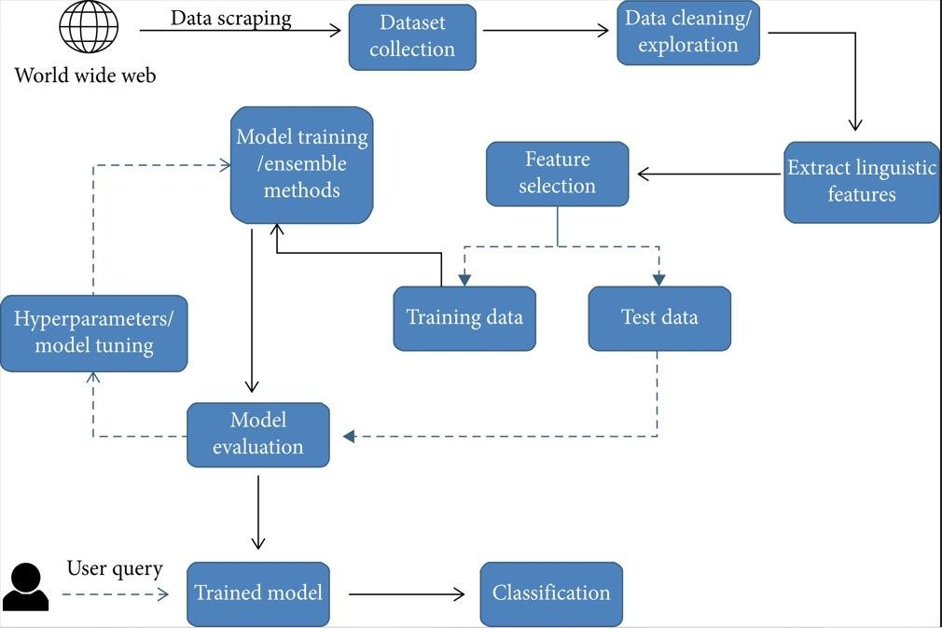
SYSTEM ARCHITECTURE
21
Figure 8.1: Architecture for training algorithms and classification of news articles.

Slide 24
22
ALGORITHM FOR THE PROPOSED SYSTEM:
Step 1: Start
Step 2: Input is collected from various sources and prepare a dataset.
Step 3: Pre-processing of data is done and dataset is divided into 2 parts training and testing data.
Step 4: Count vectorization technique is used to convert the train data into numericals.
Step 5: Logistic Regression algorithm is used to build the predictive model using the train data.
Step 6: Confusion matrix is obtained.
Step 7: Accuracy, Precision, Recall, F1 score is calculated.

Slide 25
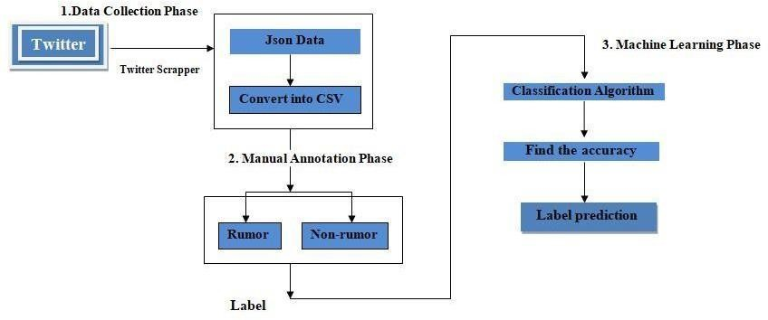
23
WORK FLOW
Figure 8.2: Work flow of system.

Slide 26
24
IMPLIMENTATION
Programming Language: Python 3.8
Machine Learning Framework: PyCharm.
As a programmer, we can perform the following using PyCharm.
Write and execute code in Python.
Import external datasets e.g., from Kaggle.

Slide 27
BUILT-IN FUNCTIONS
25
Matplotlib: This library is responsible for plotting numerical data. And that’s why it is used in data analysis.
Numpy: The name “Numpy” stands for “Numerical Python”.
NLTK: Stands for Natural Language Toolkit.

Slide 28
26
Pandas: Pandas is mainly used for data analysis and associated manipulation of tabular data in Data frames.
read_csv (): read_csv is an important pandas function to read csv files and do operations on it.
Scikit-learn: Scikit-learn includes a wide range of algorithms.
Pickle: The pickle module allows you to save Python objects to a file and load them later.

Slide 29
27
Seaborn: Seaborn is a Python data visualization library based on matplotlib that provides a high-level interface for creating informative and attractive statistical graphics.
Tqdm: Tqdm is a Python library that provides a progress bar for iterators.
WordCloud: WordCloud is a Python library for generating word clouds from text data.

Slide 30
MACHINE LEARNING
Machine Learning (ML) is a sub-category of artificial intelligence that refers to the process by which computers develop pattern recognition.
PREPROCESSING:
Data Preprocessing is that step in which the data gets transformed, or Encoded, to bring it to such a state that now the machine can easily parse.
28

Slide 31
STEPS IN TEXT PRE-PROCESSING:
STEMMING:
The main purpose of stemming is to reduce different grammatical forms / word forms of a word like its noun, adjective, verb, adverb etc. to its root form.
STOP WORD REMOVAL:
A Stop Word is a commonly used word in any natural language such as “a, an , the, for, is, was, which, are, were, from, do, with, and, so, very, that, this, no, yourselves etc.”
29

Slide 32
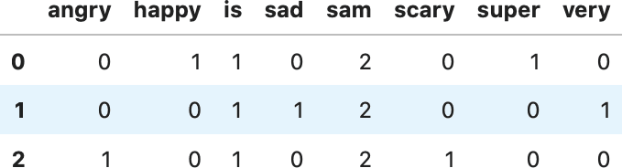
30
TEXT NORMALIZATION:
Text normalization is a process of transforming text into a single form.
COUNT VECTORIZER :
Count Vectorizer tokenizes (tokenization means breaking down a sentence or paragraph or any text into words) the text along with performing very basic preprocessing like removing the punctuation marks, converting all the words to lowercase, etc.
Example:
sam sam is super happy
sam sam is very sad
sam sam is scary angry

Slide 33

31
LOGISTIC REGRESSION ALGORITHM:
Logistic regression is a statistical method used to analyze the relationship between a dependent variable and one or more independent variables.
LOGISTIC REGRESSION EQUATION:

Slide 34
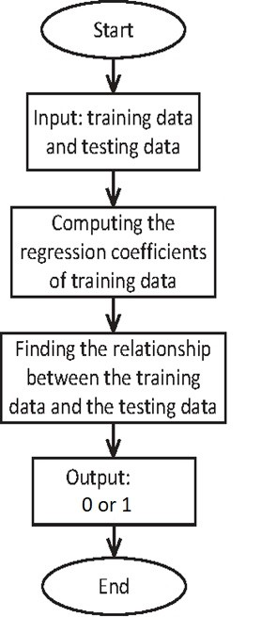
32
LOGISTIC REGRESSION FLOW CHART:
Fig 9.1: Logistic Regression Flowchart

Slide 35
33
EVALUATION MEASURES:
Whenever we build Machine Learning models, We need some form of metric to measure the goodness of the model. Bear in mind that the “goodness” of the model could have multiple interpretations.

Slide 36
34
DEFINING THE METRICS:
ACCURACY:
Whenever the accuracy metric is used, we aim to learn the closeness of a measured value to a known value.
PRECISION:
The precision metric would inform us of the number of labels that are actually labeled as positive in correspondence to the instances that the classifier labeled as positive.

Slide 37
35
RECALL:
Recall measures how well the model can recall the positive class (i.e. the number of positive labels that the model identified as positive).
F1 SCORE:
The F1 Score is Defined as the harmonic mean of precision and recall. The F1 Score is machine learning metric that can be used in classification models.

Slide 38
CODING
36
Importing The Libraries:
import pandas as pd
import seaborn as sns
import matplotlib. pyplot as plt
from tqdm import tqdm
import re
import nltk
from wordcloud import WordCloud
import pickle

Slide 39
37
Preprocessing:
def preprocess_text(text_data):
preprocessed_text = []
for sentence in tqdm(text_data):
sentence = re.sub(r'[^\w\s]', '', sentence)
preprocessed_text.append(' '.join(token.lower()
for token in str(sentence).split()
if token not in stopwords.words('english')))
return preprocessed_text

Slide 40
38
Training and Testing of data:
from sklearn.model_selection import train_test_split
from sklearn.metrics import accuracy_score
from sklearn.linear_model import LogisticRegression
x_train, x_test, y_train, y_test = train_test_split(data['text'],
data['class'],
test_size=0.25)
Applying Count Vectorizer :
from sklearn.feature_extraction.text import TfidfVectorizer
vectorization = TfidfVectorizer()
x_train = vectorization.fit_transform(x_train)
x_test = vectorization.transform(x_test)

Slide 41
Predicting Accuracy:
39
from sklearn.linear_model import LogisticRegression
model = LogisticRegression()
model.fit(x_train, y_train)
import pickle
with open('fake_news_new.pkl', 'wb') as f:
pickle.dump(model, f)
print(accuracy_score(y_train, model.predict(x_train)))
print(accuracy_score(y_test, model.predict(x_test)))
Obtaining Confusion Matrix:
from sklearn import metrics
cm = metrics.confusion_matrix(y_test, model.predict(x_test))
cm_display = metrics.ConfusionMatrixDisplay(confusion_matrix=cm,
display_labels=[False, True])
cm_display.plot()
plt.show()

Slide 42
TESTING
40
The reason for testing is to seek out blunders. Testing is that the manner toward endeavoring to seek out every disadvantage in a very work item.
TYPES OF TESTS
UNIT TESTING
INTEGRATION TESTING
VALIDATION TESTING
SYSTEM TESTING

Slide 43
41
UNIT TESTING :
Unit testing includes the structure of experiments that approve that the inward program principle is functioning, which program inputs turn out substantial yields. All alternative branches and within code stream need to be approved.
INTEGRATION TESTING:
Joining tests are intended to test incorporated programming segments to decide whether they really keep running as one program. Testing is occasion driven and is progressively worried about the fundamental result of screens or fields.

Slide 44
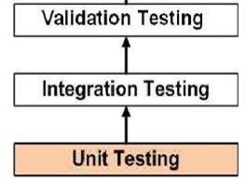
42
VALIDATION TESTING:
A building approval test (EVT) is performed on first building models, to guarantee that the essential unit performs to plan objectives and particulars.
Fig 10.1: The Testing process.

Slide 45
43
SYSTEM TESTING:
Framework testing is performed on the whole framework with regards to a Functional Requirement Specifications as well as a System Requirement Specification. Framework testing tests the structure, yet in addition the conduct and even the trusted desires for the client. It is likewise planned to test up to and past the limits characterized in the product necessities specifications.

Slide 46
44
SCENARIO OF TEST CASES
Test case ID | 1
Test case Name | Fake News Identification
Test case Description | User can identify the news is Fake or Real
Expected Result | When the user clicks on detect button it displays Fake news and its accuracy
Actual Result | As Expected
Test case ID | 2
Test case Name | Real News Identification
Test case Description | User can identify the news is Fake or Real
Expected Result | When the user clicks on detect button it displays Fake news and its accuracy
Actual Result | As Expected

Slide 47
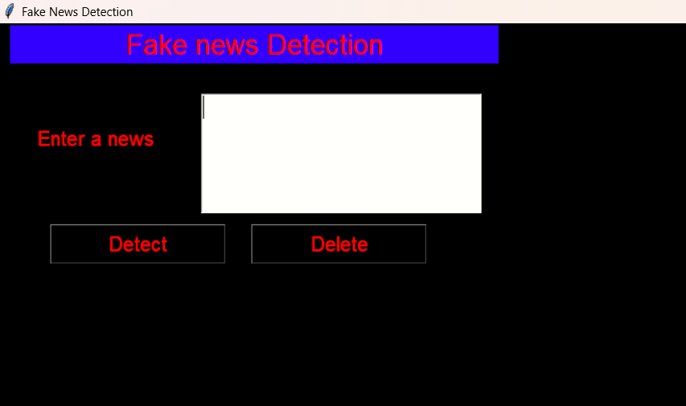
45
SNAP SHOTS
Fig 11.1: Giving Input

Slide 48
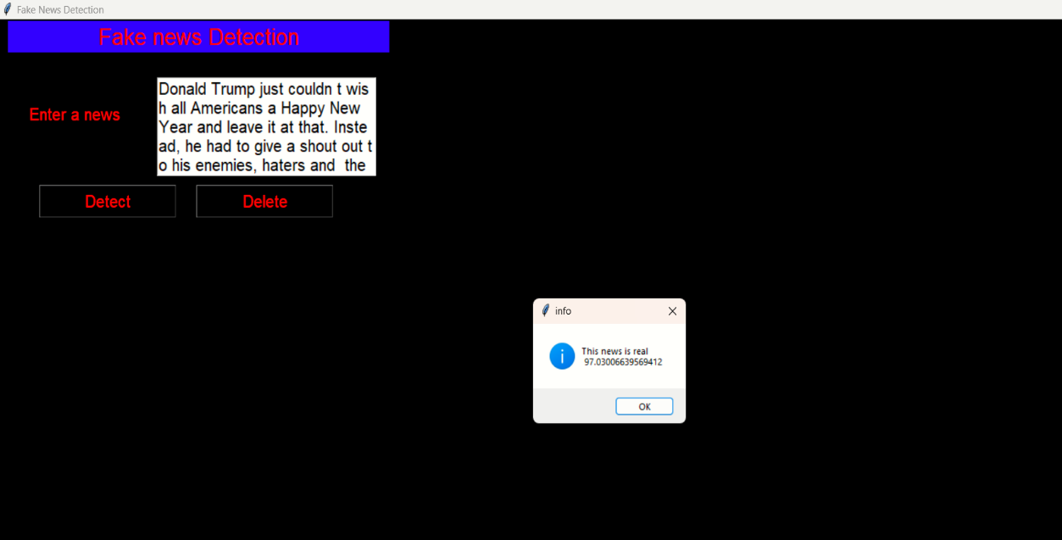
46
Fig 11.2: Output Detection (Real)

Slide 49
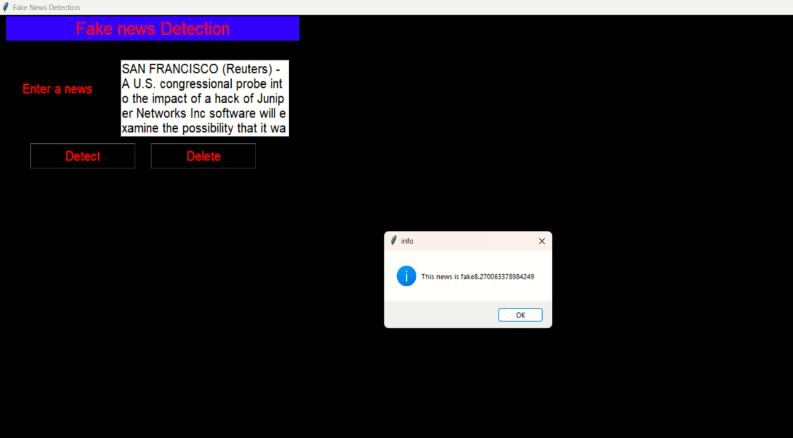
47
Fig 11.3: Output Detection (Fake)

Slide 50
48
CONCLUSION
Social media has conjointly been accustomed unfold pretend news, that has negative impacts on individual users and broader society.
We have a tendency to introduced the essential ideas and principles of faux news in each ancient media and social media.
We have tendency to conjointly more mentioned the datasets, analysis metrics in pretend news detection analysis.

Slide 51
49
FUTURE SCOPE
We want to use web scraping and get the data from various social media and websites by our self and use them in our system.
We also want to improve the accuracy by query optimization.

Slide 52
REFERENCES:
50
[1] Poonam Tijrer Fake news detection using Naïve byes, SVM, Neural Network and LSTM.
[2] Kajal Kumari — Published On July 19, 2021 and Last Modified On September 6th, 2022.
[3] Shloka Gilda, ―Evaluating Machine Learning Algorithms for Fake News Detection 2017 IEEE 15th Student Conference on Research and Development (SCOReD).
[4] Zhang, C., et al., Detecting fake news for reducing misinformation risks using analytics approaches. European Journal of Operational Research, 2019.
[5] Bondielli, A. and F. Marcelloni, A survey on fake news and rumour detection techniques. Information Sciences, 2019.

Slide 53
THANK YOU

