Slide 1

Internship Examination
RNA‑Sequencing Based Transcriptome Analysis of Neobractatin‑Treated HeLa Cells
Internship work submitted in partial fulfilment of the requirement for the degree of MASTER OF SCIENCE IN BIOINFORMATICS (SCHOOL OF LIFE SCIENCE)
Presented By
Padmavathi S
24L10925
II MSc Bioinformatics III Semester
School of Life Science, Mysuru
JSS Academy of Higher Education & Research
Mysuru-570015
Under the guidance of
Dr Mohan T C
Associate Professor
Department of Biotechnology and Bioinformatics
School of Life Science, Mysuru
JSS Academy of Higher Education & Research
Mysuru-570015
January 2026

Slide 2
Introduction
RNA sequencing (RNA-Seq) is a next-generation sequencing technique used to study the complete transcriptome of a cell.
It enables accurate quantification of gene expression and identification of differentially expressed genes under different conditions.
Neobractatin (NBT) is a natural compound reported to exhibit anticancer and cytotoxic properties in various cancer models.
HeLa cells serve as a well-established in-vitro model system for studying molecular mechanisms in cervical cancer.
This study uses RNA-Seq analysis to investigate transcriptomic changes induced by Neobractatin treatment in HeLa cells.

Slide 3

Review of Literature
RNA-Seq has emerged as a powerful tool for transcriptome-wide analysis of gene expression and drug response in cancer studies.
Several studies have demonstrated the utility of RNA-Seq in identifying differentially expressed genes and dysregulated pathways following anticancer drug treatment.
Neobractatin (NBT), a natural xanthone derivative, has been reported to exhibit anticancer activities such as growth inhibition and induction of apoptosis.
Previous studies indicate that anticancer compounds often modulate pathways including p53 signaling, apoptosis, cell cycle regulation, and metabolic processes.
However, comprehensive transcriptome-level analysis of Neobractatin-treated HeLa cells remains limited, highlighting the need for RNA-Seq-based investigation.

Slide 4
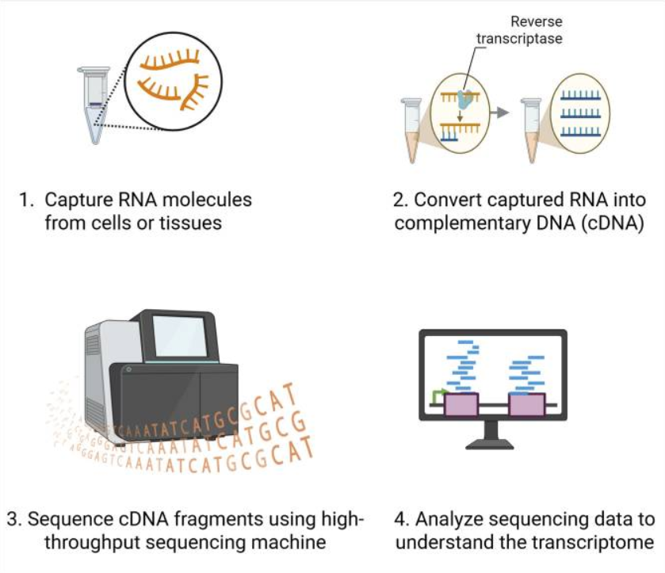
Methodology
1. Data Acquisition
RNA-Seq data of Neobractatin-treated and control HeLa cells obtained from public repositories.
Raw sequencing data downloaded in FASTQ format.
2. Quality Control (QC)
Quality assessment of raw reads performed using FastQC.
Evaluation of base quality scores, GC content, sequence duplication, and adapter contamination.

Slide 5
Methodology
3. Pre-processing
Low-quality bases and adapter sequences removed using trimming tools.
Post-trimming quality assessment performed to ensure data reliability.
4. Differential Gene Expression Analysis
Read count matrix generated and normalized.
Differential expression analysis performed using DESeq2.
Genes filtered based on log2 fold change and adjusted p-value.
5. Functional Enrichment Analysis
Gene Ontology (GO) and pathway enrichment analysis performed.
Biological interpretation of enriched pathways.

Slide 6
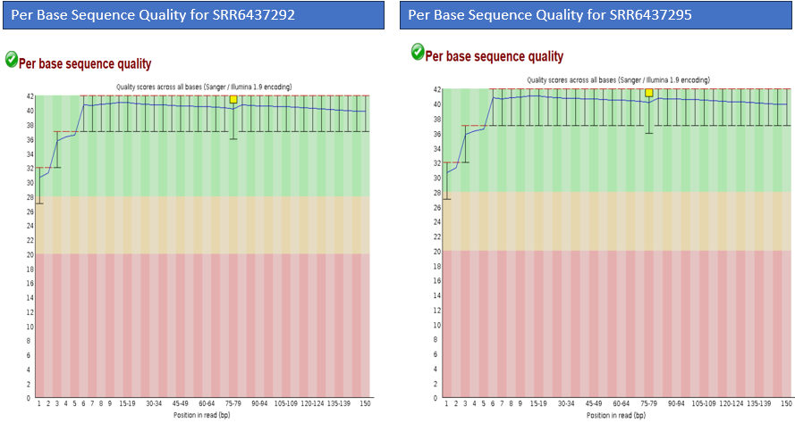
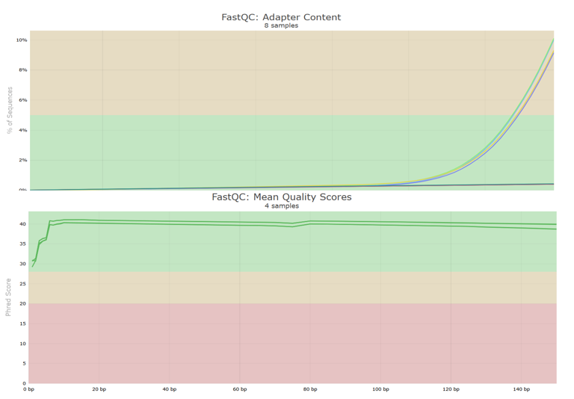
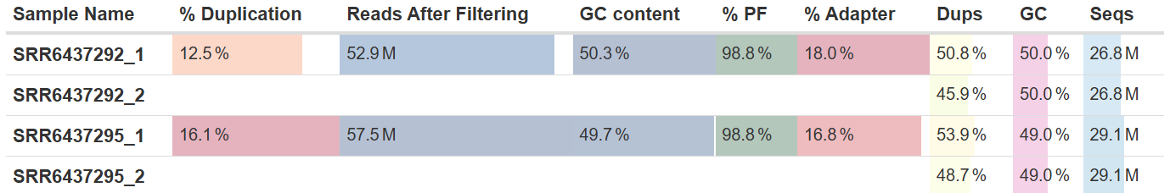
Results and Discussion
1. Quality Control Results
All samples showed high per-base quality scores (Phred > 30).
GC content was consistent across samples.
No major adapter contamination detected → Data suitable for downstream analysis.

Slide 7
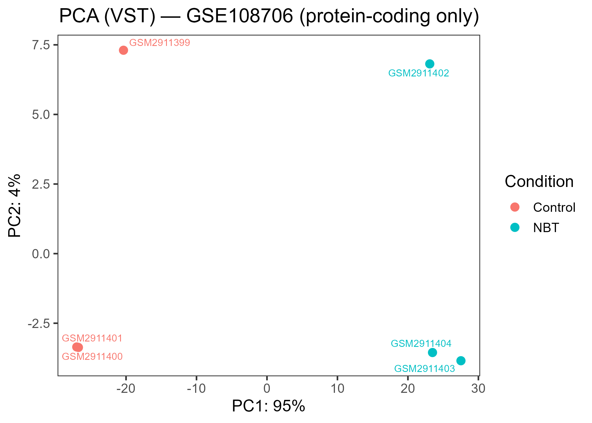
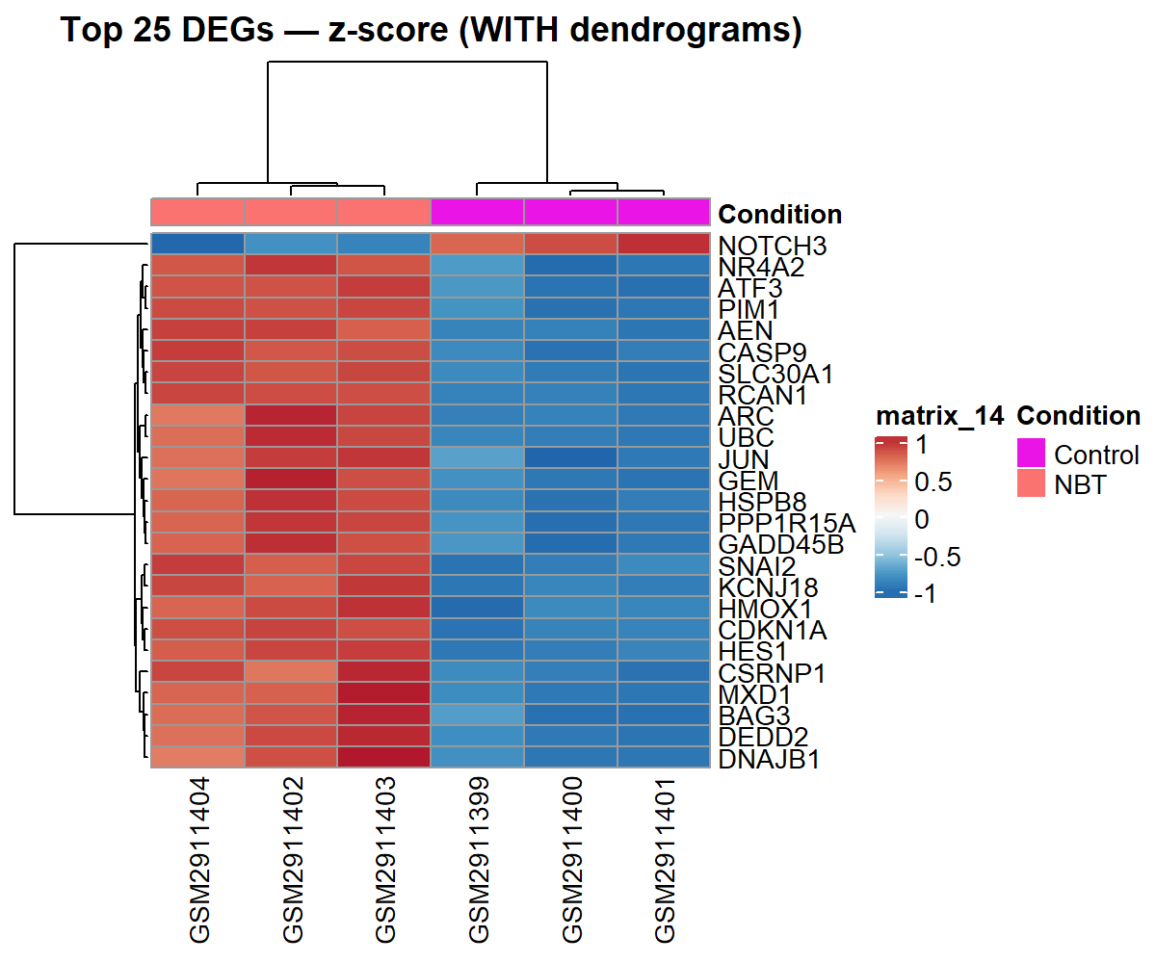
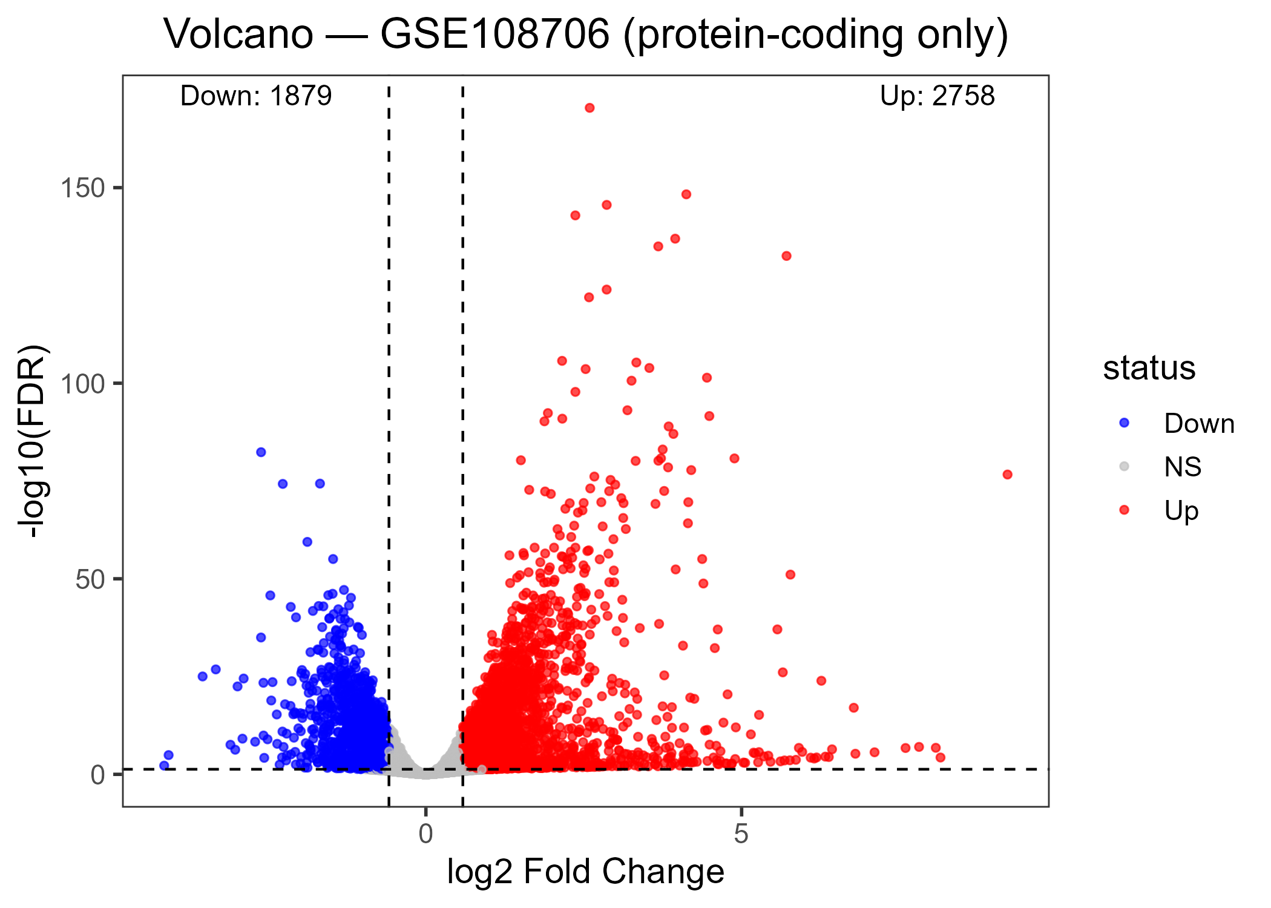
2. Exploratory Data Analysis
Principal Component Analysis (PCA) showed clear separation between control and NBT-treated samples.
Replicates clustered together, indicating good reproducibility.
3. Differential Gene Expression
Significant upregulated and downregulated genes identified after NBT treatment.
Volcano plot highlights genes with high fold change and statistical significance.
Heatmap reveals distinct expression patterns between control and treated samples.

Slide 8
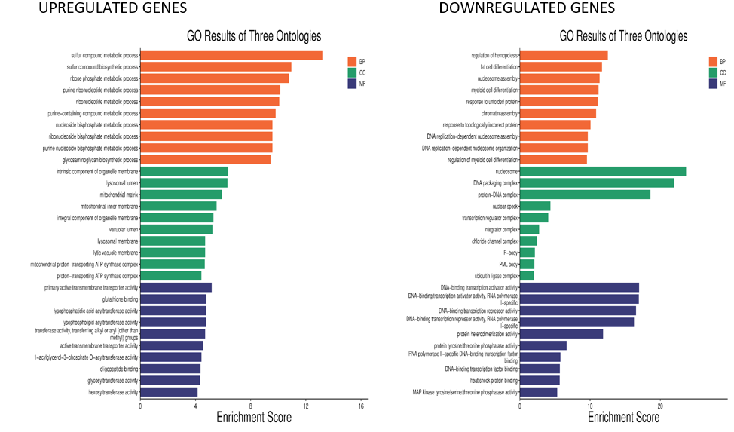
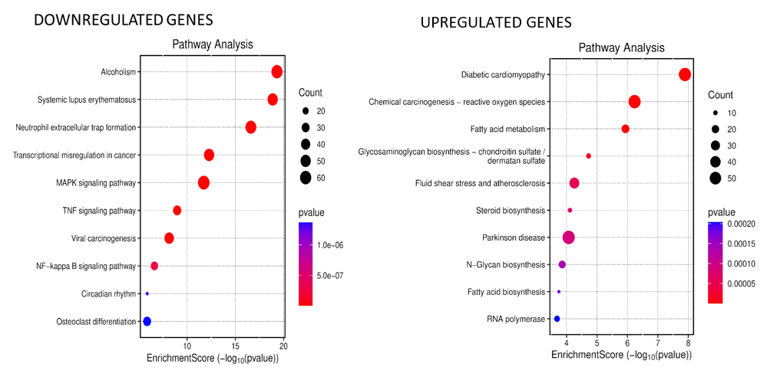
4. Functional Enrichment Analysis
Enrichment of apoptosis, p53 signaling, and stress-response pathways.
Downregulation of metabolic and biosynthetic pathways.
Results suggest transcriptional reprogramming induced by NBT.

Slide 9
Conclusion
RNA-Seq analysis revealed significant transcriptional changes in Neobractatin-treated HeLa cells compared to controls.
Differential expression analysis identified both upregulated and downregulated genes with strong statistical significance.
Pathway enrichment analysis indicated activation of apoptosis, p53 signaling, and stress-response pathways.
Suppression of metabolic and biosynthetic pathways suggests inhibition of cellular proliferation.
Overall results support the potential anticancer role of Neobractatin at the transcriptomic level.

Slide 10
THANK YOU FOR YOUR TIME AND ATTENTION

