Slide 1
stegnography
CAPSTONE PROJECT
Presented By:Sanapala Padmavathi
Student Name : Sanapala Padmavathi
College Name & Department : Sri Sivani College Of Engineering
&Computer Science Engineering

Slide 2
OUTLINE
Problem Statement
Technology used
Wow factor
End users
Result
Conclusion
Git-hub Link
Future scope

Slide 3
Problem Statement
You are given a program that hides a secret message within an image using a simple encryption scheme. The program allows a user to encrypt a message into an image and later decrypt it by entering a correct passcode

Slide 4
Technology used
Python
Cv2 Library
Operating system

Slide 5
Wow factors
RGB pixel manipulation for message hiding
Steganography-based encryption within an image
Passcode protection for decryption
Simple and user-friendly interface
Reversible encryption mechanism
Practical cryptographic demonstration for beginners

Slide 6
End users
1.Privacy-conscious Individuals
2. Digital Artists and Content Creators
3.Cybersecurity Enthusiasts and Beginners
4. Small Businesses and Startups
5. Journalists and Activists
6. Forensics and Investigative Teams
7.Teachers and Educators
8.Banking sectors

Slide 7
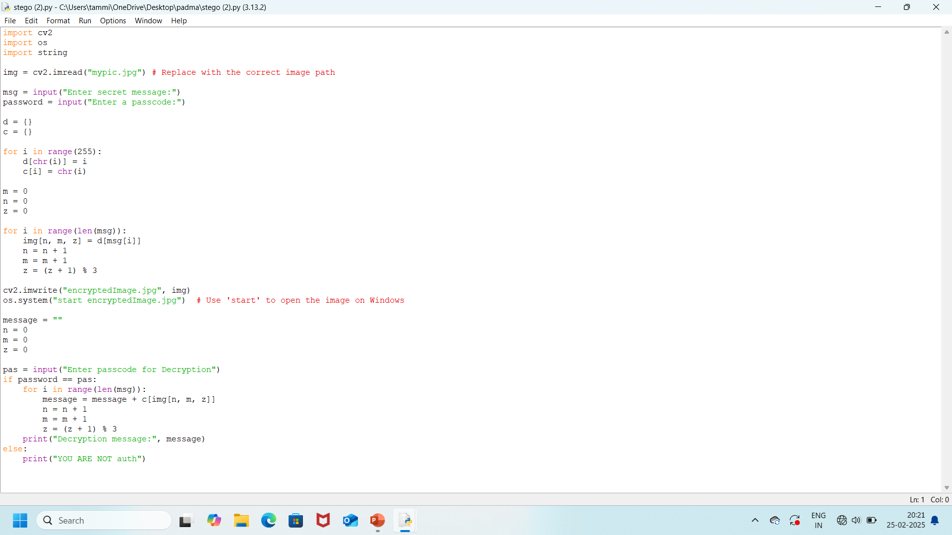
results

Slide 8
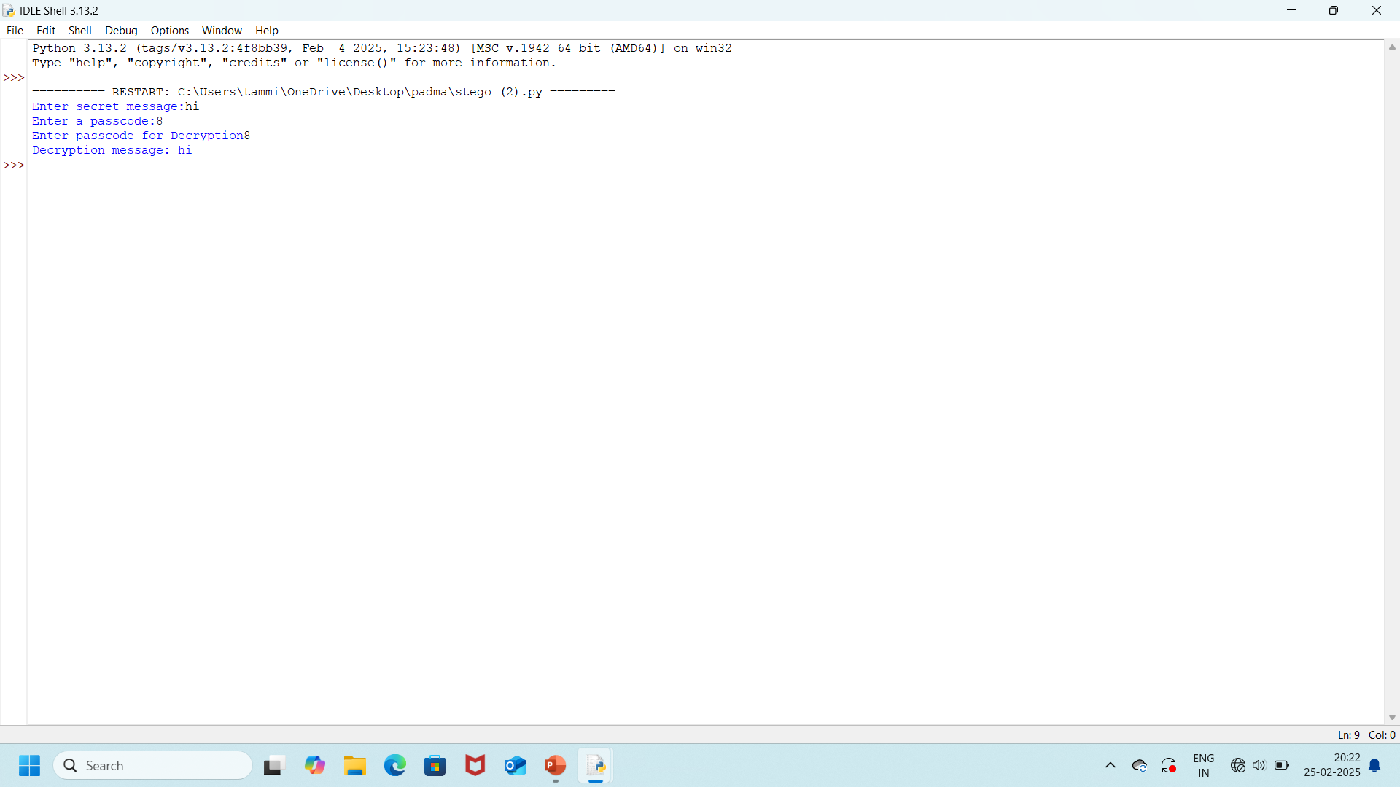
results

Slide 9

results

Slide 10
Conclusion
The code demonstrates basic steganography where a secret message is encoded in an image. A passcode is used to secure the encryption and decryption process. However, the code could benefit from improvements related to input validation, error handling, and message length verification, ensuring the image has enough pixels to store the entire message.

Slide 11
GitHub Link
https://github.com/Padmavathi01-Sanapala

Slide 12
Future scope(optional)
The current code implements a basic form of image-based encryption and decryption for hiding a secret message within the pixels of an image. While it works for its intended purpose, there are several potential improvements and features that can be added in the future to enhance its functionality, security, and robustness.

Slide 13
THANK YOU

