Slide 1
Clean Code + Time & Space Complexity

Slide 2
What is Clean Code?
Code that is easy to read, understand, modify, and debug.
Bad code works today.
Clean code works today + tomorrow + for others.

Slide 3


1. Meaningful Variable Names
BAD
CLEAN
Rule:
Names should explain why the variable exists.

Slide 4

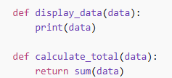
2. Follow One Job per Function (SRP)
BAD
CLEAN
Rule:
One function = one responsibility

Slide 5

3. Avoid Hard-Coding Values
BAD
CLEAN
Rule:
Use constants for fixed values.

Slide 6


4. Keep Code Readable (Spacing & Style)
BAD
CLEAN
Rule:
Code is read more than it’s written.

Slide 7


5. Comment Why, Not What
BAD
CLEAN

Slide 8

Practice

