Slide 1

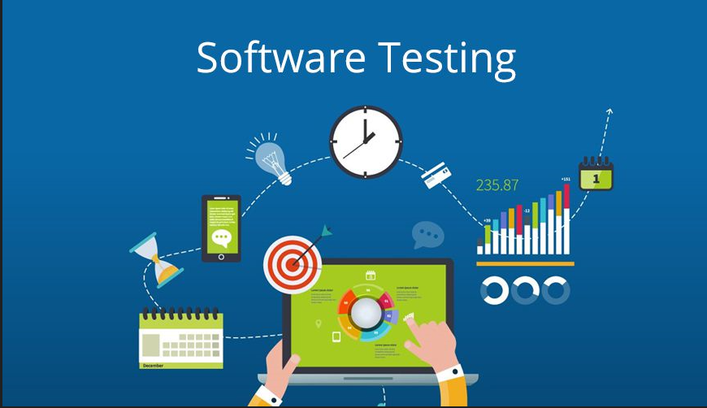
Padmini Nayak
shirva.nayak@gmail.com

Slide 2
CONTENTS
Software Testing Overview
Principles of Testing
SDLC and it’s models
Software Testing life Cycle (STLC)
Software Testing Types
Software Testing methods
Software Testing Levels
Software Testing Design techniques
Software Testing Artifacts
Defect Management Process

Slide 3
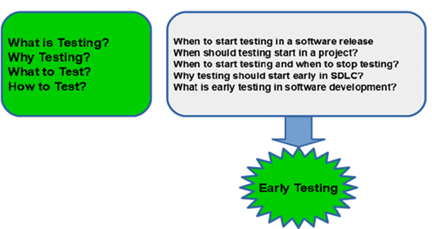
Software Testing Overview
What is Software Testing?
Software testing is the process of evaluating a system with the intent of finding bugs. It is performed to check if the system satisfies its specified requirements.
Why is testing required?
Provides Assurance and Confidence to the stakeholders that product works as expected.
Avoid defects
Early detection of defects leads to less cost and resources
Software issues can cost lives too.
Who does Testing?
Testing in its various phases is done by-
Developer
Tester
Test Manager/Lead/Architects
End users
How is Software Testing done?
Manual
Automation

Slide 4
Software Testing Overview
When do we start Software Testing?
Based on the selection of different SDLC models the testing activities done
Early testing is better
When to stop testing?
Sufficient pass percentage
After a successful test case execution
On meeting deadlines –
Mean Time Between Failure (MTBF)– MTBF is the time interval between two inherent failures. Based on the different stakeholder’s decisions, if the MTBF is quite large, one can stop the testing.
4

Slide 5
Principles of Testing
Testing Shows Presence of Defects
The goal of testing is to make the software fail
Testing talks about the presence of defects and don’t talk about the absence of defects
Exhaustive Testing is Impossible
Testing all the functionalities using all valid and invalid inputs and preconditions are not possible
Risks and priorities is considered while doing Testing and Estimating testing efforts
Early Testing
Cost effective
Defect Clustering
That SMALL module/functionality containing most of the bugs or operational failures
Pesticide Paradox
Same TC’s reapeated which no longed detect defects
Overcome by updating the TC’s regularly
Testing is Context Dependent
E.g., Banking domain testing needs different approachh than e-commerce domain
Absence of Error – Fallacy
The product should also fulfill Business Requirements and not only make it bug free.
5

Slide 6
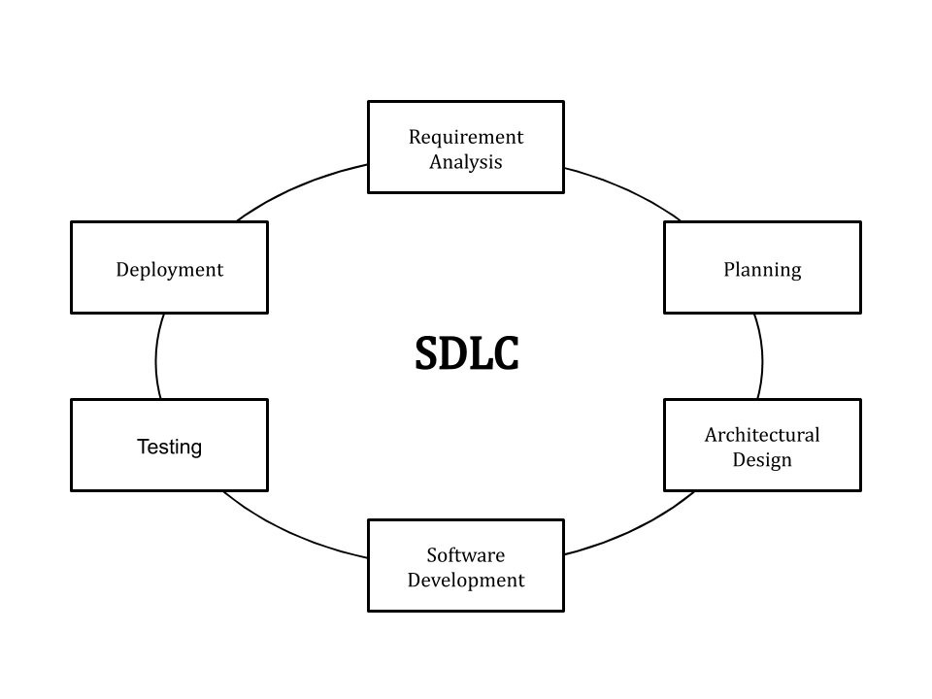
Software Development Life Cycle
SDLC stands for “Software Development Life Cycle”. It describes the various phases involved in the software development process using which we can create and maintain a software application efficiently.
Requirement Gathering & Analysis :
All the business requirements are gathered from the client in this phase
A formal document is created which defines the purpose of the product and
marks the guidelines for the other phases of the life cycle
Designing :
A layout is prepared in this phase according to the requirement specification
In this phase, the requirements are broken down into multiple modules like
login module, signup module, main functionality, etc.
Implementation :
The developer writes code using different languages and platforms,
depending on the need of the product
Testing :
Tester checks whether the software developed fulfills the specified requirements as stated in the requirement phase
Deployment
This phase involves making the software product live in the production environment.
6

Slide 7
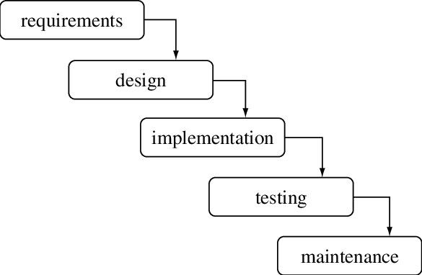
SDLC Modles
Waterfall Model
Sequential Design Process
Every next phase is begun only once the goal of previous phase is
completed
This methodology is best suitable for short term projects
where the requirements will not change
Advantages:
Requirements ,design , code do not change, so we get a
stable product
Simple to implement
Minimal Resources
Specific deliverables , High visibility
Disadvantages:
Backtracking is not possible
Change in requirements leads to change in design and code which results defects in the project due to overlapping of phases.
Customer may not be satisfied
Not flexible product
Testing is done only in testing phase .
Not suitable for long term project
7

Slide 8
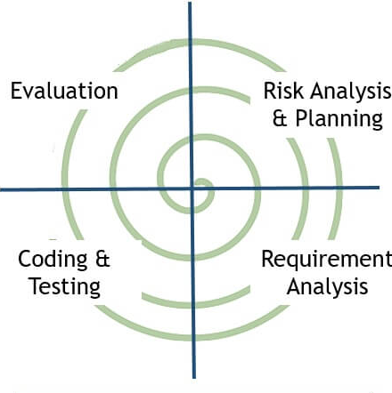
SDLC Modles
Bohem’s 88Spiral Model
Iterative in nature
More emphasis on Risk analysis
Every Iteration starts with planning and ends with the product
evaluation by the client
- e.g., Microsoft which releases the next version of the product
when the current version is in use.
Advantages:
It allows requirement changes
Suitable for large and complicated projects
It allows better risk analysis
Cost effective due to good risk management
Disadvantages:
Not suitable for small projects
The success of the project depends on the risk analysis phase
Have to hire more experienced resource especially for risk analysis
8

Slide 9
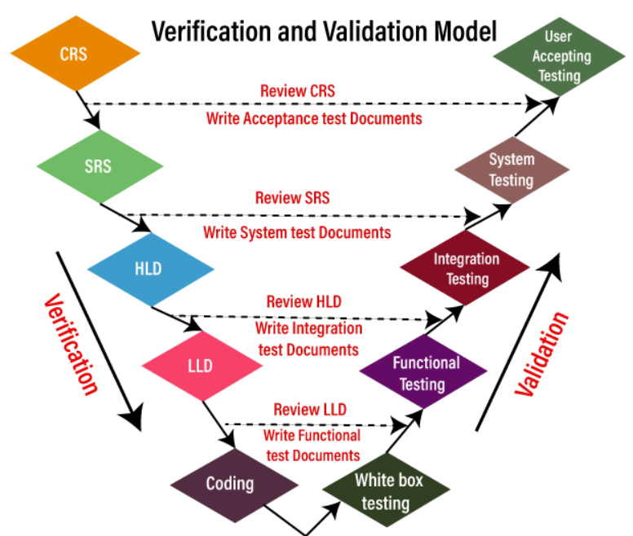
SDLC Modles
V Model (Verification &Validation)
Follows a sequential design process
Each phase of SDLC must be completed before the next phase starts
Testing involved in early stages which avoids downfall of defects.
Advantages:
Testing starts in early stages of product development which avoids
downward flow of defects and helps to find the defects in the
early stages
Test team will be ready with the test cases by the time developers
release the software which in turns saves a lot of time
Gives a quality product
Total investment is less due to less or no rework.
Disadvantages:
Initial investment is more because test team involves right from the early stage.
Whenever there is change in requirement, the same procedure continues. It leads more documentation work.
9

Slide 10
Verification Technique
Verification is a static machanism of checking documents, design, code, and program in order to check if the software has been built according to the requirements or not.
The verification process involves activities like reviews, walk-throughs and inspection
Verification Phase | Verification Acitvity | Validation Activity | Artifacts
User Requirements | Requirements Review | UAT TC Creation | Requirement Undertsanding Document(CRS) UAT TC’s
Software Specification | Hardware Requirements Design of the system Design review | System Test Plan and TC’s Tracebality Matrix | System TC’s Feasibility Report System Test Plan H/w and S/w requirements Modules to be created
Architechture Design (HLD) | Modules to be created Relationship design and dependencies Technology details Architechture design DB tables Design review | Integration Test Plan and TC’s | Design documents Itegration Test Plan and TC’s DB table design
Module Design(LLD) | S/W components designed individually Methods , classes, interfaces, etc are finalized | Creation of Unit TC’s | Unit TC’s
Coding | Code Review TC Review | Creation of Functional TC’s | TC’s and Review checklists
10

Slide 11
Validation Technique
Validation is a dynamic mechanism . The validation process involves activities like unit testing, integration testing, system testing and user acceptance testing
Validation Phase | What happens ? | Anomalies | Artifacts
Unit Testing | Tc’s created in LLD are executed White Box Testing Developers duty Piece of code is written which invokes a method to test which gives the expected result | Defects are logged and tracked | Unit test execution results
Integration Testing | Testing wheather the components work together as expected TC’s executed which are created during HLD | Defects are logged and tracked | Integration test results
System testing | Testing full-fledged application All system TC’s Non-functional TC’s are executed | Defects are logged and tracked Progress reporting Traceability Matrix updated and Risk mitigated | Test Results Test Logs Defect Reports Test Summary Reports Updated Traceability Matrices
User Acceptance testing (UAT) | Related to Business Requirements Compatibility Testing Sometimes Non - functional testings are also done | Defect are logged and tracked | Acceptance test results Updated Traceability Matrices
11

Slide 12
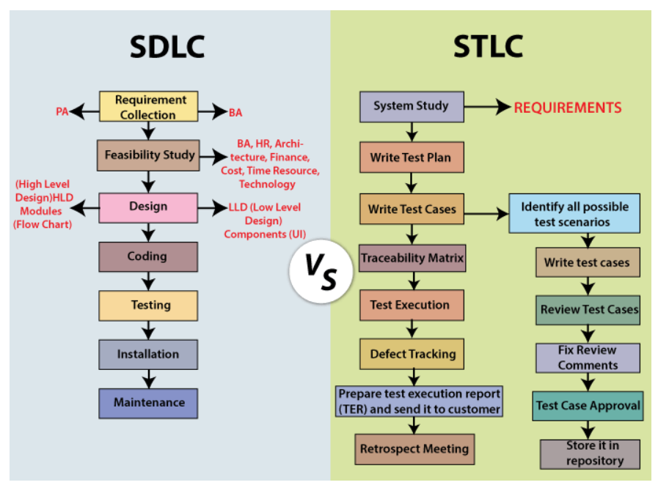
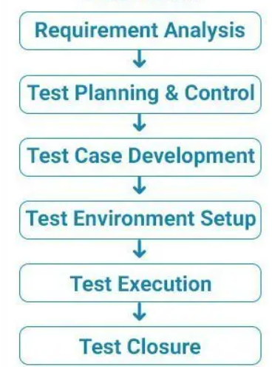
Software Testing Life Cycle
STLC stands for “Software Testing Life Cycle”. It identifies what test activities to carry out and when to accomplish those test activities.
Every phase has a definite Entry and Exit Criteria.
STLC Stages :
12

Slide 13
Software Testing Life Cycle
Phase | Activities | Entry Criteria | Exit Criteria | Deliverables
Requirement Analysis | The test team studies and analyzes the requirements If any requirement is not testable, the test team can communicate with various stakeholders | Requirements specification document Acceptance criteria document, Application architectural document | Signed off RTM, Signed off Automation Feasiblity report | Testable Requirements Automation Feasibility Report(If applicable)
Test Planning | Test Manager/Lead estimates cost and effort Test Plan Resource Planning , Roles and responsibility Tools Selection Training required | Requirements Documents, Automation feasbility report | Approved Test plan document Approved Test strategy document Signed off effort estimation document | Test Strategy document Test Plan document Test Effort estimation document
Test Design | Test Case Preparation Test Scripts(Automation) Test data Test case Reviews (Peer /Lead) Requirement Traceability Matrix(RTM) | Requirements Documents (Updated version of unclear or missing requirement) RTM, Test Plan, Test Estimation Document Automation Analysis Report | Reviewed and approved test cases Test scripts Test data | Test Cases Test Scripts Test Data RTM
Test Environment Setup | In parallel with Test Deisgn phase Set up based on S/W and H/W requirements | Test Plan Test environment setup plan, Smoke Test cases,Test Data | Working test environment setup Valid test data setup Successful somke test | Test Environment Smoke Test Results
Test Execution | Test Case Execution Defect Report Prepared Re-Testing done | Test Plan document, Test cases, Test Scripts, Test data Test Environment. | Execute all planned test cases Log all defects found | Test case Execution Report Defect Report RTM
Test Closure | Prepare Test closure report /Test matrices Retrospective meetings Analysing Test Artifacts | Testing has been completed, Test Case Execution report (make sure there are no high severity defects opened) | Signed off Test Closure report | Test Closure Report Test Matrices
13

Slide 14
Software Testing Types
Manual Testing
Tester takes over the role of an end-user and tests the software to identify any unexpected behavior or bug.
Automation Testing
Tester writes scripts and uses another software tool to test the product.
What to Automate?
Where large number of users can access the software simultaneously should be automated.
GUI items, connections with databases, field validations, etc
When to Automate?
Large and critical projects
Projects that require testing the same areas frequently
Requirements not changing frequently
Accessing the application for load and performance with many virtual users
Stable software with respect to manual testing
Availability of time
How to Auotmate?
Identifying areas within a software for automation
Selection of appropriate tool for test automation
Writing test scripts
Development of test suits
Execution of scripts
Create result reports
Identify any potential bug or performance issues
14

Slide 15
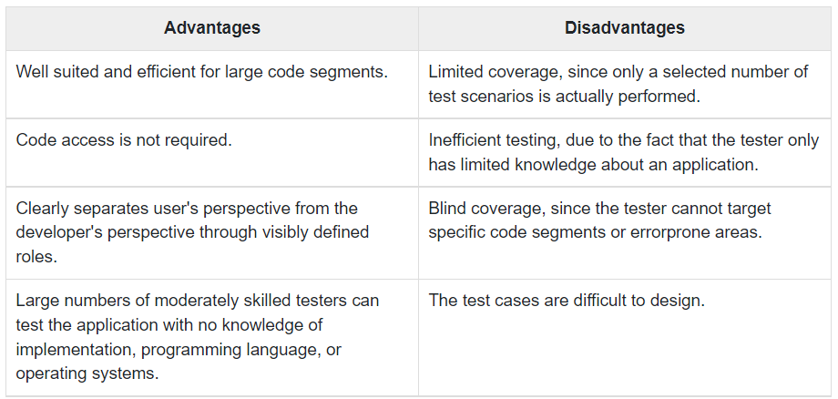
Software Testing Methods
Black-Box Testing
Testing done without having any knowledge of the interior workings of the application
Do not have access to the source code
Tester interacts with the system by giving inputs and examining outputs
15

Slide 16
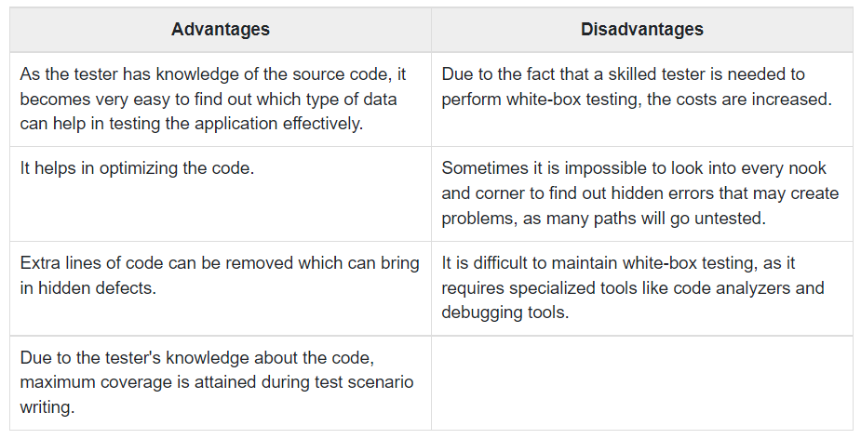
Software Testing Methods
White-Box Testing(Glass-Box or Open-Box)
Detailed investigation of internal logic and structure of the code
Need to know the internal working of the code
Tester need to debug into unit level of source code
16

Slide 17
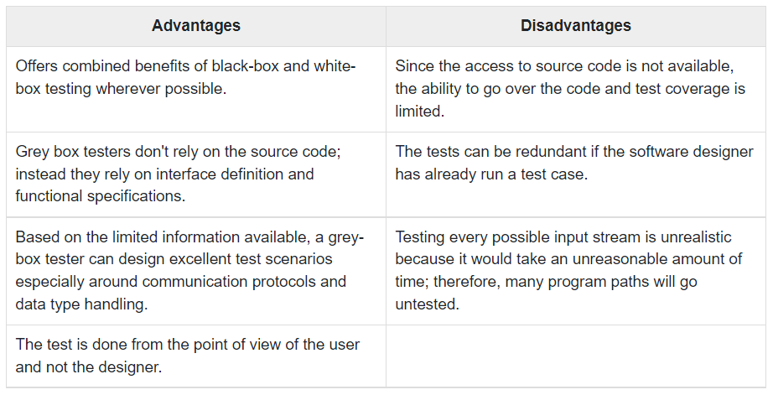
Software Testing Methods
Grey-Box Testing
Test the application with having a Partial knowledge of the internal workings of an application
Tester has access to design documents and the database
Tester can prepare better test data and test scenarios while making a test plan
17

Slide 18
Software Testing Levels
Functional Testing
Type of Black-Box testing
Conducted on a complete, integrated system to evaluate against the requirements
Non-Functional Testing
Refers to various aspects of the software such as performance, load, stress, scalability, security, compatibility
to improve the user experience on how fast the system responds to a request
Functional Testing | Non-Functional Testing
Unit Testing Integration Testing System Testing Regression Testing Acceptance Testing ReTesting Smoke Testing Sanity Testing Alpha Testing Beta Testing Positive Testing Negative Testing Ad-hoc Testing Monkey Testing | Performance Testing Load Testing Stress Testing Usability Testing Security Testing Portability Testing
18

Slide 19
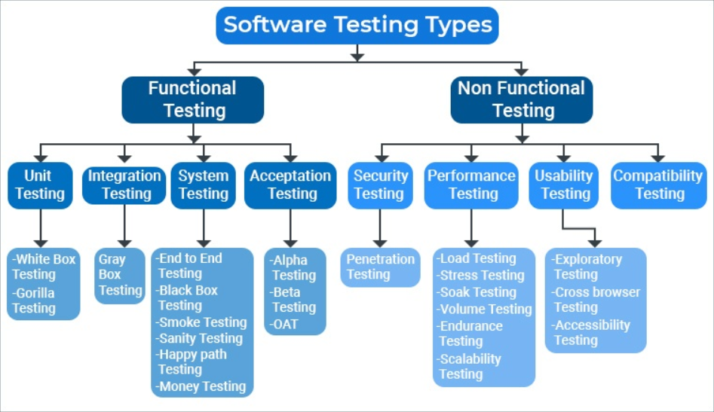
Software Testing Levels
19

Slide 20
Software Testing Levels
Type | What does it mean
Unit Testing | Test an individual unit or group of interrelated units Developer
Integration Testing | Testing Group of Components Bottom-up integration :Testing begins with unit testing, followed by modules or builds. Top-down integration :The highest-level modules are tested first and lower-level modules are tested thereafter
System testing | Whole integrated System is tested Verifyif the functional and technical specifications are met Test, verify, and validate both the business requirements and Application architecture.
Regression Testing | To verify that a fixed bug hasn't resulted in another functionality or business rule violation Testing the new changes to verify that the changes made did not affect any other area of the application.
Acceptance Testing | To test whether the system is developed according to the requirements communicated by the stakeholders. Done by Customers
Alpha Testing | Done wihtin the team Unit testing, integration testing and system testing when combined together
Beta Testing | Pre Release Testing Small intended audience
ReTesting | Testing the failed TC’s after the bugs corresponding to those TC’s have been fixed Part of bug life cycle Regression needs to be performed
20

Slide 21
Software Testing Levels
Type | What does it mean
Sanity Testing | Subset of regression testing Test bug fixes and Critical functionalities No Documentation needed
Smoke Testing | Crucial Test cases are executed (build verification test) Can be documented and automated too.
Negative Testing(Error path) | Providing invalid or unexpected data
PerformanceTesting | Application is evaluated under simulated expected or higher than expected workload. Jmeter tool (helps to create virtual users)
Load Testing | Performance testing in which the performance of the application is evaluated under the expected load Parameters tested are reponse time , load on server
Stress testing | Performance testing ,evaluated under a load much higher than the expected or the anticipated load
Usability Testing | Testing to see how easily used or operated
Security Testing | Testing system’s readiness to fight back against any external or internal attacks
21

Slide 22
Software Testing Artifacts
Test Plan
22

Slide 25

1

