Slide 1

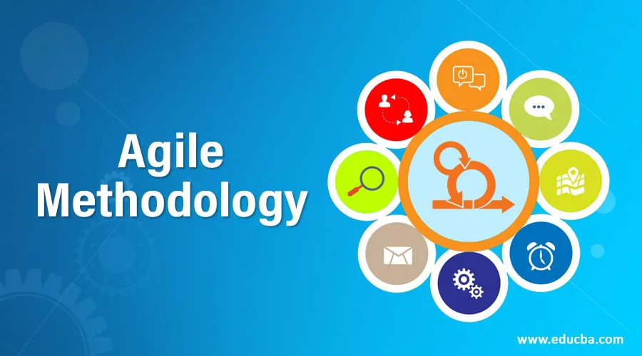
Padmini Nayak
shirva.nayak@gmail.com

Slide 2
CONTENTS
Why do we need Agile ?
What is Agile
Agile Principles
Key Agile Concepts
Advantages/Disadvantages of Agile
How to implement Agile ?
Various Agile frameworks

Slide 3
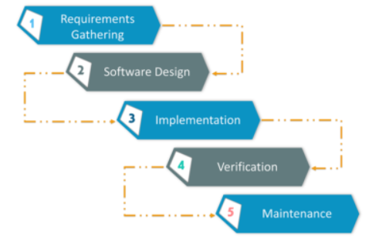
Why do we need Agile ?
We need Agile to over-come the tradition development methodology
Draw backs of Water fall methods:
Time consuming
Suitable for the projects where requirements are stable
Working model is delivered after completion of the last stage of the model.
Changes are very difficult as we need to go back to the previous stages.

Slide 4
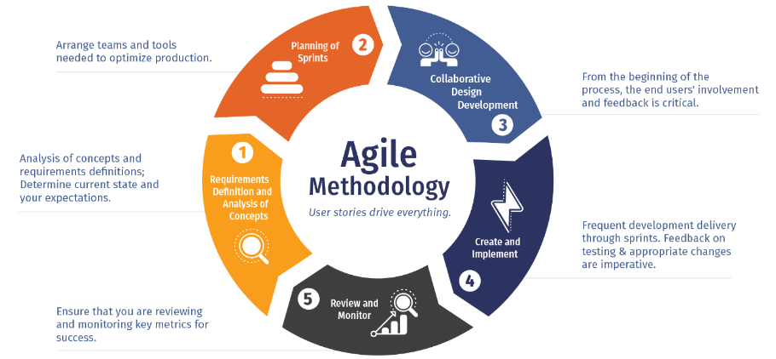
What is Agile Methodology ?
It is an iterative and incremental approach to a software development
Small incremental build presented to the user in multiple iterations
Feedbacks , changes are incorporated in the next iterations
4

Slide 5
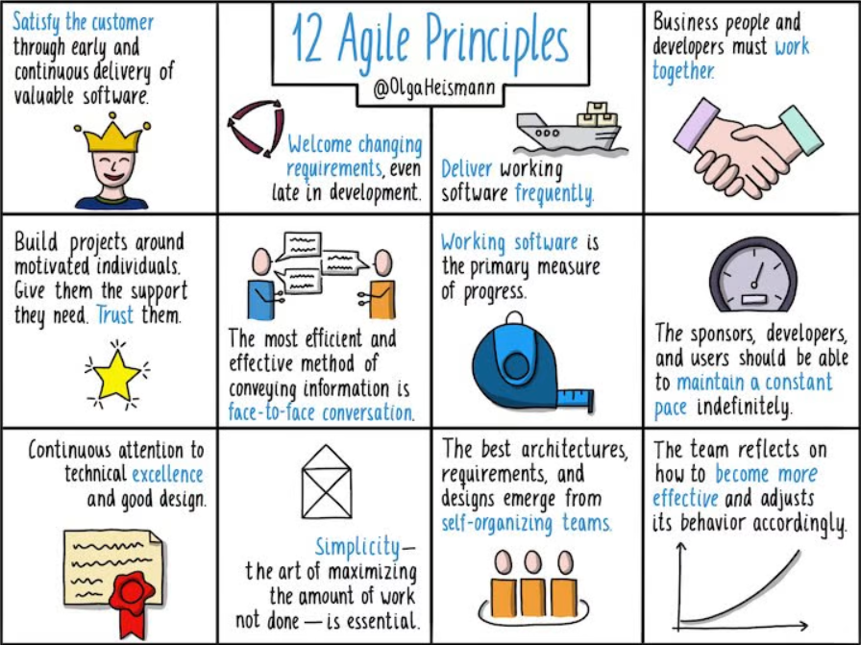
Agile Principles
The 12 principles that are mentioned in the Agile Manifesto are as follows:
5

Slide 6
Key Agile Concepts
User Stories
Entire project is divided into smaller deliverables
Those stories are considered the building blocks of the project
Individual stories are delievered iteratively
Meetings
to understand the current situation and action to be taken
Incremental Development
Software is initially created with all the features included and is called the first version
During incremental development, all the subsequent versions of the software will have improvements made to its modules
Iterative Development
Re-work on the software are structured around a series of iterations
Milestone Checks
Retrospective meetings are conducted and detailed analysis report is prepared.
User Personas
In the starting stages of the SDLC, the business development team along with the clients, map out the target audience
With that input , build the software
6

Slide 7
Advantages / Disadvantages
Advantages | Disadvantages
Agile is very much suited for projects where requirements and the end product is not very clear. | As it is highly customer-centric, so it can pose a problem when the customer does not have a clear understanding of the product and process.
It promotes customer satisfaction as their feedbacks and changes are embraced. | Lack of formal documentation and designing leads to a very high dependency on individuals for training and other tasks.
It reduces risk factors as early deliverables are made visible to the end-users. | For complex projects, the resource requirement and effort are difficult to estimate.
Exhaustive planning is not required at the beginning of the development process | Frequent deliverables, feedback, and collaboration can be very demanding for some customers.
It is easy to manage with minimal rules and more flexibility. | Because of the ever-evolving features, there is always a risk of the ever-lasting project.
Dividing the project into incremental deliverable builds leads to more focus on the quality of the product.
7

Slide 8
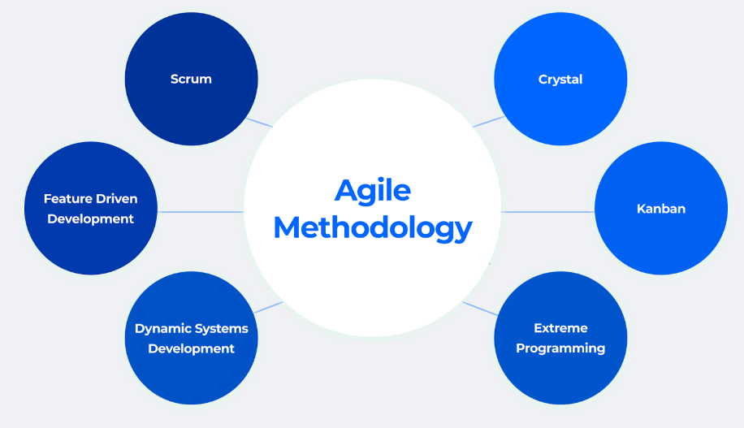
How to Implement ?
8

Slide 9
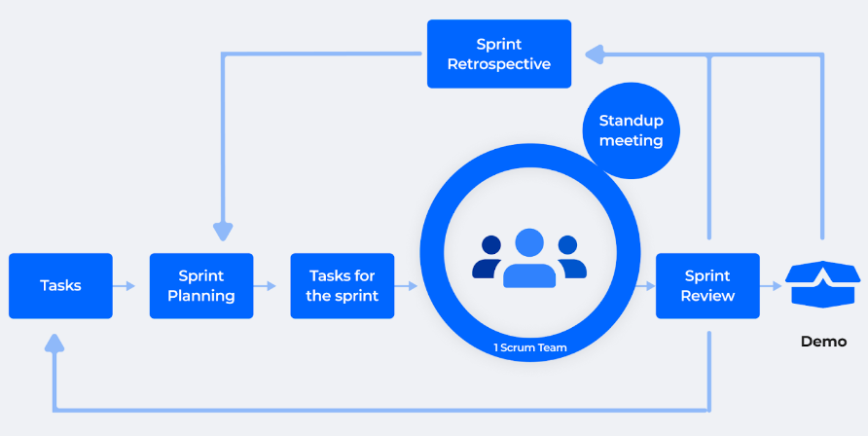
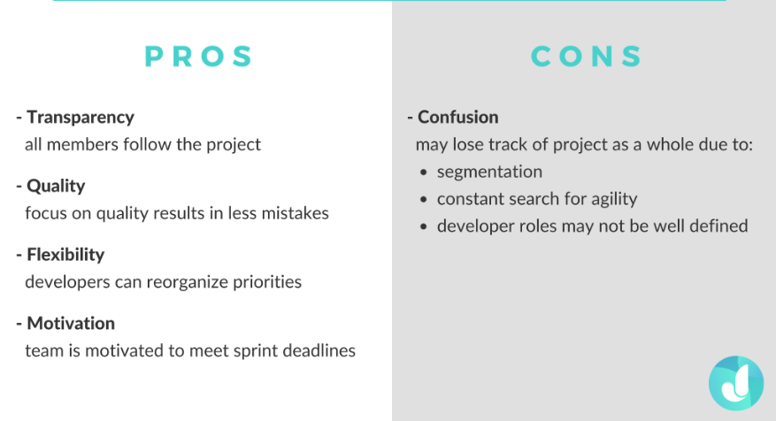
Agile frameworks
Scrum
Each iteration of a scrum is known as Sprint
Product backlog is collection of stories which is to be selected to work
During each Sprint, top user stories of Product backlog are
selected and turned into Sprint backlog
Team works on the defined sprint backlog
Team checks for the daily work
At the end of the sprint, team delivers product functionality
9

Slide 10
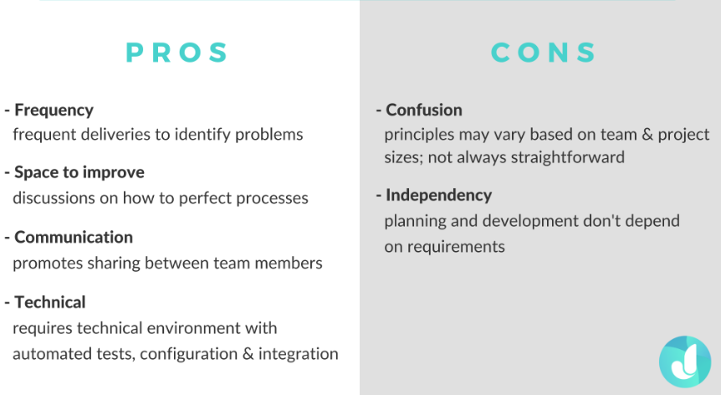
Agile frameworks
Crystal
Chartering:
Creating a development team
Preliminary feasibility analysis
Developing an initial plan and
Fine-tuning the development methodology
Cyclic delivery:
Team updates and refines the release plan
Implements a subset of the requirements through iterations
Integrated product is delivered
Review of the project plan and adopted development methodology
Wrap Up:
Deployment into the user environment,
Post- deployment reviews
Reflections are performed.
10

Slide 11
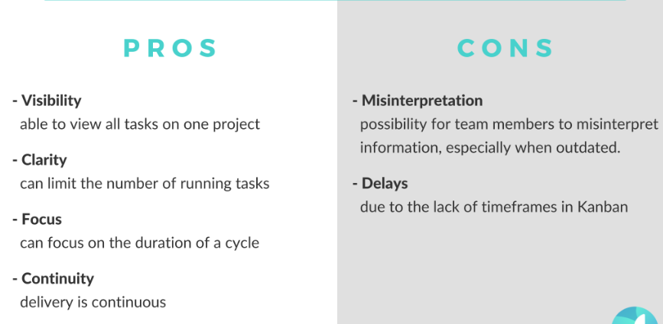
Agile frameworks
Kanban
Helps to visualize your workflow and tasks
11

Slide 12
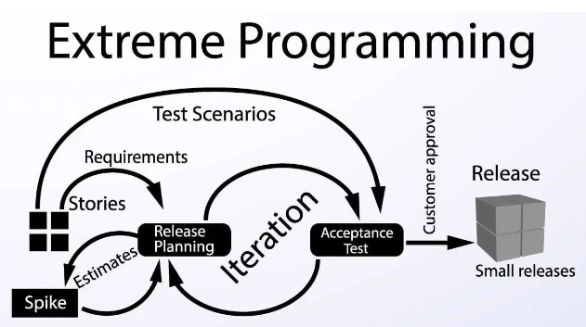
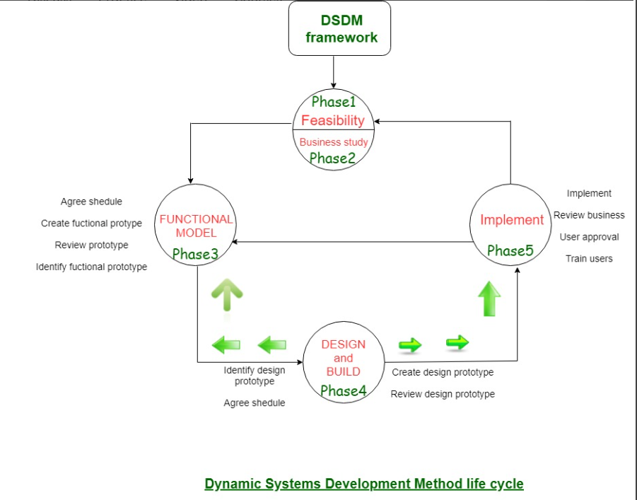
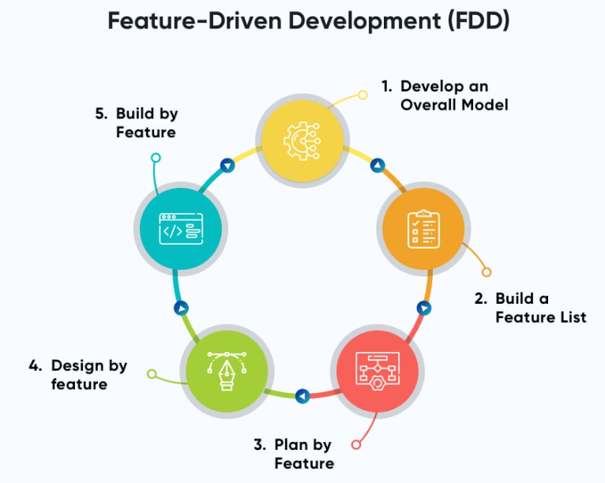
Software Testing Life Cycle
12

Slide 13

1

