Slide 1
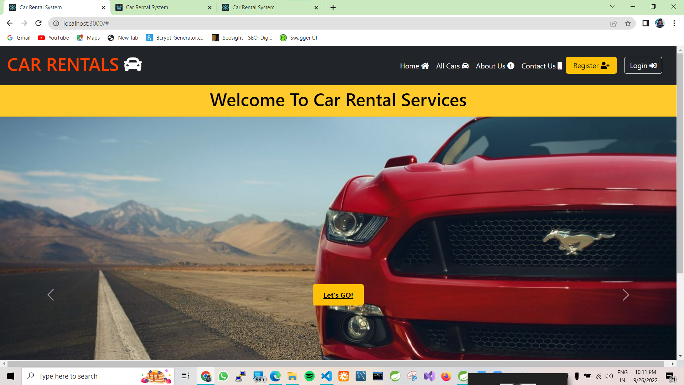

Slide 2
PRESENTATION ON
PROJECT REPORT
CAR RENTAL SYSTEM

Slide 3
Guided By :- Mrs. Rupali Thorat
Presented By :-
Myakal Gautam Birbal :-220341220117.
Padol Nitin Sudhakar :-220341220127.

Slide 4
INDEX
PROBLEM STATEMENT
INTRODUCTION
PURPOSE
PRODUCT SCOPE
OVERALL DESCRIPTION
USER CHARACTERISTICS
FUNCTIONAL REQUIREMENT
NON-FUNCTIONAL REQUIREMENT
SYSTEM FEATURES
PROJECT FEATURES
EXTERNAL INTERFACE REQUIREMENT

Slide 5
INTRODUCTION:-
Transport facility is a matter of headache for those people who do not have any personal transport in their city. On occasions like Wedding, Vacation, house shifting, and tour outside city and on many other situations they feel the necessity of a vehicle to sort out the problems. So, if it is possible to design or develop a web-based application for availing transport whenever and wherever possible, then it will be beneficial for both renter and transport provider. Now a days, by some clicks only, we can get whatever you want at home. We already know about the online shopping, e-banking etc. Similarly, The Car Rental System is the online facility to book cars online within few clicks only, some people cannot afford to have a car, for those people this system becomes very helpful. This system includes various cars as per the customer order and comfort, it place the order and deliver the car as per the location within the area. For travelling a long distance, booking can be done via internet service only.

Slide 6
Architecture :-
Front End :- React JS, Bootstrap
Back End :- Java, Spring Boot REST API, JPA
DataBase :- MySQL

Slide 7
Admin ROLES: Admin can login to the systems Verify the car information database Generate price strategy Handle the payment system Finalize the order Cancel the order

Slide 8
Employee: It updates the Database Give Information to the customer about the car Give Information to the Admin Maintain Contacts
USER:
User can login to System
Visit the Website
Place the Order
Cancel the Order

Slide 10
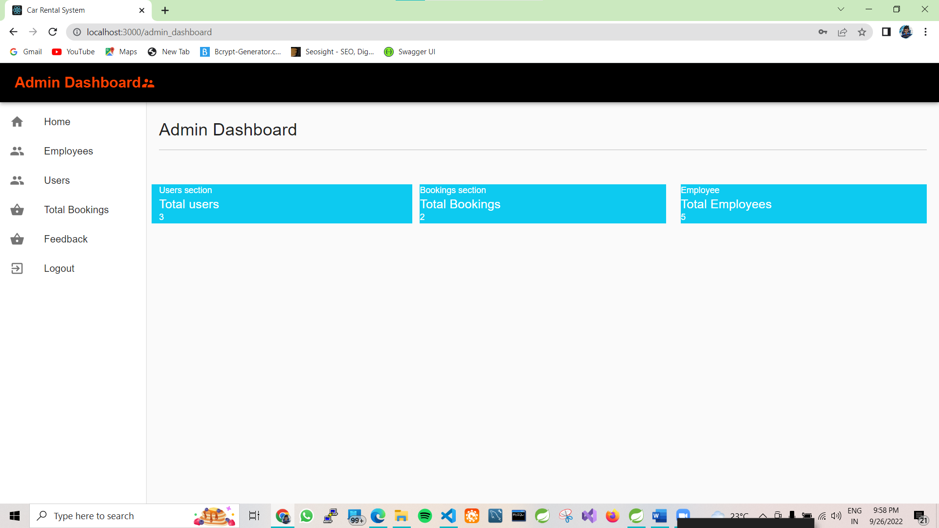

Slide 11
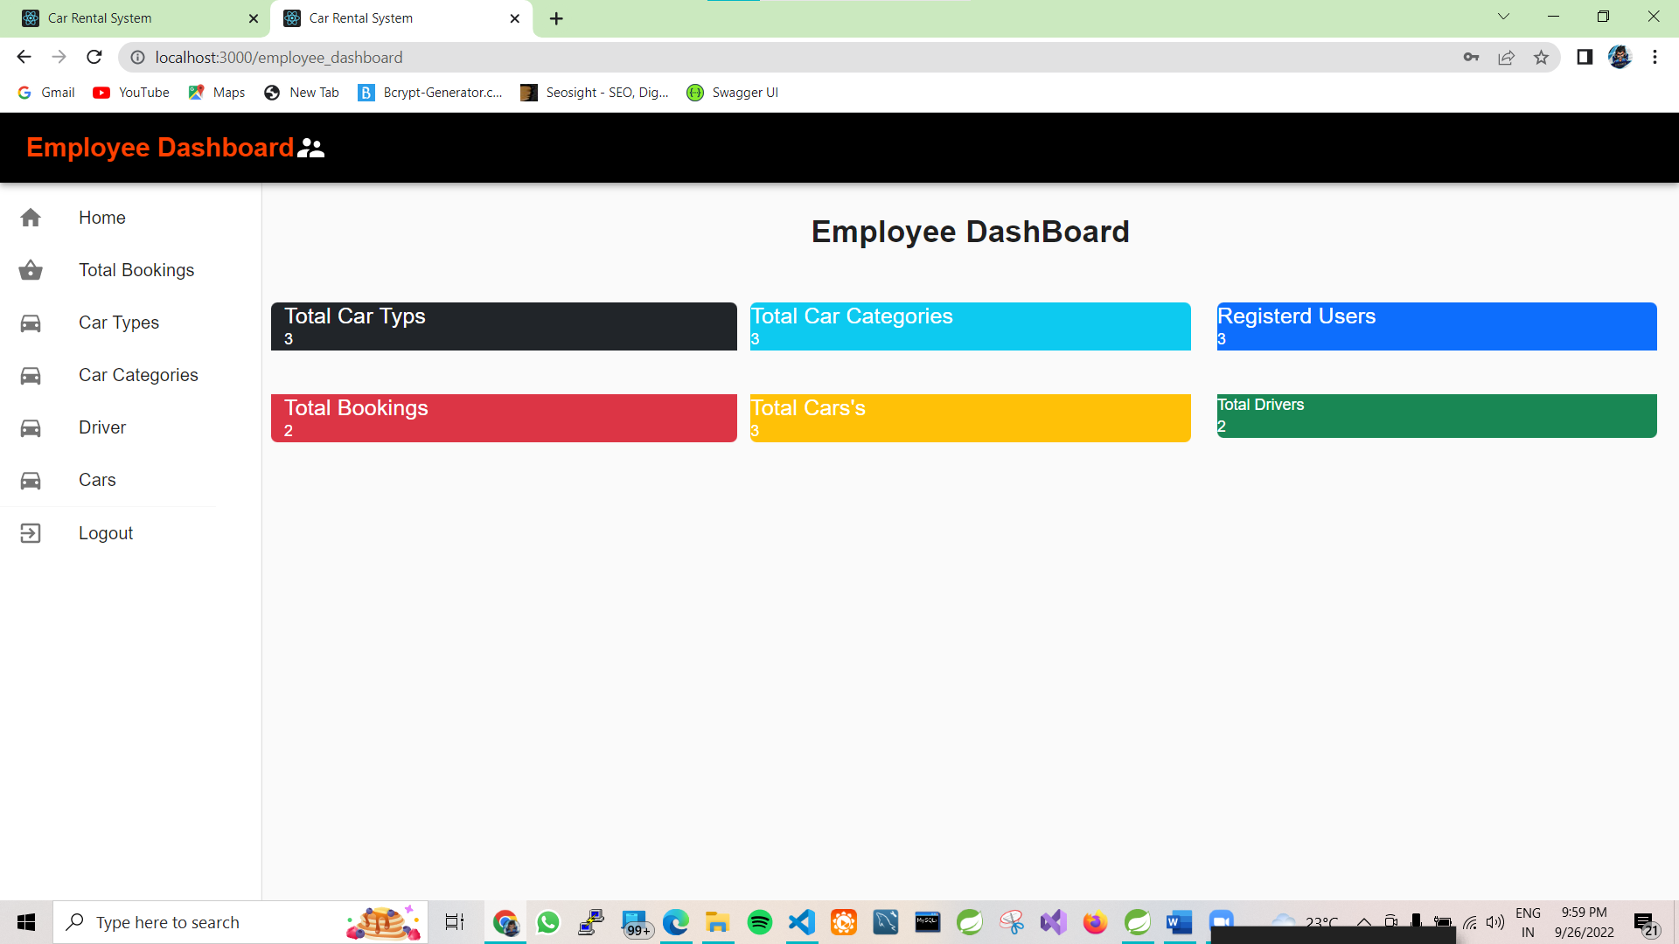

Slide 12
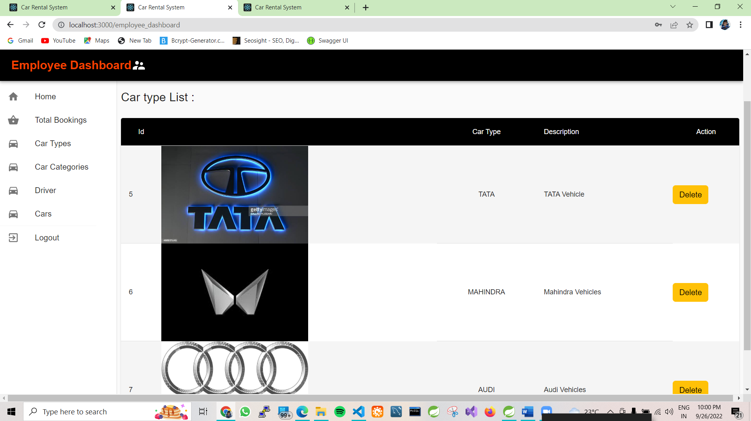

Slide 13
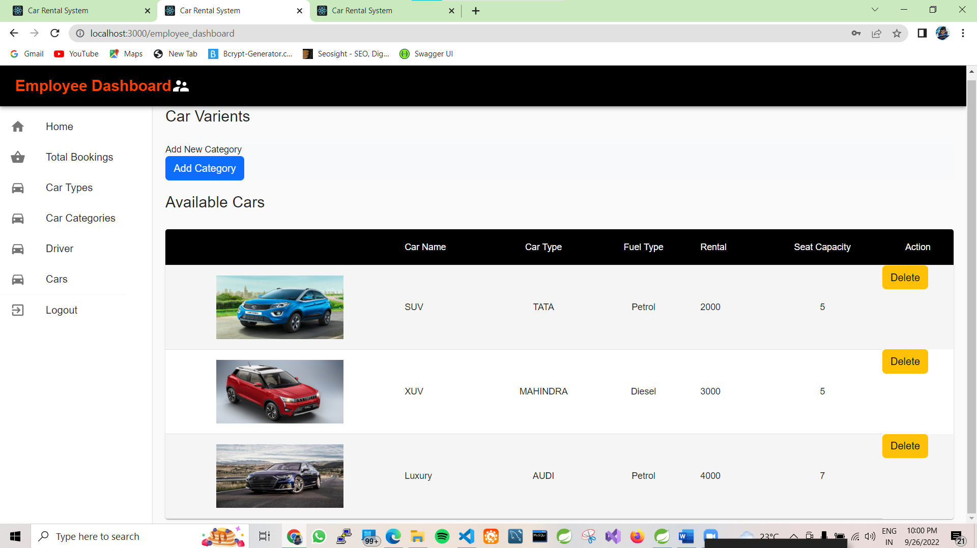

Slide 14
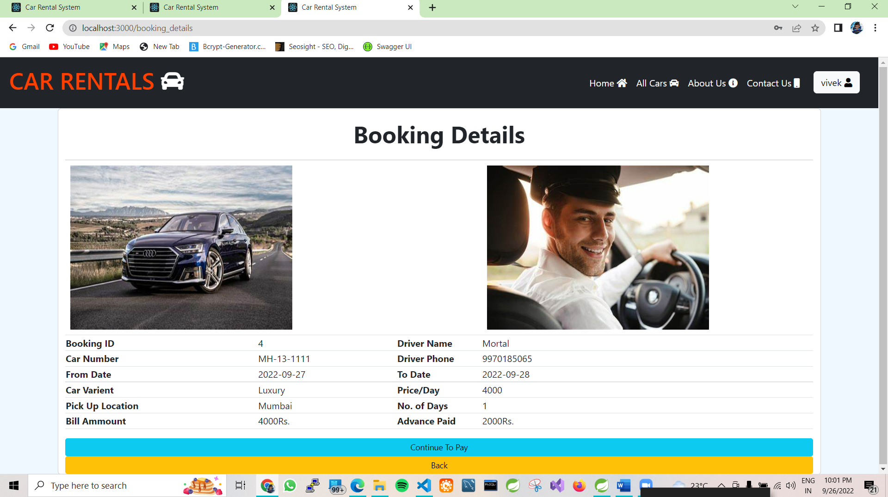

Slide 15
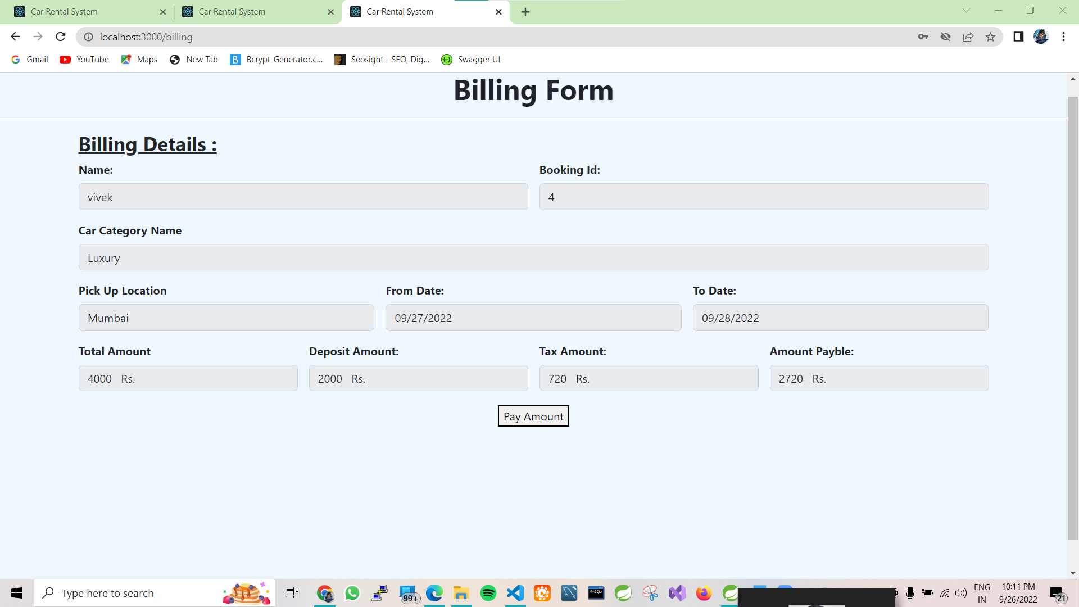

Slide 16
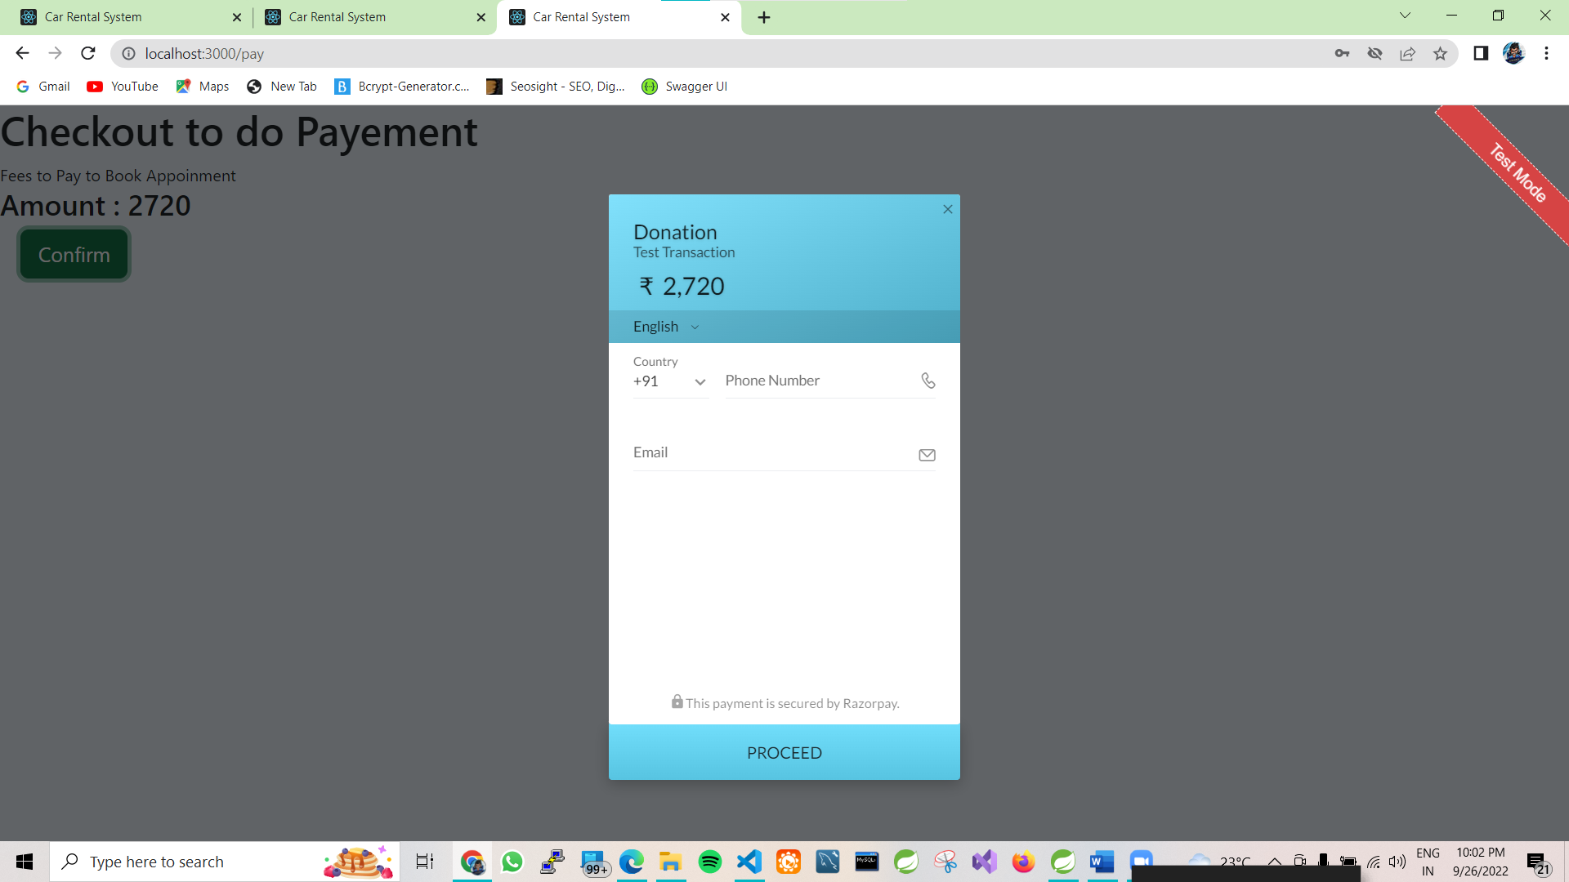

Slide 17
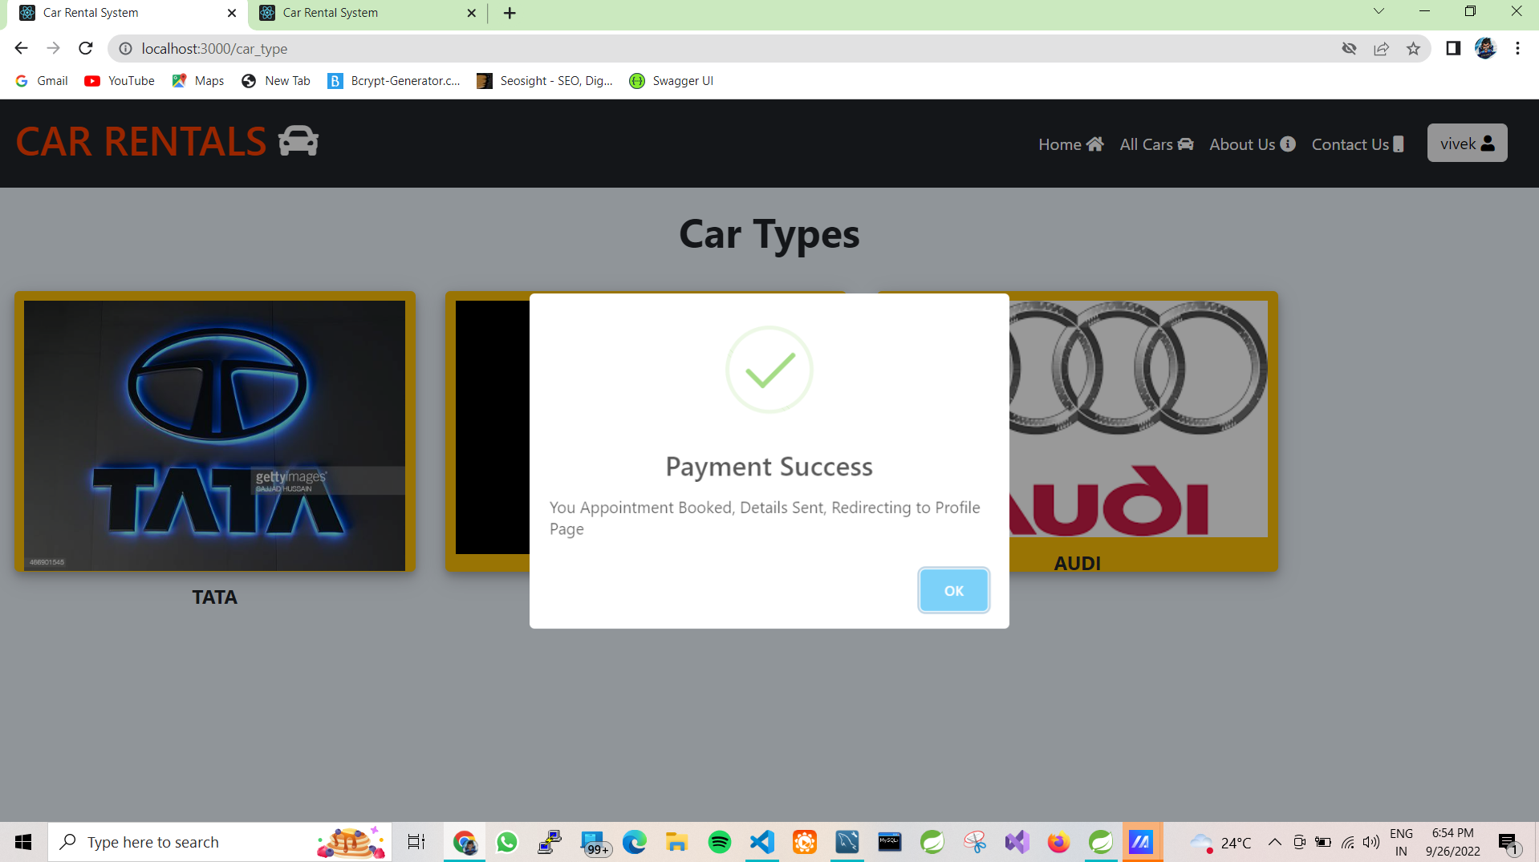

Slide 18
Future extensions or scope :- 1.Map implimentaion 2.pick-up from user location.

Slide 19
CONCLUSION :- Car rental business has emerged with a new goodies compared to the past experience where every activity concerning car rental business is limited to a physical location only. Even though the physical location has not been totally eradicated; the nature of functions and how these functions are achieved has been reshaped by the power of internet. Nowadays, customers can reserve cars online, rent car online, and have the car brought to their door step once the customer is a registered member or go to the office to pick the car. The web-based car rental system has offered an advantage to both customers as well as Car Rental Company to efficiently and effectively manage the business and satisfies customer’s need at the click of a button.

