Slide 1

Predicting COVID-19 With a Deep Neural Network
Derek Chung and Padrick Beggs

Slide 2
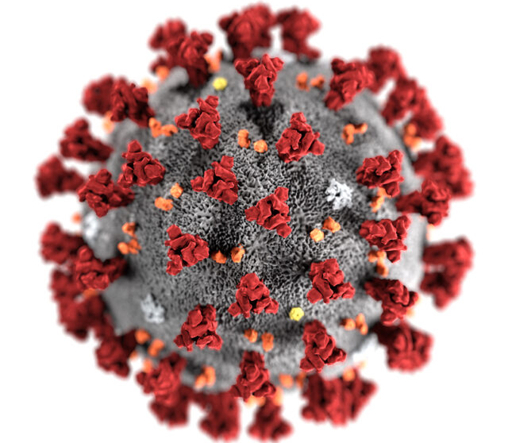
The purpose of our project
The purpose of our model is to predict the next day new total amount of worldwide cases for COVID-19. This will be done using deep neural networks.

Slide 3
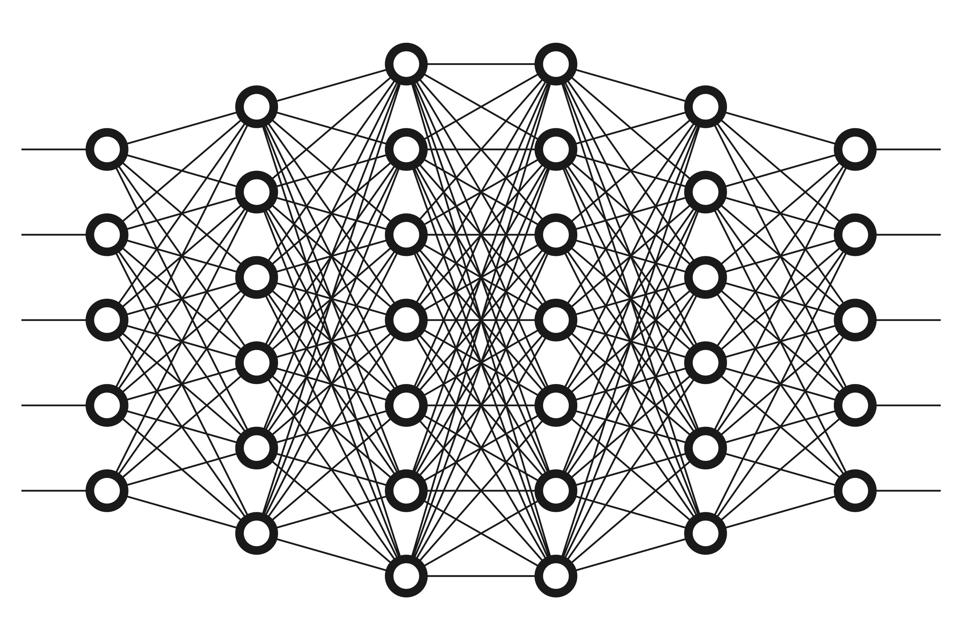
How our Neural Network Works
Uses a CNN (Convolutional neural network)
Multivariate Multiple Input Series
Loss function was Mean Squared Error
Activation function was relu

Slide 4
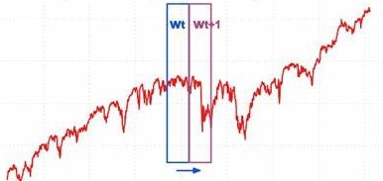
Our Approach
It was coded in python and uses the Keras and TensorFlow libraries
The data was found on Kaggle and is updated daily at the end of each day
The data was unstructured, in order to structure the dataset we used the sliding window technique
The input is the 3 prior consecutive days’ total cases prior to the day we want to predict

Slide 5
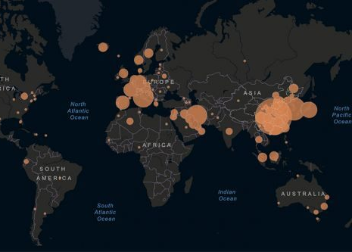
Real-world Applications
Being better prepared for a large increase in the number of hospital patients.
Warning the general public of the pandemics growing numbers.

Slide 6

Other Real-world Applications
With a more robust model we could also generalize this model to spread of other diseases
Calculate and predict optimal resource allocation for medical supplies and staff around the world

Slide 7
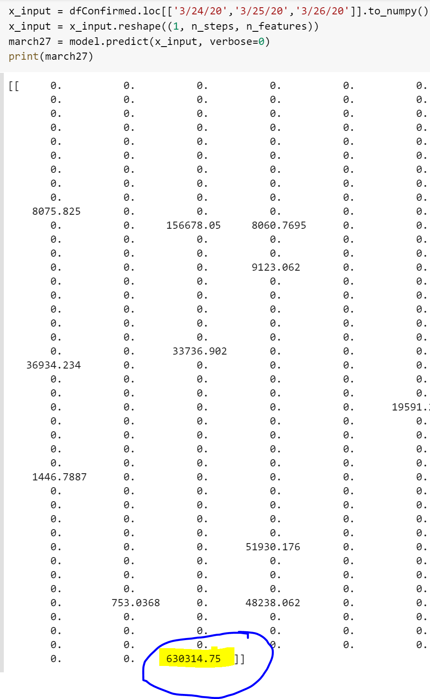
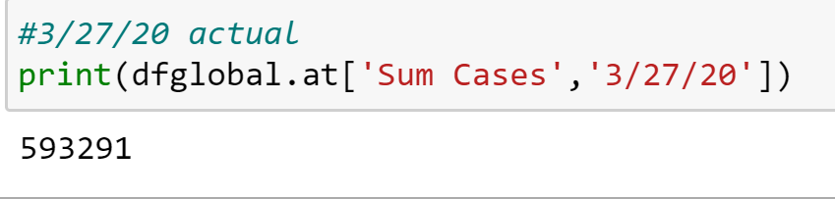
Demonstration for 3/27/2020

Slide 8
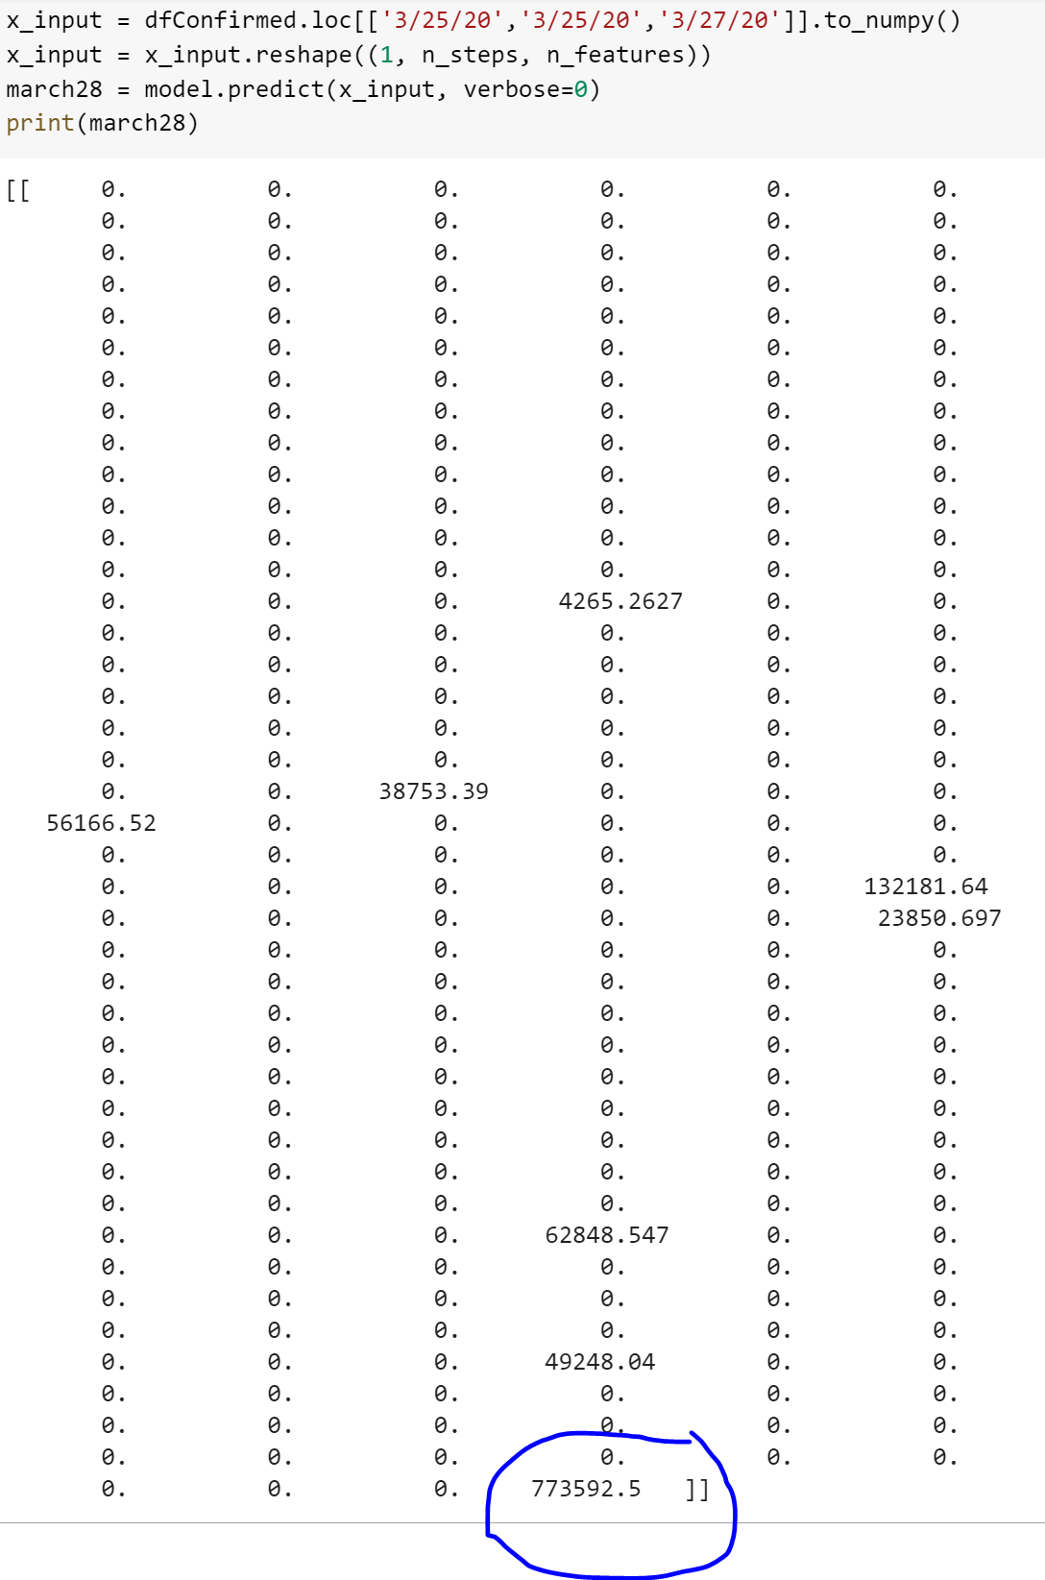
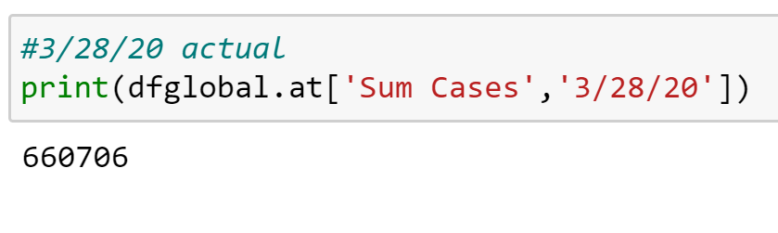
Demonstration for 3/28/2020

Slide 9
What could be improve
With more data, and more features we can create a more robust multivariate time-series forecasting model by using a recurrent neural network which has been cited to give better results.
We can also expand model to determine how far into the future the virus will continue to spread at this rate or faster.
Generally a more comprehensive understanding epidemiology.

Slide 10
Resources
https://www.kaggle.com/sudalairajkumar/novel-corona-virus-2019-dataset#time_series_covid_19_confirmed.csv
https://machinelearningmastery.com/how-to-develop-convolutional-neural-network-models-for-time-series-forecasting/
https://machinelearningmastery.com/convert-time-series-supervised-learning-problem-python/
https://www.asimovinstitute.org/neural-network-zoo/
https://stackoverflow.com/questions/20923574/whats-the-difference-between-convolutional-and-recurrent-neural-networks

