Slide 1
Autoregressive Image Generation without Vector Quantization
Li Qingfeng

Slide 2
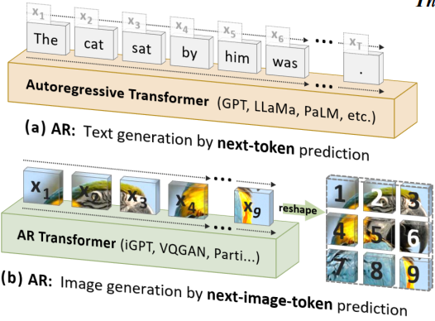
Autoregressive Image Generation (with VQ)
Why autoregressive in image generation ?
“Autoregressive model + Teacher Forcing training” has sufficient potential.
Unify the generation of images and text, i.e., multimodal large models.
Problem ?
Image is two-dimensional and has no order.
Image values are continuous rather than discrete. Only
discrete values ​​can be represented by category distribution.
How to ?
Vector Quantization : a tokenizer to discrete images

Slide 3
Is VQ Necessary in Autoregressive Image Gen?
VQ tokenizer is really difficulty to train
The sampling of quantized vector (from codebook) is not differentiable
Rethink the relationship between autoregressive and vq
Autoregression only represents "predicting the unknown based on the known"
It should have nothing to do with "whether the data value itself is discrete or continuous"
Conclusion
Pixels do not have to be modeled as class distributions
The real key is to properly model the distribution of each pixel so that we can sample from it and have a corresponding loss function to measure the quality of the modeling.

Slide 4
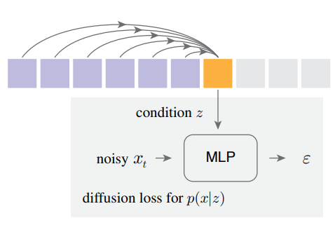

MAR model
Diffusion models model continuous distribution
Play in latent space like LDM, so what is modeled is the distribution of each latent variable
Unlike the usual diffusion models the joint distribution of all pixels, here it models distribution of each token
Therefore, a simple MLP Diffusion model can be used
Autoregressive model
helps assisted diffusion model to do conditional generation
the part generated by the autoregressive network is the conditional variable of the token
Diffusion loss

Slide 5
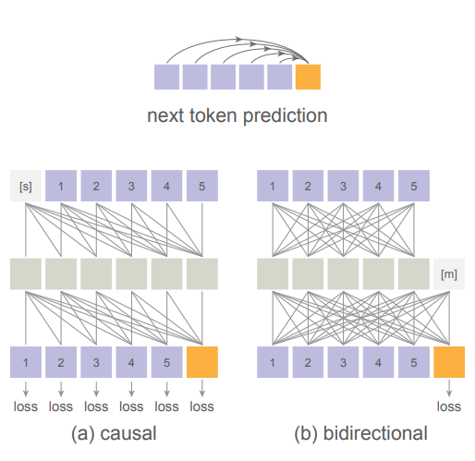
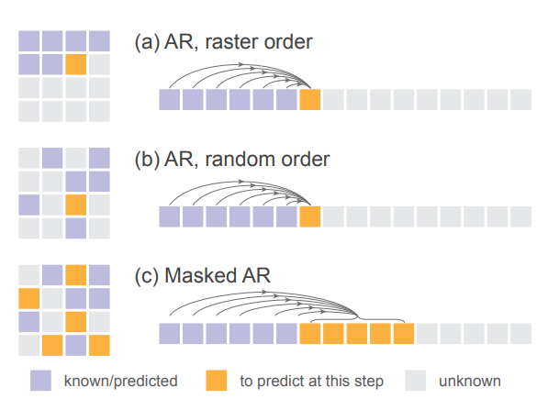

Re-examining the significance of autoregression
What exactly is “true autoregression”?
“Predicting the unknown based on the known", not limited to one-by-one.
Order : not limited to from left to right
Number : not limited to next one but could be next set-of-tokens prediction
Autoregressive model
Randomly predict a batch of tokens, and then predict the next batch of unknown (also randomly selected) tokens based on the predicted batch of tokens.
Not limited to causal attention transformer but could be bidirectional attention transformer

Slide 6
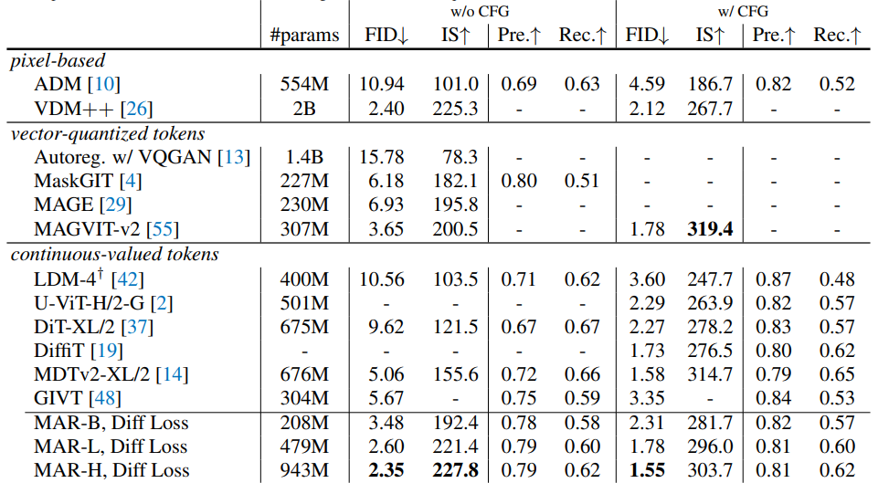
Experiment

Slide 7
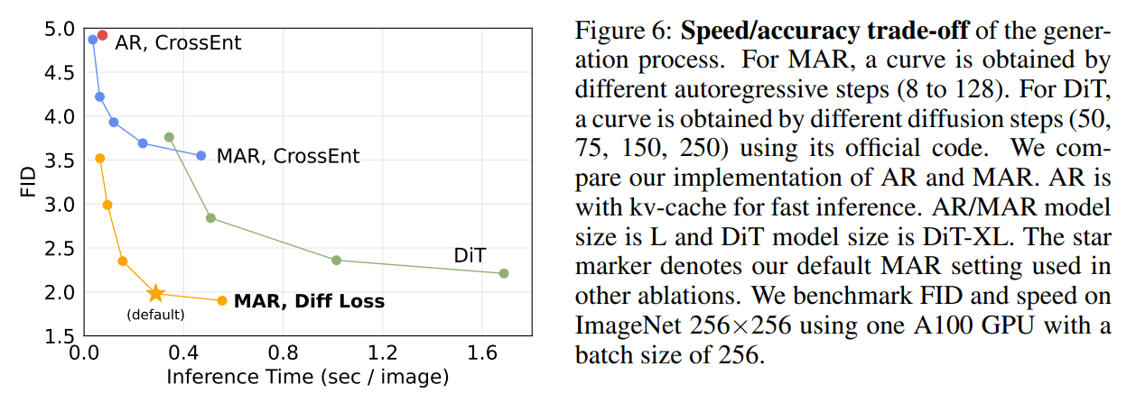
Speed/accuracy trade-off

Slide 8
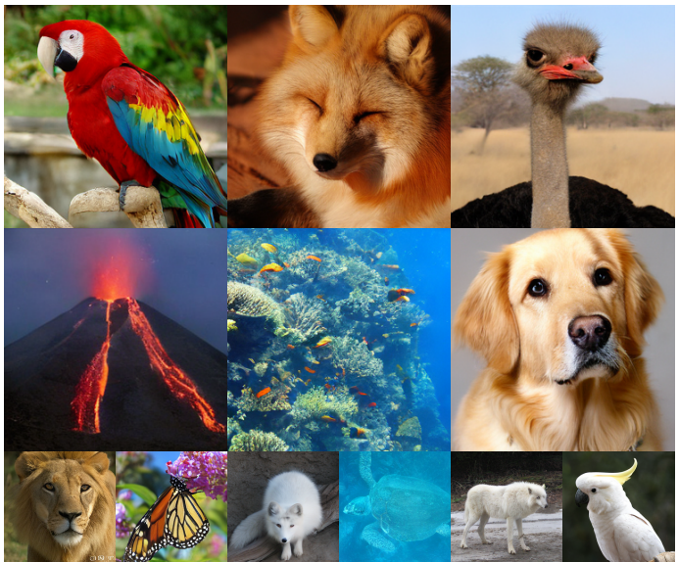
Qualitative Results

Slide 9
Li, Tianhong, et al. "Autoregressive Image Generation without Vector Quantization." arXiv preprint arXiv:2406.11838 (2024).

