Slide 1
Neural Networks Theory

Slide 2
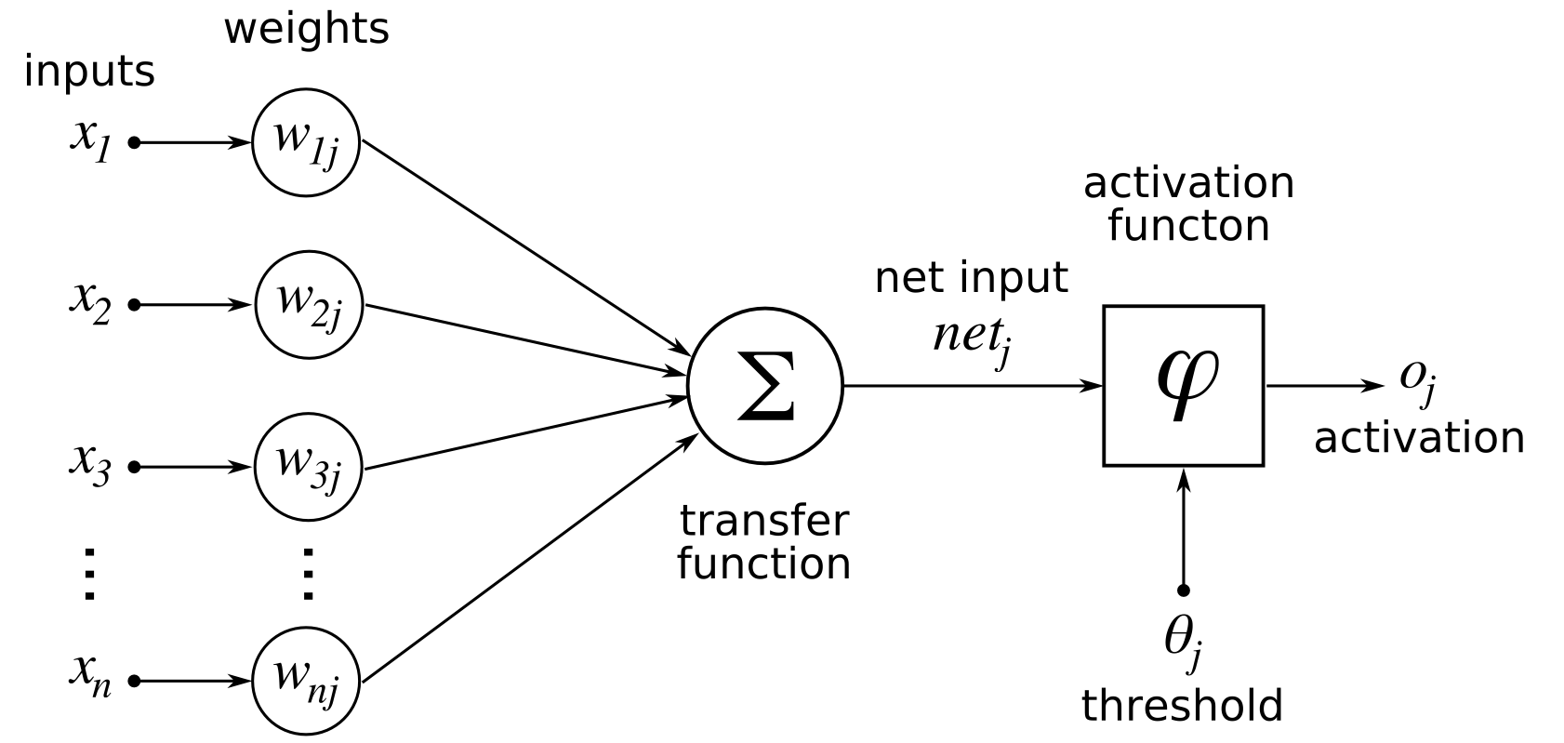
Artificial Neurons
Notes:
-consists of a set of value, multiplied by their respective weights
-added together
-put through activation function
-send the value to the next layer

Slide 3
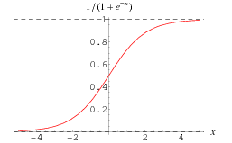
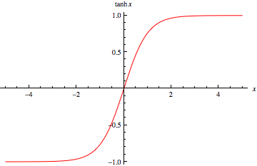
Activation Functions
Sigmoid
Tangent Hyperbolic
Notes:
-their main purpose is to convert a input signal of a node in a A-NN to an output signal
-sigmoid
-tangent hyperbolic
-vanishing gradient problem
-gru takes care of that, will speak about later

Slide 4
Types Of Neural Networks
Feed Forward
Information ﬂows through the function being evaluated from x, through the intermediate computations used to deﬁne f, and ﬁnally to the output y
Recurrent Neural Network
Good at processing sequenced data for predictions
Gated Recurrent Networks
Mostly same as the recurrent neural network, only solves vanishing gradient problem

Slide 5
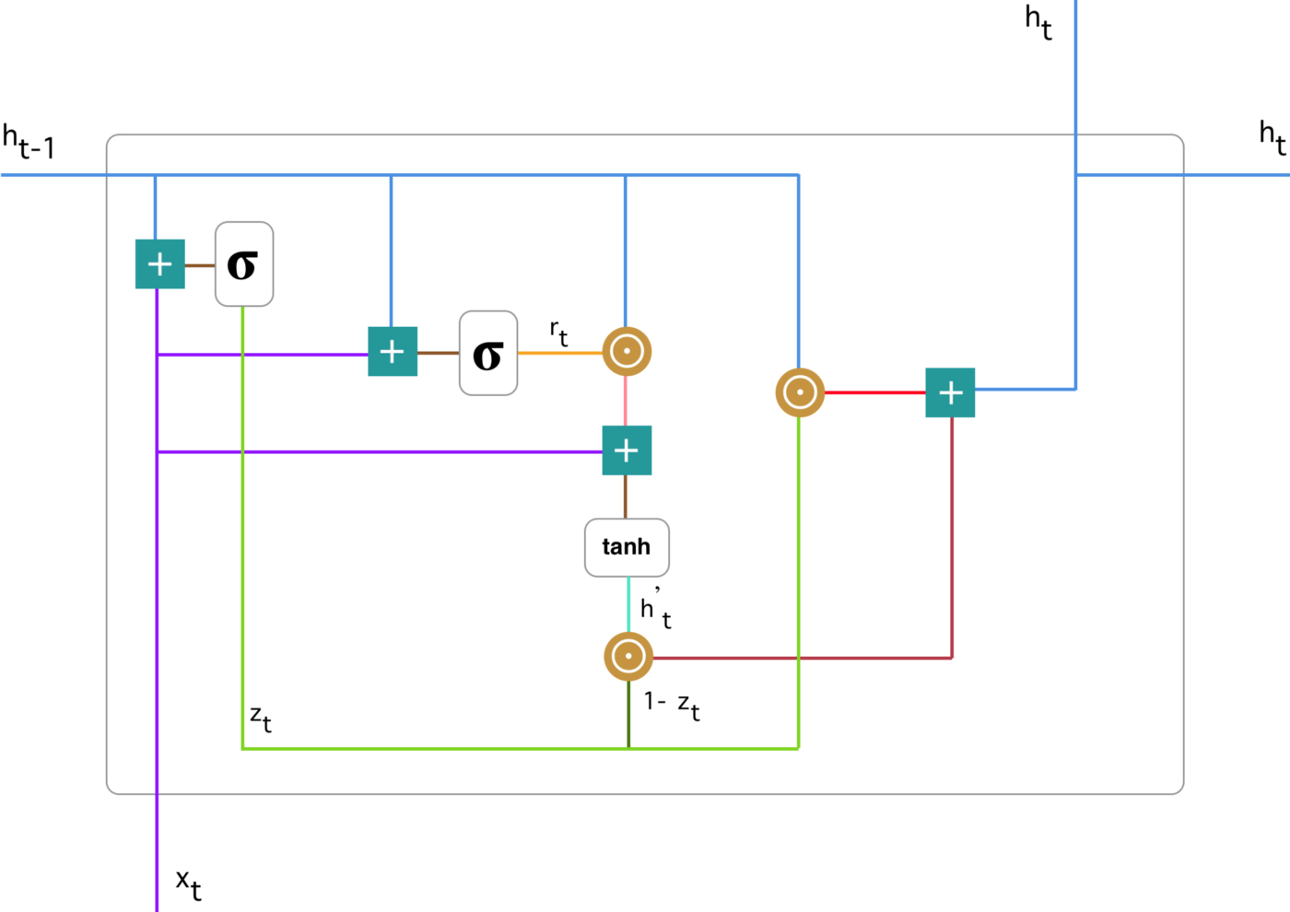
Gated Recurrent Unit Networks

Slide 6
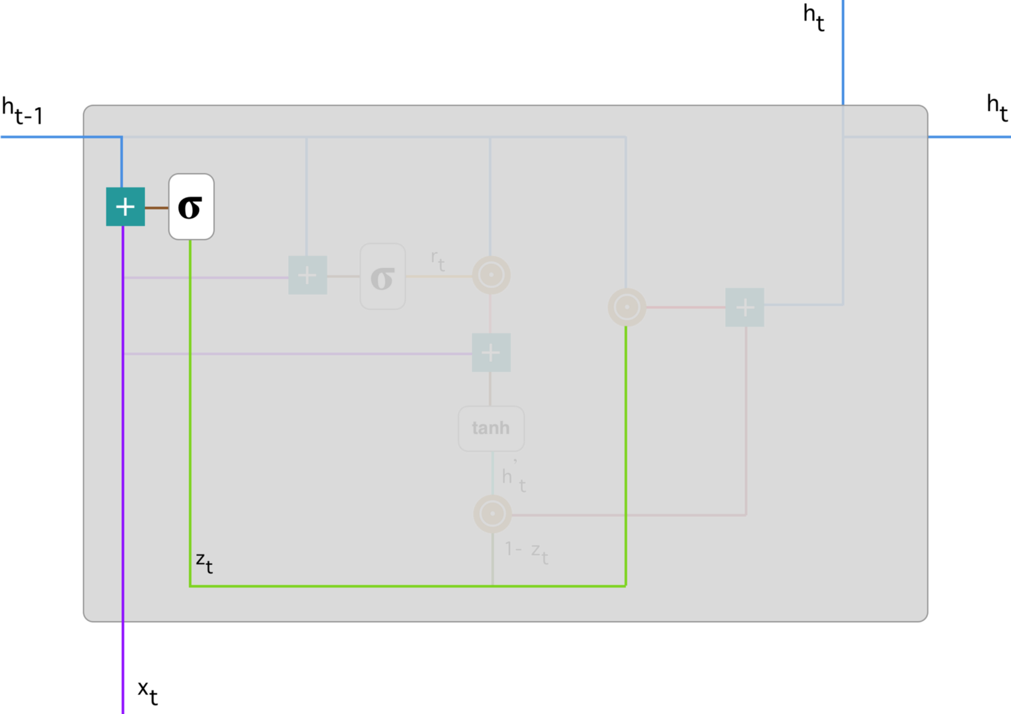
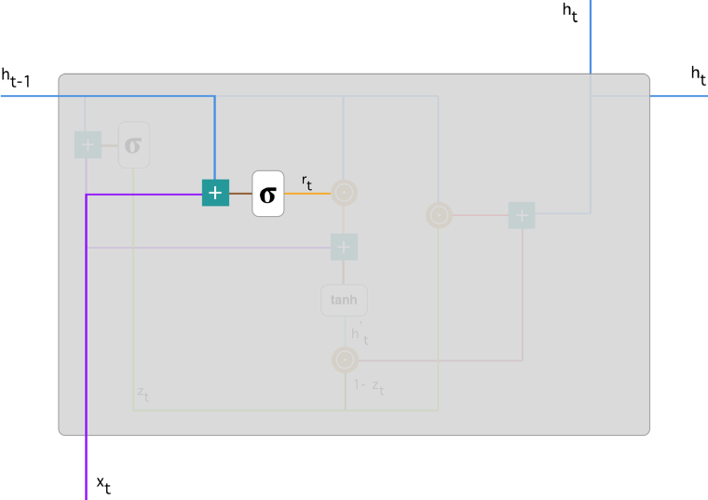
Update Gate
Reset Gate

Slide 7
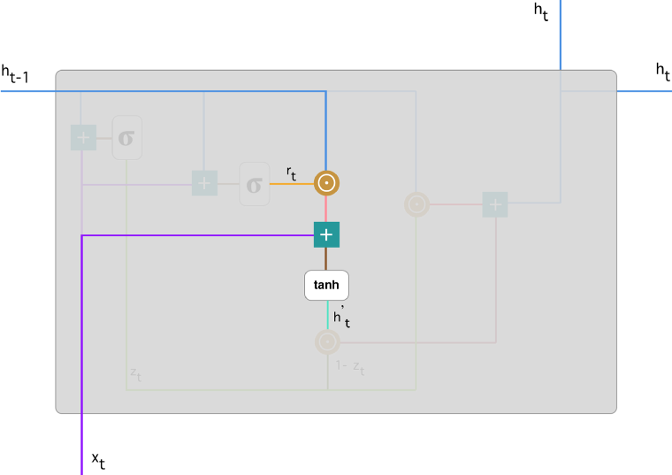
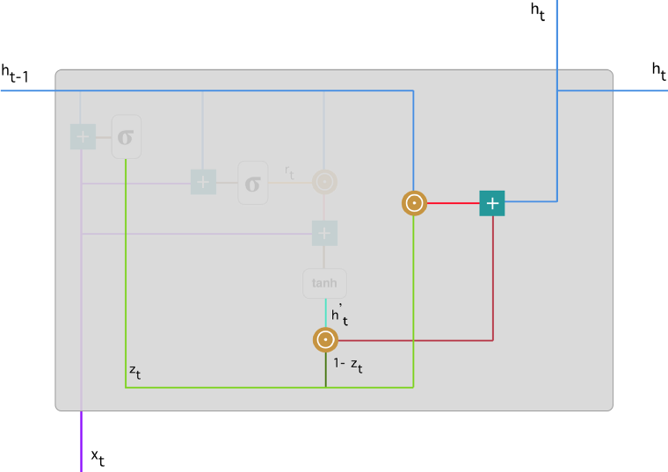
Current Memory Content
Final Memory at Current Time Step

Slide 8
Regularization Methods
Dropout
Batch Normalization

Slide 9
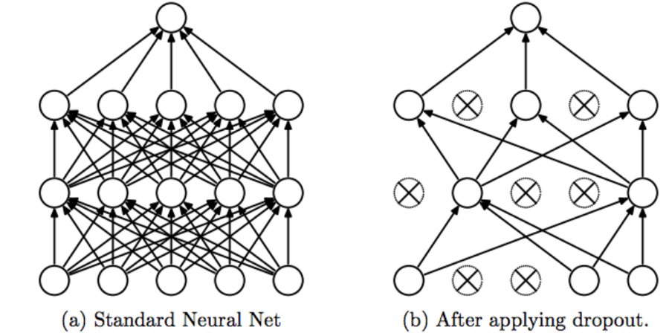
Dropout

