Slide 1
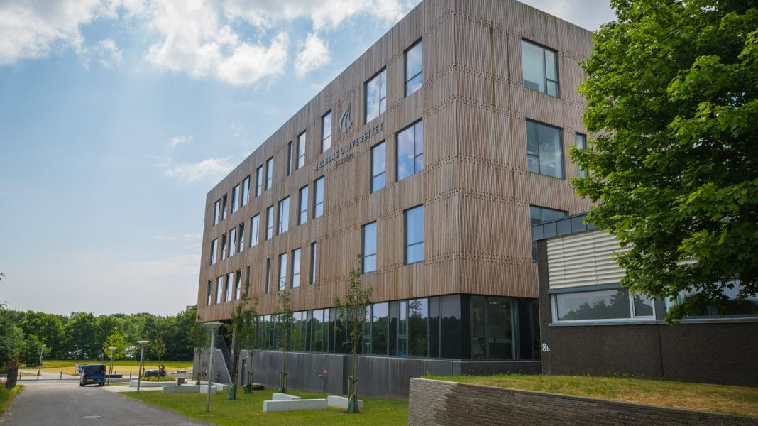
Directional Filtering and Noise Suppression
By Paulius Riauka, Tita Lasickas, Razvan Bucur, Darius Chira

Slide 2
Neural Networks Theory

Slide 3
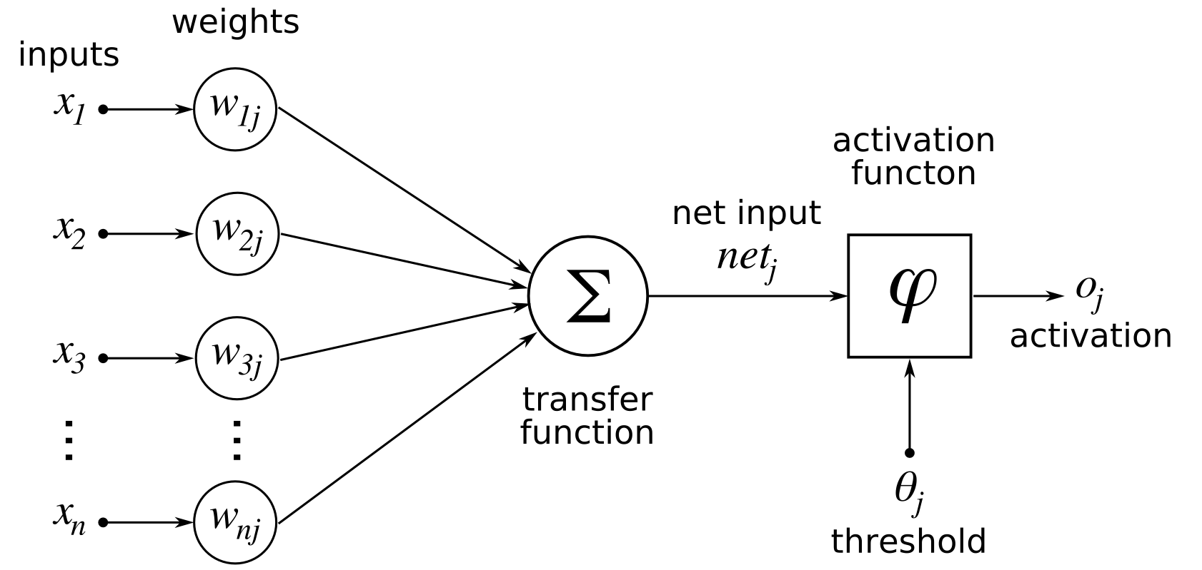
Artificial Neurons
Notes:
-consists of a set of value, multiplied by their respective weights
-added together
-put through activation function
-send the value to the next layer

Slide 4
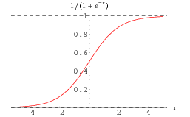
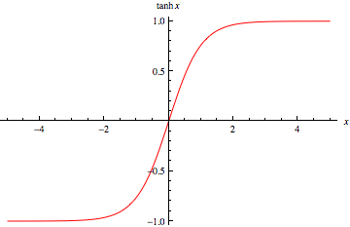
Activation Functions
Sigmoid
Tangent Hyperbolic
Notes:
-their main purpose is to convert a input signal of a node in a A-NN to an output signal
-sigmoid
-tangent hyperbolic
-vanishing gradient problem
-gru takes care of that, will speak about later

Slide 5
Types Of Neural Networks
Feed Forward
Information ﬂows through the function being evaluated from x, through the intermediate computations used to deﬁne f, and ﬁnally to the output y
Recurrent Neural Network
Good at processing sequenced data for predictions
Gated Recurrent Networks
Mostly same as the recurrent neural network, only solves vanishing gradient problem

Slide 6
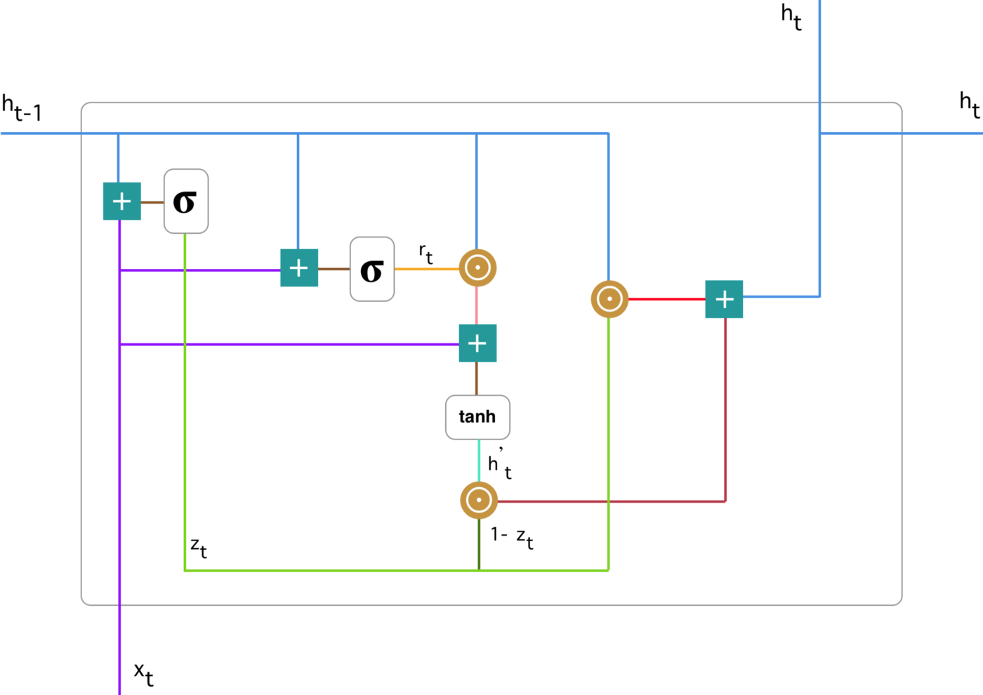
Gated Recurrent Unit Networks

Slide 7
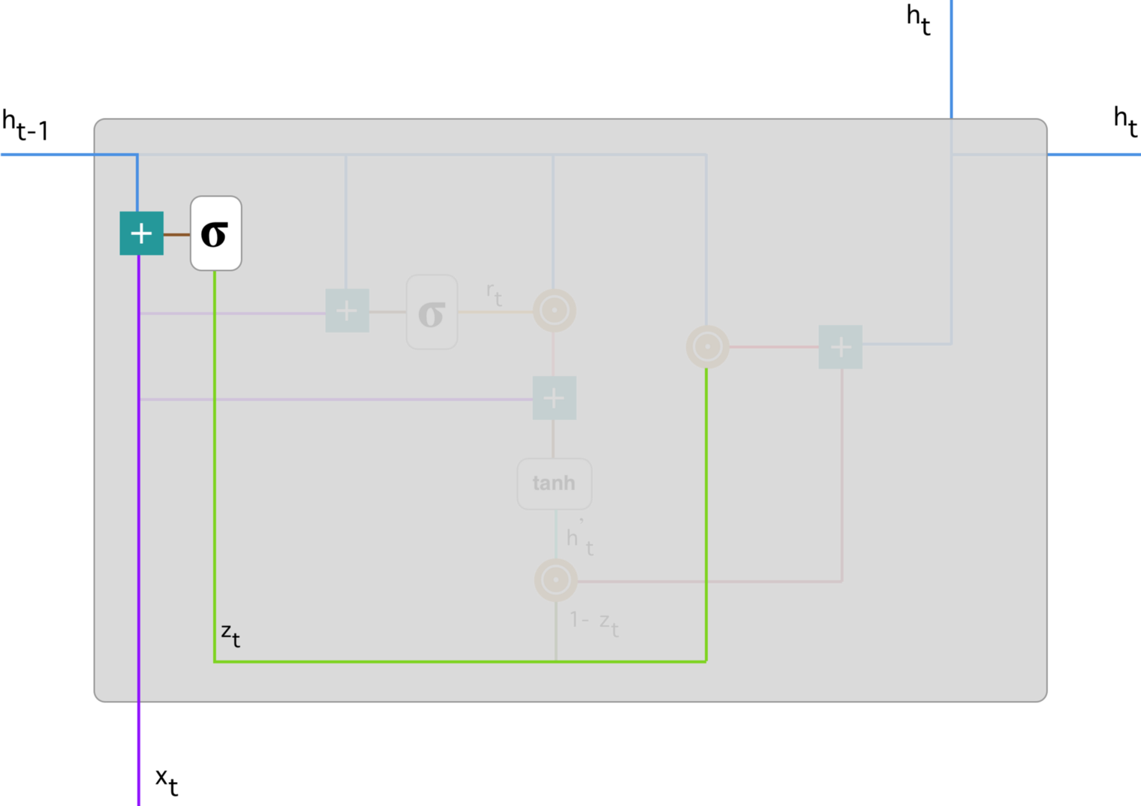
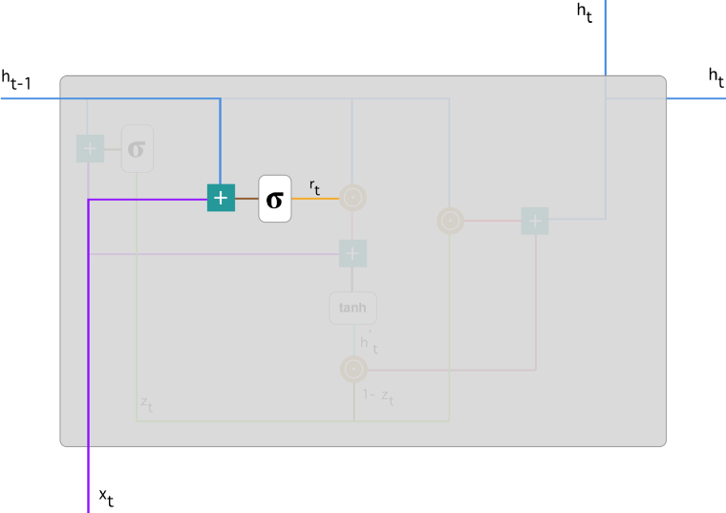
Update Gate
Reset Gate

Slide 8
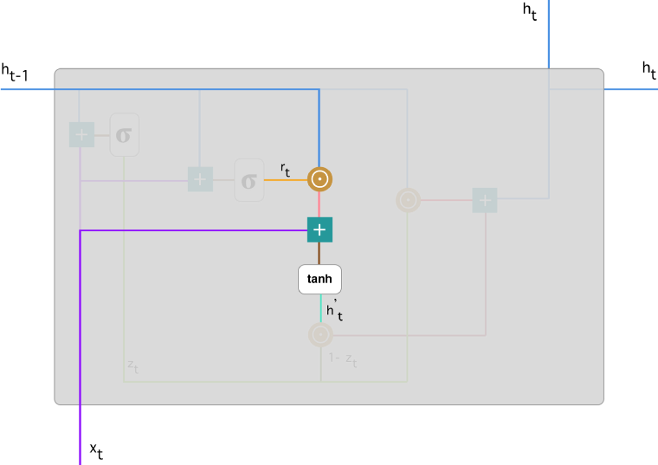
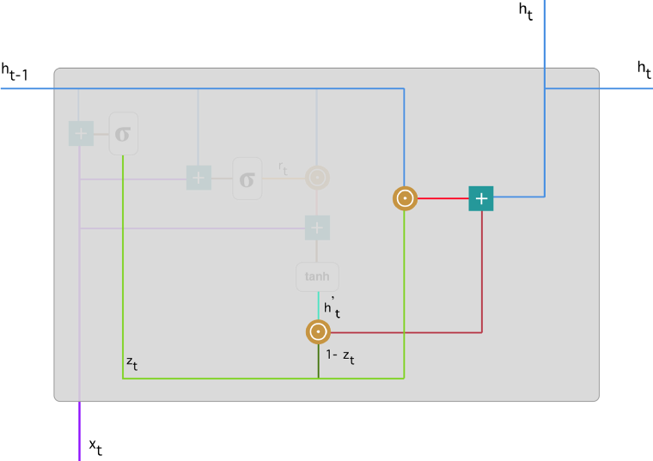
Current Memory Content
Final Memory at Current Time Step

Slide 9
Regularization Methods
Dropout
Batch Normalization

Slide 10
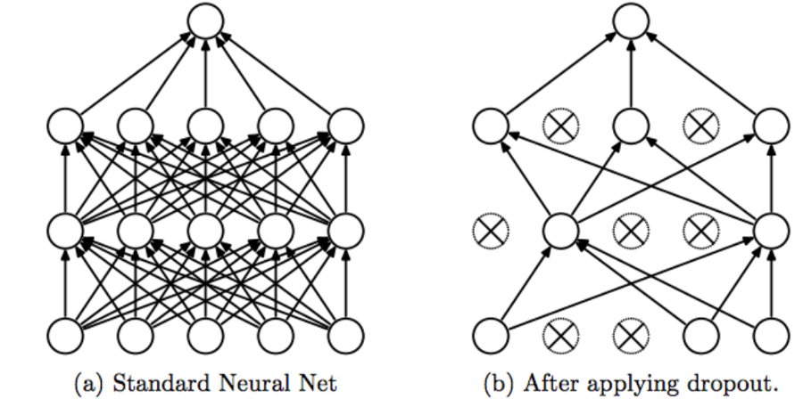
Dropout

Slide 19

Data Pre-processing
Notes:
Talk about how the data has to be pre-processed, a lot of sound files

Slide 20
Data Pre-processing
Notes:
-Talk about where you got the data
-how is it processed and why
-different lenghts, different sampling rates, different recording types
-how is it combined
-what data is at the end

Slide 21
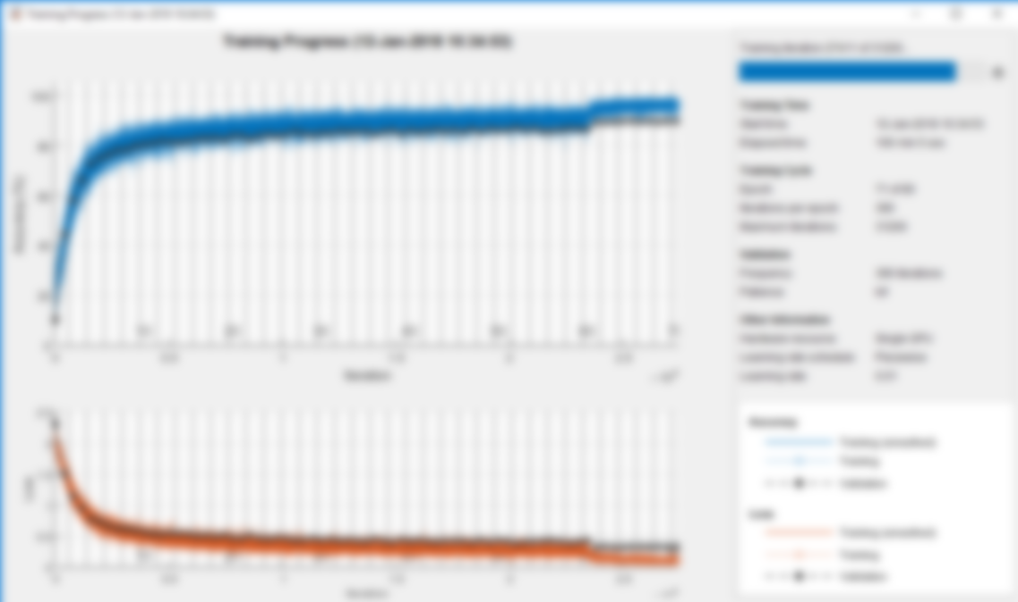
Training Methods
Notes:
- 2 training methods why

Slide 22
Training Methods
Notes:
-how we tested both methods
-what we concluded, why one didnt work

Slide 23
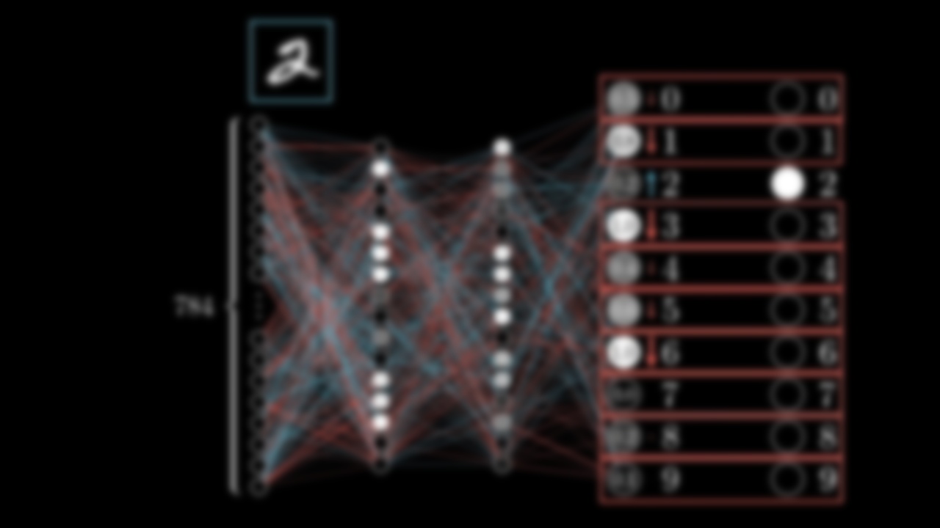
Neural Network Models
Notes:
-talk about why multiple models
-------------different slide maybe
-what each model does
-how and why
-which we choosed and why

Slide 24
Neural Network Models

Slide 25
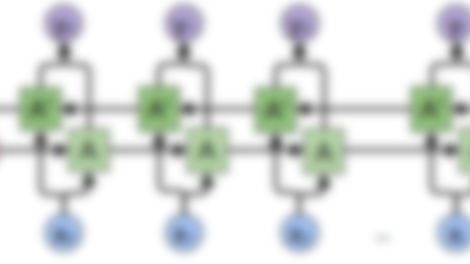
Model Description
Notes:
-detalied explenation on what we chose and why
-how it works
--------maybe different slide

Slide 26
Model Description

Slide 27
Discussion
Notes:
-microphojnes bullshit
-software bullshit, probably embedded would be better
-three sound sources thingy
-training bullshit
- Biggest THING why we dont have audio results

Slide 28
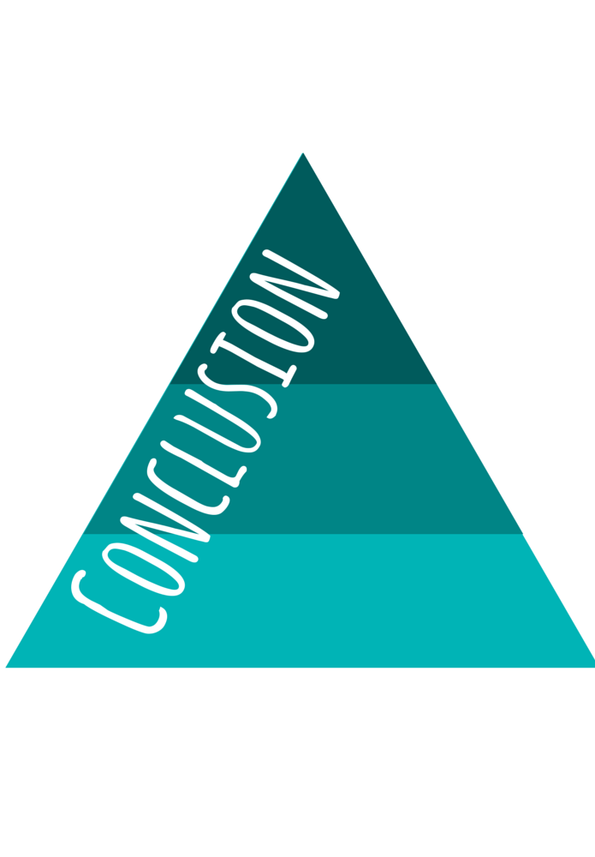
Conclusion
Notes:
-what worked
-what didnt
-why both only partially worked
-bullshit about how we focused on research and that why everything is crap
-we discovered a lot of things from which we could benefit

Slide 29

Thank you for you attention
Notes:
- Say thank you

