Slide 1
Qubit Tapering
Team 10
Members: Marek Bina, Yu-Sin Siao, Han-Yu Lu, Dean, CS Wu
Notes:
Hello everyone! We are team 10. Today, we're going to share our exploration of qubit tapering.

Slide 2
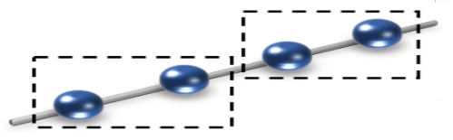
Our goals for hackathon
Get familiar with the concept of tapering
Run experiment on H₂ , HeH⁺ , H₂O and NH₃
Obtain tapered qubit Hamiltonian of Hydrogen chain
Notes:
Our hackathon journey was guided by these three goals, each progressively challenging:
1. **Get Familiar with Tapering:** We dived into the concept of quantum tapering, exploring its intricacies and potential benefits.
2. **Run Experiments:** We conducted experiments on small molecules like H2, H2O studying how tapering could simplify their quantum simulation.
3. **Tapered Hamiltonian of Hydrogen Chain:** We pushed our limits by applying tapering to a periodic material, the hydrogen chain, aiming to simplify its complex Hamiltonian.

Slide 3
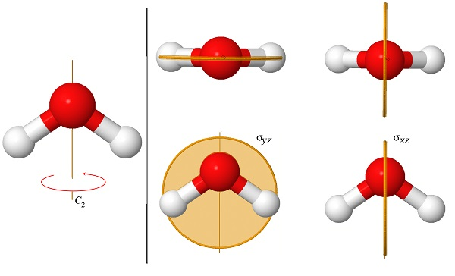
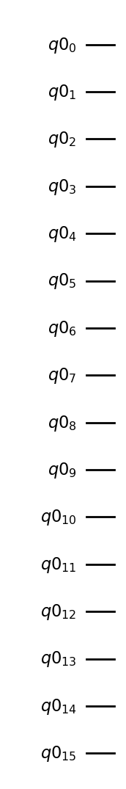
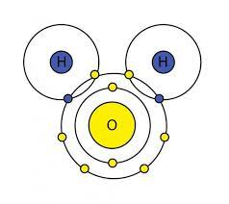
How does tapering work?
= 16 qubits?
The Configuration of the Water Molecule | (psu.edu)
The Symmetry Of Water Molecules (ozmo.io)
Notes:
Imagine a water molecule with 16 electrons. Simulating it with 16 qubits might sound overwhelming, right? Now, let's consider its symmetry. If we rotate it 180 degrees or mirror it along the xz plane, the molecule remains unchanged. This inherent symmetry means we don't need all those qubits, as some capture redundant information. this is essential because today's quantum computers have limited qubits. So, by embracing symmetry, we can simulate complex molecules with less cost, and this is how tapering does.

Slide 4
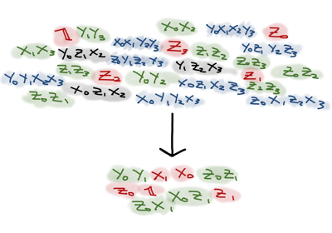
What can tapering do?
Simplify calculation’s complexity thus lowering error rates
Reduces the number of experiments required to be run
Improvement is exponential in the number of qubits tapered
1910.14644.pdf (arxiv.org)
Qubit tapering (pennylane.ai)
Notes:
1. **Simplify Calculations:** Tapering simplifies the complexity of our calculations, making them more manageable and reducing error rates.
Current state-of-the-art quantum computers are limited in size and coherence, therefore optimizing resources (means qubits) to execute quantum algorithms is very crucial.
2.Reduced Experimentation: Moreover, it diminishes the number of experiments we must conduct, conserving time and resources while maintaining accuracy.
3. **Exponential Improvement:** The improvement grows exponentially with the number of qubits tapered. The more qubits we tapered the easier we find the ground state.

Slide 5
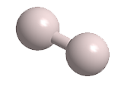
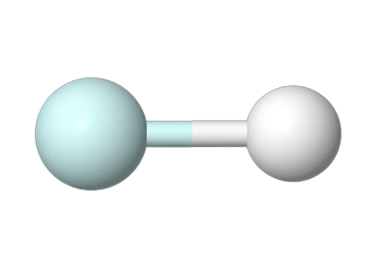
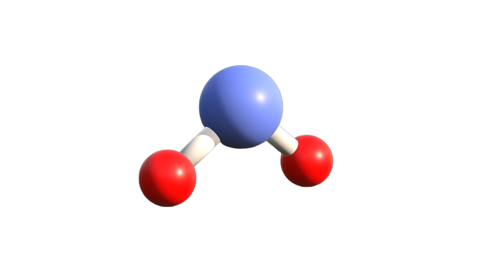
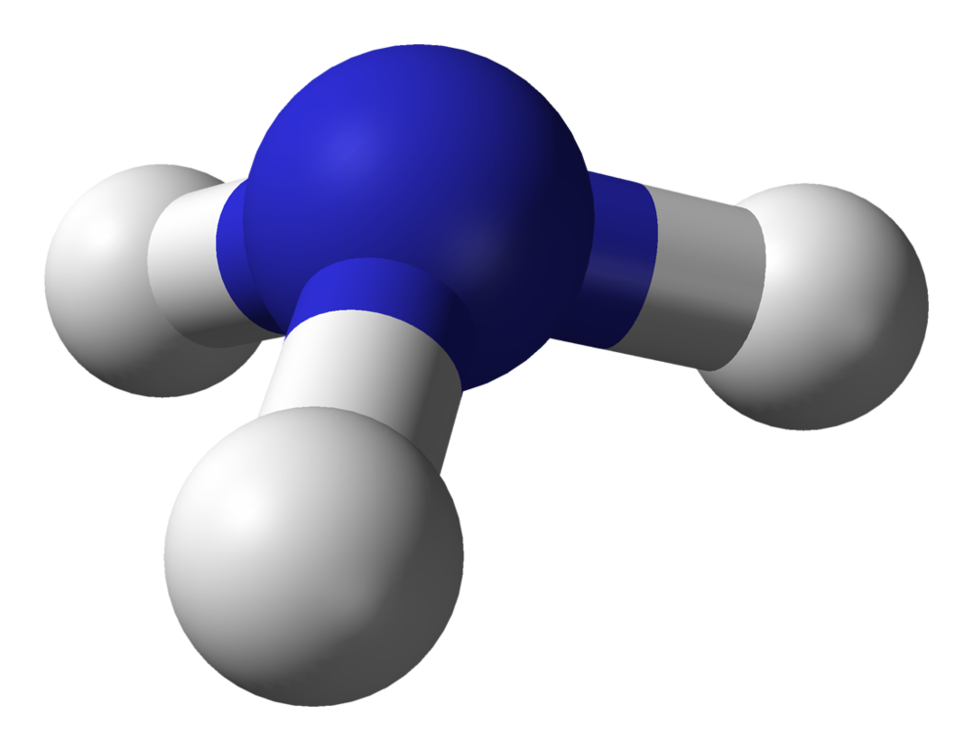
Experiment
H₂
HeH+
H₂O
NH₃
Notes:
For the experiments we used these molecules that are small enough to be able to simulate their behavior

Slide 6
Tapering results
# of qubits
 | Before tapering | After tapering
H₂ | 4 | 1
HeH+ | 4 | 2
H₂O | 14 | 10
NH₃ | 16 | 14
Notes:
In this table we can see number of required qubits for simulation of molecules behavior before and after tapering.

Slide 7
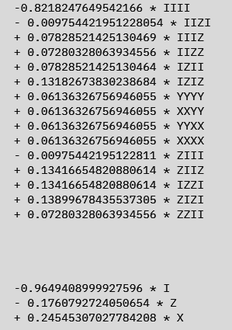
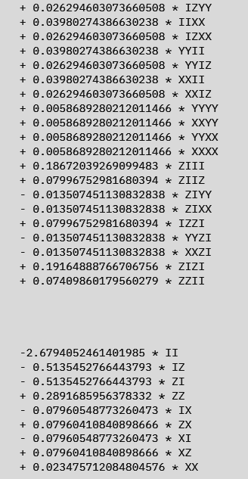
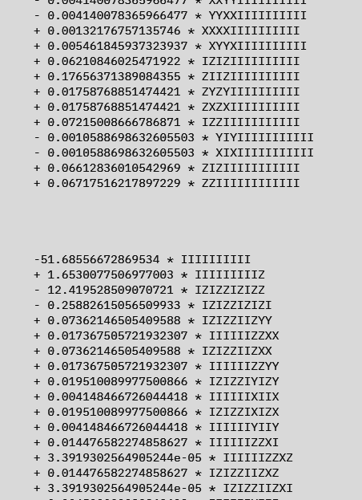
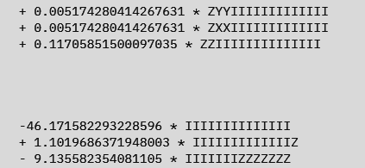
Tapering results
H₂ HeH+
H₂O NH₃

Slide 8
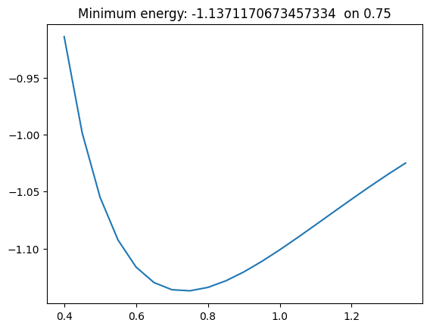
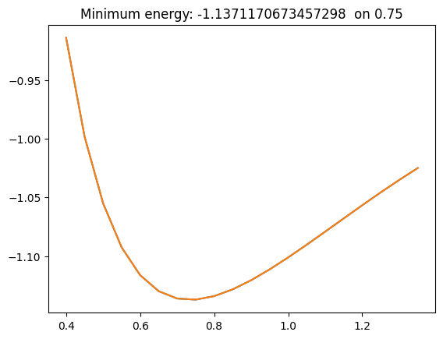
Ground state energy result(H2)
before after
Å
Å

Slide 9
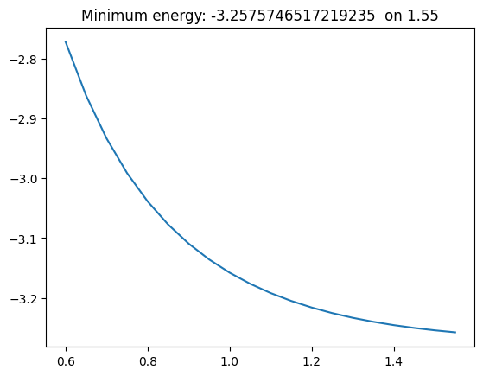
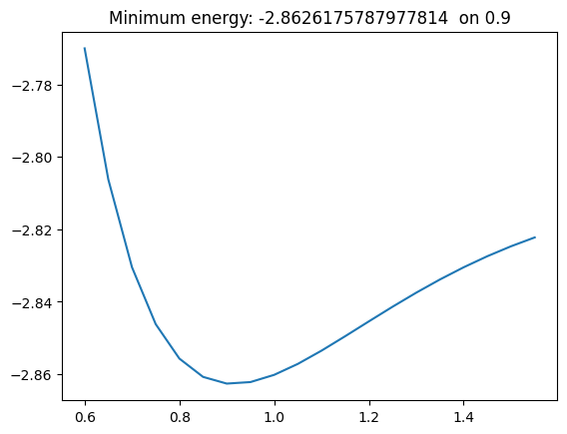
Ground state energy result(HeH+)
before after
Å
Å

Slide 10
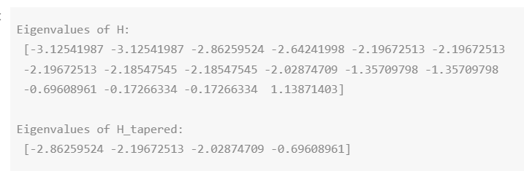
Ground state energy result(HeH+)

Slide 11


Ground state energy result(HeH+ with VQE)
before after
Å
Å

Slide 12
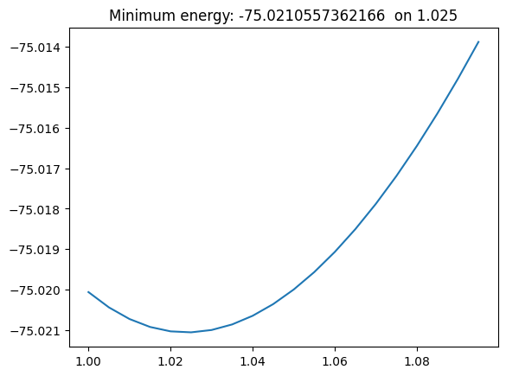

Ground state energy result(H2O)
before after
Å
Å

Slide 13
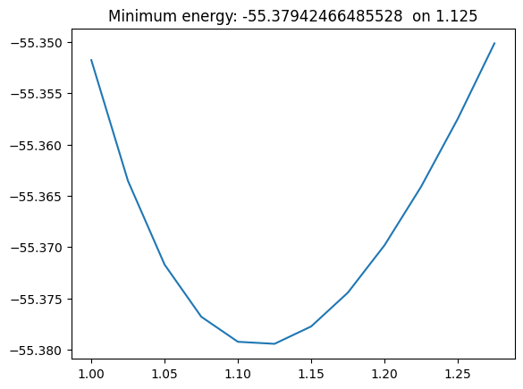

Ground state energy result(NH3)
before after
Å
Å

Slide 14
Ground state energy result
 | Before tapering | After tapering | Accuracy(%)
H₂ | -1.13728 | -1.13728 | 99.99%
HeH+ | -2.86268 | -2.86268 | 99.99%
H₂O | -75.02103 | -75.02103 | 99.99%
NH₃ | -55.37949 | -55.37949 | 99.99%

Slide 15
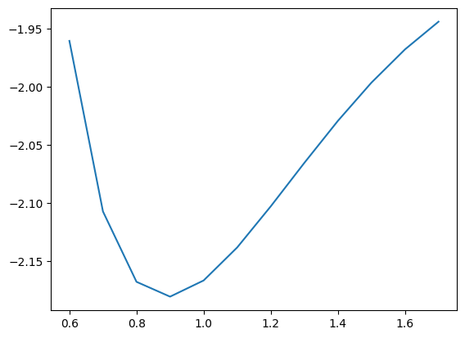
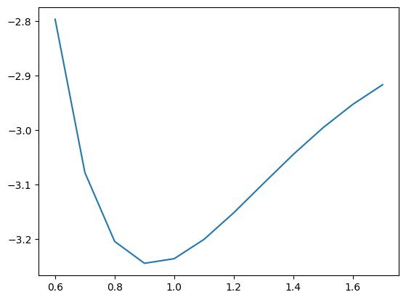
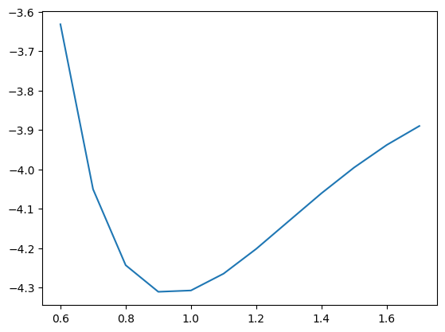
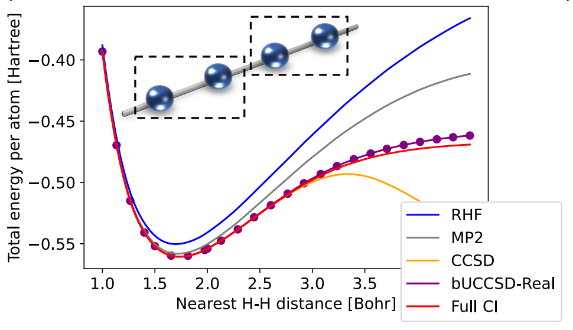
Hydrogen chains?
H₄
H₆
H₈
Yoshioka, Nobuyuki, et al. "Variational quantum simulation for periodic materials." Physical Review Research 4.1 (2022): 013052.
Notes:
1-a) For the challenge part, we try to obtain tapered qubit Hamiltonian of Hydrogen chain which the structure is periodic.
1-b) Our method is as same as what we've done to previous molecules, just added the number of hydrogen to see if we can get silimar curve like the below reference.
1-c)We tried H4, H6 and H8, but our laptop is not good enough to run H10 and longer chain. .....?

Slide 16
Challenges during the Hackathon
FreezeCoreTransformer()
Notes:
2-a) The other challenge we met is that the running time of the VQE method to solve H2O and NH3 are too long, we can only show the result by using classical motheod (numpy).
2-b) After discussing, we found out that we could add the class "Freeze Core Transformer" to reduce the electronic structure problem, which means make sure that it would run during the VQE process, it

Slide 17

Impact on Quantum Community
Drug Discovery and Design
Catalyst Design
Nanotechnology

Slide 18
What we have done and Future work
We learned:
The concept of simulating moleclues
Tapering qubits
Find the ground state energy by qiskit
Future work:
Try tapering the bigger molecules
Run on a real quantum computer
Test different ansatz or basis to improve the performance of VQE
Notes:
My team has shown our work in the previous slides. So I would like to sum up what we learn from this topic, and what we can do in the future. first, we learned the concept of simulating moleclues by quantum computing and the concept of qubits tapering.
For example, we get second-quantization from Psycf driver first, and then do qubit-mapping by Jordan-Wigner transform, and we taper qubit based on some kind of symmetries, finally we calculate the ground state energy by VQE and numpyeigensolver and then campare them.
So what we can go futher in the futur, maybe we can try

Slide 19
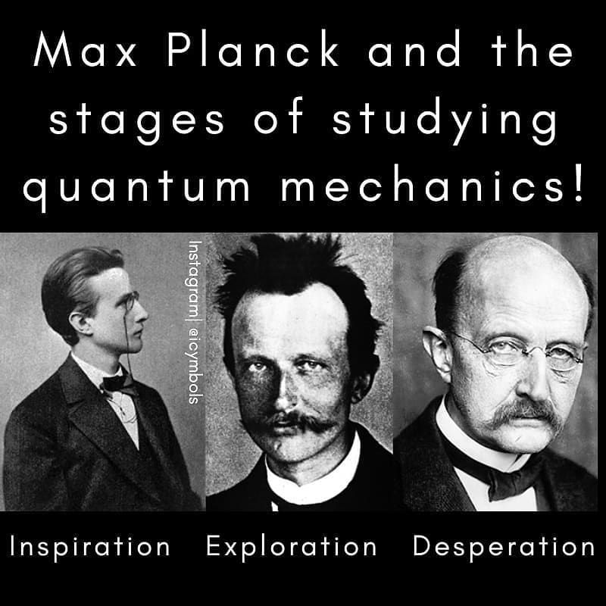
Conclusion
Learning & Applying qubit tapering with Qiskit
Comparison between VQE and NumPy Eigensolver
Challenging the challenge – Hydrogen chain
Friendship & Collaborating
Notes:
Conquer the challenge - "Embracing the struggle, our collective effort engaged with the challenge, reflecting a shared journey where its formidable presence, while prevailing, did not deter our commitment."

